Slide 1
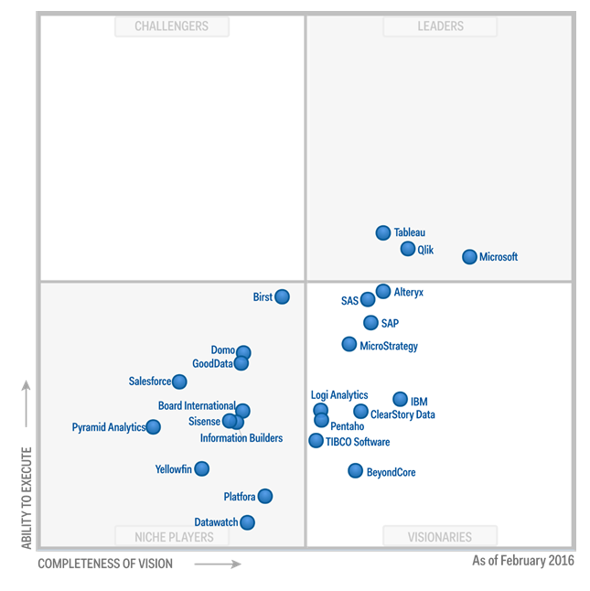
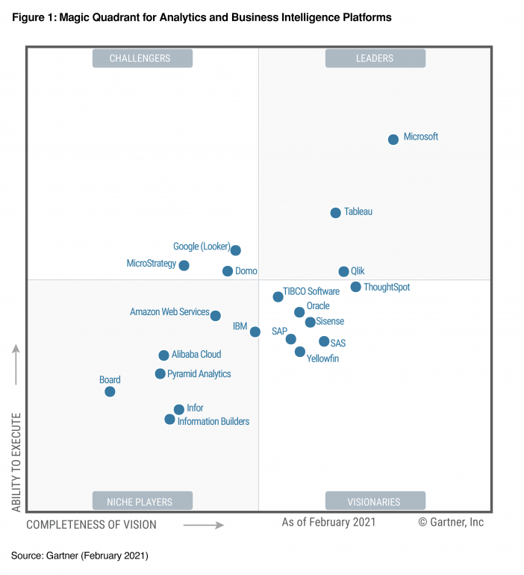
Fig 1. 2017 vs 2021 BI tool quadrant

Slide 2
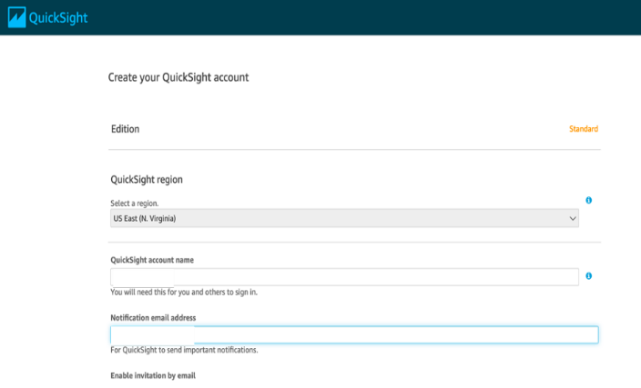
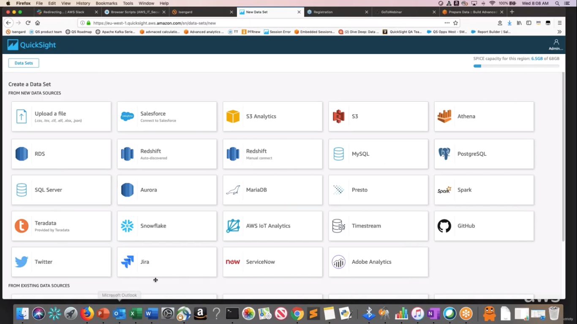
Fig 2. QuickSight account Fig 3. Data sources

Slide 3
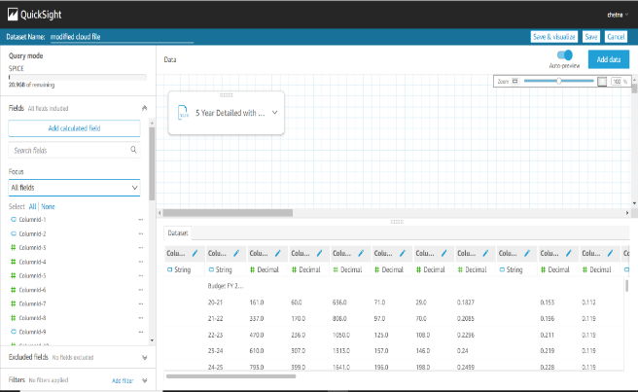
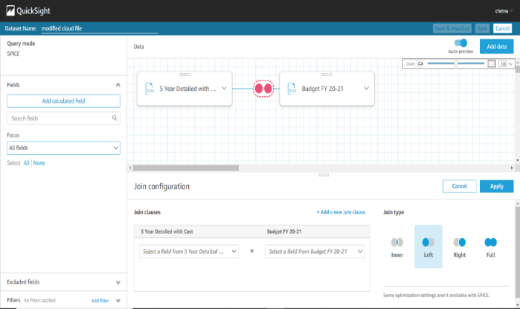
Fig 4. Data set preparation

Slide 4
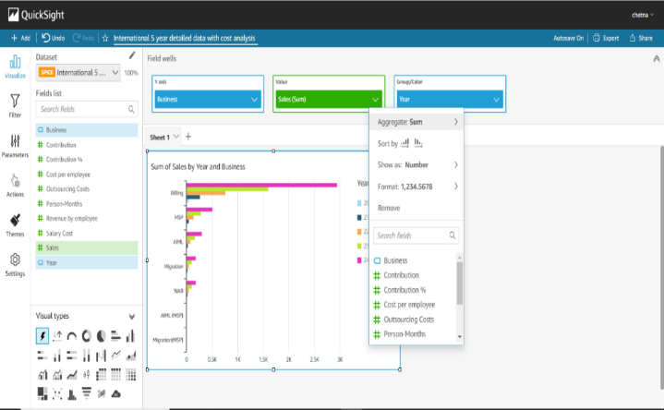
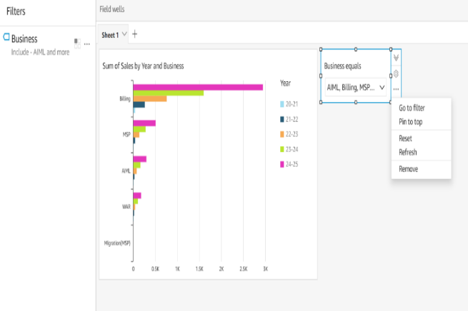
Fig 5. Visual findings

Slide 5
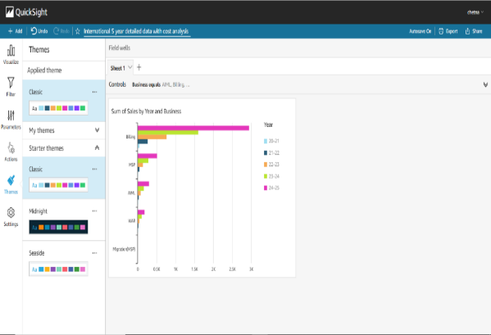
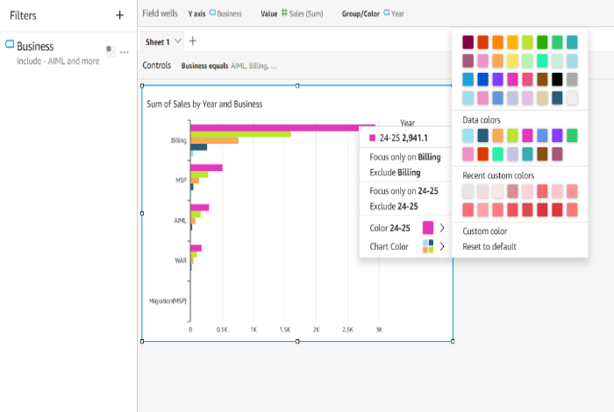
Fig 6. Filtering options

Slide 6
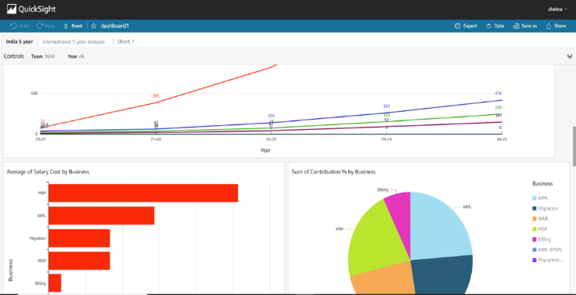
Fig 7. Published dashboard

Slide 7
Comparison of QuickSight with other BI tools in market:
 | Qlik Sense | Power BI | Tableau | QuickSight
Pricing | $30/user/month | $9.99/user/month | $70/user/month | $9/user/month
Free trial | Yes 30-day | Yes 60-day | Yes 14-day | Yes 30-day
Mobile version | Yes | Yes | Yes | Yes
Point-in-time analytics | Yes | Yes | Yes | Yes
Real-time analytics | No | Yes | Yes | Yes
Data prep tools | Yes | Yes | Yes | Yes
Prompts | Yes | Yes | No | No
Tools to integrate | Yes | Yes | Yes | Yes
Formatting queries | Yes | Yes | Yes | Yes
Data exploration guidance | Yes | Yes | Yes | No
Semantic Querying | Yes | No | No | No
Social media analytics | Yes | Yes | Yes | Yes
Visualization | Yes | Yes | Yes | Yes
Collaboration | Yes | Yes | Yes | Yes

