Slide 1

Project on Tmdb movie data
By: G S Kaushik
Under Guidance Of
- Dr. Aakansha Gupta

Slide 2
Introduction
Movies that cost over $100 million can still fail, why so?
A production company wants to analyze a movie dataset to identify what kinds of movies perform well in cinemas, which genres they belong to, and so on.
It will help the company predict if a movie will be a commercial success, if the movie will be highly rated, etc.
As a data analyst, need to answer certain questions by carrying out the upcoming tasks. Which will help the production company to grow their business.

Slide 3

CONTENT
Task 1 Pg 1
Task 2 Pg 2
Task 3 Pg 3
Task 4 Pg 4
Task 5 Pg 5
Task 6 Pg 6
Task 7 Pg 7
Task 8 Pg 8
Task 9 Pg 9
Task 10 Pg 10
Task 11 Pg 11

Slide 4

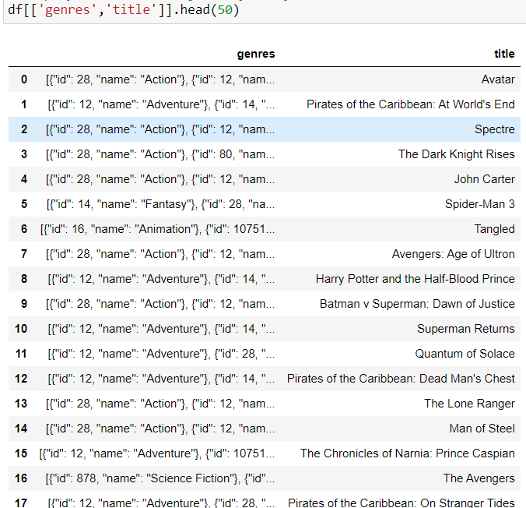
Task 1
Display number of rows and columns in data set
Display genre and title of the first 50 movies
There are 4803 movies in a given data set

Slide 5
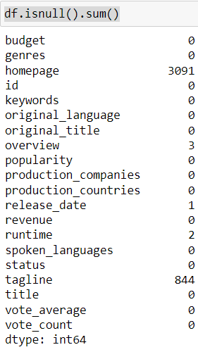
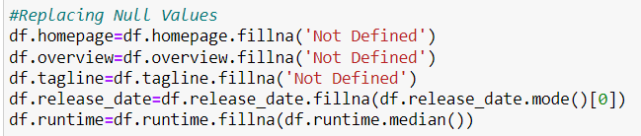
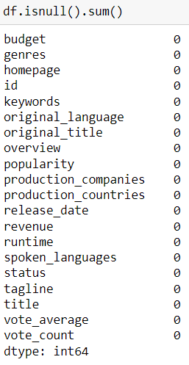
Task 2
Treating Null Values
Before there where null values after treating there is no null values

Slide 6
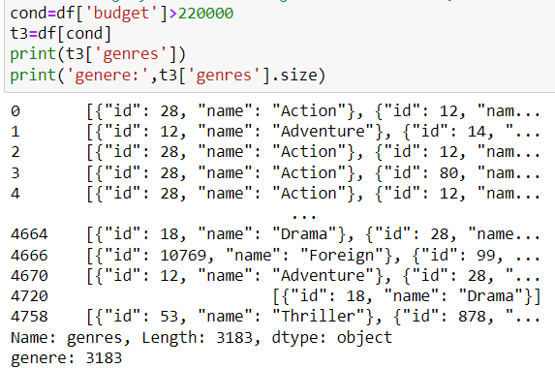
Task 3
Movie category that have budget more then $220,000
There are 3183 different combination of genres
Where budget is more then $220,000

Slide 7
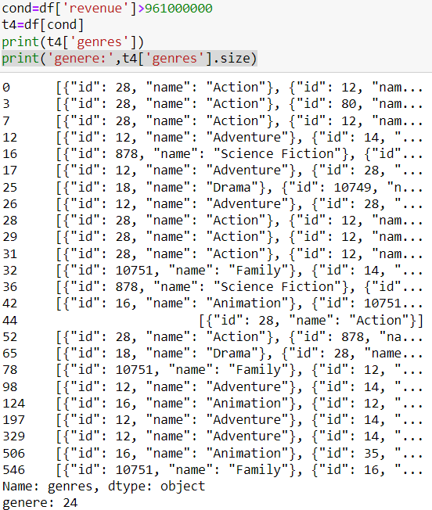
Task 4
Movie category that have revenue more then $961,000,000
There are 24 different combination of genres
Where revenue collected is more then $961,000,000

Slide 8
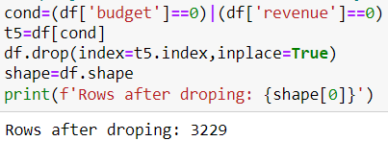
Task 5
Dropping the rows where Value is zero for both revenue and budget
After dropping there are only 3229 movies

Slide 9
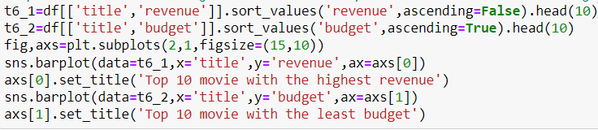
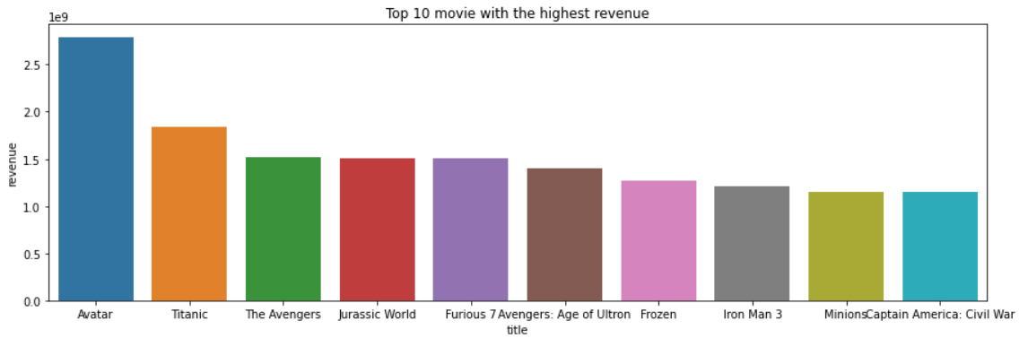
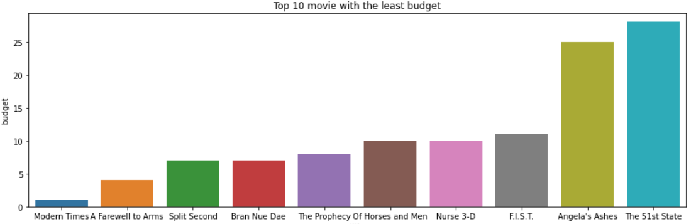
Task 6
Top 10 movie with the highest revenue and top 10 movie with the least budget
Avatar has collected highest revenue.
Where modern times has least budget

Slide 10

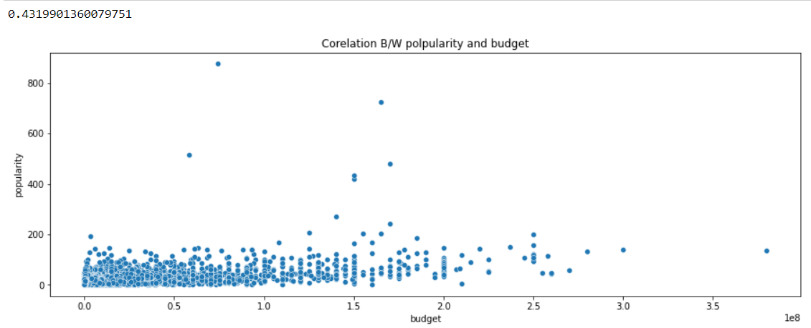
Task 7
Correlation Between budget and Popularity
There is positive correlation as the budget increase popularity increases for some extent

Slide 11
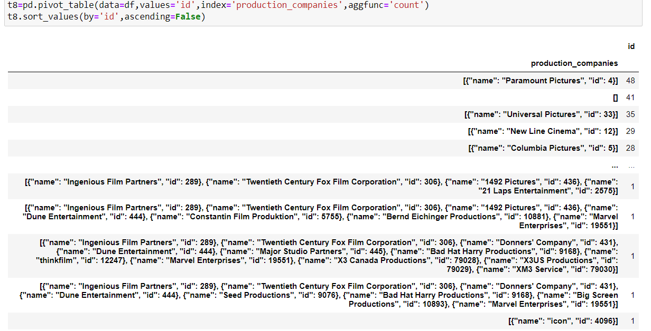
Task 8
Name of all production companies along with the number of movies they produced
There are 2633 unique combination of production houses

Slide 12
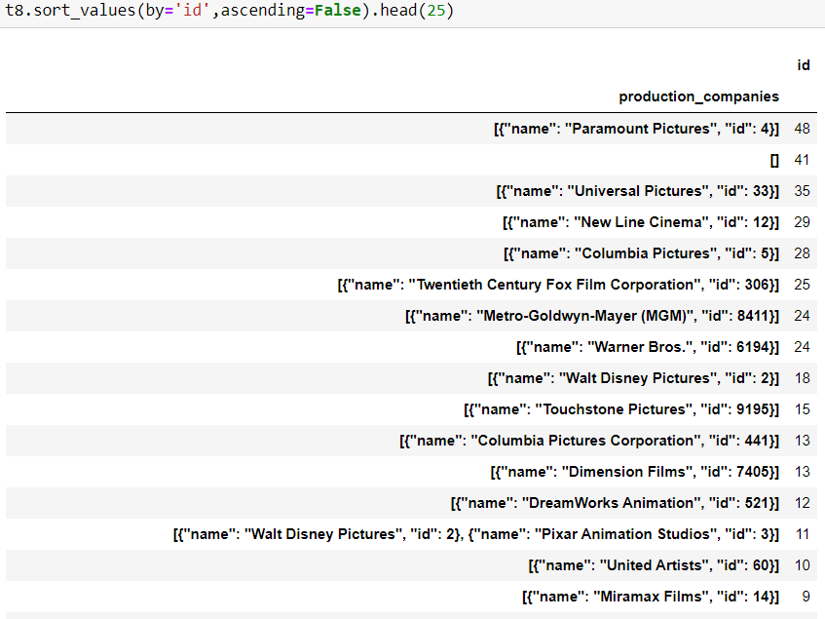
Task 9
Top 25 production companies based on number of film
Paramount Pictures has produced highest movie

Slide 13
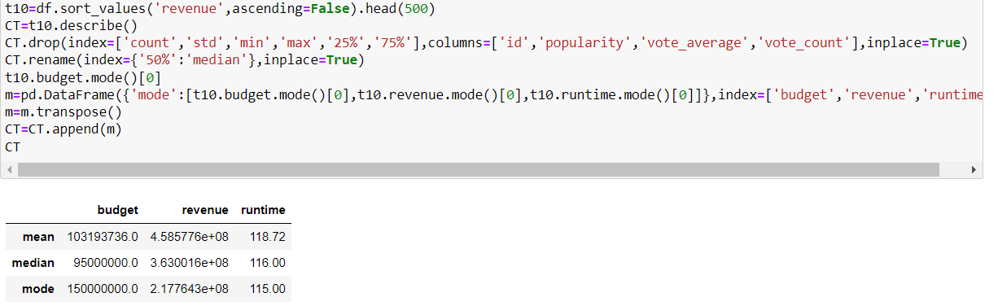
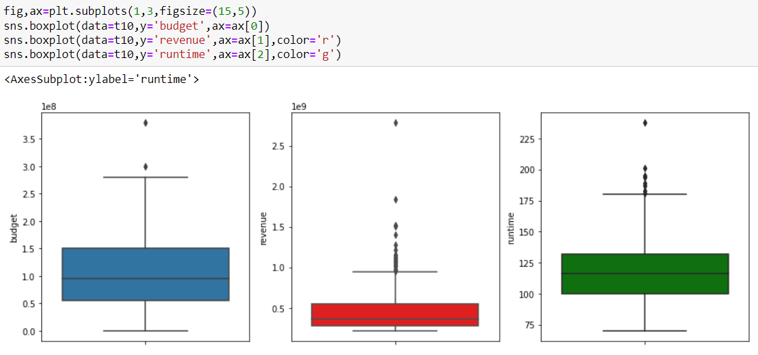
Task 10
Central tendency for Budget , revenue and runtime
75% of the movie budget lies under 1.5 million . But the revenue collected is less.
I most of the time runtime is less then 125 min

Slide 14
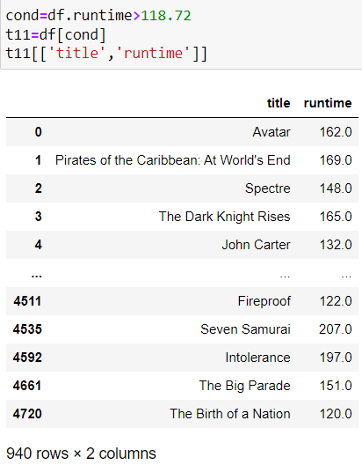
Task 11
Movies with above average runtime
There are 940 movies with above average runtime.

Slide 15

Summary
Action and Adventures are some of the genre where audience get attracted the most.
As the movie budget is high popularity is also high.
Movie with above average runtime are more in demand.
As the budget in high there may be chances of collecting less revenue.

Slide 16
Thank you

