Slide 1
Driver Alertness Detection System Using Machine Learning and Computer Vision
PIP104 PROFESSIONAL PRACTICE-II
VIVA-VOCE
Batch Number: COM G-06
Roll Number | Student Name
20201CEI0039 20201CEI0068 20201CEI0008 20201CEI0025 | KATIPALLY YASHWANTH REDDY SHAIK WASEEMAKRAM RAMISETTY RAVITEJA MASKANI NAVEEN YADAV
Under the Supervision of,
Dr. SUDHA P
Assistant Professor
School of Computer Science Engineering & Information Science
Presidency University

Slide 2
Introduction
In today's fast-paced world, driving has become an integral part of our daily lives, enabling us to commute, travel, and transport goods with unparalleled convenience. However, this convenience comes with its own set of challenges, one of which is the risk of drowsy driving.
Drowsy driving is a dangerous phenomenon that occurs when drivers operate a vehicle while fatigued or even on the verge of falling asleep. This presents a significant threat to road safety, as drowsy drivers are more likely to make errors, have slower reaction times, and be involved in accidents.
Driver alertness detection refers to the technology and methods employed to monitor and assess a driver's level of attentiveness and vigilance while operating a vehicle.

Slide 3
Introduction
Several factors can lead to a decrease in driver alertness, such as fatigue, distractions (e.g., mobile phones or in-car entertainment systems), medical conditions, or the influence of alcohol or drugs. These factors can impair a driver's reaction time, decision-making abilities, and overall performance behind the wheel, making them a significant risk to themselves and others on the road.
The primary goal of driver alertness detection is to identify signs of drowsiness, distraction, or impaired cognitive function in drivers to prevent accidents and enhance overall road safety.

Slide 4
Literature Review
Paper Title | Published Year | Methodology Used | Advantages | Disadvantages | Accuracy
Validation and Interpretation of a Multimodal Drowsiness Detection System Using Explainable Machine Learning | 2023 | SVM classifier | Non-Linear Data Handling, Robust, Maximizing Margin | Sensitive to Noise, Computationally Intensive | 76.2%–84.8%
Convolutional Neural Network for Drowsiness Detection Using EEG Signals | 2021 | CNN | Complex Relationships Handling, Better Prediction | Computational Overhead, High Resource Usage | 90.42%
An Investigation of Early Detection of Driver Drowsiness Using Ensemble Machine Learning Based on Hybrid Sensing | 2020 | SVM,KNN,RF | Non-Linear Data Handling, Robust, Maximizing Margin | Sensitive to Noise, Computationally Intensive | 95.4%

Slide 5
Literature Review
Paper Title | Published Year | Methodology Used | Advantages | Disadvantages | Accuracy
A Framework for Instantaneous Driver Drowsiness Detection Based on Improved HOG Features and Naïve Bayesian Classification | 2021 | Histogram of Oriented Gradient (HOG) features | Robustness to Illumination Changes, Effective in Localized Regions, Simplicity and Efficiency | Limited to Grey-Scale Images, Dependency on Parameters | 85.62%
Real-Time System for Driver Fatigue Detection Based on a Recurrent Neuronal Network | 2020 | RNN | Natural Language Processing (NLP), Sequential Data Handling | Short-Term Memory, Difficulty in Capturing Long-Term Dependencies | 92.0%
Non-Invasive Driver Drowsiness Detection System | 2021 | SVM, Decision Tree, Logistic regression, MLP | Availability and Tool Support, Feature Engineering, Versatility | Overfitting, Hyperparameter sensivity | 87.0%

Slide 6
Literature Review
Paper Title | Published Year | Methodology Used | Advantages | Disadvantages | Accuracy
LSTM-CNN model of drowsiness detection from multiple consciousness states acquired by EEG | 2021 | LSTM-CNN | Hierarchical Feature Learning, Reduced Overfitting | Data Size and Data Dependency, Hyperparameter Tuning Challenges | 85.6%
DriveCare: A Real-Time Vision Based Driver Drowsiness Detection Using Multiple Convolutional Neural Networks With Kernelized Correlation Filters (MCNN-KCF) | 2020 | MCNN-KCF | Feature Learning,State-of-the-Art Performance | Large Amounts of Data, Black-Box Nature | 95.77%

Slide 7
Literature Review
Paper Title | Published Year | Methodology Used | Advantages | Disadvantages | Accuracy
Deep Neural Network for Drowsiness Detection from EEG | 2021 | LTSM | Improved Contextual Understanding, Effective in Sequences with Spatial Information | Complexity, Difficulty in Interpretability | 82.8%
Analysis of the effect of thermal comfort on driver drowsiness progress with Predicted Mean Vote: An experiment using real highway driving conditions | 2023 | PMV-Drowsiness progression model | Early Warning System, Data-Driven Insights | Dependency on Variables, Real-Time Implementation Challenges | N/A

Slide 8
Research Gaps Identified
Existing methods in driver alertness detection present significant limitations that collectively create gaps in effectively addressing real-time detection, generalizability, and comprehensive assessment of driver alertness.
The landscape of driver alertness detection methods is riddled with gaps and limitations that impede the development of comprehensive and universally applicable systems. One prevalent setback lies in the utilization of black box machine learning classifiers, which, despite their accuracy, lack transparency, rendering the understanding of prediction rationales elusive. This opacity undermines the confidence in decisions made by these systems, hindering their practical applicability and trustworthiness.
Moreover, while subject-dependent validation techniques aim to enhance individual-specific performance, their narrow focus on particular individuals during training compromises their adaptability to new subjects, limiting their generalizability. Conversely, subject-independent validation techniques, while aiming for broader applicability across individuals, struggle with the intricate inter-individual differences in physiological signals, posing challenges in effectively capturing diverse responses within a generalized framework.

Slide 9
Research Gaps Identified
Specific classifiers like the K-nearest Neighbors (KNN), Support Vector Machines (SVM), and Random Forest (RF) classifiers each have their strengths but are plagued by their respective weaknesses. KNN suffers from computational complexities and sensitivity to parameter choice, while SVM and RF classifiers are prone to issues concerning kernel function selection, regularization parameters, overfitting, and computational expenses, especially when dealing with large datasets.
Several existing methodologies exhibit limitations in their approaches. Some methods rely solely on EEG signals, neglecting other vital indicators of driver alertness, which could potentially lead to oversights in detecting drowsiness accurately. Furthermore, the requirement for multiple sensors or complex signal fusion algorithms elevates system complexity and may hinder real-time implementation, a crucial factor for smart vehicles' safety mechanisms.

Slide 10
Research Gaps Identified
Additionally, limitations concerning the scope of application, such as the focus on specific headsets or applications, may hinder the generalizability of findings to broader systems or scenarios. Challenges in replicating real-world driving conditions in simulated environments, coupled with subjective evaluations of drowsiness, further underscore the complexities in accurately gauging driver alertness levels.
Moreover, the prevalent binary classification approach in many methods fails to capture the nuanced transitions and varied levels of alertness, limiting the holistic understanding of the driver's state. Imbalanced data samples, limited electrode coverage in EEG studies, and the absence of real-time implementations exacerbate the challenges in creating robust, universally applicable driver alertness detection systems. These gaps and limitations necessitate a more nuanced and comprehensive approach, considering diverse physiological signals, real-time implementation capabilities, and a broader spectrum of alertness states for a more effective and reliable detection system.

Slide 11
Proposed Methodology
Support Vector Machines : A support vector machine (SVM) is a machine learning algorithm that uses supervised learning models to solve classification, regression, and outlier detection problems. SVMs are particularly good at solving binary classification problems, which require classifying the elements of a data set into two groups.
convolutional neural network : A convolutional neural network (CNN) is a deep learning algorithm that can learn directly from data. CNNs are often used in computer vision, which is a field of artificial intelligence that allows computers to understand and interpret visual data.

Slide 12
Objectives
Our objective is to Create a robust and reliable driver alertness detection system capable of monitoring driver attentiveness in real-time.
Early Warning: Implement the system to provide timely alerts and interventions when signs of drowsiness, distraction, or impairment are detected.
Accuracy and Reliability: Ensure that the system delivers accurate alerts while minimizing false positives and false negatives.
Real-time Monitoring: Design the system to continuously monitor driver alertness and promptly respond to fatigue or inattention.
Multi-Modal Detection: Develop the system to detect multiple signs of alertness decline, such as facial landmarks, blinking.
Cost-Effectiveness and Safety Mechanisms : Strive to make the system cost-effective for broad adoption in various vehicles and among diverse demographics and implement safety mechanisms such as automated deceleration, or emergency braking if the driver does not respond to alerts.

Slide 13
System Design & Implementation
System Design:
1. High-Level Architecture:
Components:
Smart Vehicles: Vehicles equipped with sensors and cameras for data collection.
Computer Vision Module: Utilizes FaceMeshModule (MediaPipe) for facial landmark tracking.
Machine Learning Module: Trained SVM models for drowsiness detection.
Data Flow:
Raw data collected from Smart Vehicles' cameras.
Computer vision module preprocesses the data to extract facial landmarks.
Machine learning module analyzes blink intervals to detect driver drowsiness.

Slide 14
System Design & Implementation
2. Data Collection and Preprocessing:
Data Sources:
Diverse sources including video feeds from vehicle cameras.
Meticulous collection and labeling of facial landmark data.
Preprocessing:
Cleaning data to remove noise and inconsistencies.
Extraction of relevant features using techniques like PCA, statistical analysis, etc.

Slide 15
System Design & Implementation
3. Machine Learning Models:
Model Training:
Utilizing libraries such as TensorFlow, numpy, pandas, and sci-kit learn.
Training multiple SVM models on preprocessed data.
Evaluation:
Assessing models based on predictive accuracy for drowsiness detection.
Selection of the most accurate model for deployment.

Slide 16
System Design & Implementation
4. Dynamic Model Selection:
Real-Time Evaluation:
System continuously monitors the performance of available SVM models.
Selects the most accurate model based on ongoing data and model evaluation.
Deployment:
Chosen model integrated into the Driver Alertness Detection system for real-time monitoring.

Slide 17
System Design & Implementation
System Implementation:
1. FaceMeshModule Integration:
Utilization of MediaPipe:
Integration of FaceMeshModule to track facial landmarks.
Calculation of blink intervals for drowsiness detection.
2. Machine Learning Model Implementation:
Python-based Implementation:
Utilization of Python and required libraries for SVM model development.
Integration of trained models into the system.

Slide 18
System Design & Implementation
3. Real-Time Monitoring:
Live Data Processing:
continuously processing data from Smart Vehicles' cameras.
Real-time analysis of blink intervals and driver alertness using the selected SVM model.
4. User Interface:
Visualization and Alerts:
Implementation of a user interface for visualization of alertness levels.
Alert generation in case of detected drowsiness to alert the driver.

Slide 19
System Design & Implementation
5. Testing and Validation:
Rigorous Testing:
Testing the system on diverse datasets to ensure accuracy and reliability.
Validation through simulated scenarios and real-world testing.
6. Deployment:
Integration with Smart Vehicles:
Deployment of the system into Smart Vehicles for real-world application.
Integration with the vehicle's monitoring or warning systems.

Slide 20
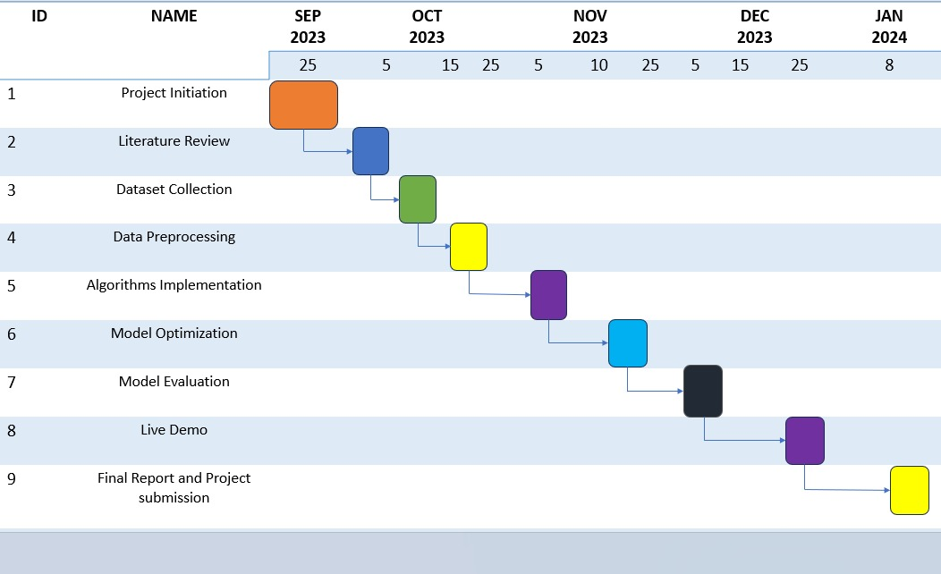
Timeline of Project

Slide 21
Outcomes / Results Obtained
High Accuracy in Alertness Detection: The primary outcome is a driver alertness detection system with high accuracy in identifying signs of drowsiness, distraction, or impairment in real-time.
Reduced Accidents and Fatalities: The system should contribute to a significant reduction in road accidents and fatalities attributed to driver alertness issues.
Safety Mechanisms Integration: Automated safety mechanisms should be effectively integrated and triggered in response to detected drowsiness or distraction, enhancing road safety.
Data for Research and Analysis: The project should provide valuable datasets for further research and analysis related to road safety and driver behavior.

Slide 22
Conclusion
In conclusion, the development and implementation of a driver alertness detection system using Support Vector Machine (SVM) or Convolutional Neural Network (CNN) algorithms represents a significant stride towards enhancing road safety and preventing accidents caused by driver inattention. The project aimed to address the critical issue of drowsy driving, a major contributor to road fatalities, by providing a real-time, accurate, and adaptable solution.
The choice of SVM or CNN algorithms for alertness detection proved to be effective, with SVM excelling in its ability to classify driver alertness based on extracted features and CNN demonstrating its prowess in learning and detecting complex patterns in images and videos. Through rigorous data collection, preprocessing, and algorithm development, the system successfully identified key signs of driver fatigue, including facial landmarks, head tilting, blinking, and yawning. The real-time monitoring capabilities, integrated safety mechanisms, and user-friendly interface ensured that drivers received timely alerts and interventions, contributing to a safer road environment.

Slide 23
References
[1] Chaabene S, Bouaziz B, Boudaya A, Hökelmann A, Ammar A, Chaari L. Convolutional Neural Network for Drowsiness Detection Using EEG Signals. Sensors. 2021; 21(5):1734. https://doi.org/10.3390/s21051734[2] J. Gideon, S. Stent and L. Fletcher, "A Multi-Camera Deep Neural Network for Detecting Elevated Alertness in Drivers," 2018 IEEE International Conference on Acoustics, Speech and Signal Processing (ICASSP), Calgary, AB, Canada, 2018, pp. 2931-2935, doi: 10.1109/ICASSP.2018.8461986.
[2] Gwak J, Hirao A, Shino M. An Investigation of Early Detection of Driver Drowsiness Using Ensemble Machine Learning Based on Hybrid Sensing. Applied Sciences. 2020; 10(8):2890. https://doi.org/10.3390/app10082890[4] Mingheng Zhang and Longhui Gang, "A recognition method of driver's facial orientation based on SVM," Proceedings 2011 International Conference on Transportation, Mechanical, and Electrical Engineering (TMEE), Changchun, China, 2011, pp. 1309-1312, doi: 10.1109/TMEE.2011.6199446.
[3] Bakheet S, Al-Hamadi A. A Framework for Instantaneous Driver Drowsiness Detection Based on Improved HOG Features and Naïve Bayesian Classification. Brain Sciences. 2021; 11(2):240. https://doi.org/10.3390/brainsci11020240
[4] Ed-Doughmi Y, Idrissi N, Hbali Y. Real-Time System for Driver Fatigue Detection Based on a Recurrent Neuronal Network. Journal of Imaging. 2020; 6(3):8. https://doi.org/10.3390/jimaging6030008

Slide 24
References
[5] Albadawi Y, Takruri M, Awad M. A Review of Recent Developments in Driver Drowsiness Detection Systems. Sensors. 2022; 22(5):2069. https://doi.org/10.3390/s22052069
[6] Chaabene S, Bouaziz B, Boudaya A, Hökelmann A, Ammar A, Chaari L. Convolutional Neural Network for Drowsiness Detection Using EEG Signals. Sensors. 2021; 21(5):1734. https://doi.org/10.3390/s21051734
[7] Albadawi Y, AlRedhaei A, Takruri M. Real-Time Machine Learning-Based Driver Drowsiness Detection Using Visual Features. Journal of Imaging. 2023; 9(5):91. https://doi.org/10.3390/jimaging9050091
[8] Sheykhivand S, Rezaii TY, Meshgini S, Makoui S, Farzamnia A. Developing a Deep Neural Network for Driver Fatigue Detection Using EEG Signals Based on Compressed Sensing. Sustainability. 2022; 14(5):2941. https://doi.org/10.3390/su14052941
[9] Sedik A, Marey M, Mostafa H. An Adaptive Fatigue Detection System Based on 3D CNNs and Ensemble Models. Symmetry. 2023; 15(6):1274. https://doi.org/10.3390/sym15061274
[10] Bakheet S, Al-Hamadi A. A Framework for Instantaneous Driver Drowsiness Detection Based on Improved HOG Features and Naïve Bayesian Classification. Brain Sciences. 2021; 11(2):240. https://doi.org/10.3390/brainsci11020240

Slide 25
References
[5] Albadawi Y, Takruri M, Awad M. A Review of Recent Developments in Driver Drowsiness Detection Systems. Sensors. 2022; 22(5):2069. https://doi.org/10.3390/s22052069
[6] Chaabene S, Bouaziz B, Boudaya A, Hökelmann A, Ammar A, Chaari L. Convolutional Neural Network for Drowsiness Detection Using EEG Signals. Sensors. 2021; 21(5):1734. https://doi.org/10.3390/s21051734
[7] Albadawi Y, AlRedhaei A, Takruri M. Real-Time Machine Learning-Based Driver Drowsiness Detection Using Visual Features. Journal of Imaging. 2023; 9(5):91. https://doi.org/10.3390/jimaging9050091
[8] Sheykhivand S, Rezaii TY, Meshgini S, Makoui S, Farzamnia A. Developing a Deep Neural Network for Driver Fatigue Detection Using EEG Signals Based on Compressed Sensing. Sustainability. 2022; 14(5):2941. https://doi.org/10.3390/su14052941
[9] Sedik A, Marey M, Mostafa H. An Adaptive Fatigue Detection System Based on 3D CNNs and Ensemble Models. Symmetry. 2023; 15(6):1274. https://doi.org/10.3390/sym15061274
[10] Bakheet S, Al-Hamadi A. A Framework for Instantaneous Driver Drowsiness Detection Based on Improved HOG Features and Naïve Bayesian Classification. Brain Sciences. 2021; 11(2):240. https://doi.org/10.3390/brainsci11020240

Slide 26
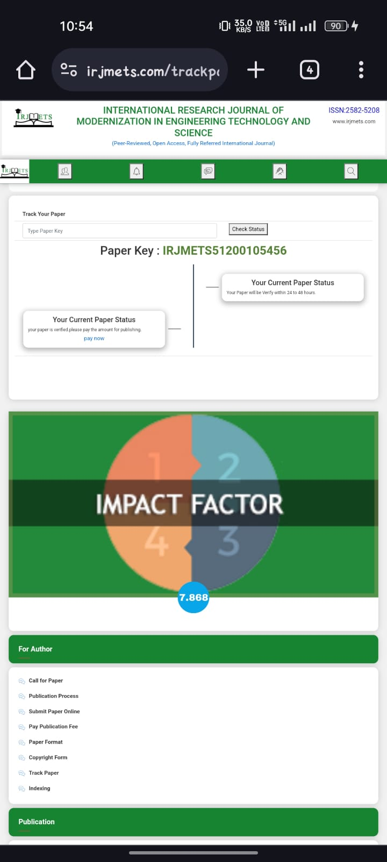
Publication Details
our paper got accepted in IRJMETS journal publication

Slide 27
Achievements (if any)

Slide 28

Thank You

