Slide 1

Exploratory Data Analysis
on
Trending YouTube Videos
By
Venugopal Katragadda(A20544776)
Sannihitha Gudimalla (A20560248)
Sruthi Kondapalli (A20554780)
Bezawada Sai Sravanya (A20561552)

Slide 2



Executive Summary
Key research issue
Findings
Future Work
This research aims to explore the dynamics behind YouTube trending videos and pinpoint the critical factors that drive their success. Through a comprehensive analysis, we investigated various aspects of trending content to gain meaningful insights into what contributes to a video's popularity on the platform.
Our analysis provided important insights into several factors influencing trending videos, including optimal category choices, ideal title lengths, and the influence of sentiment in descriptions on viewership. We also compared our results with existing trends to offer a broader perspective on the data. However, our efforts to apply cluster analysis for deeper insights were less successful than anticipated.
Future work could involve a deeper examination of the identified clusters and the development of predictive models to forecast a video's likelihood of trending. Such models would leverage key input features to not only predict trending potential but also provide strategic recommendations for optimizing content to enhance its chances of achieving trending status.

Slide 3




Overview of project
Methodology
DATA COLLECTION
DATA PREPROCESSING
EXPLORATORY DATA ANALYSIS (EDA)
CLUSTER ANALYSIS

Slide 4
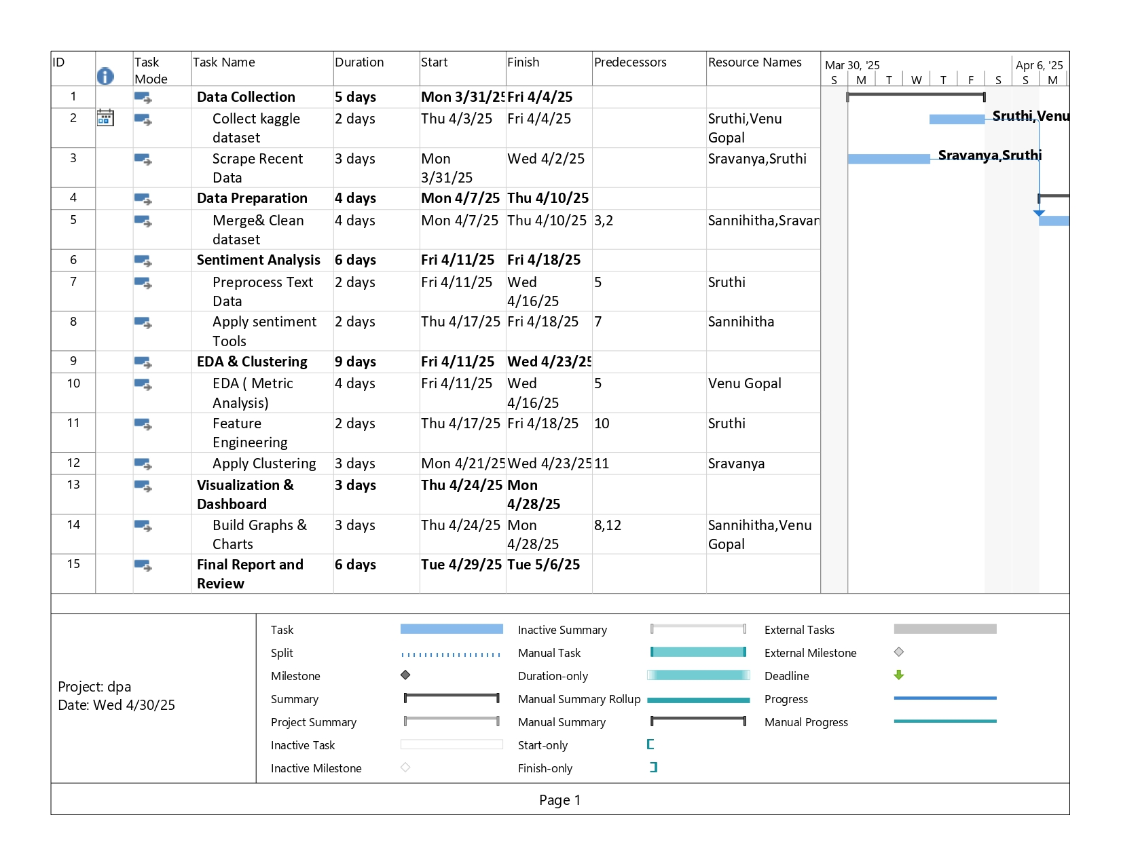
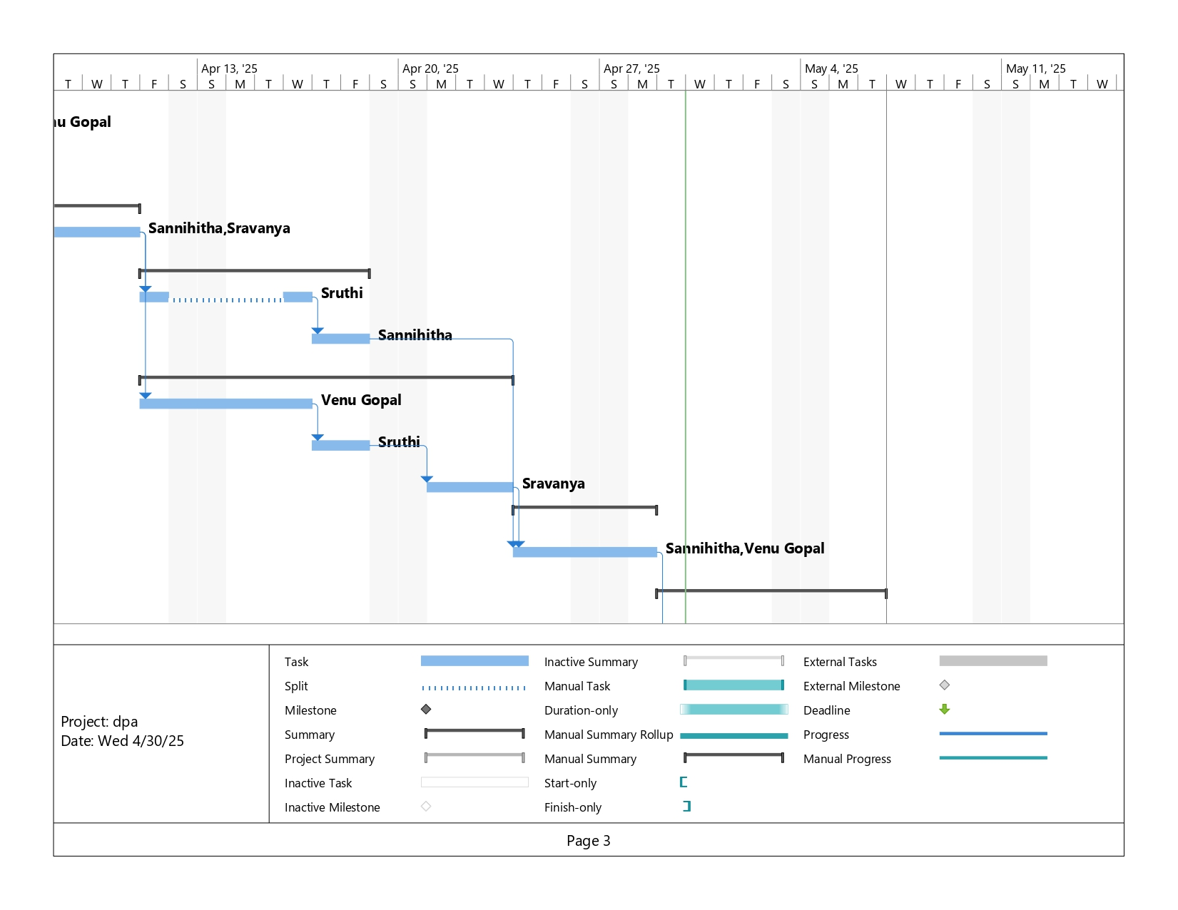
Updated Plan:
1. We made a lot more graphs and charts than we first thought. These visuals helped us see trends in the YouTube data more clearly.
2. We faced unexpected problems with the YouTube data scrapping. It took us longer to get the data we needed, but we found solutions and kept going with our analysis.
Project Plan

Slide 5
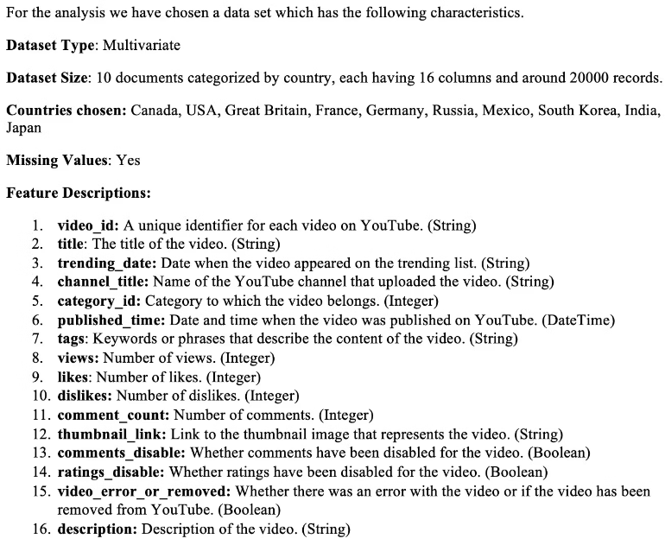
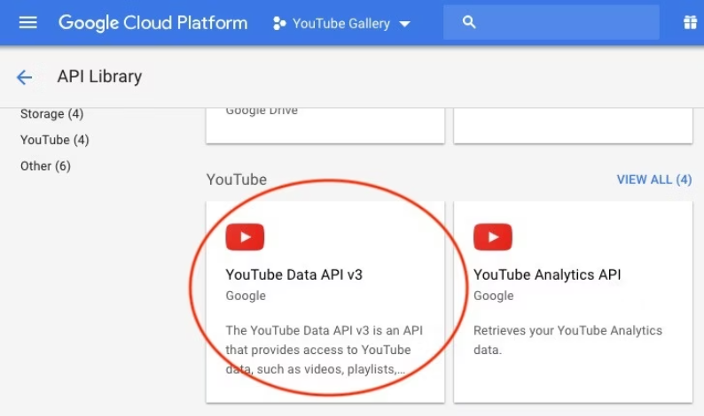
Data Sources
Kaggle Dataset
YouTube API

Slide 6





Data Preprocessing
Converting the categorical variable category_ID and incorporating a new country variable.
Handling missing values and Duplicates
Convert the 'trending_date' and 'published_time' columns to datetime format
Extracting from 'published_time' such as the day of the week or hour of the day the video was published.
Text pre - processing for Sentiment analysis

Slide 7
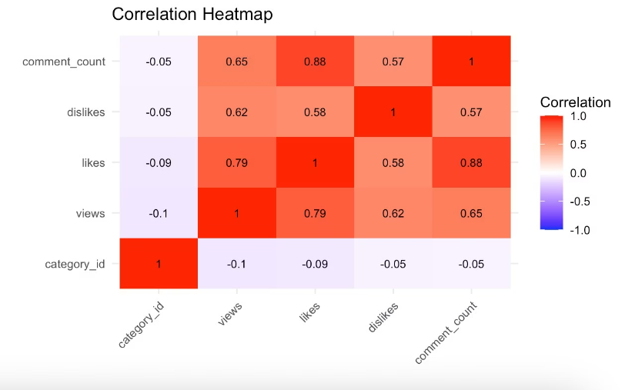
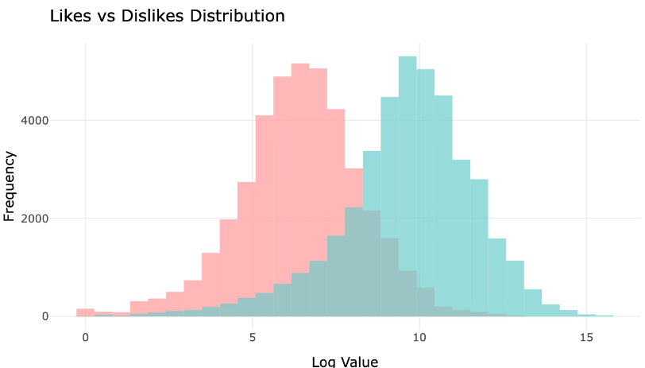
Exploratory Data Analysis
CORRELATION MATRIX
DISTRIBUTION PLOT

Slide 8
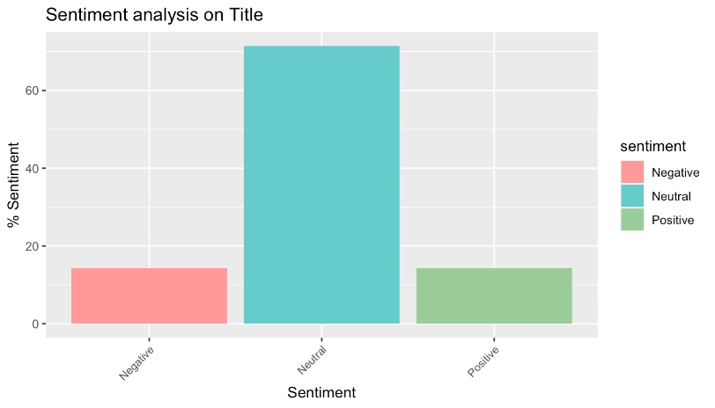
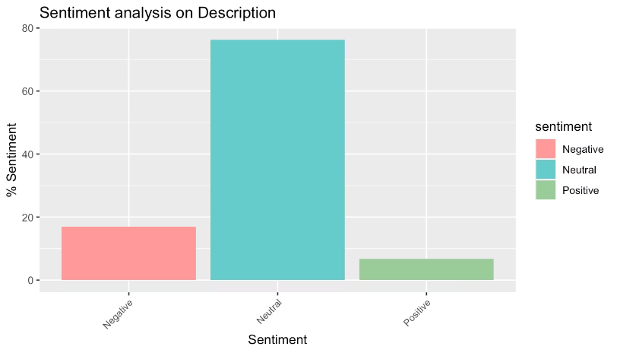
Sentiment Analysis

Slide 9
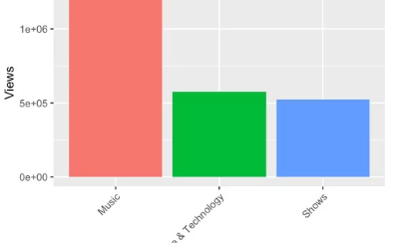
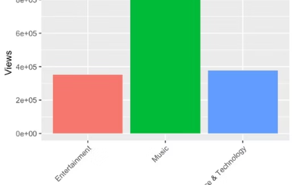
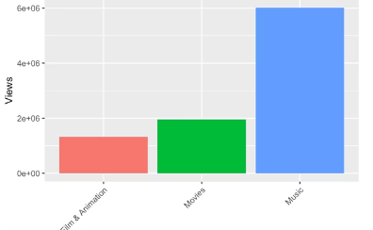
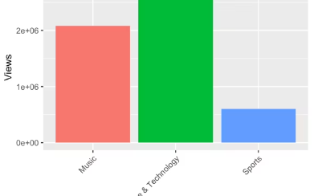
WHAT ARE THE TOP 3 CATEGORIES BASED ON THE NUMBER OF VIEWS, FOR EACH OF THE COUNTRIES?

Slide 10
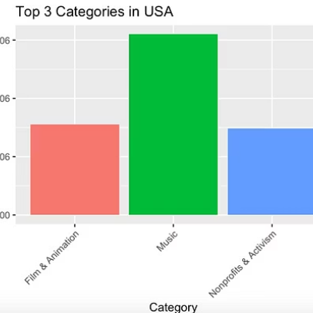
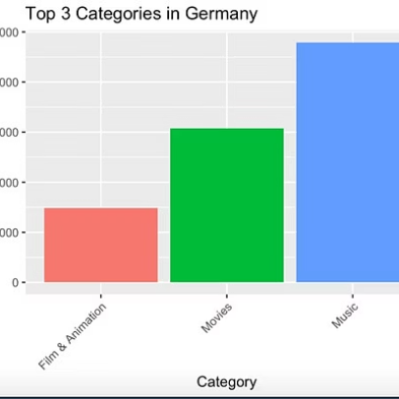
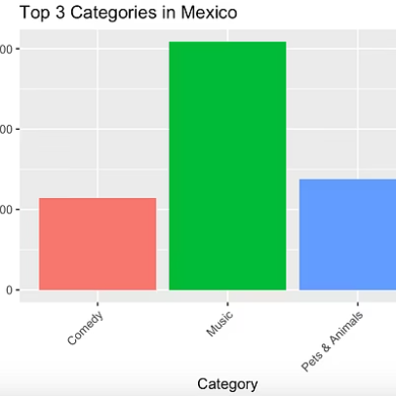
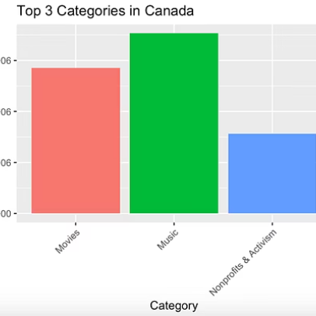
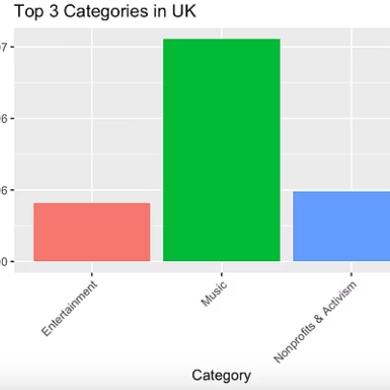
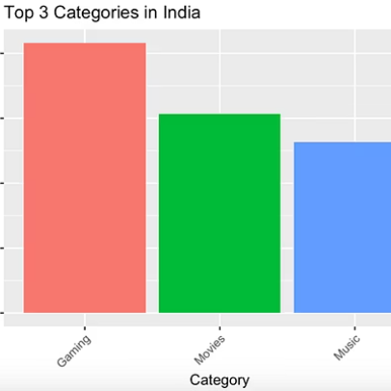

Slide 11
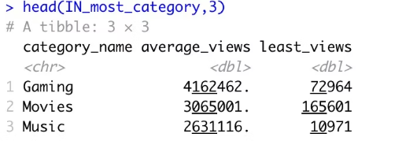
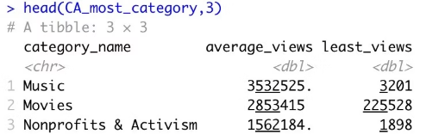
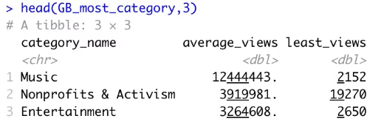
Countries with highest least views

Slide 12
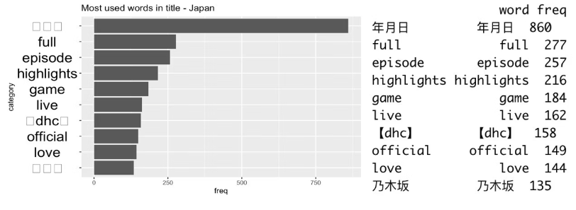
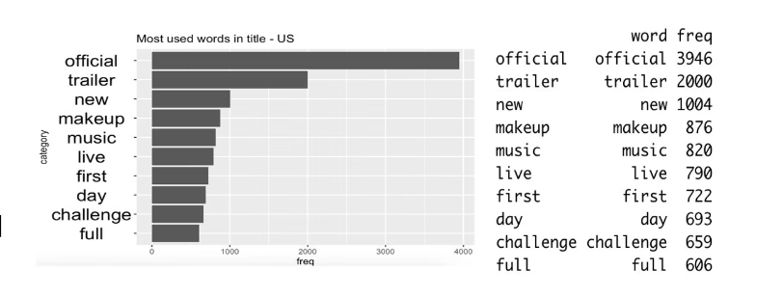
ARE THERE SPECIFIC KEYWORDS IN THE TITLE THAT ARE MORE LIKELY TO RESULT IN A VIDEO TRENDING?

Slide 13
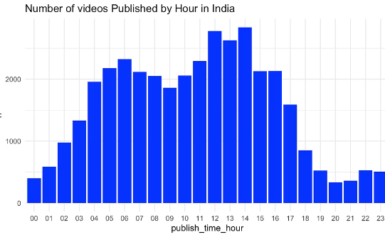
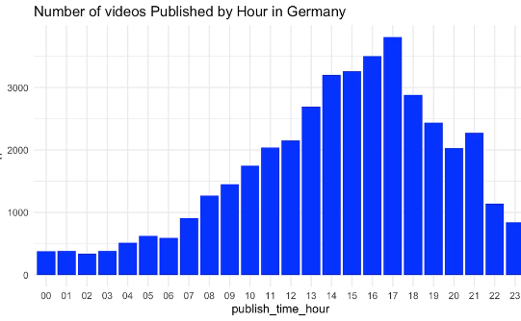
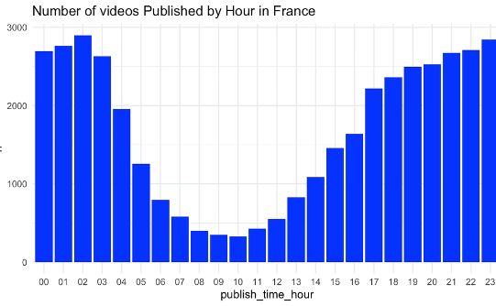
HOUR OF THE DAY WHEN TRENDING VIDEOS ARE UPLOADED

Slide 14
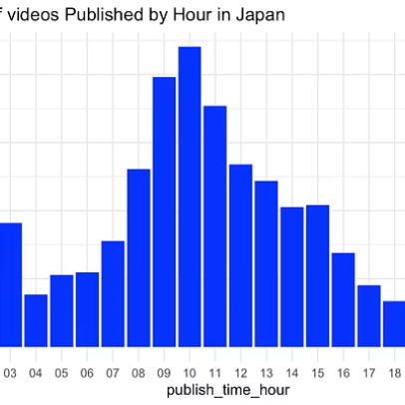
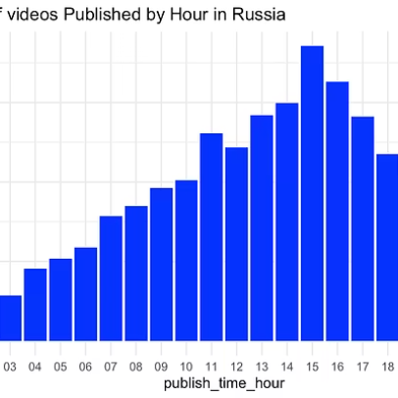
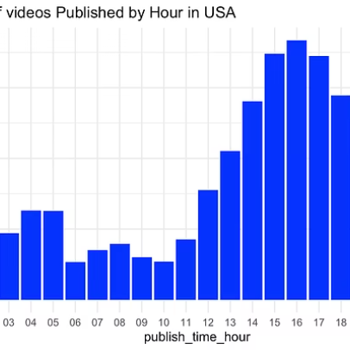
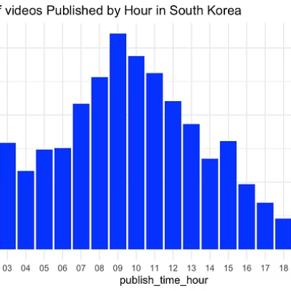
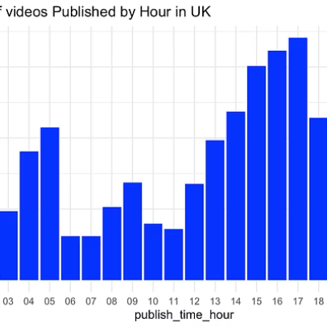
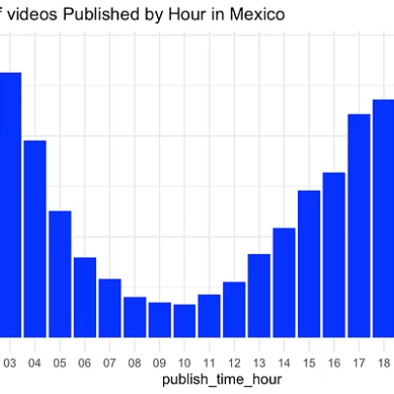

Slide 15
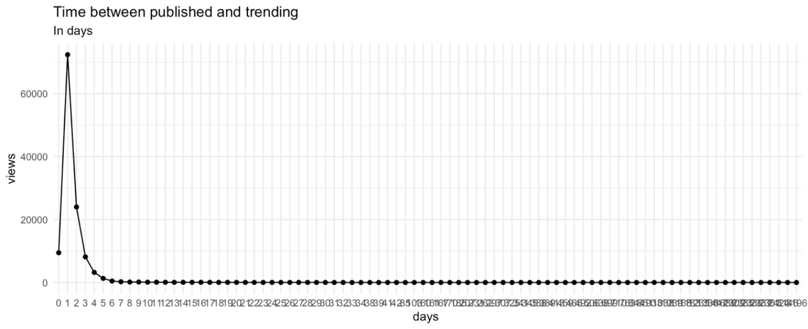
TIME BETWEEN PUBLISHING AND TRENDING?

Slide 16
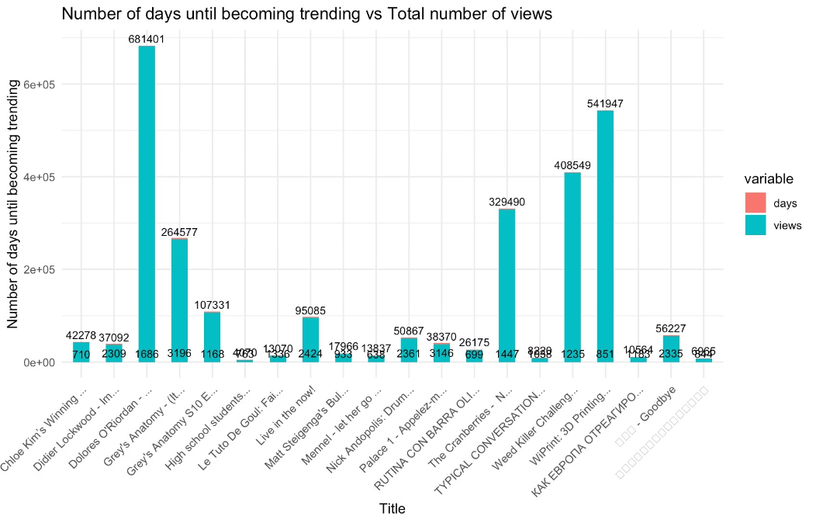
VIDEOS THAT WAITED THE LONGEST BEFORE THEY BECAME TRENDING

Slide 17
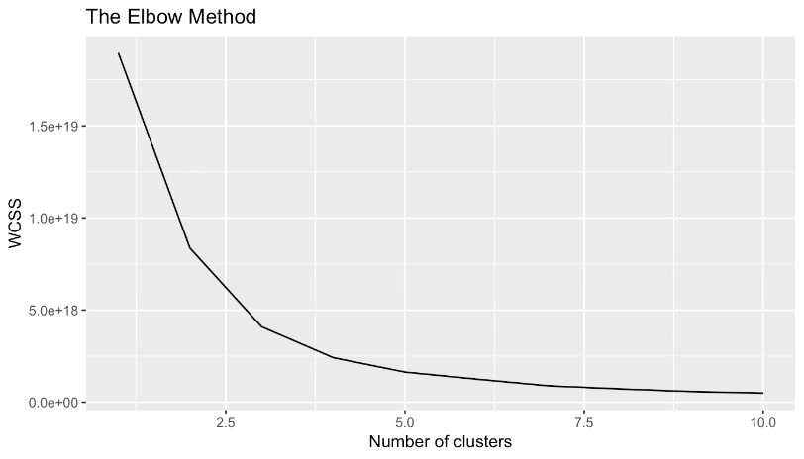
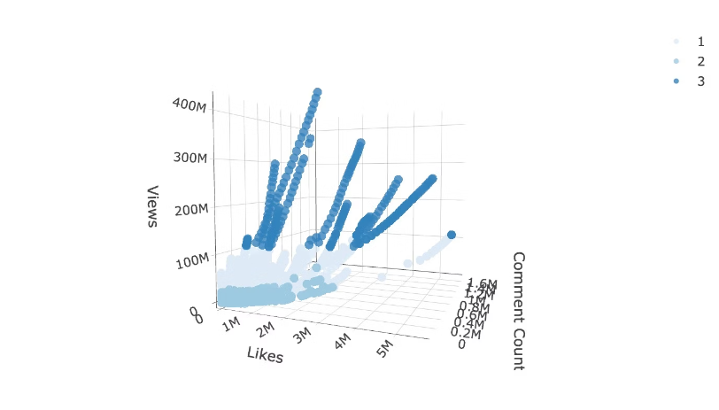
Model Training and Evaluation
k-means clustering

Slide 18
Cluster Analysis
Cluster 1 (Size: 2946):
Cluster 2 (Size: 372768):
Cluster 3 (Size: 228):
The mean values for data_total.likes, data_total.dislikes, data_total.views, and data_total.comment_count are notably high.
This cluster is the largest among the three identified clusters.
This cluster is the smallest among the three identified clusters.
The mean values for data_total.likes, data_total.dislikes, data_total.views, and data_total.comment_count are significantly lower than those of Cluster 1 but higher than those of Cluster 3.
It exhibits the lowest mean values for data_total.likes, data_total.dislikes, data_total.views, and data_total.comment_count compared to the other clusters.
This indicates that Cluster 1 likely corresponds to highly popular and engaging videos, characterized by substantial numbers of likes, views, dislikes, and comments.
This suggests that the cluster likely represents videos or content that are less popular and less engaging, characterized by comparatively fewer likes, views, dislikes, and comments.
This suggests that the cluster likely represents moderately popular and engaging videos, characterized by a moderate number of likes, views, dislikes, and comments.

Slide 19
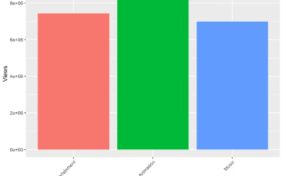
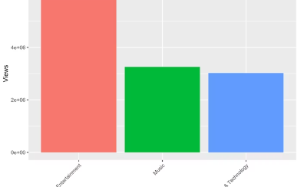
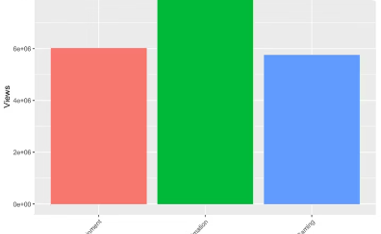
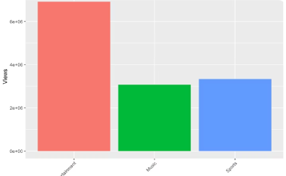
Analysis on scraped data
Top 3 Categories in Canada
Top 3 Categories in France
Top 3 Categories in Germany
Top 3 Categories in Mexico

Slide 20
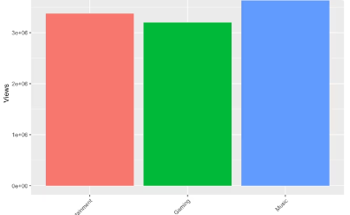
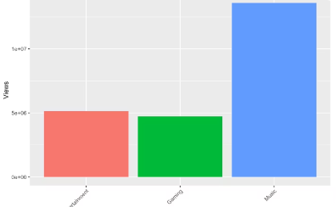
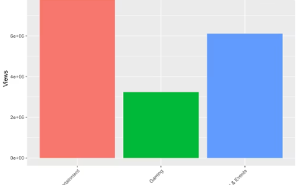
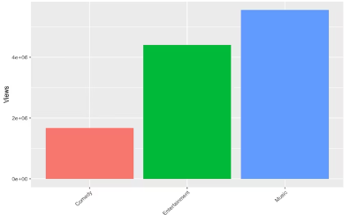

Slide 21
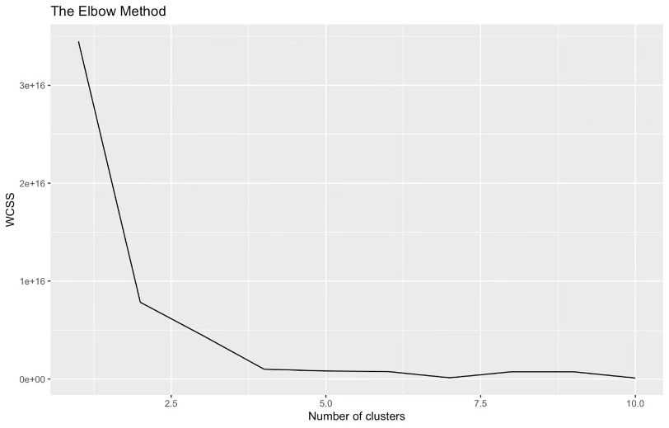
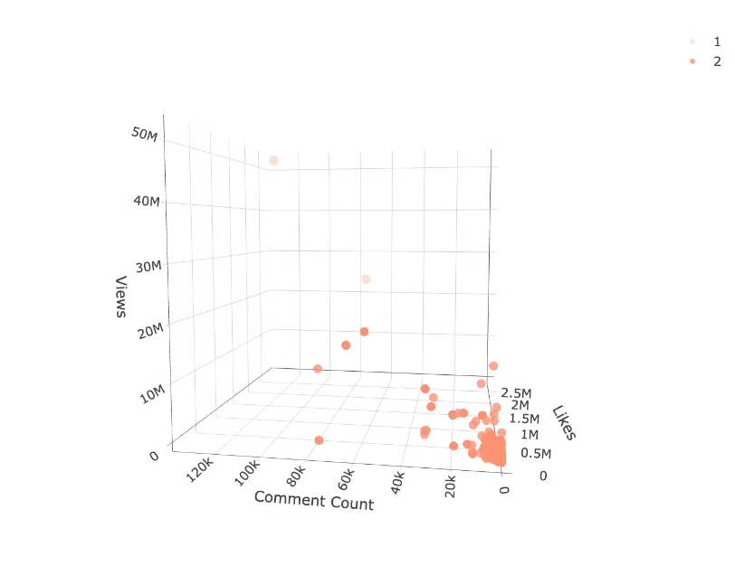
k-means clustering on scraped data

Slide 22
Conclusions
Gained insights into the optimal choice of video category, the ideal title length, and the potential influence of description sentiment on viewership.
Compared the findings with current trends to obtain a comprehensive view of the data. Overall, the trends observed in the current data closely align with those identified in past data.
An attempt was made to perform cluster analysis to uncover more nuanced insights; however, the results were not as successful as anticipated.
Future work involves a deeper exploration of the identified clusters and the development of methods to predict video trends.

Slide 23
Thank You!

