Slide 1
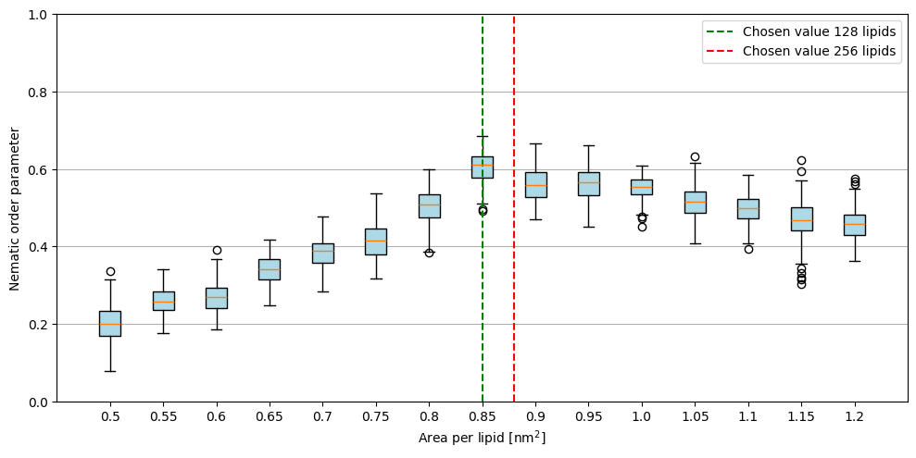
Bilayer start 128 lipids, equlibrate at T = 0.8, skip first 1000τ

Slide 2
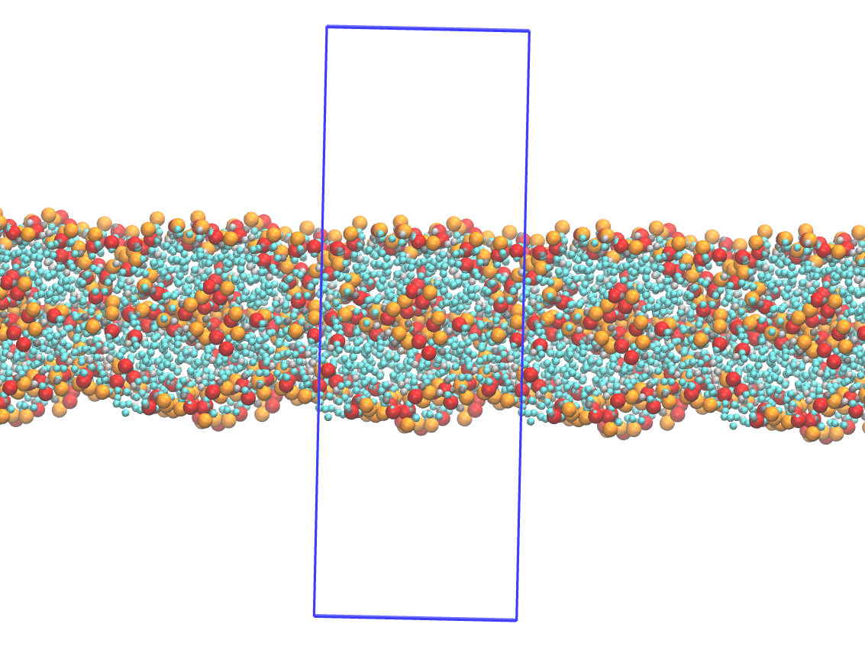
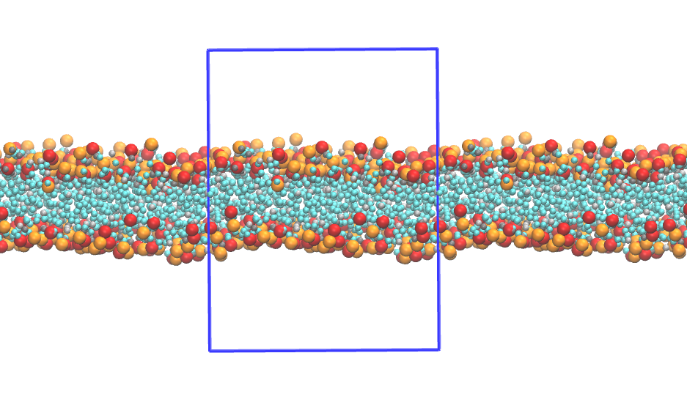
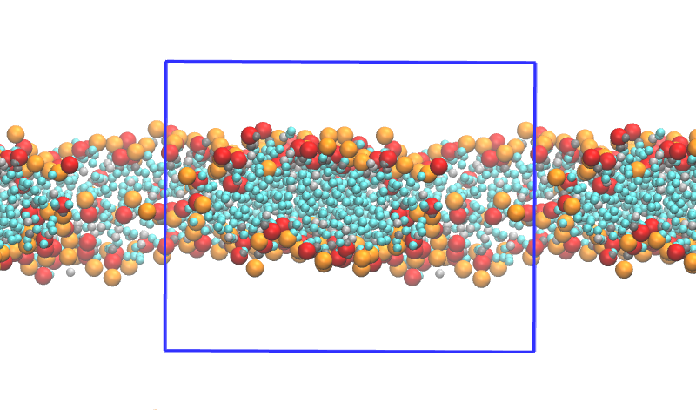
Apl = 0.5 nm²
Apl = 0.85 nm²
Apl = 12 nm²

Slide 3
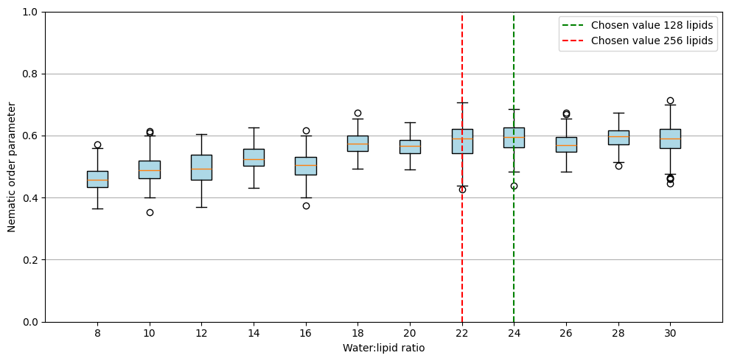
→ 128 lipids: apl = 0.85 nm², wpl = 22, ρ = 3
→ 256 lipids: apl = 0.88nm², wpl = 24, ρ = 3

Slide 4
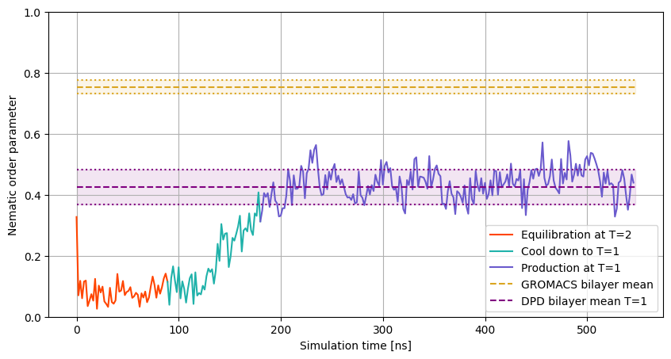
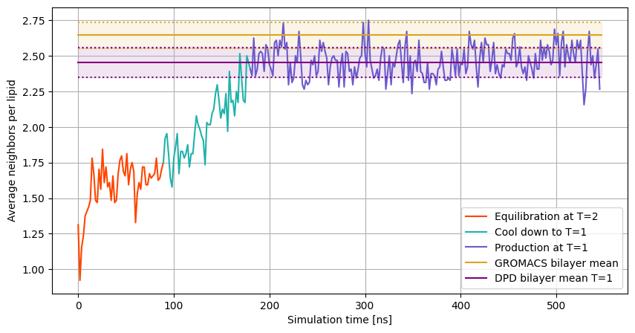
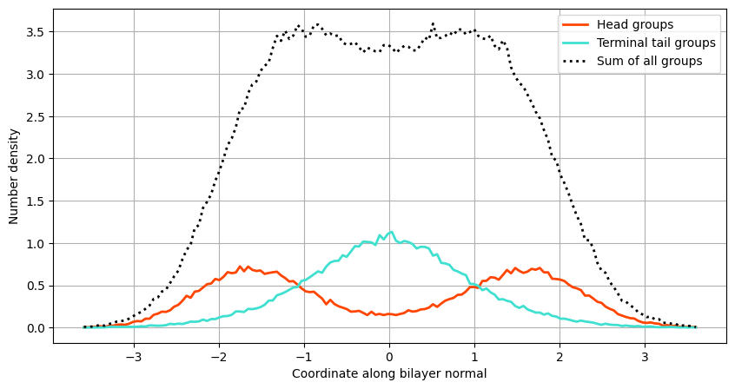
T = 1, 128 lipids
1) Lipid soup
2) Equilibration at T = 2
3) Cool down to T = 1
4) Production at T = 1

Slide 5
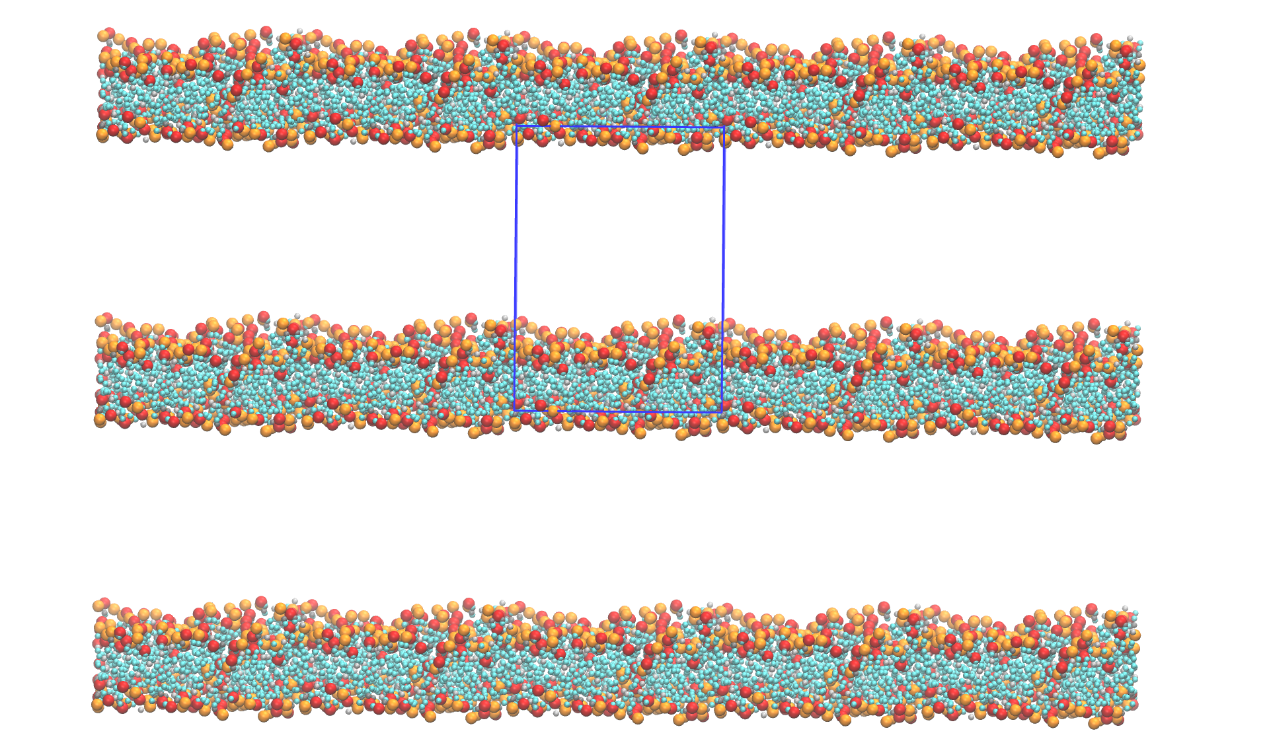
T = 1, 128 lipids

Slide 6
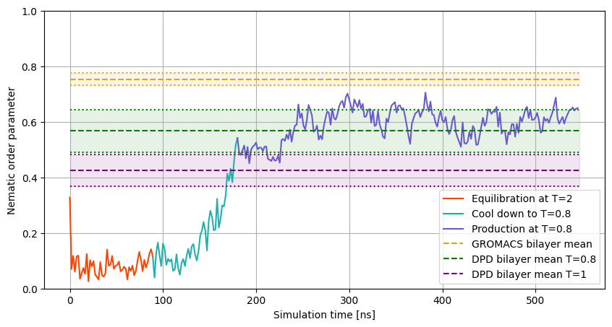
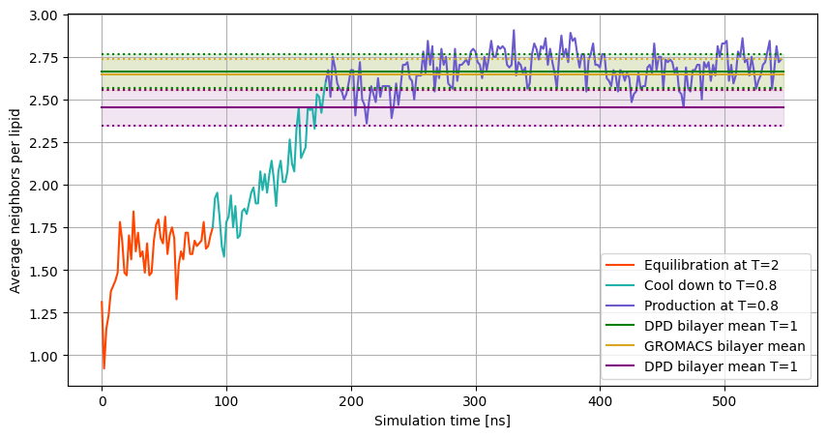
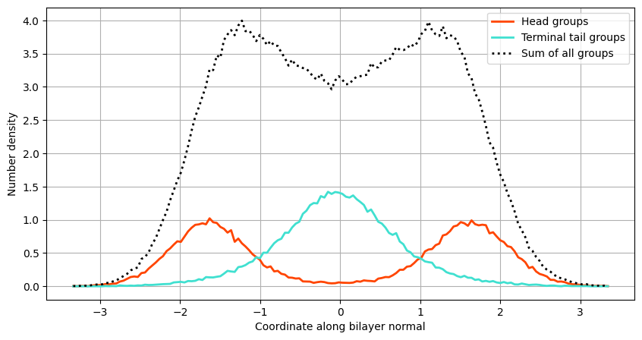
T = 0.8, 128 lipids
1) Lipid soup
2) Equilibration at T = 2
3) Cool down to T = 0.8
4) Production at T = 0.8

Slide 7
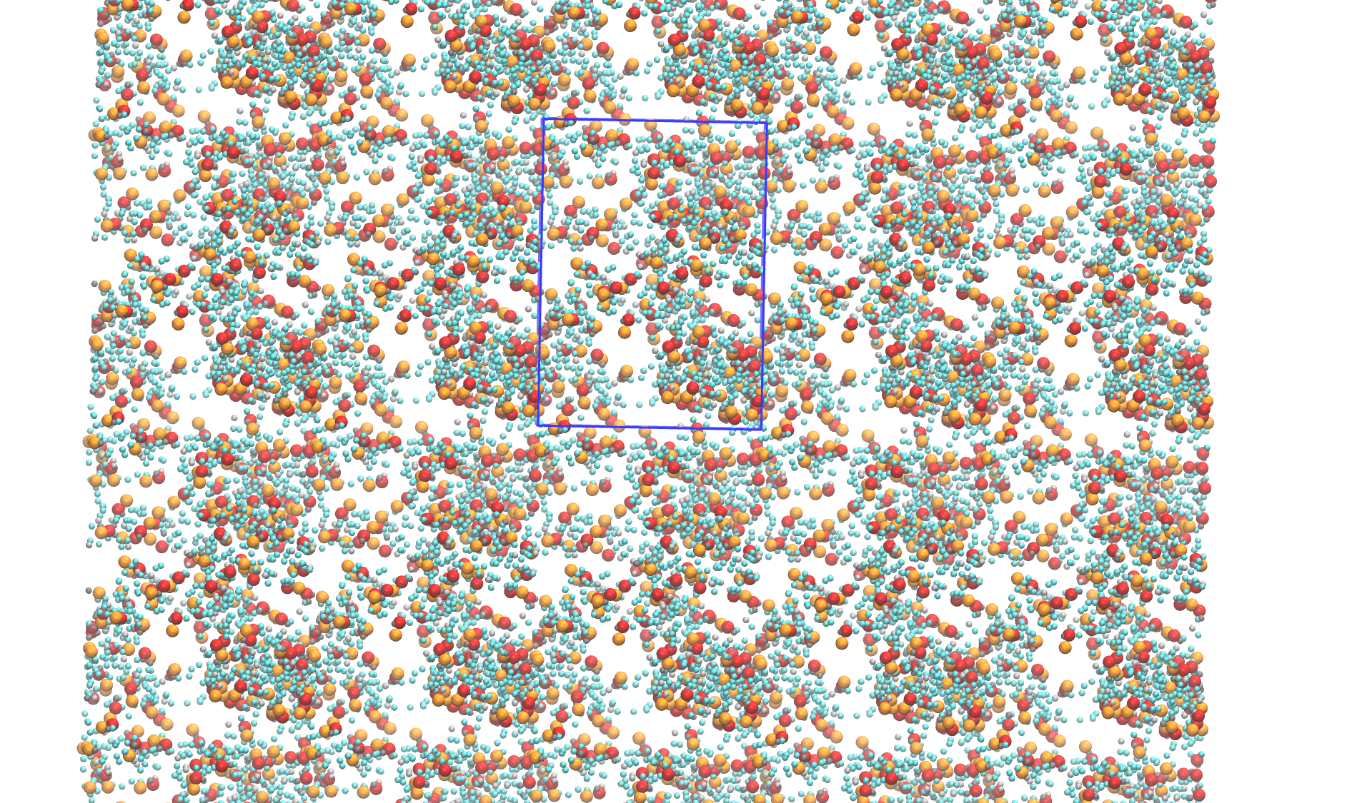
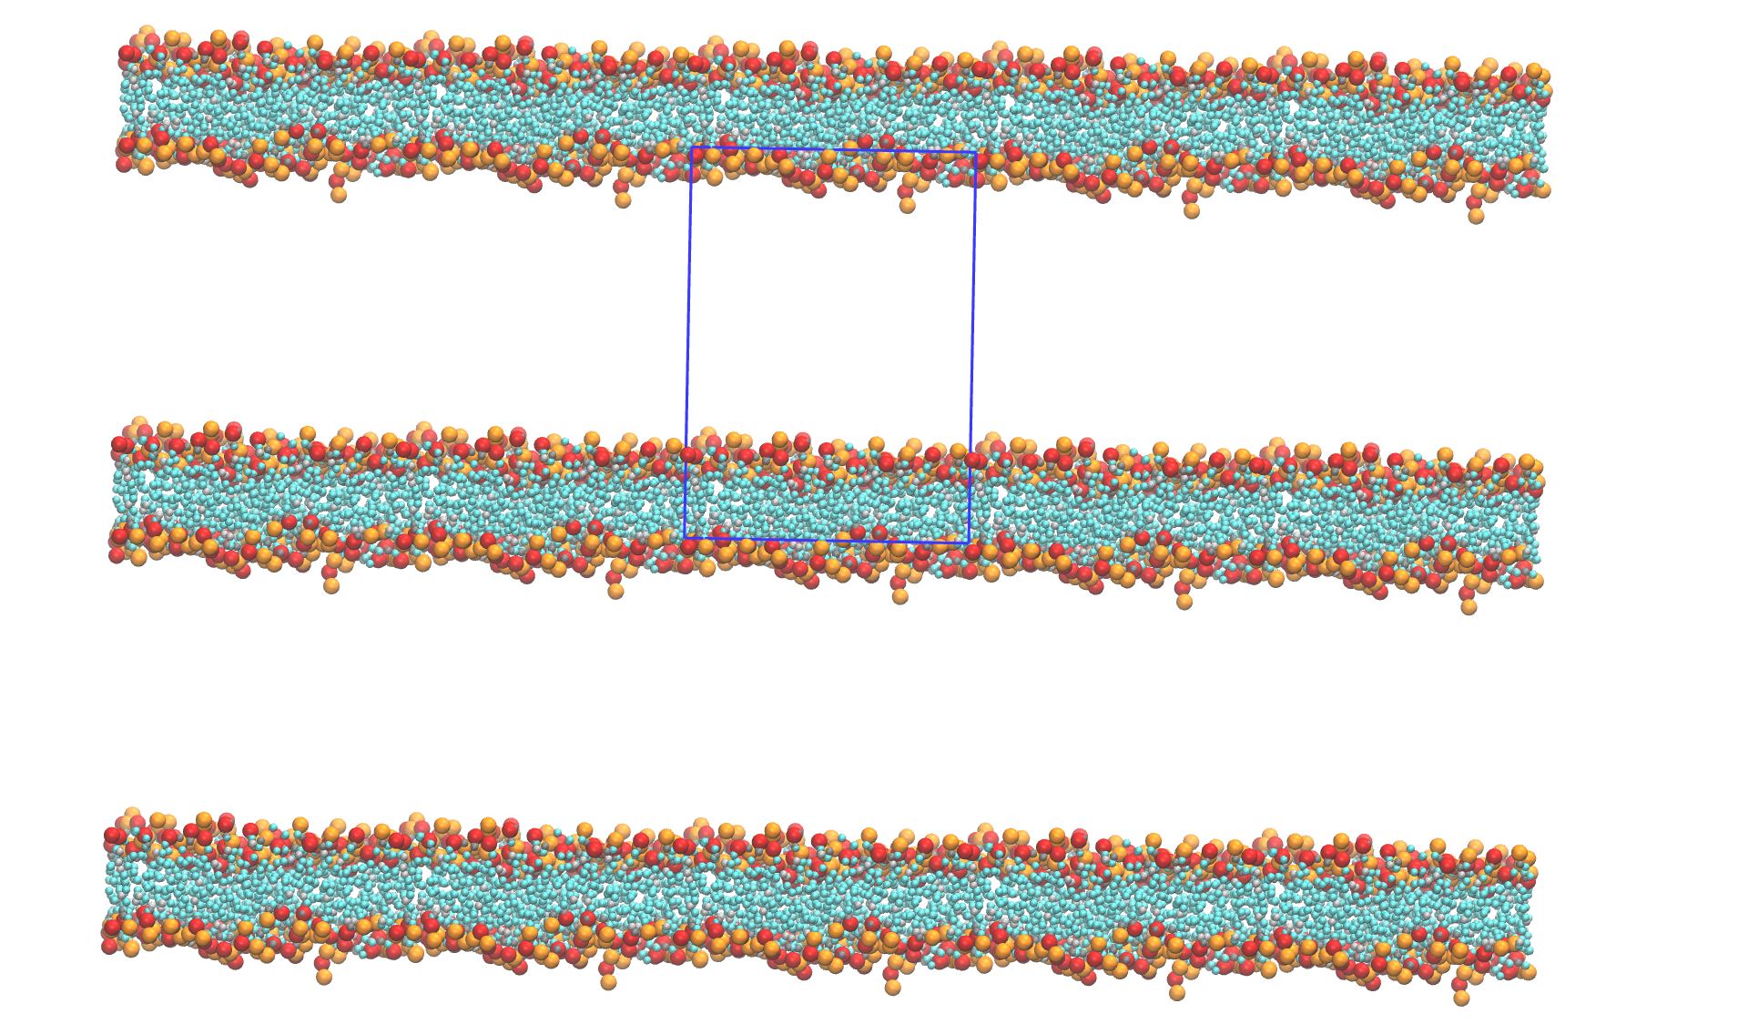
T = 0.8, 128 lipids

Slide 8
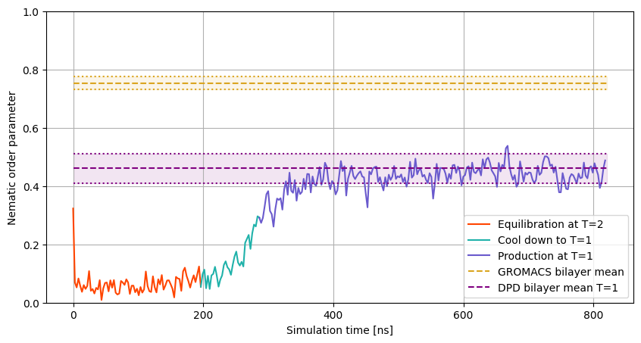
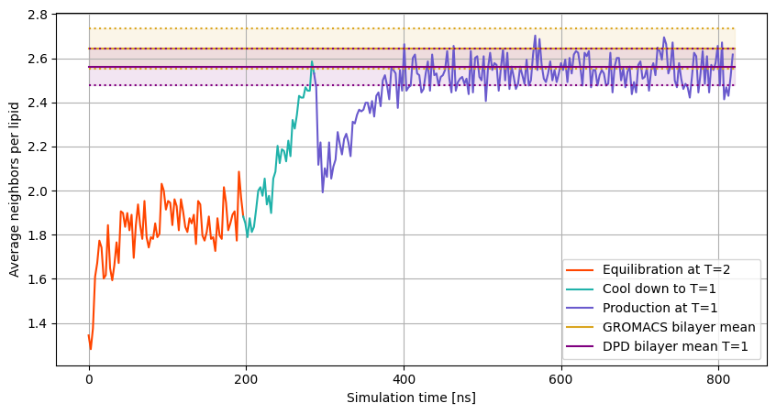
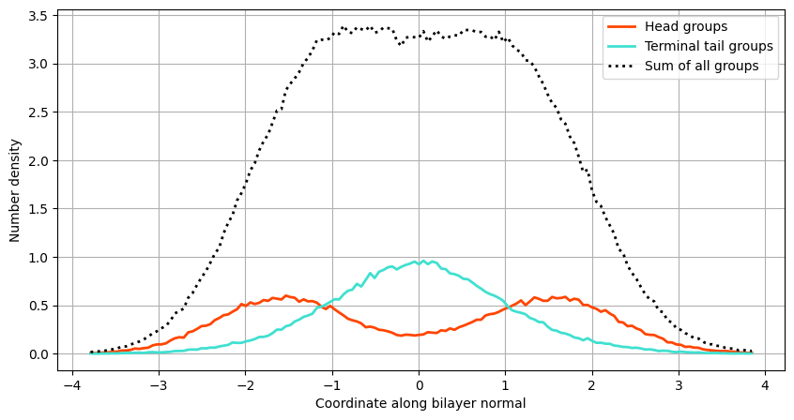
T = 1, 256 lipids
1) Lipids soup
2) Equilibrate at T = 2
3) Cool down to T = 1
4) Deform Box to fit into
quadratic form
5) Production at T = 1

Slide 9
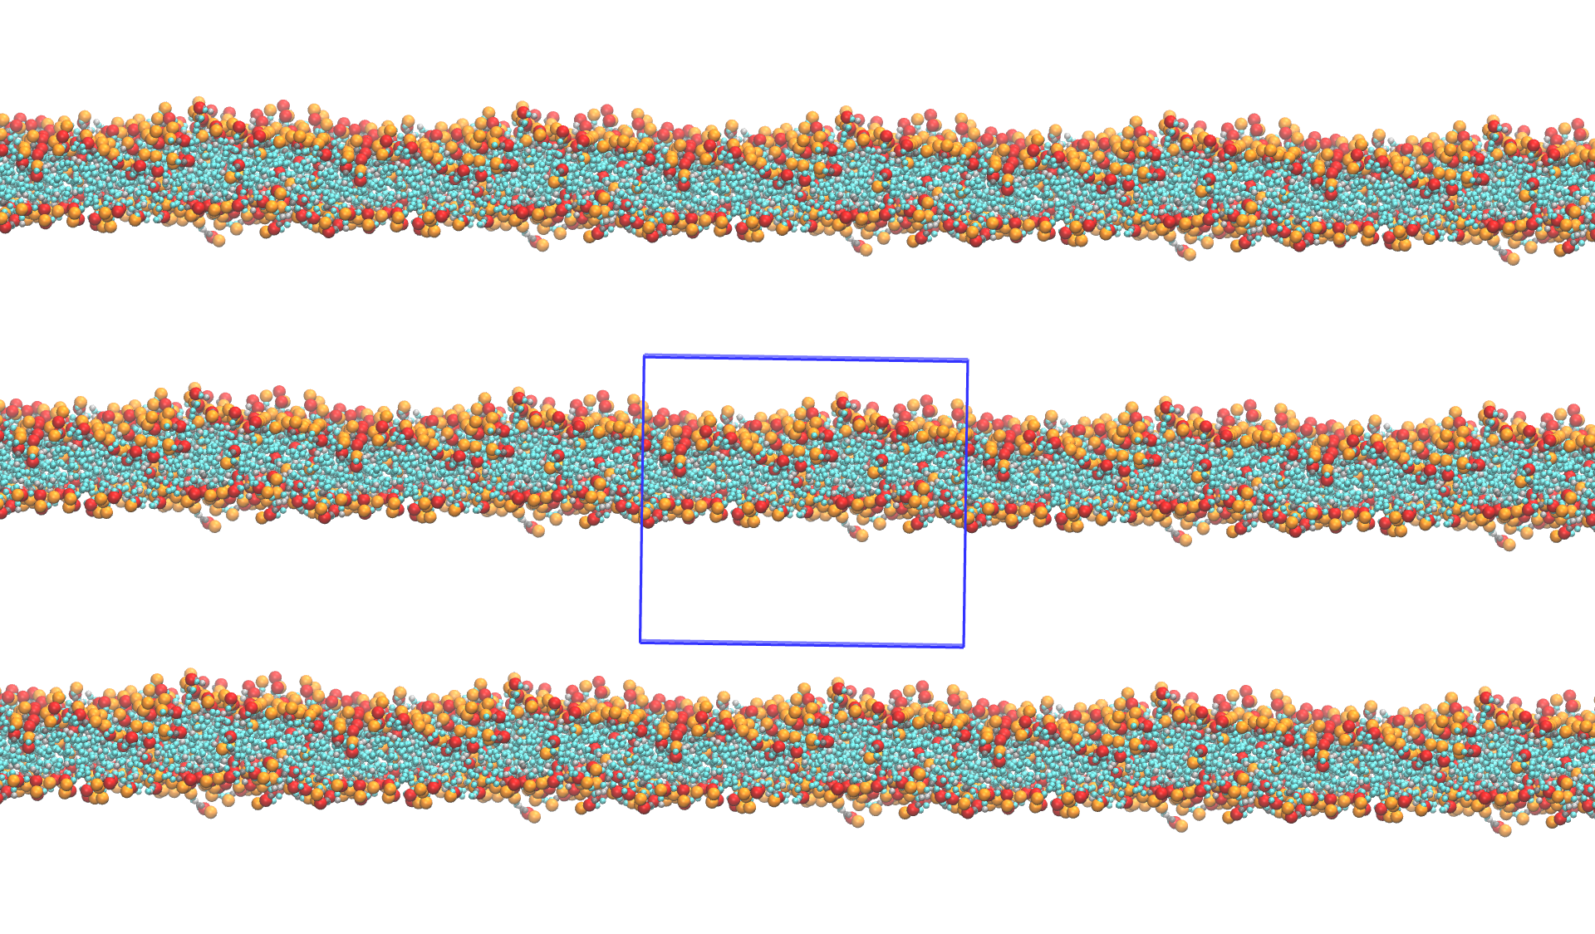
T = 1, 256 lipids

Slide 10
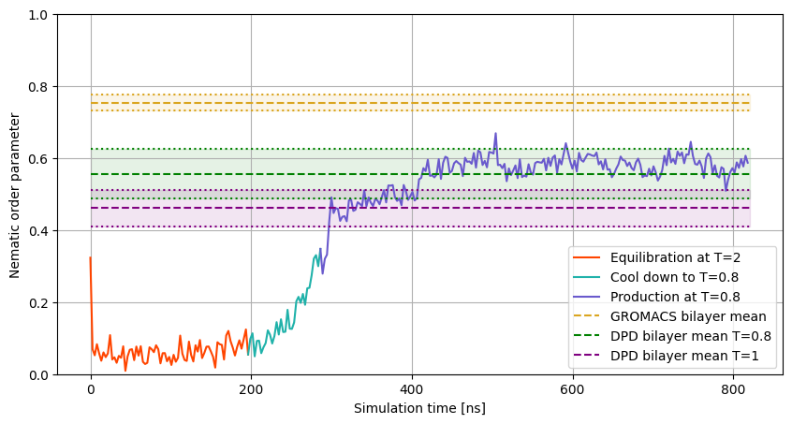
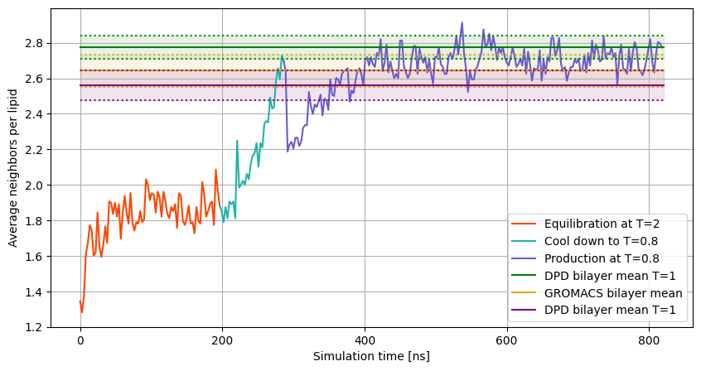
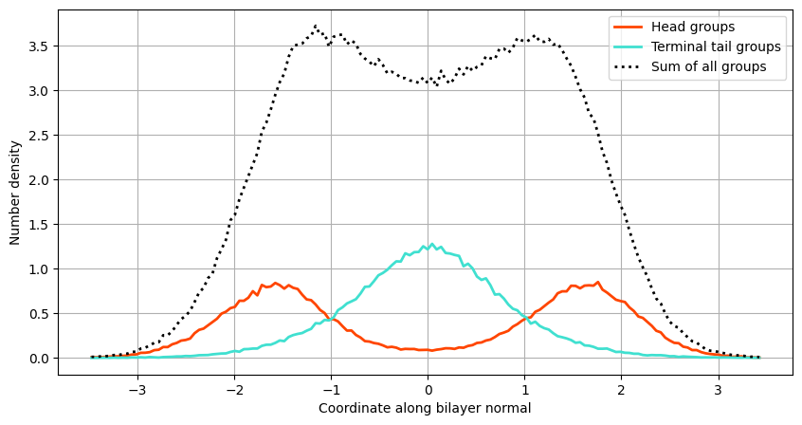
T = 0.8, 256 lipids
1) Lipids soup
2) Equilibrate at T = 2
3) Cool down to T = 1
4) Deform Box to fit into
quadratic form
5) Production at T = 1

Slide 11
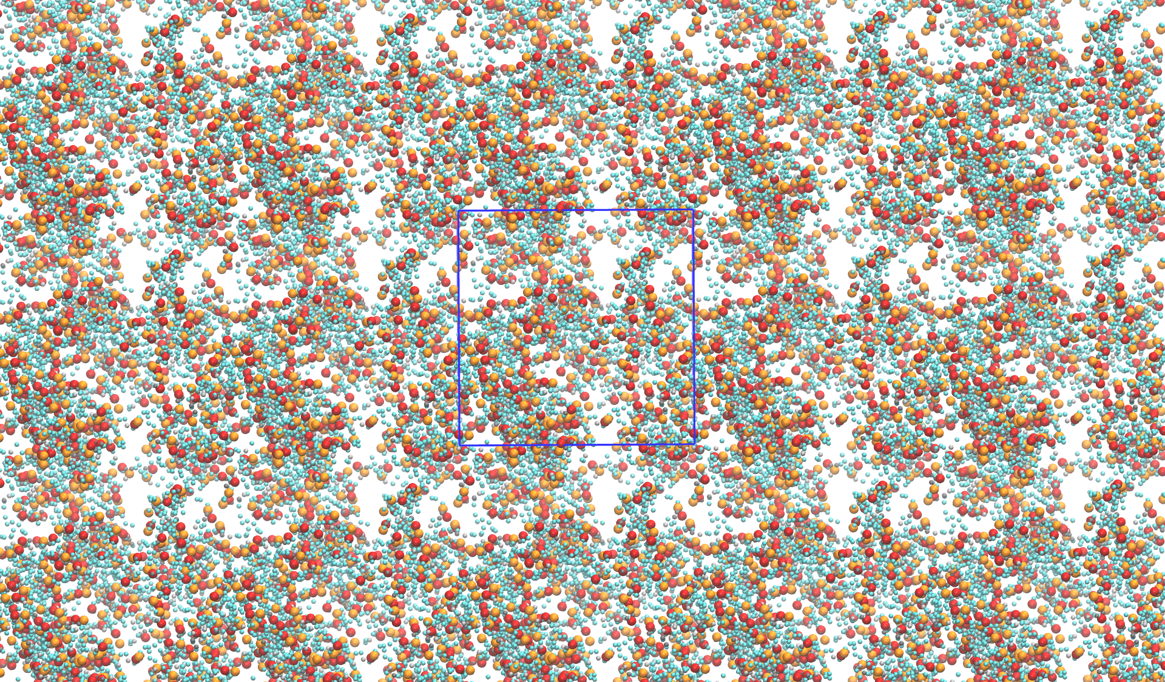
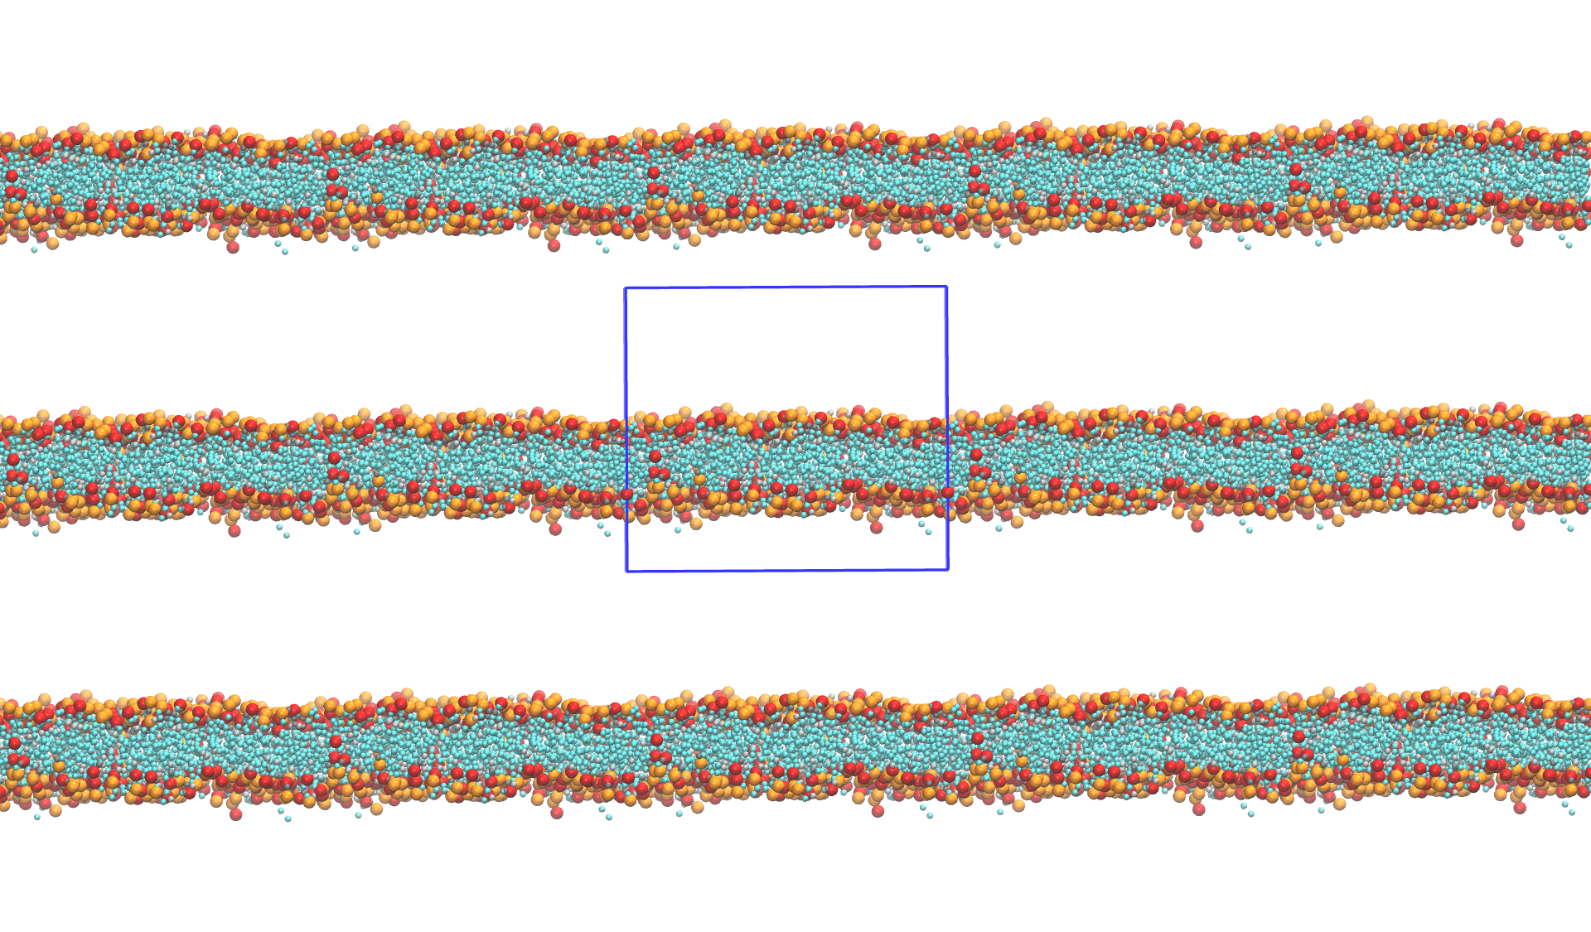
T = 0.8, 256 lipids

