Slide 1
Contextualized Commonsense Inference in Dialogues
Sidhardha Grandhi - CS19BTECH11050
Akhil Mylavarapu - ES19BTECH11014

Slide 2
Contents
01
02
03
Introduction
Paper Summary
About CCInference
Takeaway from the paper
Code Implementation
Explanation regarding the code

Slide 3
01
Introduction

Slide 4
Contextualized Commonsense Inference in Dialogues
Contextualized Commonsense inference in dialogues (CCInference), which draws on both contextual data and common sense knowledge, is to predict an appropriate reaction or action in a context of conversation. It involves understanding the dialogue's implicit objectives and meaning and making educated predictions about the dialogue's next course of action utilising background knowledge.
Recent developments in NLP, especially the creation of pre-trained language models like BERT, GPT-3, and RoBERTa, have made important strides in the field of CCInference. These models are capable of making precise predictions in conversational scenarios by efficiently learning from massive volumes of data and utilising context and common sense information.

Slide 5
CICERO:
A Dataset for Contextualized
Commonsense Inference in Dialogues
2

Slide 6
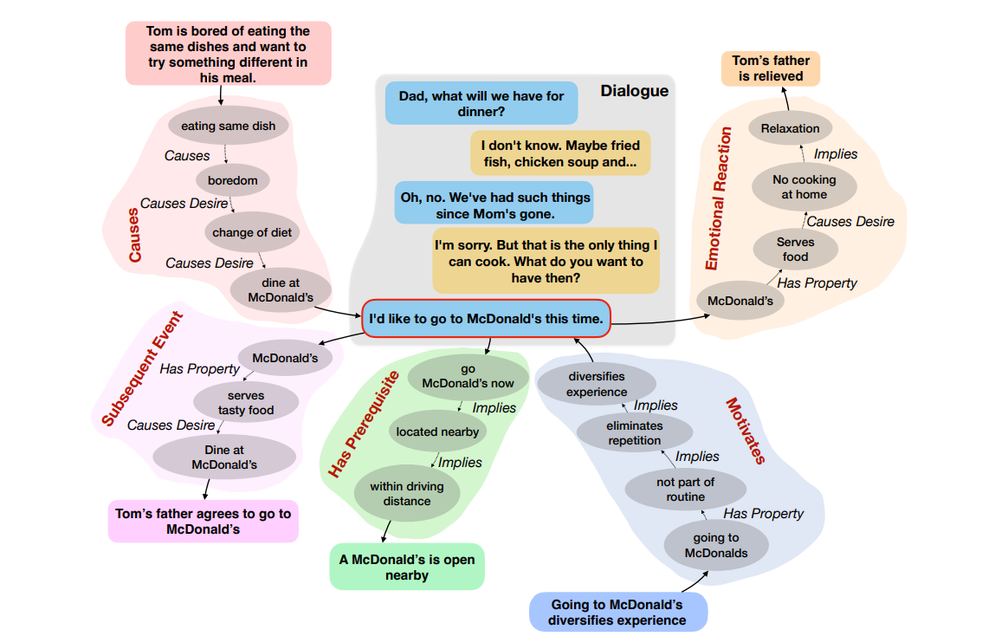
CICERO
The dataset CICERO consists of dyadic conversations with five reasoning-based inferences: Cause, Subsequent event, Prerequisite, Motivation, and Emotional reaction. The dataset contains 53,105 of inferences from 5,672 dialogues.

Slide 7
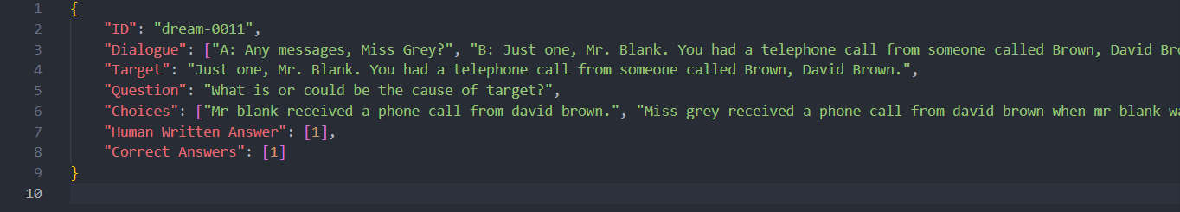
Tasks
Task 1: NLG
To generate the answer to question Q, representing one of the five inference types, for a target utterance Ut in a dialogue D.
Task 2: MCQ
Given dialogue D, target Ut , one of the five questions (inference type) Q, true answer At, alternate choices Ft = {Ft1, Ft2, Ft3, Ft4}, the aim is to select the correct answer and additionally any answer among Ft which might be correct.

Slide 8
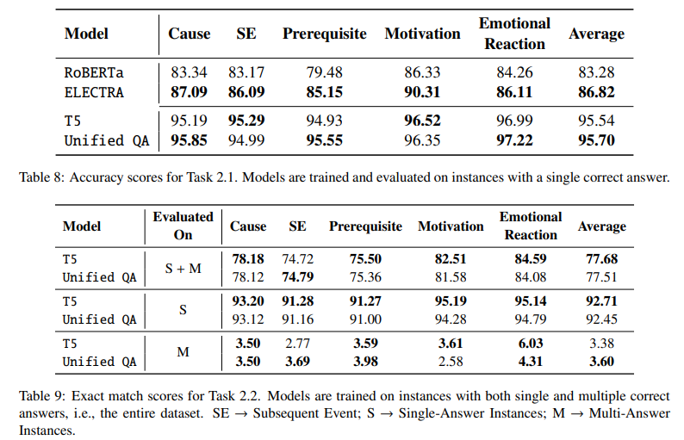
Results of MCQ task

Slide 9
03
Code Implementation

Slide 10
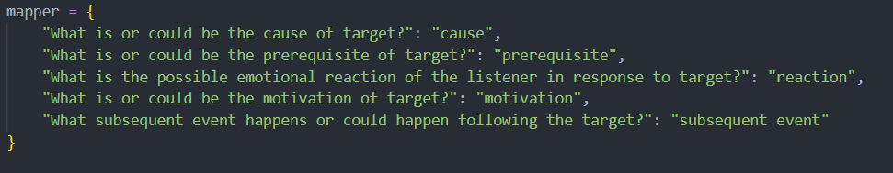
Code Implementation
Some notifiers from the data:
The IDs are majorjy of 3 types, Dream, Mutual, Daily-Dialogue.
The unique questions are 5 in number and they are:

Slide 11
Code Implementation
Implementation steps
Pre-processing the text data Tokenizing and lemmatizing the given data of Dialogue, Choices, Target with nltk
Vectorizing based on the Input data by using CountVectorizer. TFIDFVectorizer was also considered, but not used due to computational constraints
Using label encoder to Encode the Questions and mapping the Hand written answers and Correct answers to their choices.
Model
Using Sequential model as it is known for sentiment analysis. We have added 5 more layers over that at the moment.

Slide 12
Code Implementation
Model(contd.)
Embedding Layer: This layer converts the input sequence of integers into dense vectors of fixed size.
Bidirectional LSTM Layer: This layer is a type of RNN layer that allows the model to take into account both the previous and next context when processing the input sequence.
Dense Layer: This layer is a fully connected layer that applies a linear transformation to the input data. The relu activation function is used to introduce non-linearity.
Dropout Layer: This layer is used to prevent overfitting in the model. We have set the dropout rate to 0.5.
Dense Layer: This layer is the output layer of the model and uses the softmax activation function to convert the model's final output into a probability distribution over the possible choices.

Slide 13
Thanks!
Any questions?

