Slide 1

GitHub Copilot Hackathon
Team Name - LLM Professors
Team Leader Name - Salil Gautam
Team Leader Email Address - salil.gtm@gmail.com

Slide 2


Brief Summary of Project:
Weather Forecasting Tool
A command-line tool that accepts a city's name and returns the current weather forecast.
leverages OpenWeatherMapAPI to fetch weather data
The project is entirely built with the help of GitHub CoPilot which majorly helped in :
Parsing the Data
Building the command-line tool
Error handling
Spell Checking to correct city names

Slide 3
Business Challenge / Use Cases

Slide 4
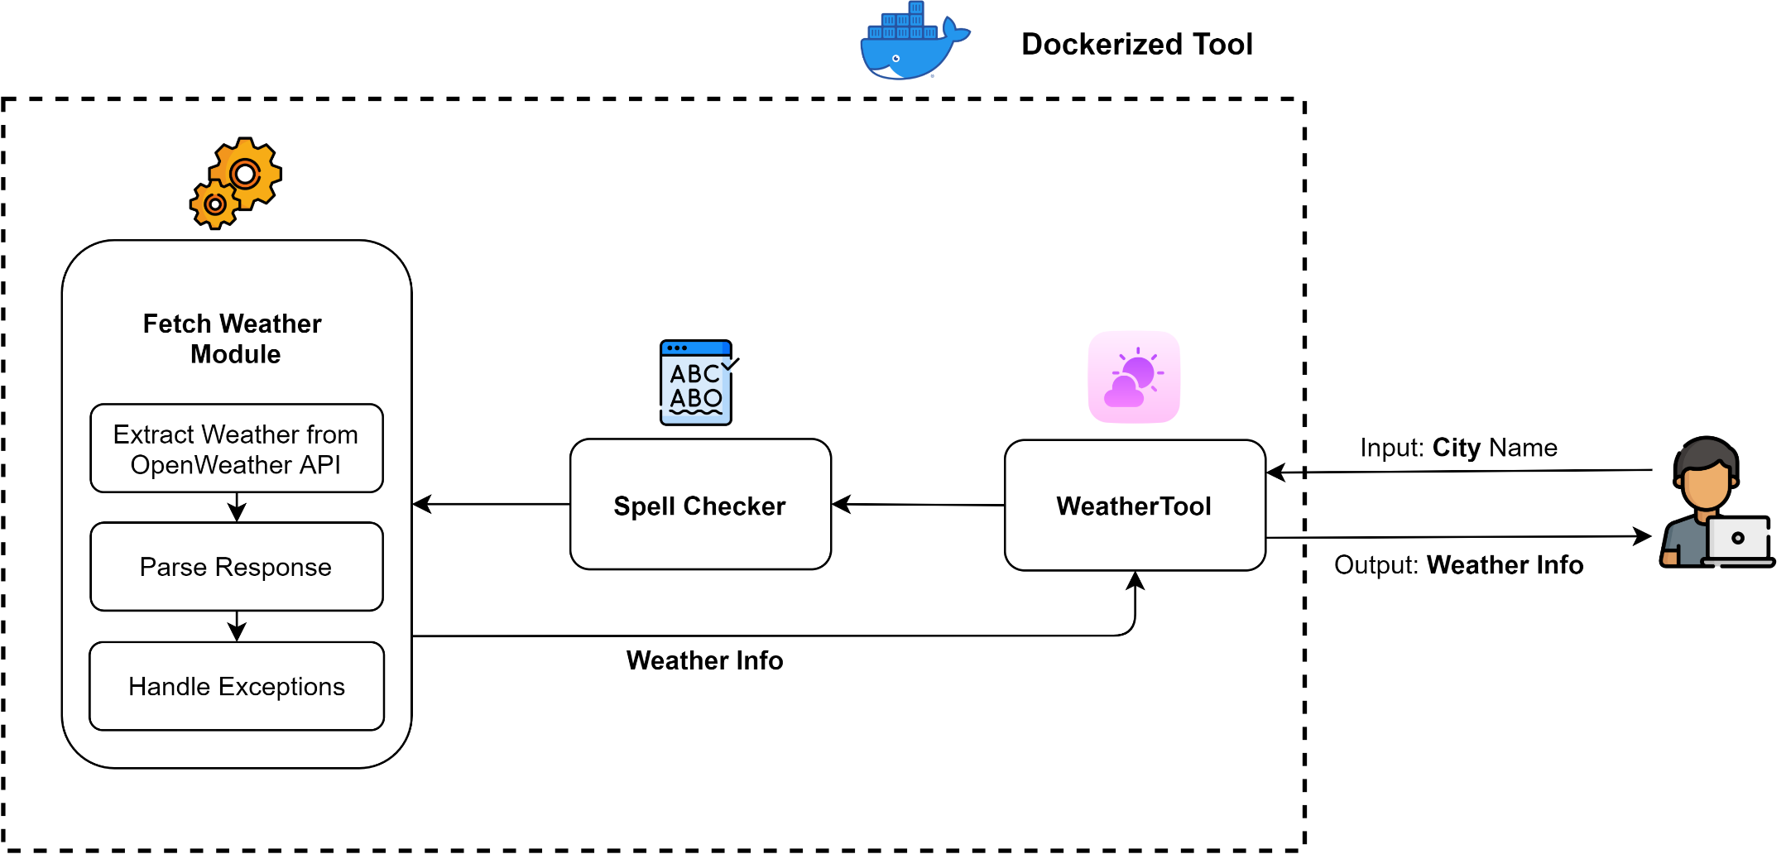
Proposed Solution
Our solution is entirely dockerized so it can be put on any pod and should be up and ready to serve.

Slide 5





Technology/Tool Stack Used:

Slide 6
Mention of usage of Github Copilot

Slide 7
Source code in zip file / Github link :
https://github.com/G-Slient/Weatherapplication_copilot

Slide 8
Execution Demo(Video/Screenshots) showing usage of the GitHub Copilot Platform

Slide 9
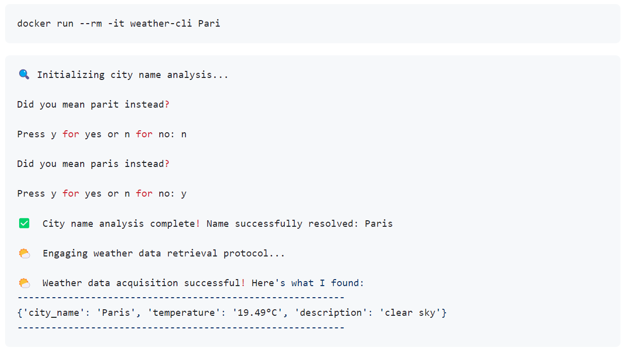
Tool Demo (Screenshot)

Slide 10
THANK YOU

