Slide 1
Employee Satisfaction
Here is where my presentation begins…..

Slide 2
Contents OF THIS template
Fonts | To view this template correctly in PowerPoint, download and install the fonts we used
Used and alternative resources | An assortment of graphic resources that are suitable for use in this presentation
Thanks slide | You must keep it so that proper credits for our design are given
Colors | All the colors used in this presentation
Icons and infographic resources | These can be used in the template, and their size and color can be edited
Editable presentation theme | You can edit the master slides easily.

Slide 3
Table of contents :
01
02
03
04
05
06
Back Story
Business Objectives
Data Info
Insights
Visualization
Conclusion

Slide 4


COLOR INDICATOR’S :
These are the color Palette’s used in my Project for the Pie-Chart ,Graphs and Heatmap…

Slide 5

BACK STORY
I started this project to better understand what makes employees happy or unhappy at work. By cleaning and organizing the data, we can clearly see patterns and problems that might be affecting job satisfaction. This helps HR and managers make smart decisions to improve the work environment and keep employees motivated and committed.

Slide 6
Business Objective :
-> no proper communication: employee’s feel left out because they don’t get enough updates from the managers or hr. -> less feedback: employees don’t get told how they’re doing or how to get better. ->no help with stress: employees feel they can’t talk about stress or problems with managers. ->no growth plans: employees don’t see chances to grow or get promoted. ->poor benefits: some of the employee think the salary healthcare or benefits aren’t good enough.

Slide 7
APPROCH :
✅ Data Collection – Surveyed on real employee’s from different organizations
✅ Data Cleaning – Removed irrelevant columns and standardized responses
✅ Data Visualization – Used bar charts and pie charts to highlight trends
✅ Tools Used – Python (Pandas, Seaborn, Plotly, SciPy)

Slide 8
DATA INFO :
Job_Role –
Tenure_at_Company
Role_Satisfaction(1-10)
Skills_Alignment
Work_Motivation_Frequency
Value_of_Contributions
Workload_Manageability
Feedback_Frequency
Manager_Relationship_Rating
Growth_Opportunites
Overall_Job_Satisfaction(1-5)
Overall_Work_Experience(1-5)
Company_Recommendation(1-5)
Manager_Communication
Benefits_Package_Rating
Benefits_Package_Rating
Benefits_Satisfaction
Work_Stress_Frequency
Main_Stress_Cause
Comfort_Discussing_Stress
Considering_Leaving
Years_at_Copmany
Salary_Increases_(Past_2_Years)
Average_Sick_Days
Healthcare_Premium_Coverage_(%)
Overtime_Hours_(Last_month)
Benefits_Satisfaction
Recommendation-to_a_friend

Slide 9

VISUALIZATION

Slide 10
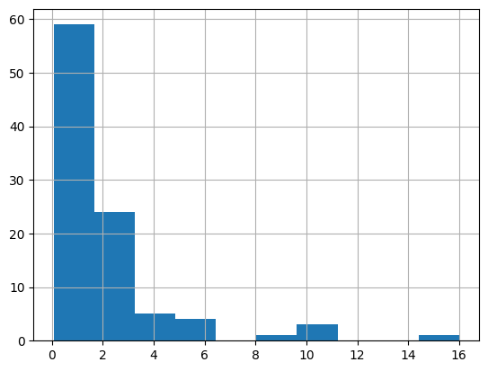
HISTPLOT OF TENURE AT COMPANY
X - Tenure at Company
Tell’s us about the tenure of working employee’s
Y -
No.of Employee rate
Y-axis
X-axis

Slide 11
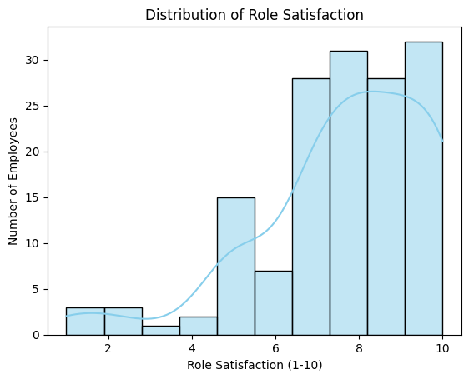
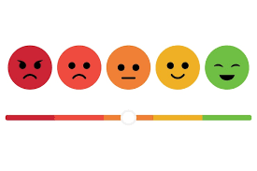
HISTPLOT-DISTRIBUTION OF ROLE SATISFACTION
X axis - Employee Satisfaction
Y axis – Number of Employee

Slide 12
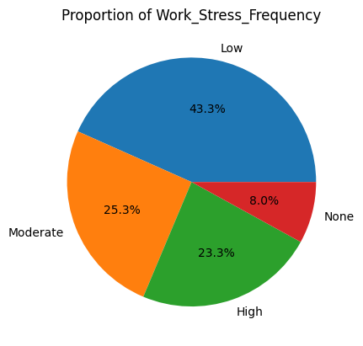
PIE CHART- PROPORTION OF WORK STRESS FREQUENCY

Slide 13
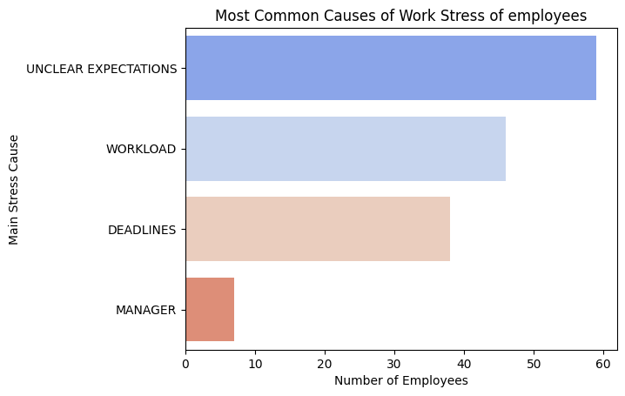

BARPLOT- MOST COMMON CAUSES OF WORK STREES OF EMPLOYEES

Slide 14
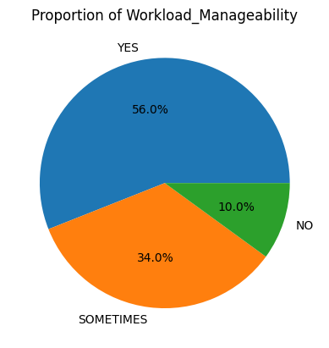
PIE CHART- PROPORTION OF WORKLOAD MANAGEABILITY

Slide 15
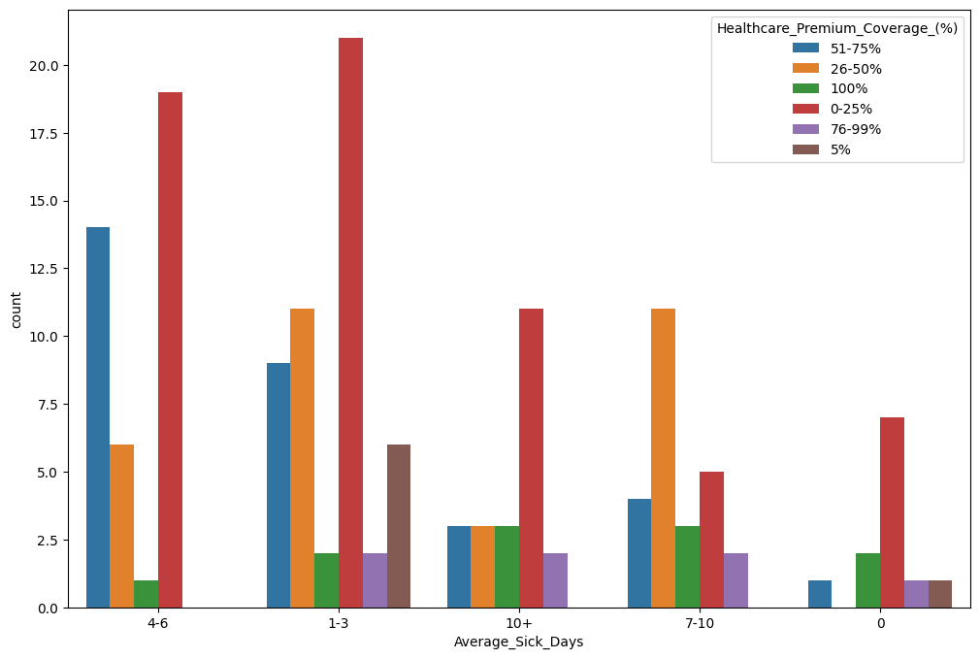

Healthcare benefits vs sick leaves
This plot tells us about the Average sick days taken by employee and Healthcare Benfits assured from the Company…..

Slide 16
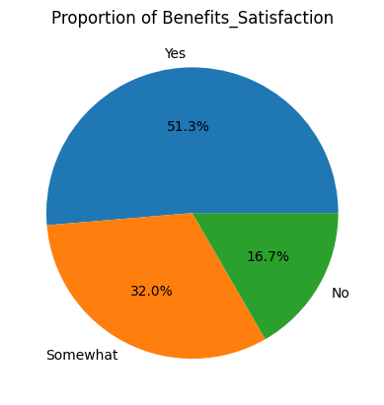
PIE CHART- PROPORTION OF BENEFITS SATISFACTION

Slide 17
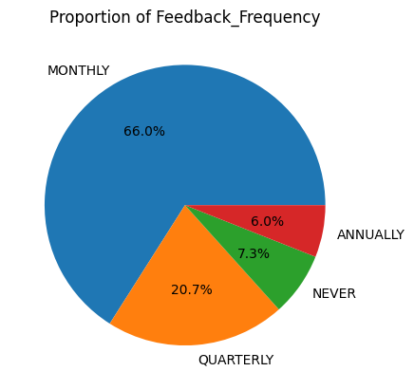
PIE CHART- PROPORTION OF FEEDBACK FREQUENCY

Slide 18
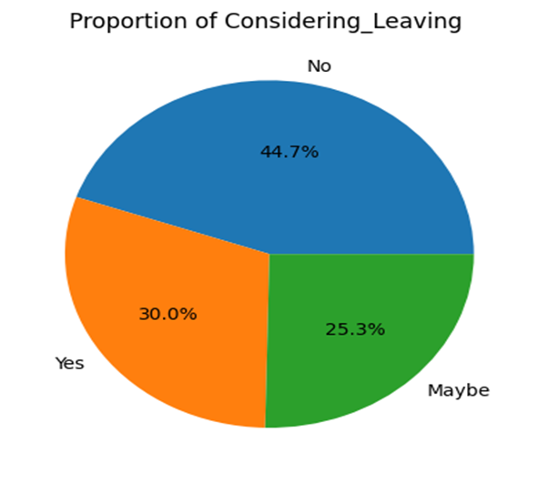
PIE CHART- PROPORTION OF CONSIDERING LEAVING

Slide 19


BUSINESS INSIGHTS:
-> TALK MORE:
MAKE SURE EMPLOYEES,MANAGERS AND HR’s TALK OPENLYAND OFTEN
-> GIVE FEEDBACK:
MANAGERS SHOULD GIVE REGULAR FEEDBACKS TO HELP EMPLOYEES IMPROVE
->RIGHT JOB FOR THE RIGHT PERSON:
PUT PEOPLE IN THE ROLES THAT MATCH THEIR SKILLS AND INTERESTS
->HELP WITH STRESS:
SUPPORT EMPLOYEES WHEN THEY FEEL STRESSED OR OVERWHELMED
->BETTER BENIFTS AND GROWTH:
OFFER GOOD BENEFITS AND CHANCES TO GROW IN THEIR CAREER

Slide 20

THE CONCLUSION
This project helps the company take smart actions to improve employee satisfaction, leading to better retention and overall performance and I personally feel Employee’s should maintain a good relationship with HR’s and Manager’s.

Slide 21
THANK YOU
HOPE EVERYONE LIKED IT…
G VAMSHI

