Slide 2




Minimum Cost Edit Distance
Edit a source string into a target string
Each edit has a cost
Find the minimum cost edit(s)
actress
insert(s)
actres
delete(t)
minimum cost edit distance can be accomplished in multiple ways
actrest
insert(t)
acrest
insert(a)
Only 4 ways to edit source to target for this pair
crest

Slide 3
Minimum Cost Edit Distance
target
source
actress
minimum cost edit distance can be accomplished in multiple ways
actres
actrest
Only 4 ways to edit source to target for this pair
acrest
crest

Slide 4
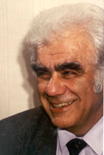
Levenshtein Distance
Cost is fixed across characters
Insertion cost is 1
Deletion cost is 1
Two different costs for substitutions
Substitution cost is 1 (transformation)
Substitution cost is 2 (one deletion + one insertion)
Левенштейн Владимир
What’s the edit distance?
Vladimir Levenshtein

Slide 5

Minimum Cost Edit Distance
An alignment between target and source
Find D(n,m) recursively

Slide 6
Function MinEditDistance (target, source)
n = length(target)
m = length(source)
Create matrix D of size (n+1,m+1)
D[0,0] = 0
for i = 1 to n
D[i,0] = D[i-1,0] + insert-cost
for j = 1 to m
D[0,j] = D[0,j-1] + delete-cost
for i = 1 to n
for j = 1 to m
D[i,j] = MIN(D[i-1,j] + insert-cost,
D[i-1,j-1] + subst/eq-cost,
D[i,j-1] + delete-cost)
return D[n,m]

Slide 7
Consider two strings:
target = g₁a₂m₃b₄l₅e₆
source= g₁u₂m₃b₄o₅
We want to find D(6,5)
We find this recursively using values of D(i,j) where i≤6 j≤5
For example, consider how to compute D(4,3)
target = g₁a₂m₃b₄
Case 1: SUBSTITUTE b₄ for m₃
Use previously stored value for D(3,2)
Cost(g₁a₂m₃b and g₁u₂m) = D(3,2) + cost(b≈m)
For substitution: D(i,j) = D(i-1,j-1) + cost(subst)
source= g₁u₂m₃
D(3,2)
D(4,2)
Case 2: INSERT b₄
Use previously stored value for D(3,3)
Cost(g₁a₂m₃b and g₁u₂m₃) = D(3,3) + cost(ins b)
For substitution: D(i,j) = D(i-1,j) + cost(ins)
D(3,3)
D(4,3)
Case 3: DELETE m₃
Use previously stored value for D(4,2)
Cost(g₁a₂m₃b₄ and g₁u₂m) = D(4,2) + cost(del m)
For substitution: D(i,j) = D(i-1,j-1) + cost(subst)

Slide 8

target
g
a
m
b
l
e
0
1
2
3
4
5
6
g
1
0
1
2
3
4
5
e
u
2
1
2
3
4
5
6
s
source
m
3
2
3
2
3
4
5
e
b
4
3
4
3
2
3
4
e
i
o
5
4
5
4
3
4
5
s

Slide 9
Edit Distance and FSTs
Algorithm using a Finite-state transducer:
construct a finite-state transducer with all possible ways to transduce source into target
We do this transduction one char at a time
A transition x:x gets zero cost and a transition on ε:x (insertion) or x:ε (deletion) for any char x gets cost 1
Finding minimum cost edit distance == Finding the shortest path from start state to final state

Slide 10
Edit Distance and FSTs
Lets assume we want to edit source string 1010 into the target string 1110
The alphabet is just 1 and 0
SOURCE
TARGET

Slide 11
Edit Distance and FSTs
Construct a FST that allows strings to be edited
EDITS

Slide 12
Edit Distance and FSTs
Compose SOURCE and EDITS and TARGET

Slide 13
Edit Distance and FSTs
The shortest path is the minimum edit FST from SOURCE (1010) to TARGET (1110)

Slide 14
Edit distance
Useful in many NLP applications
In some cases, we need edits with multiple characters, e.g. 2 chars deleted for one cost
Comparing system output with human output, e.g. input: ibm output: IBM vs. Ibm (TrueCasing of speech recognition output)
Error correction
Defined over character edits or word edits, e.g. MT evaluation:
Foreign investment in Jiangsu ‘s agriculture on the increase
Foreign investment in Jiangsu agricultural investment increased

Slide 15
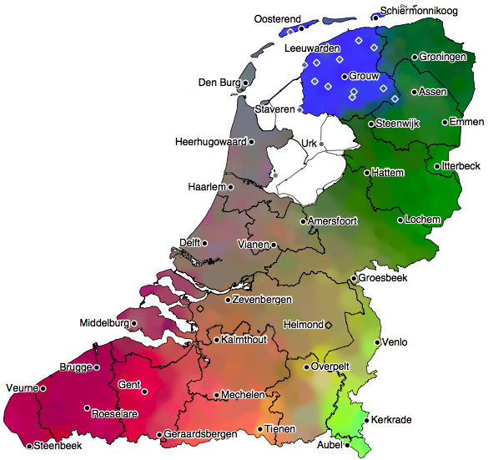
Pronunciation
dialect map of
the Netherlands
based on phonetic
edit-distance
(W. Heeringa
Phd thesis, 2004)

Slide 16
Variable Cost Edit Distance
So far, we have seen edit distance with uniform insert/delete cost
In different applications, we might want different insert/delete costs for different items
For example, consider the simple application of spelling correction
Users typing on a qwerty keyboard will make certain errors more frequently than others
So we can consider insert/delete costs in terms of a probability that a certain alignment occurs between the correct word and the typo word

Slide 17
Spelling Correction
Types of spelling correction
non-word error detection
e.g. hte for the
isolated word error detection
e.g. acres vs. access (cannot decide if it is the right word for the context)
context-dependent error detection (real world errors)
e.g. she is a talented acres vs. she is a talented actress
For simplicity, we will consider the case with exactly 1 error

Slide 18
Noisy Channel Model
Source
original input
Noisy Channel
noisy observation
P(original input | noisy obs)
Decoder

Slide 19



Bayes Rule: computing P(orig | noisy)
let x = original input, y = noisy observation
Bayes Rule

Slide 20
Chain Rule
Approximations: Bias vs. Variance
less bias
less variance

Slide 21
Single Error Spelling Correction
Insertion (addition)
acress vs. cress
Deletion
acress vs. actress
Substitution
acress vs. access
Transposition (reversal)
acress vs. caress

Slide 22


Noisy Channel Model for Spelling Correction (Kernighan, Church and Gale, 1990)
t is the word with a single typo and c is the correct word
Find the best candidate for the correct word
Bayes Rule
C is all the words in the vocabulary; |C| = N

Slide 23
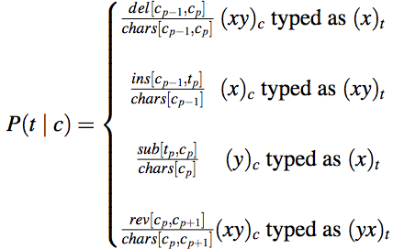

Noisy Channel Model for Spelling Correction (Kernighan, Church and Gale, 1990) single error, condition on previous letter
t = poton
c = potion
del[t,i]=427
chars[t,i]=575
P = .7426
P(poton | potion)
t = poton
c = piton
sub[o,i]=568
chars[i]=1406
P = .4039
P(poton | piton)

Slide 24
Noisy Channel model for Spelling Correction
The del, ins, sub, rev matrix values need data in which contain known errors
(training data)
e.g. Birbeck spelling error corpus (from 1984!)
Accuracy on single errors on unseen data
(test data)

Slide 25
Noisy Channel model for Spelling Correction
Easily extended to multiple spelling errors in a word using edit distance algorithm (however, using learned costs for ins, del, replace)
Experiments: 87% accuracy for machine vs. 98% average human accuracy
What are the limitations of this model?
… was called a “stellar and versatile acress whose combination of sass and glamour has defined her …
KCG model best guess is acres

