Slide 1
Natural Language Processing
anoopsarkar.github.io/nlp-class

Slide 2
Programming Languages
C, C++, Java, Python, …
unambiguous
fixed
designed
learnable?
known simple semantics
Natural Languages
French, English, Korean, Chinese, Tagalog, …
ambiguous
evolving
transmitted
learnable
complex semantics

Slide 3
Why is NLP computationally hard?

Slide 4
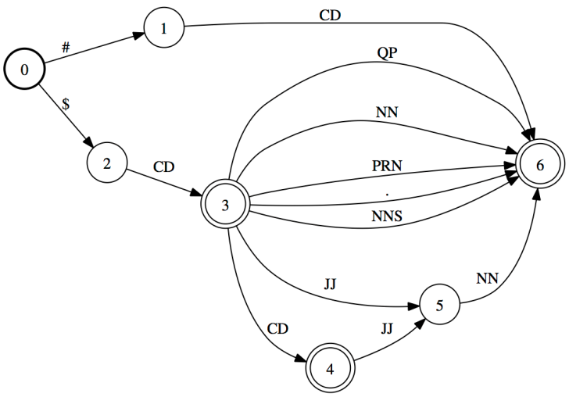
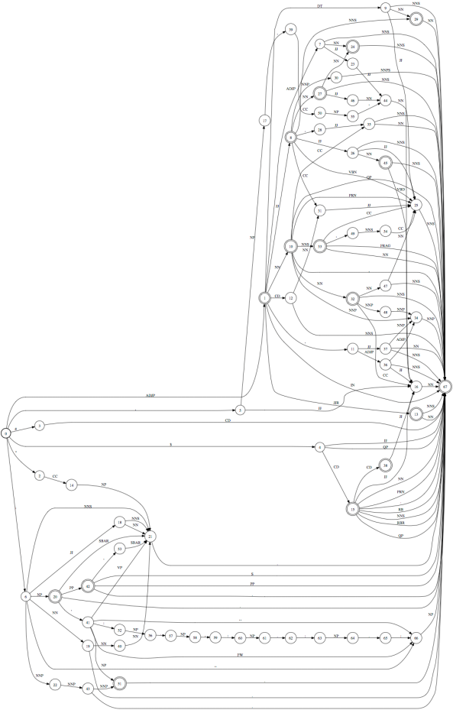
$
20
happy
meal
$
CD
JJ
NN
a noun phrase type
10 noun phrase types
100 noun phrase types
6K noun phrase types
Language is complex
1000 noun phrase types

Slide 5
Language is ambiguous
Lung cancer in women mushrooms
Mushrooms is noun or a verb?
Ban on nude dancing on governor's desk
Similar to “if-then-else” ambiguity
Island Monks Fly in Satellite to Watch Pope Funeral
“fly in” vs. “fly [_{OBJ} in Satellite]” hidden segmentation
British Left Waffles on Falkland Islands
Is it British/Noun Left/Verb or British Left/NP Waffles/Verb?

Slide 6
Language is Parsed
for more see crashblossoms.com
Google's Computer Might Betters Translation Tool
New York Times March 8, 2010
Number of Lothian patients made ill by drinking rockets
Edinburgh Evening News, March 4, 2010
Violinist linked to JAL crash blossoms
http://languagelog.ldc.upenn.edu/nll/?p=1693

Slide 7

Different levels of language
Phonetics: acoustic and perceptual elements
Phonology: basic sounds (phonemes) and rules for combination
e.g. vowel harmony. Anupu is pronunciation of Anoop in Classic Period Mayan
Morphology: how morphemes combine to form words, relationship of phonemes to meaning
e.g. delight-ed vs. de-light-ed

Slide 8
Different levels of language
Syntax: sentence formation
e.g. The clown who the musician hits watches the ballerina
Semantics: meaning (from syntax to logical formulas)
e.g. Everyone is not here => what does this mean? Nobody / Not everyone is here.
Pragmatics: meaning that is not part of compositional meaning,
e.g. This professor dresses even worse than Anoop!

Slide 9
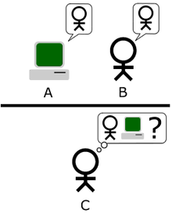
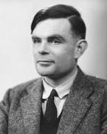
Imagine an "Imitation Game," in which a man and a woman go into separate rooms and guests try to tell them apart by writing a series of questions and reading the typewritten answers sent back. In this game both the man and the woman aim to convince the guests that they are the other.
We now ask the question, "What will happen when a machine takes the part of A in this game?" Will the interrogator decide wrongly as often when the game is played like this as he does when the game is played between a man and a woman? These questions replace our original, "Can machines think?"
Alan Turing

Slide 10
Winograd Schema
(H. Levesque, AAAI 2011)
The town councillors refused to give the angry demonstrators a permit because they feared violence.
Who feared violence?
Answer 0: the town councillors
Answer 1: the angry demonstrators
The town councillors refused to give the angry demonstrators a permit because they advocated violence.
Who advocated violence?
Answer 0: the town councillors
Answer 1: the angry demonstrators

Slide 11
Some examples of NLP tasks

Slide 12
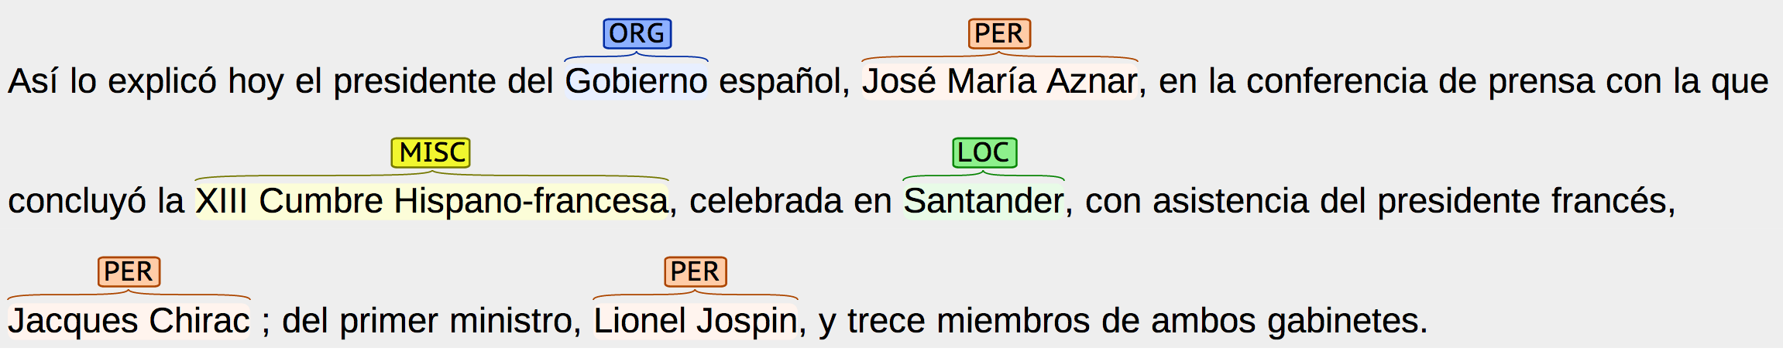
Information Extraction

Slide 13
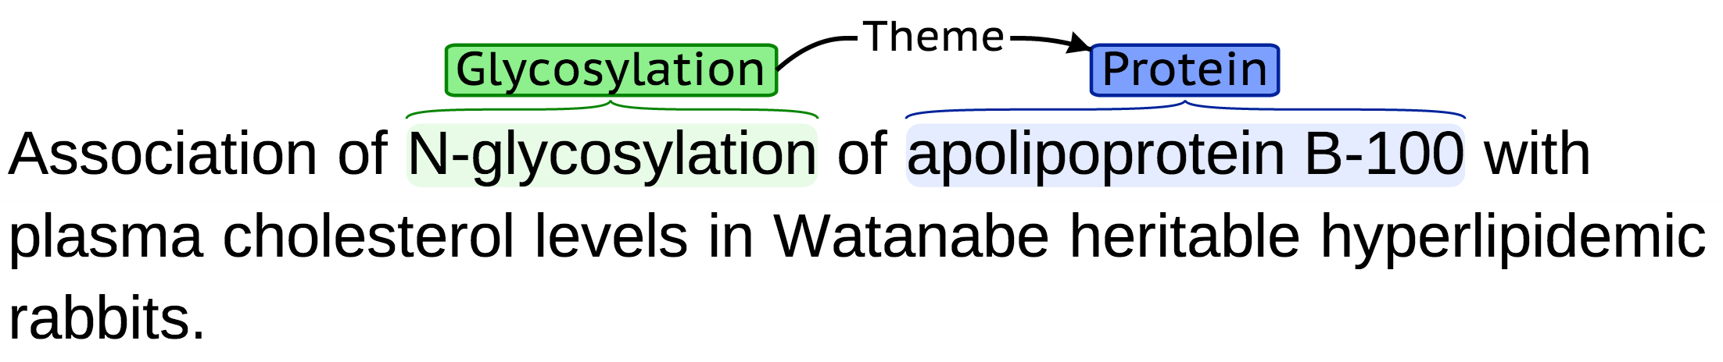
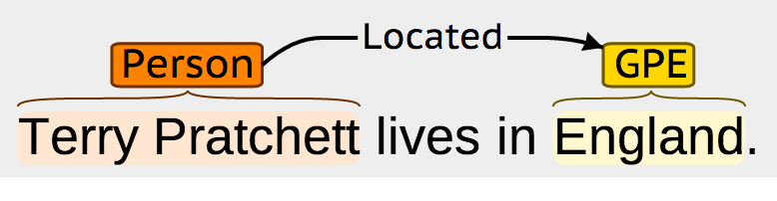
Information Extraction

Slide 14
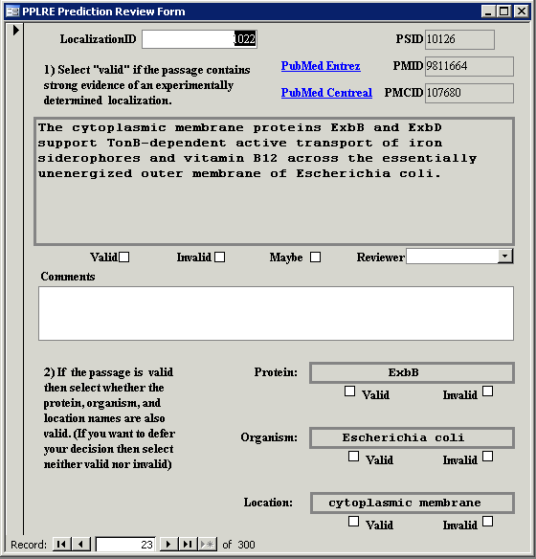

Slide 15
SQuASH: SFU QA Summarization System Input: 25 news articles, Complex question Output: 250-word summary
A. Canadian Prime Minister Jean Chretien has ruled out the possibility that the French-speaking province of Quebec could declare independence even if a majority of Quebeckers vote for secession in the next referendum. Premier Lucien Bouchard and the separatist Parti Quebecois have retained control of Canada's largest province, possibly setting the stage for a bitter confrontation with the rest of Canada, and possibly another referendum on independence. Canada's Supreme Court managed to rule on the question of Quebec secession without infuriating leaders on either side of a bitter ideological divide. ...
Q. Describe developments in the movement for the independence of
Quebec from Canada.

Slide 16
Headline Generation
Headline A: US launches air raids in Somalia
Headline B: Somalia says dozens killed in US attack
Headline C: Many dead after US strike in Somalia
Headline D: US Launches New Attacks in Somalia
Headline E: US strikes terrorist targets in Somalia
Cluster of headlines for an event on Google News

Slide 17
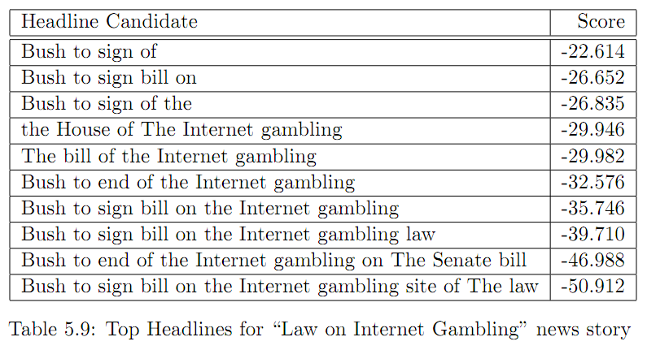
Headline Generation

Slide 18
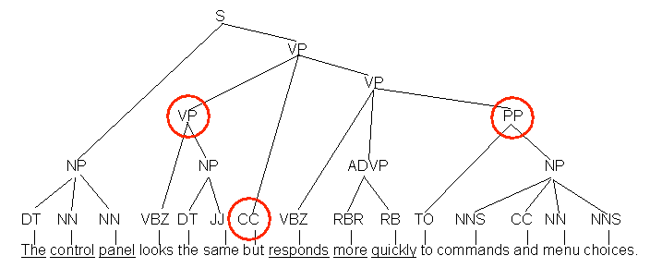
Sentence Compression

Slide 19
Paraphrasing
open borders imply increasing racial fragmentation in european countries .
open borders imply increasing racial fragmentation in the countries of europe .
open borders imply increasing racial fragmentation in european states .
open borders imply increasing racial fragmentation in europe .
open borders imply increasing racial fragmentation in european nations .
open borders imply increasing racial fragmentation in the european countries .
Why is paraphrasing useful?

Slide 20
Sentiment detection
http://www.machinedlearnings.com/2011/01/happiness-is-warm-tweet.html
Annotate tweets using labels from http://en.wikipedia.org/wiki/List_of_emoticons
10 Happiest Tweets
@WRiTExMiND no doubt! <--guess who I got tht from? Bwahaha anyway doe I like surprising people it's kinda my thing so ur welcome! And hi :)
@skvillain yeh wiz is dope, got his own lil wave poppin! I'm fuccin wid big sean too he signed to kanye label g.o.o.d music
And @pumahbeatz opened for @MarshaAmbrosius & blazed! So proud of him! Go bro! & Marsha was absolutely amazing! Awesome night all around. =)
Awesome! RT @robscoms: Great 24 hours with nephews. Watched Tron, homemade mac & cheese for dinner, Wii, pancakes & Despicable Me this am!
Good Morning 2 U Too RT @mzmonique718: Morningggg twitt birds!...up and getting ready for church...have a good day and LETS GO GIANTS!
Goodmorning #cleveland, have a blessed day stay focused and be productive and thank god for life
AMEN!!!>>>RT @DrSanlare: Daddy looks soooo good!!! God is amazing! To GOD be the glory and victory #TeamJesus Glad I serve an awesome God
AGREED!! RT @ILoveElizCruz: Amen to dat... We're some awesome people! RT @itsVonnell_Mars: @ILoveElizCruz gotta love my sign lol
#word thanks! :) RT @Steph0e: @IBtunes HAppy Birthday love!!! =) still a fan of ya movement... yay you get another year to be dope!!! YES!!
Happy bday isaannRT @isan_coy: Selamatt ulang tahun yaaa RT @Phitz_bow: Selamat siangg RT @isan_coy: Slamat pagiiii

Slide 21
Sentiment detection
http://www.machinedlearnings.com/2011/01/happiness-is-warm-tweet.html
Annotate tweets using labels from http://en.wikipedia.org/wiki/List_of_emoticons
10 Saddest Tweets
Migraine, sore throat, cough & stomach pains. Why me God?
Ik moet werken omg !! Ik lig nog in bed en ben zo moe .. Moet alleen opstaan en tis koud buitn :(
I Feel Horrible ' My Voice Is Gone Nd I'm Coughing Every 5 Minutes ' I Hate Feeling Like This :-/
SMFH !!! Stomach Hurting ; Aggy ; Upset ; Tired ;; Madd Mixxy Shyt Yo !
Worrying about my dad got me feeling sick I hate this!! I wish I could solve all these problems but I am only 1 person & can do so much..
Malam2 menggigil+ga bs napas+sakit kepala....badan remuk redam *I miss my husband's hug....#nangismanja#
Waking up with a sore throat = no bueno. Hoping someone didn't get me ill and it's just from sleeping. D:
Aaaa ini tenggorokan gak enak, idung gatel bgt bawaannya pengen bersin terus. Calon2 mau sakit nih -___-
I'm scared of being alone, I can't see to breathe when I am lost in this dream, I need you to hold me?
Why the hell is suzie so afraid of evelyn! Smfh no bitch is gonna hav me scared I dnt see it being possible its not!

Slide 22
Word Segmentation (in Chinese)
北京大学生体育馆
- 北京 (Beijing) 大学生 (university students) 体育馆 (gym)
The gym for university students in Beijing.
-北京大学 (Peking University) 生 (give birth to) 体育馆 (gym)
Peking University gave birth to the gym?

Slide 23
Statistical Machine Translation
SMT uses parallel corpora to automatically learn a translation
SOURCE: 目前 , 某些 西方 国家 已经 宣布 终止 对 津巴布韦 的 经济援助 .
H1: at present , some western nations have already announced their
termination of economic aid to zimbabwe .
H2: at present , certain western countries have already suspended their economic
aids to zimbabwe .
H3: so far , some western countries have declared ending economic aid to zimbabwe .
H4: some western countries have already halted economic aid to zinbarbwe at present .
SYSTEM: at present , some western countries have announced the* end* of the*
financial* assistance* to zimbabwe .
Open Source Machine Translation! www.statmt.org

Slide 24
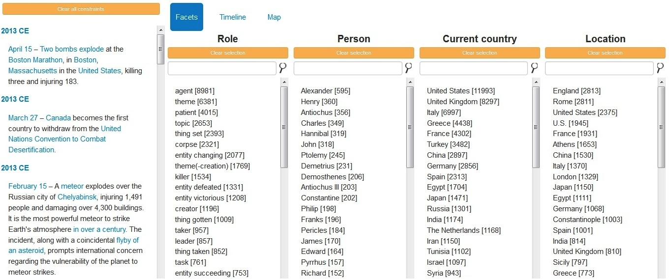
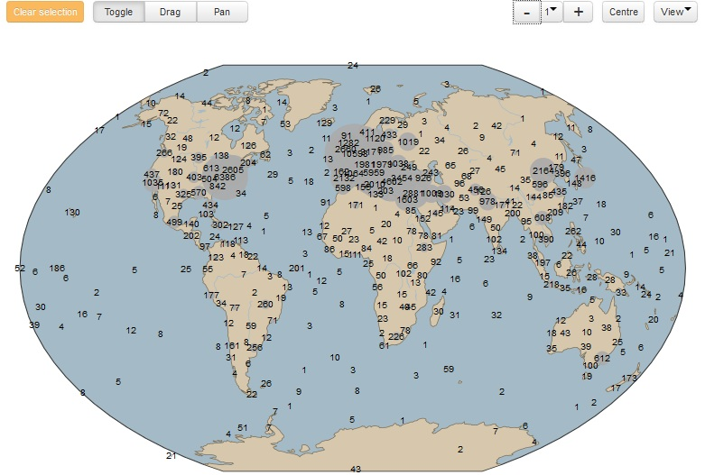
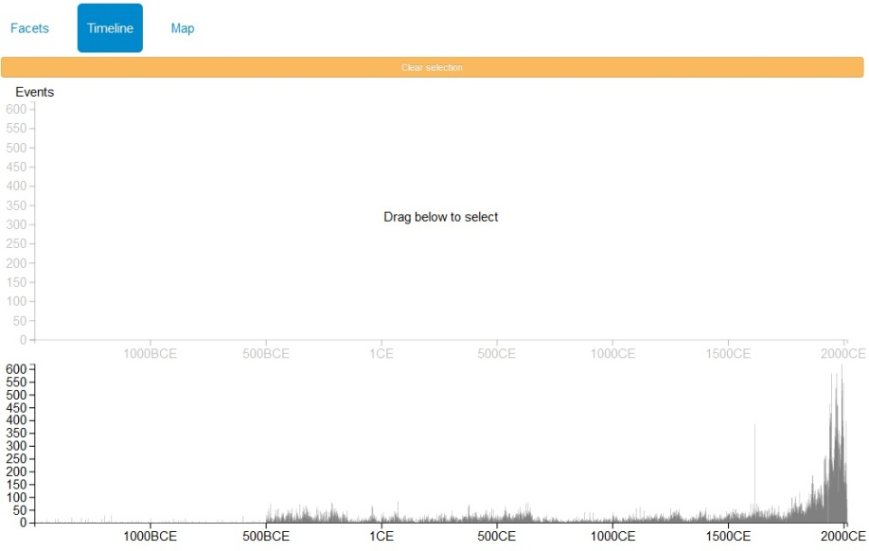
Visualization of Information
Faceted Browsing
Map
Timeline

Slide 25
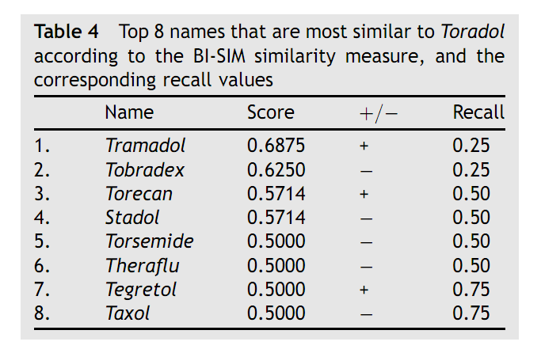
Identifying confusable drug names
G. Kondrak and B. Dorr

Slide 26
Holy Grail: Understanding Language
Can we generate language from our knowledge of language?
Can we convert a natural language utterance into a model (or some other fancy logic thing)
Can we map it into a database?
Can we map it into a mental picture (or a real one?)
Demo: WordsEye (from Richard Sproat’s group at AT&T)

Slide 27
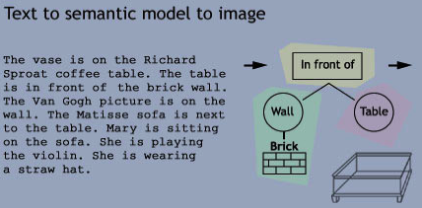
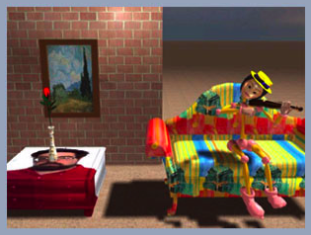

Slide 28
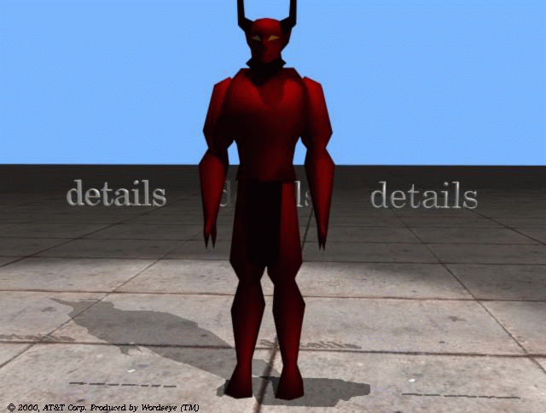
The Devil is in the details

Slide 29
Topics in NLP research
Dialogue and Interactive Systems
Discourse and Pragmatics
Generation and Summarization
Information Extraction and Question Answering
Information Retrieval
Language Resources and Evaluation
Language and Vision
Linguistic and Psycholinguistic Aspects of CL
Machine Learning for NLP
Machine Translation
NLP for Web, Social Media and Social Sciences
NLP-enabled Technology
Phonology, Morphology and Word Segmentation
Semantics
Sentiment Analysis and Opinion Mining
Spoken Language Processing
Tagging, Chunking, Syntax and Parsing
Text Categorization and Topic Models

