Slide 1




User Models, Metrics and Measures of Search: A Tutorial on the CWL Evaluation Framework ACM CHIIR UMMMS 2021
by
Leif Azzopardi, Alistair Moffat, Paul Thomas and Guido Zuccon

Slide 2




Who are we?
Leif Azzopardi, @leifos
Associate Professor, University of Strathclyde Studying how information systems shape and influence people and society with models of user behavior, interaction and performance.
Alistair Moffat
Professor, University of Melbourne Searching for better information retrieval metrics, text and index compression methods, and information retrieval heuristics.
Paul Thomas, @pt_ir
Senior Applied Scientist, Microsoft Bing
Studying how people use search systems, and using that to evaluate current systems and build new ones.
Guido Zuccon, @guidozuc
Associate Professor, University of Queensland
Researching and developing formal models of search, ranking, and research diversification, especially in the domain of e-health.

Slide 3
But, what about you?
Notes:
Who wants to model the user behavour?
Who wants to measure the system performance?
Who wants to decide what the system should do?

Slide 4
Evaluation
What is evaluation?
Measure the effectiveness, efficiency and cost of a system
Search Effectiveness: how good a system is in retrieving relevant documents
This is the focus of this tutorial
Search Efficiency: how fast a system is in retrieving documents
Often there is trade-off between effectiveness and efficiency
Cost: how much does it cost to run the system ($$, Kw/h, etc)
Usually cost is determined by the desired level of effectiveness and efficiency

Slide 5
Why do we want to Evaluate?
Say whether the system is any good
Compare two systems, so as to choose the “best” (or best fit)
(What about evaluating users?)

Slide 6
Test your evaluation intuition
Which SERP is better?
SERP one
SERP two
Good
Bad
Good
Bad
Bad
Bad
Bad
Good
Bad
Bad
Bad
Bad

Slide 7
Test your evaluation intuition
Which SERP is better?
SERP one
SERP two
Good
Good
Good
Good
Bad
Bad
Bad
Good
Bad
Bad
Bad
Bad
Notes:
Two is at least as good as one
RR says they’re the same

Slide 8
Test your evaluation intuition
Which SERP is better?
SERP one
SERP two
Bad
Good
Bad
Bad
Bad
Bad
Good
Bad
Good
Bad
Good
Bad
Notes:
P differs to RR for example
Depends on the searcher’s goal.
Like a five set tennis match, it ain’t over till its over.
Maybe it’s never over….

Slide 9
Metric Choices
There are lots!
P@k, precision at depth k: fraction of the top k which are relevant
RBP, rank-biased precision: geometrically-decreasing importance
RR, reciprocal rank: 1 / rank of the first relevant result
NDCG, normalized discounted cumulative gain: logarithmically-decreasing importance, and scaled by available relevance
AP: average of precision values, at positions where there’s relevance
And don’t forget: TBG, ERR, U-measure, Bejewelled, BPref, INSQ, INST…
Notes:
There are lots!
Many in use e.g. at TREC, in SIGIR papers; many many perpetrated in the literature (some by us)
And they all seem to have different units – more on this later
Lots of metrics: anything in common, any coherent way to talk about these?
Any way to discuss, trade off, choose?
Yes: examine the model underlying each

Slide 10
Metric Choices
Lots of metrics:
why are there several measures?
which measure is best?
which measure should I use?
anything in common, any coherent way to talk about these?
Any way to discuss, trade off, choose?
Yes: examine the model underlying each
In this tutorial, we introduce you to the C/W/L framework that allows you to understand, analyse and compare metrics
Notes:
There are lots!
Many in use e.g. at TREC, in SIGIR papers; many many perpetrated in the literature (some by us)
And they all seem to have different units – more on this later
Lots of metrics: anything in common, any coherent way to talk about these?
Any way to discuss, trade off, choose?
Yes: examine the model underlying each

Slide 11
Tutorial’s Motivations
To understand, build and apply …
Notes:
The tutorial aims to give you the toolboxs for guiding you among these decisions. And this toolbox is centered around economic models. But why Economics?
Economics …

Slide 12
Tutorial’s Goals
Give you the knowledge and skills to:
Explain the C/W/L framework and the different measurements it incorporates;
Design a metric given the C/W/L framework; and
Infer, hypothesize and predict user behaviors and performance.

Slide 13
Schedule

Slide 14
Course slides at:
https://ielab.io/tutorials/ummms2021
youtube channel

Slide 15
Introduction to Evaluation

Slide 16
Evaluation Measures
Measures make sense in the context of a task
A measure is a model — so you need to use the measure that best models the task you are considering
models the user satisfaction and behaviour

Slide 17
User Behavior and System Performance

Slide 18


Behavior and Performance
(2) Measure quality of output shown.
(1) Decide what items to show in response to user input.
Interaction
Observed
User Behaviors
System Output/Ranking
(3) Understand how users will response to changes.

Slide 19
Behavior and Performance
Models of
User Behavior
Predictions of
System Performance
Interaction
Observed
User Behaviors
System Output/Ranking
Predictions of
User Behavior
Model of
System Performance

Slide 20
Behavior and Performance
Models of
User Behavior
Predictions of
System Performance
Estimation of
Relevance /
Ranking
Interaction
Observed
User Behaviors
System Output/Ranking
Predictions of
User Behavior
Model of
System Performance

Slide 21









System ranking…
Users behaving…
Given a query, the system returns a ranked list of documents…
and the user inspects the top 10 documents…
then Precision at 10 = 4/10.
More precisely,
p@10 = 0.4 relevant docs / doc inspected
Model of User Behavior
Vary the model of user behavior
Prediction of System Performance
obtain different predictions of system performance
Notes:
P@10 = 0.4 relevant docs / doc inspect

Slide 22
What is a model?
“a deliberate simplification of something complicated with the objective of making it more tractable” Frigg, Roman and Hartmann, Stephan, 2018. “Models in Science”, in The Stanford Encyclopedia of Philosophy.
“a physical, conceptual, or mathematical representation of a real phenomenon that is difficult to observe directly” Rogers, 2012. “Scientific modeling”, in Encyclopædia Britannica.
“A simplified description, especially a mathematical one, of a system or process, to assist calculations and predictions” OED, 2019.

Slide 24
Offline, Online Evaluation; User Studies
Effectiveness evaluation categorized in three broad classes: Offline, Online, User Studies
The evaluation methods we see here are offline methods: the system is not live, experiments are done through simulations.
They do not involve actual users
The topic of this tutorial
What if we want to test a system in production, live, as it gets used? Online evaluation!
Online evaluation: Test (or even train) using live traffic on a search engine
See offline video for pointers
Offline evaluation with users: User Studies — non-production systems, careful control on user, task, interactions, feedback
See offline video for pointers

Slide 25
Measuring a SERP: Offline/test collection metrics

Slide 26
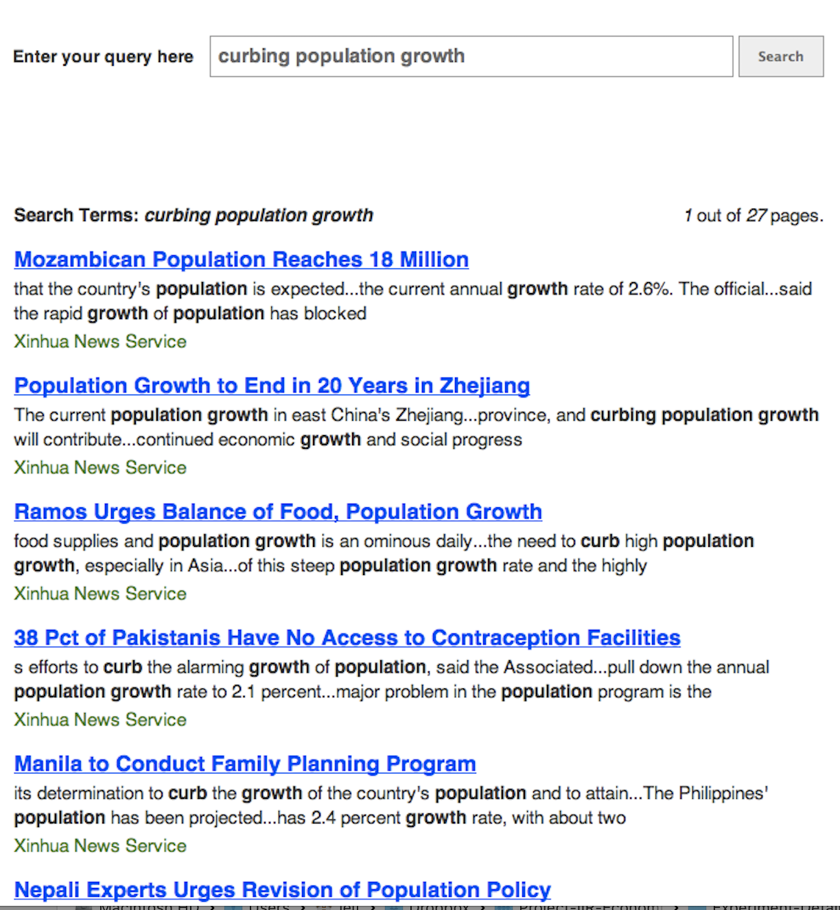


Bad
Bad
Good
Fair
Good
Weight
×
Gain

Slide 27
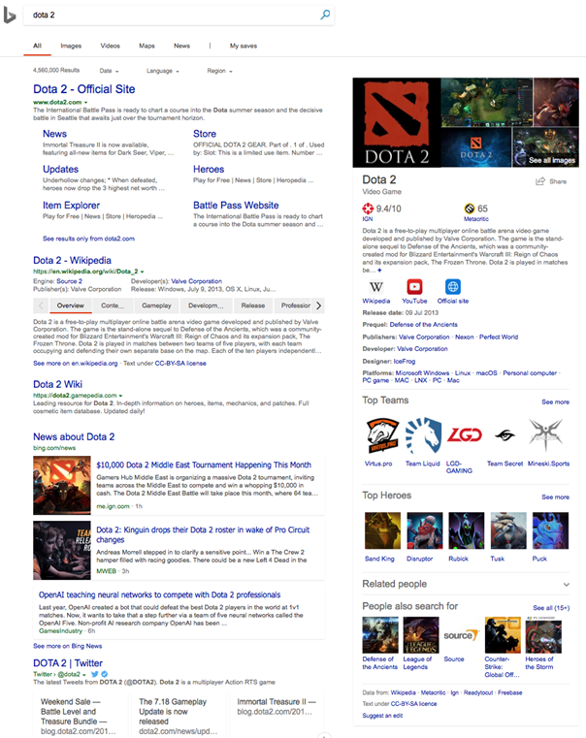
☛
sort of
approximates
☛
Ranked list, top down
Web SERP
Homogenous elements

Slide 28
Why offline evaluation
Cheap
Fast
Repeatable
Tells us about the real experience
?
Notes:
Good for repeated experimentation
We use them ‘cause we believe they have external validity; that is, that they tell us what the real experience would be like; they predict some aspect of the searchers’ experience
They are only as good as they are valid

Slide 29
Basic Evaluation Measures in IR

Slide 30
Precision at cutoff

Slide 31
Reciprocal Rank

Slide 32
Average Precision (AP)

Slide 33
nDCG

Slide 34
Rank Biased Precision (RBP)

Slide 35
The Cranfield Paradigm of Test Collections

Slide 36
Framework for evaluation: Cranfield/TREC
In practice, how do we go about using these measures?
The Cranfield/TREC experiments:
Formalises a way to experimentally evaluate IR systems
Predicates the development of test collections to measure IR effectiveness
A set of queries: sufficiently large & representative
A set of documents: large & representative
A set of relevance assessments for query-doc pairs
Need for completeness/exhaustivity?

Slide 37
TREC (and its sisters)
TREC (TExt Retrieval Conference - http://trec.nist.gov/) is an initiative from NIST (US gov agency) for the evaluation of IR systems
Other initiatives exist:
CLEF: based in Europe, initial focus on cross-lingual IR
NTCIR: based in Japan, focus on Asian languages
FIRE: based in India, focus on Indian languages
TREC is probability the most thorough and reliable: sizeable budgets for assessments; attract many participants; diversity in participants submissions and efforts

Slide 38
Example TREC Collections
Update to modern ones

Slide 39
TREC Topic Example

Slide 40
Relevance Assessments
Obtaining relevance assessments is an expensive, time-consuming process
who does it?
what are the instructions?
what is the level of agreement?
TREC judgments
depend on task being evaluated (e.g., NIST assessors, medical experts, crowd)
Early collections had binary assessments; recent ones are graded
agreement good because of “narrative”

Slide 41
A qrel file
101 0 AP880212-0047 1
101 0 AP880219-0139 0
101 0 AP880219-0166 0
101 0 AP880222-0172 0
101 0 AP880223-0104 0
101 0 AP880229-0146 0
101 0 AP880314-0113 0
101 0 AP880314-0121 0
101 0 AP880314-0145 0
101 0 AP880320-0041 0
101 0 AP880321-0117 0
101 0 AP880323-0210 0
101 0 AP880323-0211 0
101 0 AP880324-0256 0
101 0 AP880326-0149 0
101 0 AP880329-0195 0
101 0 AP880329-0201 0
101 0 AP880330-0014 1
101 0 AP880330-0182 0
101 0 AP880404-0207 0
101 0 AP880414-0171 0
…………………

Slide 42
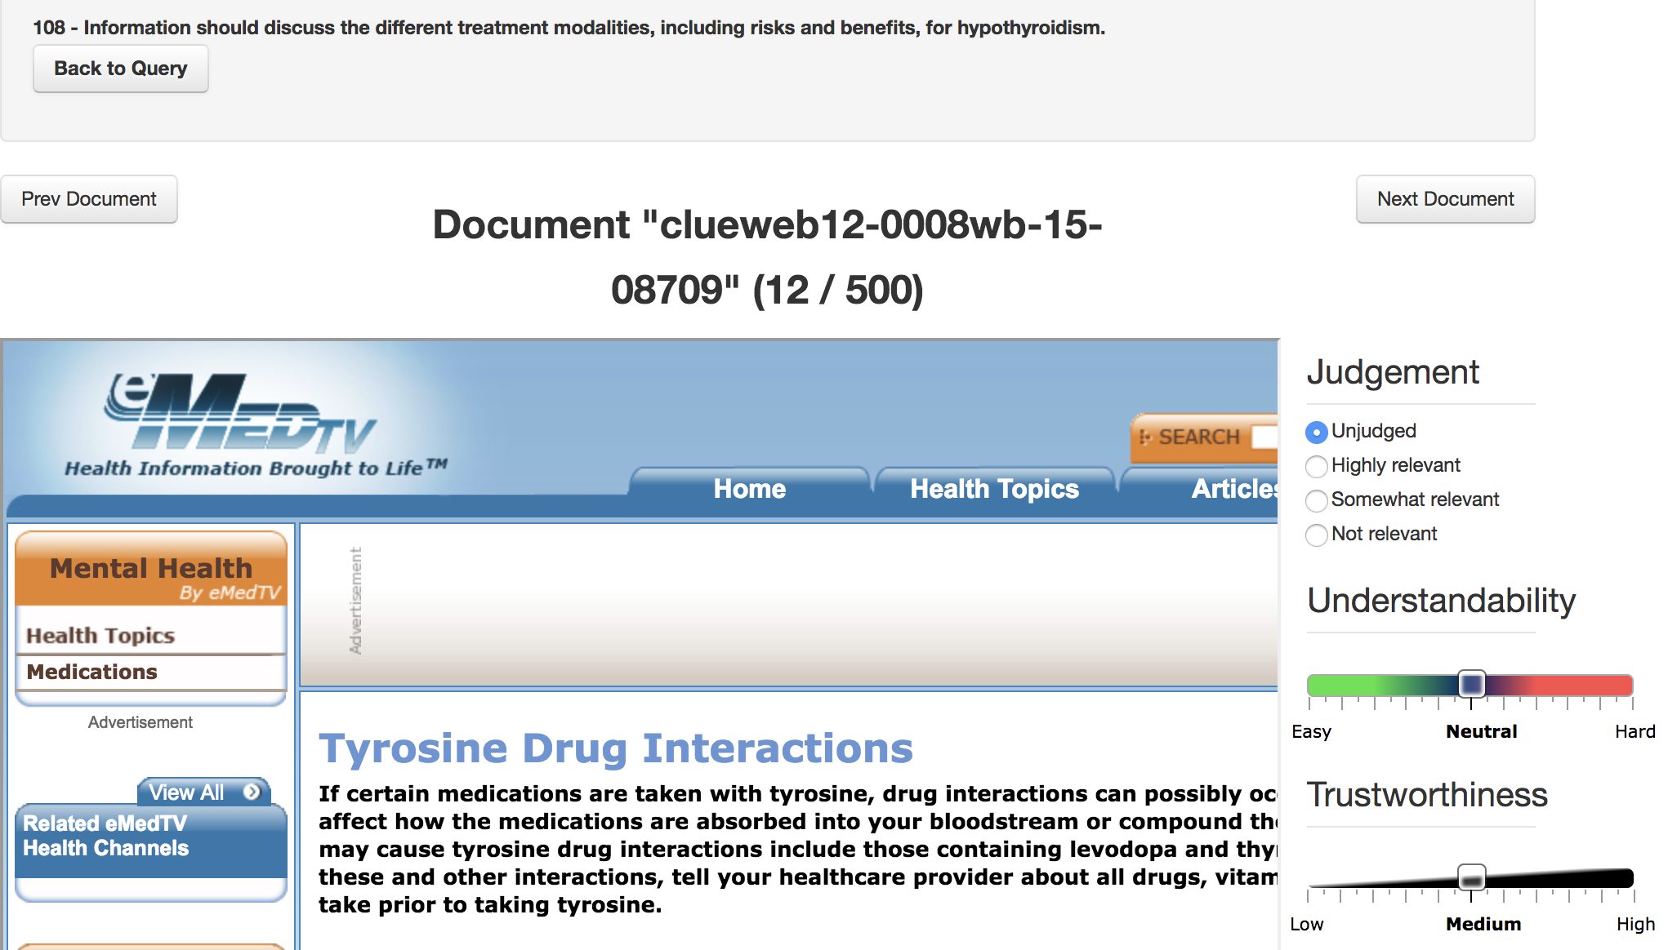
An example assessment exercise
Relevation! for CLEF 2017 eHealth: http://clef2017relevation.ielab.webfactional.com

Slide 43
A TREC Result File
101 Q0 WSJ870226-0091 1 0.7194 Brkly3
101 Q0 WSJ861216-0134 2 0.7078 Brkly3
101 Q0 AP890130-0077 3 0.7005 Brkly3
101 Q0 WSJ880523-0063 4 0.6999 Brkly3
101 Q0 WSJ881007-0136 5 0.6932 Brkly3
101 Q0 AP881030-0049 6 0.6912 Brkly3
101 Q0 AP880714-0012 7 0.6844 Brkly3
101 Q0 AP890426-0036 8 0.6844 Brkly3
101 Q0 AP881024-0011 9 0.6800 Brkly3
101 Q0 AP880608-0123 10 0.6766 Brkly3
101 Q0 WSJ870408-0045 11 0.6745 Brkly3
101 Q0 AP880314-0145 12 0.6743 Brkly3
101 Q0 AP890717-0130 13 0.6683 Brkly3
101 Q0 WSJ870715-0122 14 0.6663 Brkly3
101 Q0 AP891215-0115 15 0.6651 Brkly3
101 Q0 WSJ880712-0128 16 0.6614 Brkly3
101 Q0 AP890718-0020 17 0.6609 Brkly3
101 Q0 AP880611-0055 18 0.6601 Brkly3
101 Q0 DOE1-76-0712 19 0.6598 Brkly3
101 Q0 AP880610-0262 20 0.6585 Brkly3
…………………………..

Slide 44
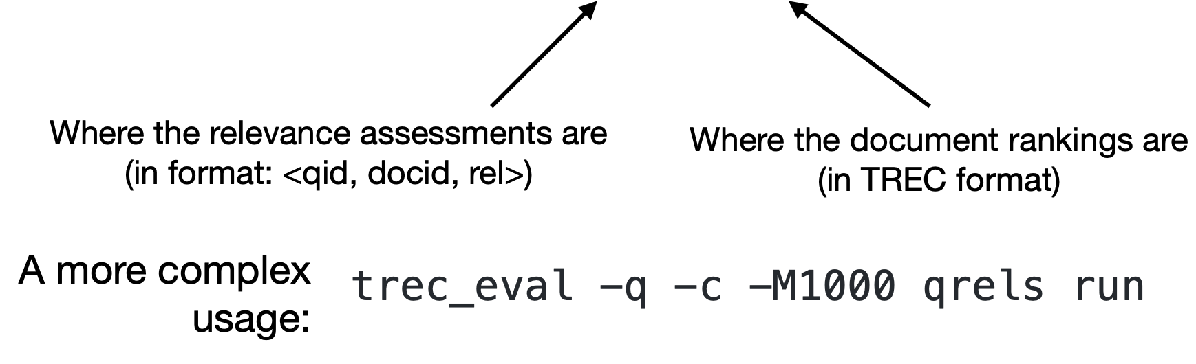
The trec_eval Tool
IR has a large number of evaluation measures: different measures for different domains, tasks, user models
There are standard/reference implementations
trec_eval is one such implementation of a number of IR measures: http://trec.nist.gov/trec_eval/
Usage:
trec_eval qrels run

Slide 45
trec_eval Tips & Tricks
-m
Judgement depths
-l (labels)
rel_str

Slide 46
trec-tools

Slide 47
Pooling
Exhaustive assessments for all documents in a collection is not practical
A simple top-k pooling
top k results (for past TRECs, k varied between 50 and 200) from the rankings obtained by different search engines (or retrieval algorithms) are merged into a pool
duplicates are removed
documents are presented in some random order to the relevance judges
Produces a large number of relevance judgments for each query, although still incomplete

Slide 48
Incomplete Relevance Assessments

Slide 49
Meta-Evaluation: is our evaluation good?

Slide 50
Is our Evaluation Good?
How do we know if our measure is good?
How do we know if our collection is good?
Does our evaluation setup predict user behavior / user satisfaction?

Slide 51
Metric Choices
Lots of metrics:
why are there several measures?
which measure is best?
which measure should I use?
anything in common, any coherent way to talk about these?
Any way to discuss, trade off, choose?
Yes: examine the model underlying each
In this tutorial, we introduce you to the C/W/L framework that allows you to understand, analyse and compare metrics
Notes:
There are lots!
Many in use e.g. at TREC, in SIGIR papers; many many perpetrated in the literature (some by us)
And they all seem to have different units – more on this later
Lots of metrics: anything in common, any coherent way to talk about these?
Any way to discuss, trade off, choose?
Yes: examine the model underlying each

