Slide 1




User Models, Metrics and Measures of Search: A Tutorial on the CWL Evaluation Framework ACM CHIIR UMMMS 2021
by
Leif Azzopardi, Alistair Moffat, Paul Thomas and Guido Zuccon

Slide 2
Section Two: What is C/W/L?
Presenter: Alistair Moffat

Slide 3
Measuring the usefulness of a ranking?
Let’s suppose that a numeric gain can be attached to each document in the ranking, and that 0 ≤ r(i) ≤ 1 is the gain attached to the document at rank i.
A gain of zero means “useless”, and a gain of one means “fully useful”.
How do we measure the usefulness of the ranking as a whole??

Slide 4
When one user looks at a ranking
First document
Second document
Third document
Fourth document
[and then stops looking]

Slide 5
When a second user looks at the same ranking
First document
Second document
[and then stops looking]

Slide 6
When a third user looks at the same ranking
First document
Second document
Third document
Fourth document
Fifth document
[and then stops looking]

Slide 7
When a fourth user looks at the same ranking
First document
Second document
Third document
Fourth document
Fifth document
Sixth document
[and then stops looking]

Slide 8
When a fifth user looks at the same ranking
First document
Second document
Third document
Fourth document
[and then stops looking]

Slide 9
When a sixth user looks at the same ranking
First document
[and then stops looking]

Slide 10
When a seventh user looks at the same ranking
First document
Second document
[and then stops looking]

Slide 11
When an “average” user looks at the same ranking
First document
Second document
Third document
Fourth document
Fifth document
Sixth document
Seventh document

Slide 12
When an “average” user looks at the same ranking
First document
Second document
Third document
Fourth document
Fifth document
Sixth document
Seventh document
C(1): probability of continuing from doc 1 to doc 2
C(2): probability of continuing from doc 2 to doc 3
C(3): probability of continuing from doc 3 to doc 4
C(4): probability of continuing from doc 4 to doc 5
C(5): probability of continuing from doc 5 to doc 6
C(6): probability of continuing from doc 6 to doc 7

Slide 13
Huh? What is C(i)?
Define C(i) to be:
the conditional continuation probability that a randomly selected user will proceed from document i in the ranking to document i+1
given that they have just looked at document i, and
assuming that users always start at the top of the ranking at the first document (rank position 1).

Slide 14
Huh? What is C(i)?
Clearly, 0 ≤ C(i) ≤ 1 for each depth i in the ranking.
And C(k+1) onward are immaterial if C(k)=0 occurs for some k.
What factors might affect C(i)??

Slide 15
Huh? What is C(i)?
Example: suppose that users are modelled as always looking at the first five documents in the ranking, and never going beyond those five.
Then C(1)=C(2)=C(3)=C(4)=1.0, and C(5)=0.0.
If this pattern of behavior makes you think about the metric precision at depth five, P@5, your instincts are working well.
And if it doesn’t, well, you’ll find out why it should have in just a minute!

Slide 16
Huh? What is C(i)?
Example: suppose that users are modelled as always continuing from depth i to depth i+1 with some constant probability 𝜙, that is, C(i)=𝜙 for all i.
Now what? Now there will be non-zero “probability of being viewed” that can be calculated for every position in the ranking.
For each different function C(i) a weight can be derived and associated with the document at rank i.

Slide 17
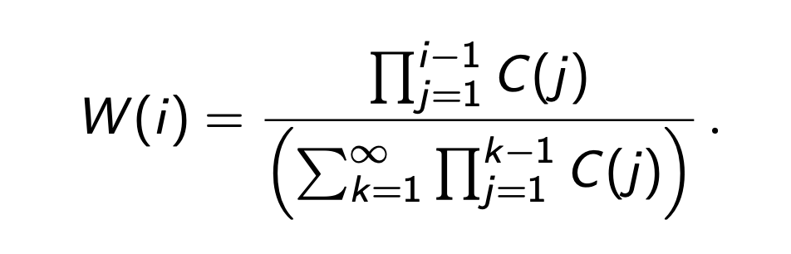
Huh? What are these “weights”?
We can compute the corresponding W(i) function for any C(i) function.
It captures the fraction of all user attention associated with the document in the i’th place of the ranking:
Example: C(1..4)=1.0, C(5..)=0; then W(1..5)=0.2, W(6..)=0.0.
Example: C(i)=𝜙; then W(i)=(1 – 𝜙)𝜙^{(i-1)} .

Slide 18
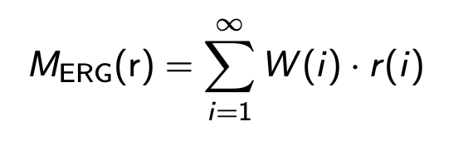
Huh? What are these “weights”?
Can now compute the expected rate of gain version of the “metric” defined by the values associated with the function C(i):
Example: C(1..4)=1.0, C(5..)=0; then W(1..5)=0.2, W(6..)=0.0.
The corresponding metric is Precision at Depth Five, P@5.

Slide 19
Huh? What are these “weights”?
Example: if C(i)=𝜙; then W(i)=(1 – 𝜙)𝜙^{(i-1)}.
The corresponding metric is Rank-Biased Precision. When 𝜙=0, the user is completely impatient, matching P@1. When 𝜙=0.5, the user is somewhat impatient, expected search depth is two.
When 𝜙=0.95, the user is relatively patient, and expected search depth = 20.

Slide 20
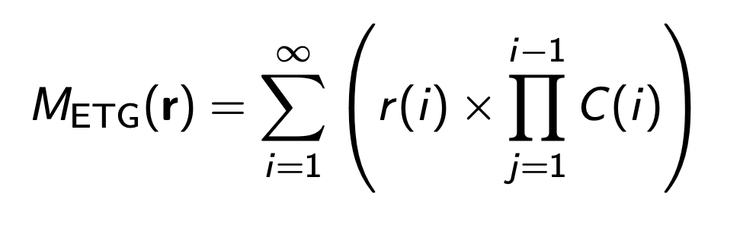
ERG versus ETG metrics
Can also compute the expected total gain:
This is the total “usefulness” derived by the average user when viewing the SERP in question.

Slide 21
ERG versus ETG metrics
Simple algebra then gives the expected viewing depth (the average number of documents viewed by users) as 1/W(1).
ERG metrics measure systems based on the rate at which their users acquire “usefulness”, and have units of “rels/document”.
ETG metrics measure systems based on the total “usefulness” acquired by users, and have units of “rels”.

Slide 22
What factors could/should/might affect C(i)?
Some “directional” hypotheses, assuming a user who searching for, and hoping to acquire, a total of T units of gain:
When T is larger, C(i) is larger, AOTBE
When i is larger, C(i) is larger, AOTBE
As the relevance collected gets larger, C(i) gets smaller, AOTBE.

Slide 23
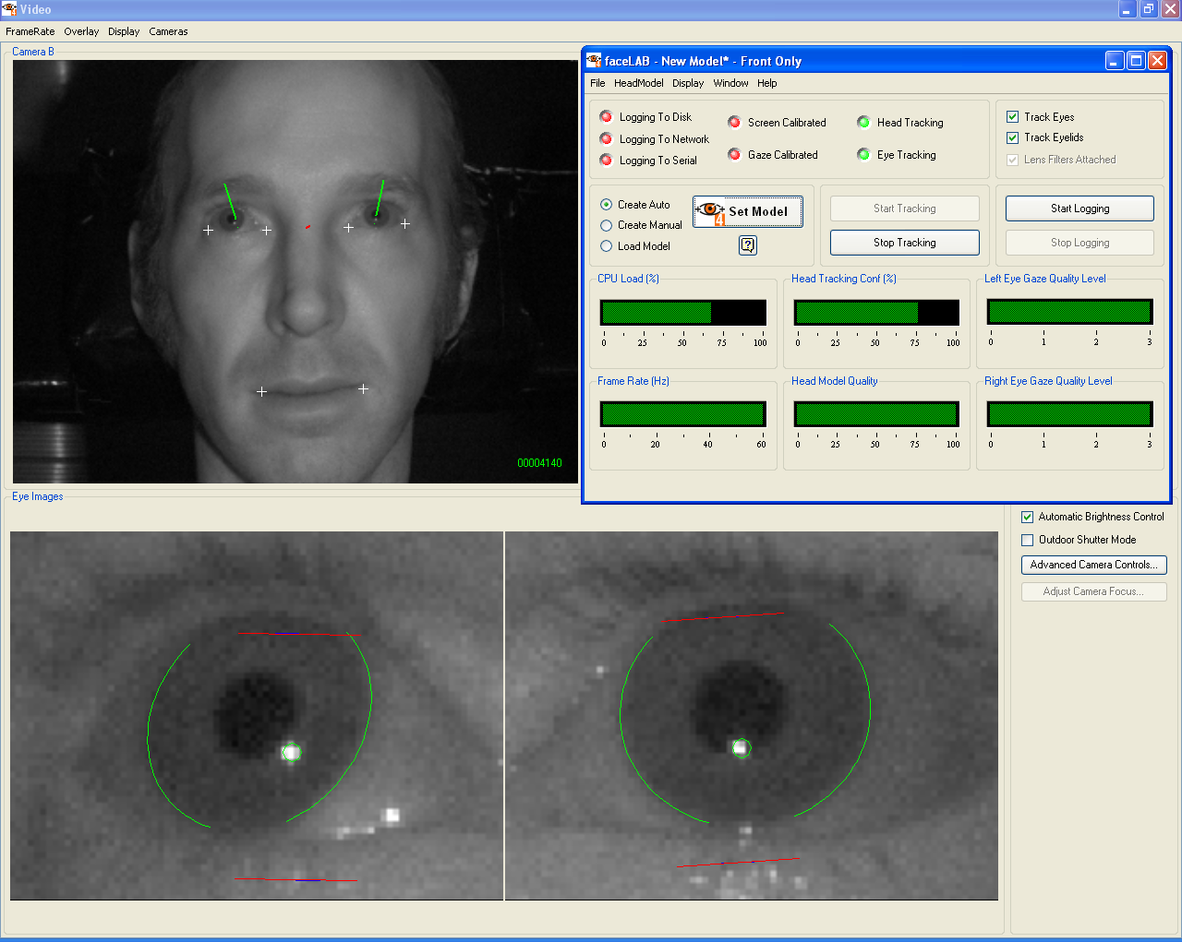
Is there any evidence??
Source: Paul Thomas.

Slide 24
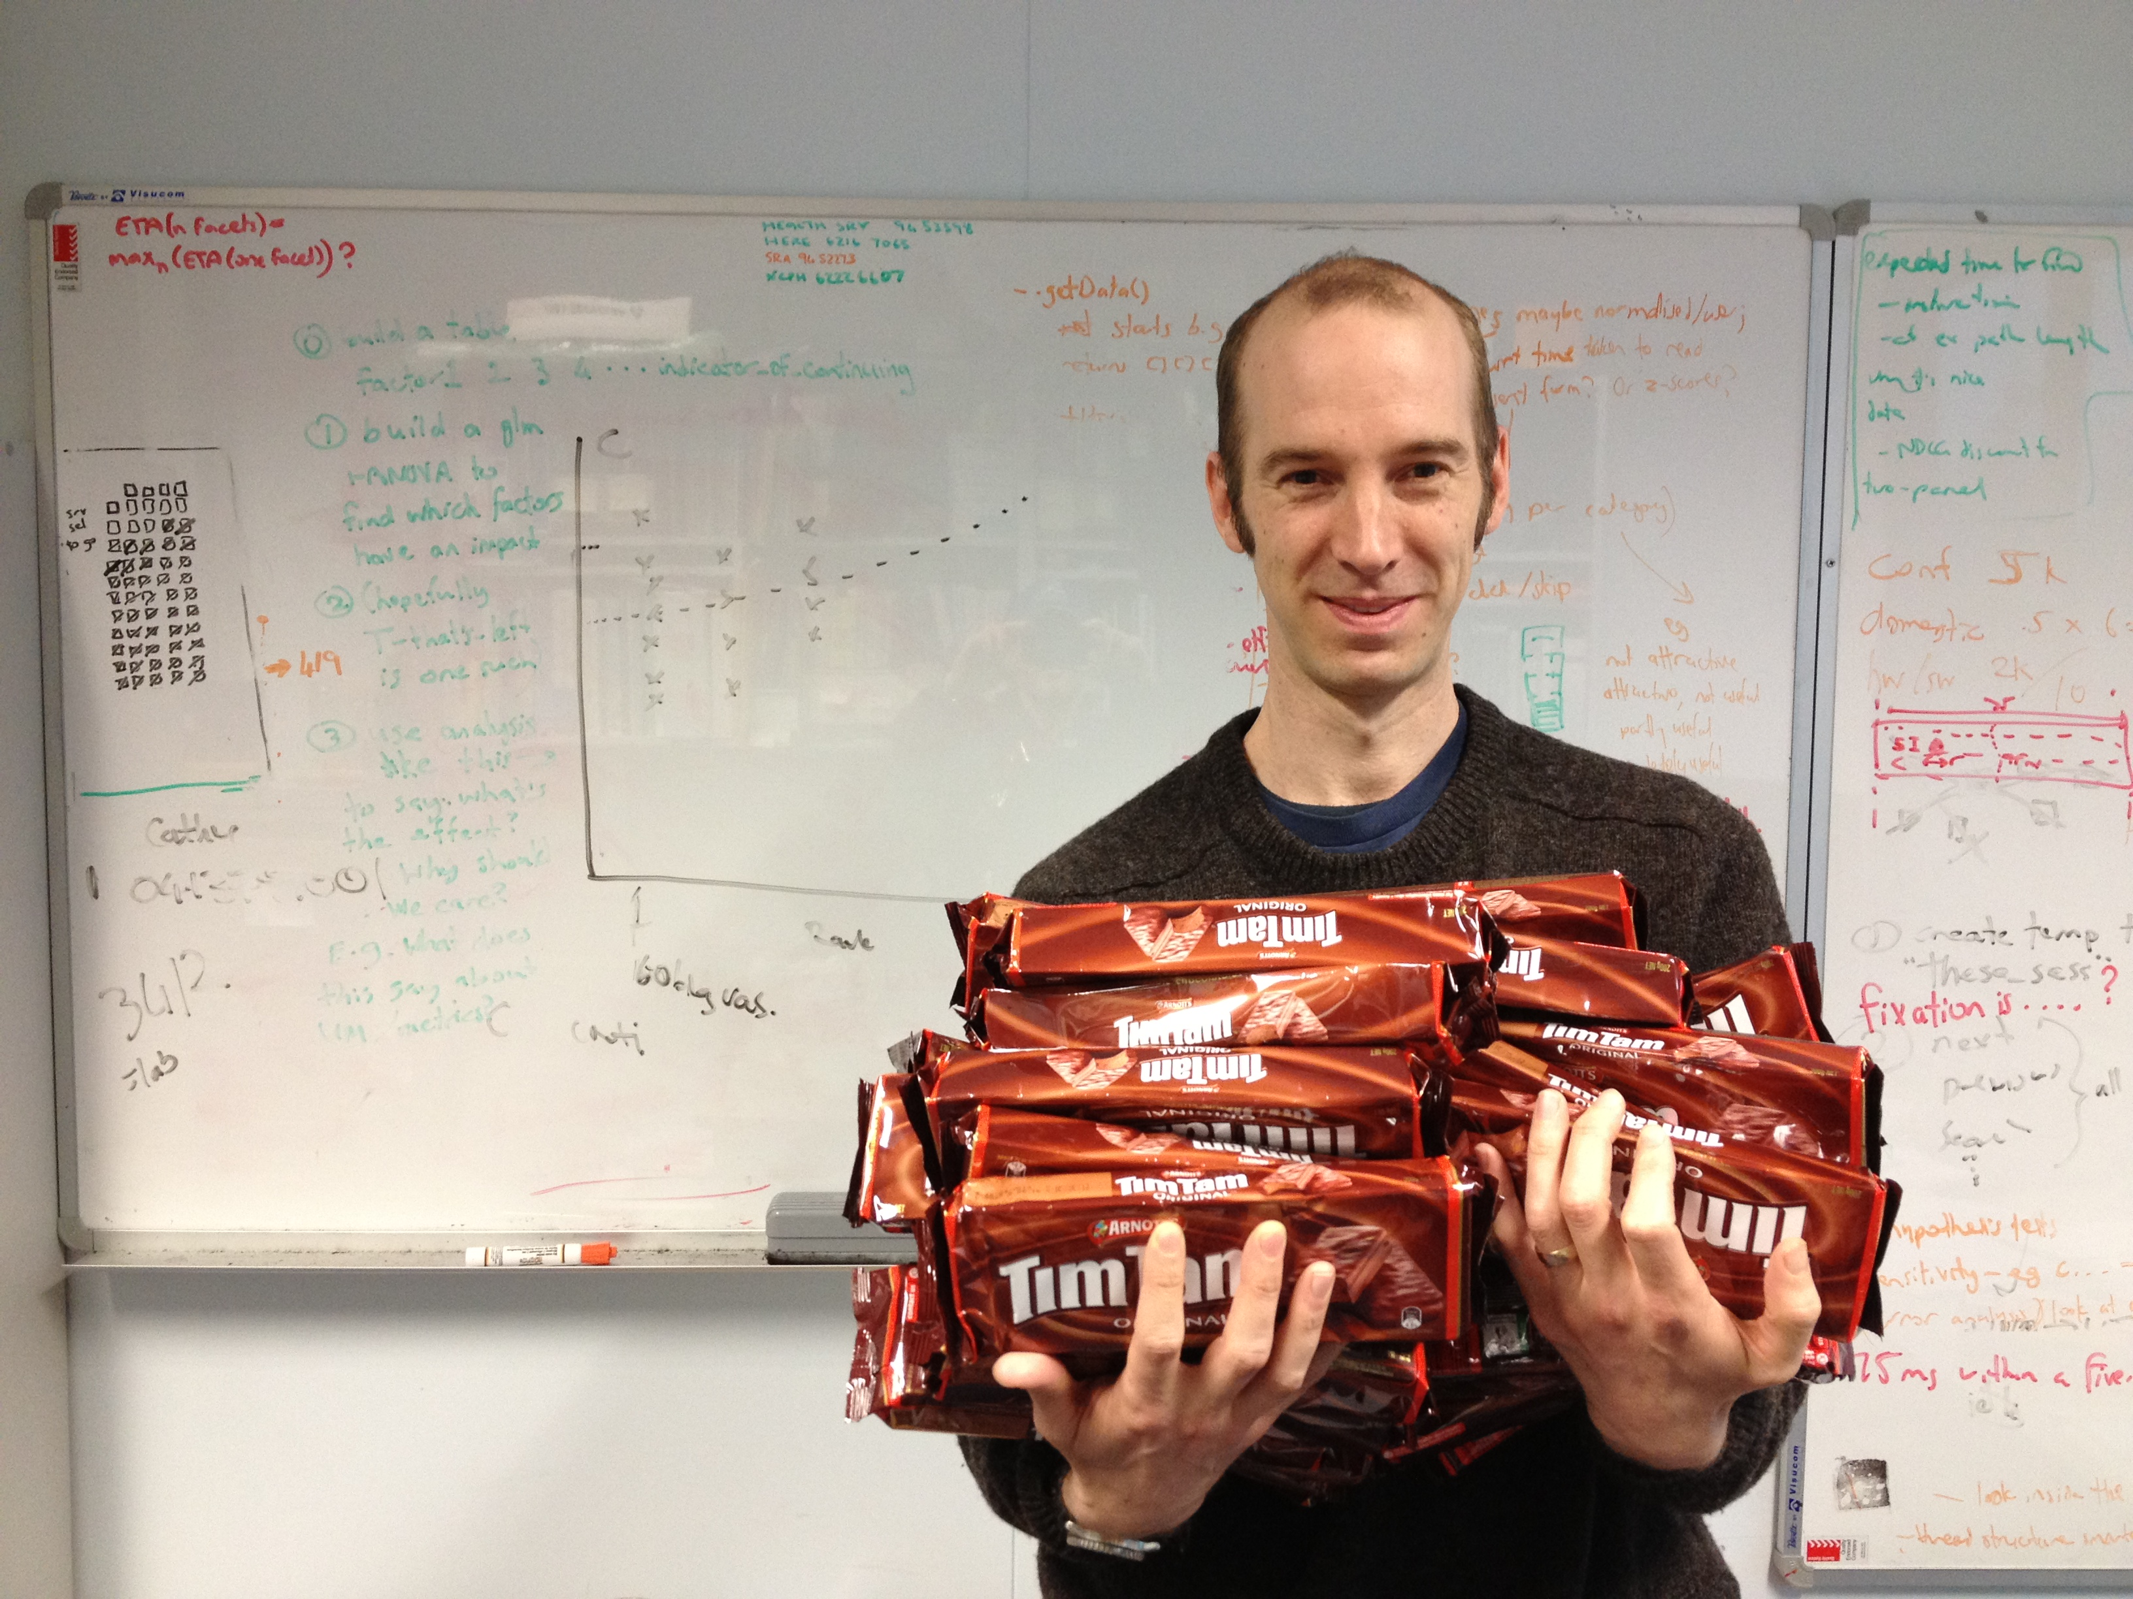
Is there any evidence??
Source: Paul Thomas.

Slide 25
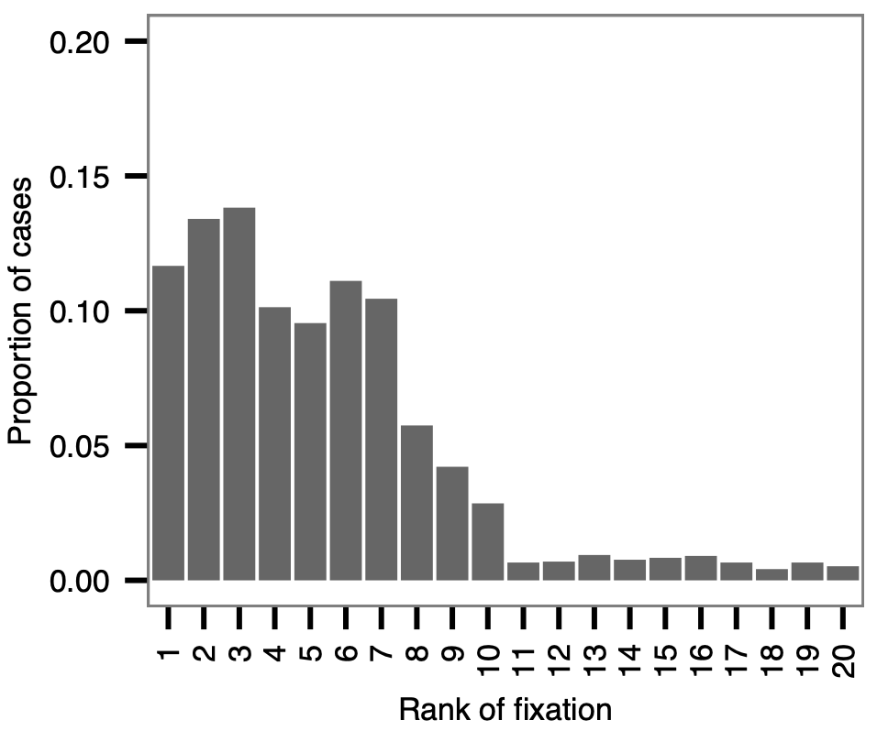
Is there any evidence??
Graph: Thomas et al., AIRS 2013.

Slide 26
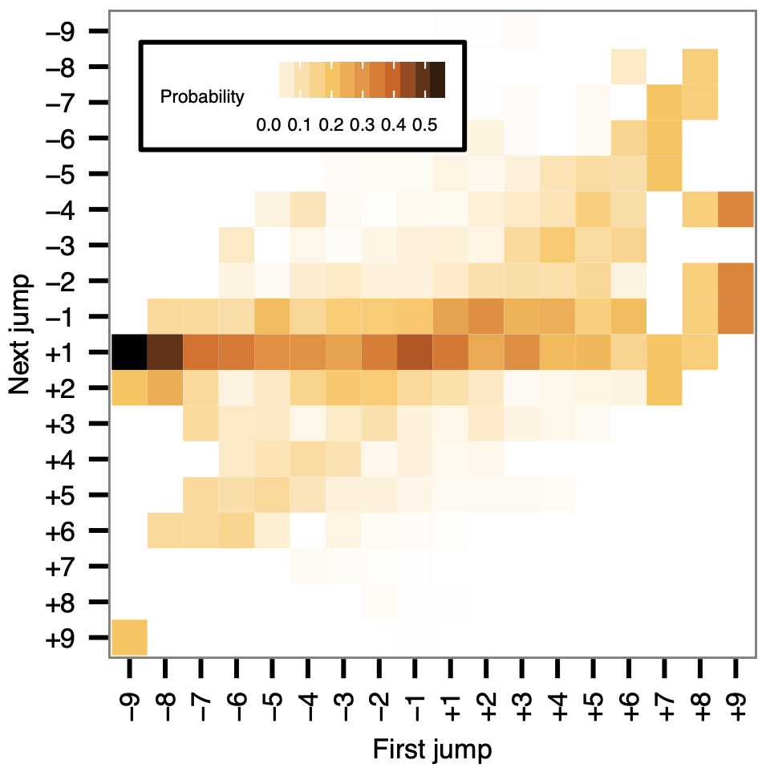
Is there any evidence??
Graph: Thomas et al., AIRS 2013.

Slide 27
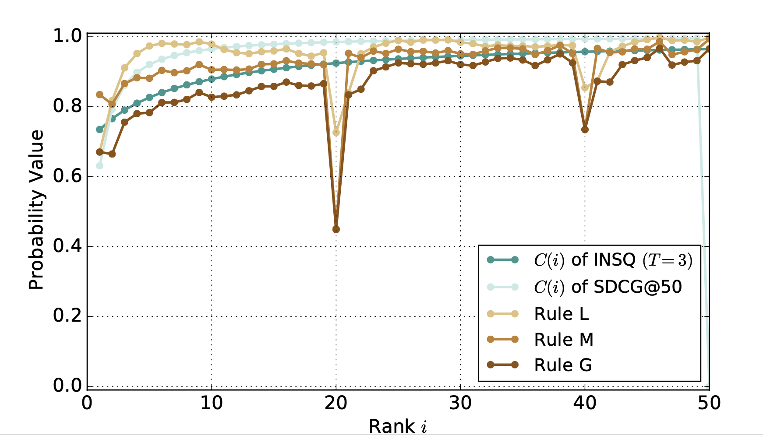
Is there any evidence?
Inferred C(i) for job search users, web browser, pages of 20.
Graph: Wicaksono & Moffat, CIKM 2018, with thanks to Seek.com.

Slide 28
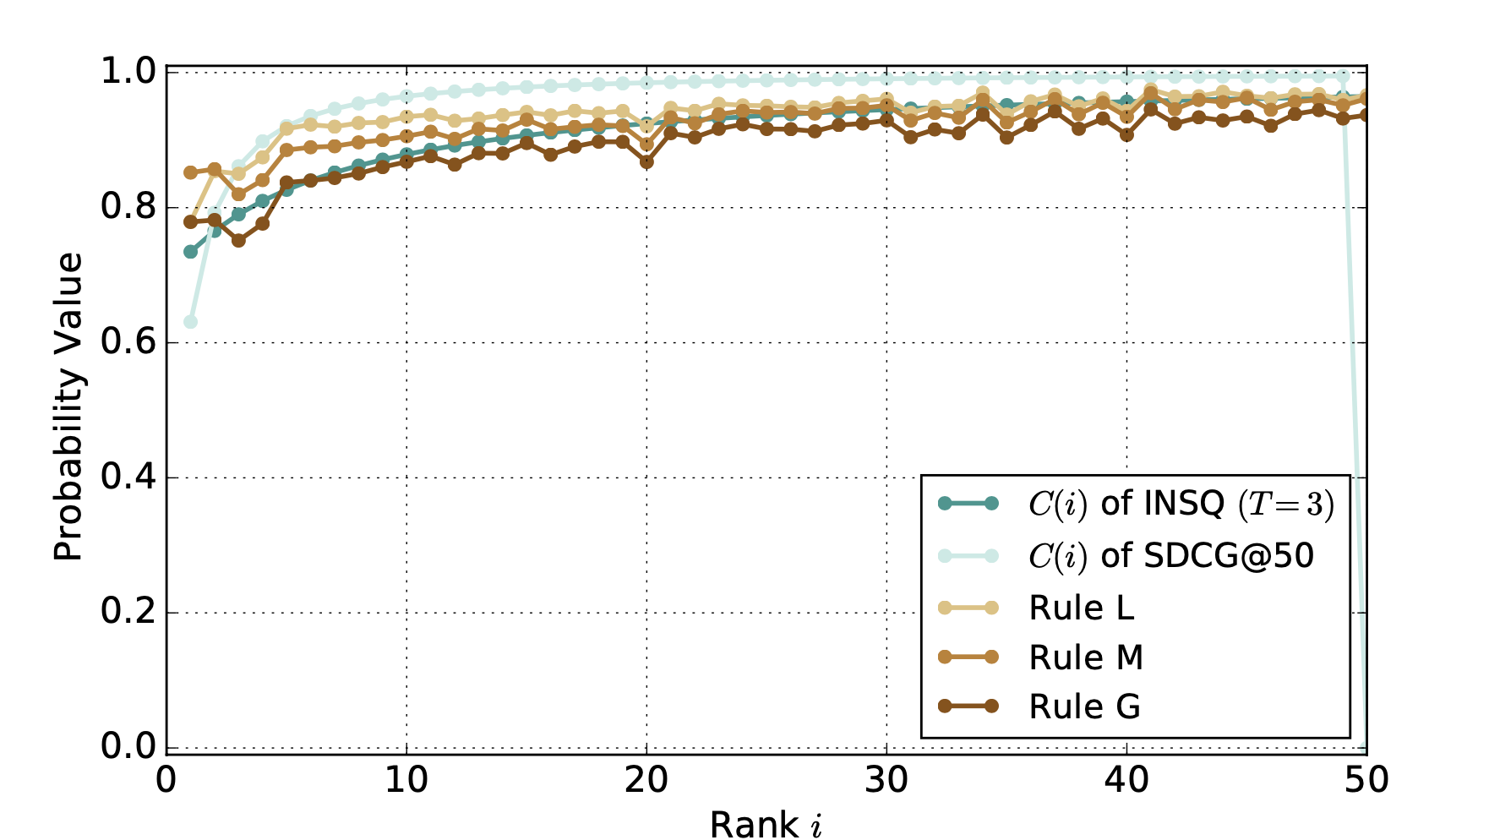
Is there any evidence?
Inferred C(i) for job search users, phone app with continuous scroll.
Graph: Wicaksono & Moffat, CIKM 2018, with thanks to Seek.com.

Slide 29
Formulating metrics (1)
Already covered in examples: if C(i)=1 for 1 ≤ i < k, and C(k)=0, then the CWL metric is P@k.
And W(i)=1/k for 1 ≤ i ≤ k, with W(i)=0 for i > k.
The expected viewing depth is k.
That was an easy one, to get started.

Slide 30
Formulating metrics (2)
Also already introduced: if C(i)=𝜙 for all i, then
W(1) = (1 – 𝜙),
W(i+1) = 𝜙 W(i), and
expected viewing depth is 1/(1 – 𝜙).
Rank-biased precision assigns non-zero weight to every document in the ranking.
But unless 𝜙 > 0.95, the actual weight assigned at ranks > 50 is negligible.

Slide 31
Formulating metrics (3)
What about a user who seeks one useful document, and stops if they find it?
Set C(i) = 1 – r(i), and suppose that r(i) is binary, either zero or one. The metric is now adaptive, in that user behavior depends upon what they have seen. (Wow!)
Then W(i) = 1/d, where d is the rank of the first relevant document.
This is Reciprocal Rank!
(Could also have non-binary C(i) = 1 – r(i), but does not equate to ERR.)

Slide 32
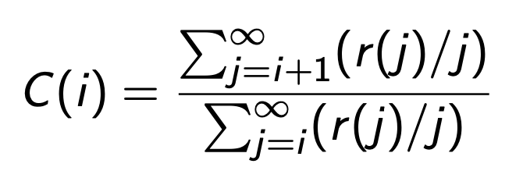
Formulating metrics (4)
What about the metric defined by this function?
The user is modeled as deciding what to do now (at rank i) based on relevance values they have not yet seen (from ranks j>i).
This is the definition of Average Precision. Yes!

Slide 33
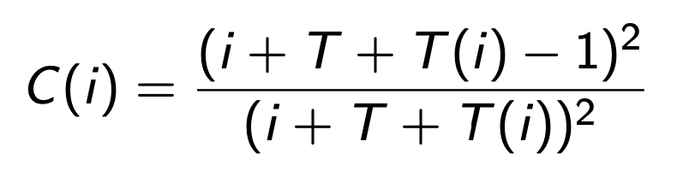
Formulating metrics (5)
Suppose the user starts their search with the hope of acquiring T units of “usefulness”. And suppose that by rank i, they have acquired R(i) units.
Define T(i) = T – R(i) as the “unmet requirement” at depth i. Then take
This is the definition of a metric named INST.

Slide 34
Formulating metrics (5) – Huh?
INST has these properties (AOTBE):
When T is larger, C(i) is larger – goal sensitive
When i is larger, C(i) is larger – sunk effort
As R(i) gets larger and T(i) gets smaller, C(i) gets smaller – adaptive.

Slide 35
Formulating metrics (6)
You don’t have to use any of those metrics!
If you have an understanding of your users and how they interact with your SERPs, you can define your own C(i) function, and use it to measure the effectiveness of your system as to strive to provide a better search experience.

Slide 36
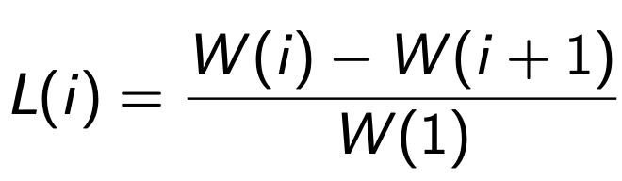
Hey, hang on! What about L?
We have talked about C(i). And about W(i). What happened to L(i)?
It is the “last” function, the probability that the document at rank i will be the last one inspected by the user.
It can be computed from either C(i) or from W(i):

Slide 37
See, Double You, ‘Ell!
C(i)
L(i)
W(i)

Slide 38
Something’s missing: Residuals
To completely evaluate a metric, need relevance judgments.
What if full judgments are not available?
Compute a residual by calculating two scores:
first, assuming all unjudged document have r(i)=0
then, assuming all unjudged documents have r(i)=1
True score is between these extremes. The residual is the width of the interval.
If the residual is large, your experiment may have a problem.

Slide 39
Summary of Section II
C/W/L metrics are constructed by hypothesizing behavior over a population of users.
The critical component is C(i), the conditional continuation probability. But they can also be defined via W(i) and/or L(i), each leads to the other two.
From any of C/W/L, ERG and ETG metrics are available, including ones that are goal sensitive and/or adaptive.
Residuals should be monitored, and not ignored.

Slide 40
Summary of Section II
C/W/L metrics are constructed by hypothesizing behavior over a population of users.
The critical component is C(i), the conditional continuation probability. But they can also be defined via W(i) and/or L(i), each leads to the other two.
From any of C/W/L, ERG and ETG metrics are available, including ones that are goal sensitive and/or adaptive.
Residuals should be monitored, and not ignored.
C/W/L Spells “Cool”

Slide 42
What factors affect the usefulness of a ranking?
Maybe some or all of:
How much “usefulness” the user was looking for in the first place
The extent to which they found it
The time that they needed to spend looking
All three?
We already know how to measure “time”: it can be counted using “documents inspected”, or in “seconds” (or in minutes, or hours).
We still need a way to measure “usefulness”.

Slide 43
What factors affect the usefulness of a ranking?
And what do we want to report?
The total amount of “usefulness” the user received?
The rate at which the user gained “usefulness”?
The time taken until the user stopped looking?
All three?

Slide 44
Measuring the usefulness of a document?
This is the classic question of relevance.
In isolation (a single document) we might just use categories: “not at all, “a little”, “a lot”, “perfect”.
In a context (such as in a ranked list), we might also be interested in additional aspects like diversity (different aspects of the topic) and novelty (fresh documents).

