Slide 1




User Models, Metrics and Measures of Search: A Tutorial on the CWL Evaluation Framework ACM CHIIR UMMMS 2021
by
Leif Azzopardi, Alistair Moffat, Paul Thomas and Guido Zuccon

Slide 2
CWL-EVAL DEMO
https://github.com/ireval/cwl

Slide 3
cwl-eval demo
How to install cwl-eval?
You will need Python 3.7
pip install cwl-eval
How to use cwl-eval?
Cwl-eval takes the following Inputs:
gain_file (which is in trec qrel file format)
Binary relevance (1,0) can be used or
Gain values (typically between 0 and 1)
result_file (which is in trec result file format)

Slide 4
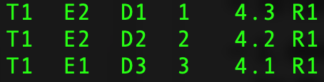
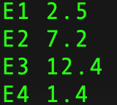
cwl-demo
How do you calculate the expected cost, & expected total cost?
To calculate costs you will need to do two things.
Denote which result item is of what result type
in the result_file
Include a cost file that maps result type to a cost
in a cost_file
Result item type
Result item type
Cost of Item type

Slide 5
cwl-demo
How do you calculate the expected cost, & expected total cost?
Once you have the mappings you can add ”-c cost_file” to then calculate the costs.
Note that you determine the units of the costs
Where you could use:
Time (sec)
Length (number of chars, or number of terms)
Dollars and cents

Slide 6
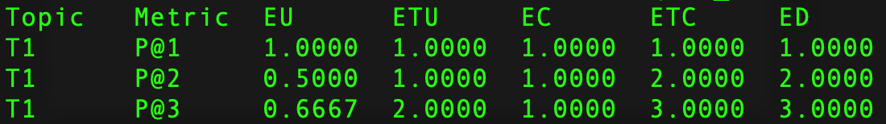
cwl-demo
How to show the column names?
If you’d like to show the names for each column include “-n”
How to include the residuals in the output?
If you’d like to show the residuals include “-r”

Slide 7
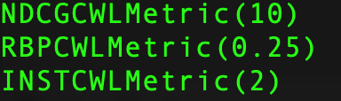
cwl-demo
How specify the metrics you want?
If you want to control what measures you want to output then specify them “-m file.to.metrics”
CWL Metrics with param values

Slide 8
cwl-eval demo
How to get the BibTeX for the metrics?
If you want cwl-eval to provide you with the list of references to the metrics that you have specified in your metrics file then you can use the “–b” flag and specify where you want the BibTeX to be saved to.
How to cite cwl eval ☺ ?
Azzopardi, Thomas and Moffat, cwl_eval: An Evaluation Tool for Information Retrieval, Proc. of the 42nd International ACM SIGIR Conference, SIGIR2019

Slide 9
cwl-eval demo
What are the differences between cwl-eval and trec-eval?
trec_eval re-orders the results based on the score.
trec_eval is not gain sensitive (binary relevance).
In cwl-eval a relevance value of 2, is interpreted as 2 units of gain
cwl-eval reports all measures in the same units – you can directly compare the estimates by each metric.
cwl-eval reports EU, ETU, EC, ETC, ED and can also report residuals outputting them into a Pandas dataframe friendly format.

Slide 10
User Models, Metrics and Measures of Search: A Tutorial on the CWL Evaluation Framework ACM CHIIR UMMMS 2021
by
Leif Azzopardi, Alistair Moffat, Paul Thomas and Guido Zuccon

Slide 11
Adding your own CWL metric
https://github.com/ireval/cwl

Slide 12
cwl classes
Ranking
Is a class to represent the costs and gains for a query
cwl_ruler/CWLRuler
Is a container class that creates all the CWLMetrics
measures/cwl_metrics/CWLMetrics
Base class for creating new metrics
Subclass, and then define the
c_vector()
Or define the w_vector() and convert the w’s to c’s
Define the metric_name for reporting

Slide 13
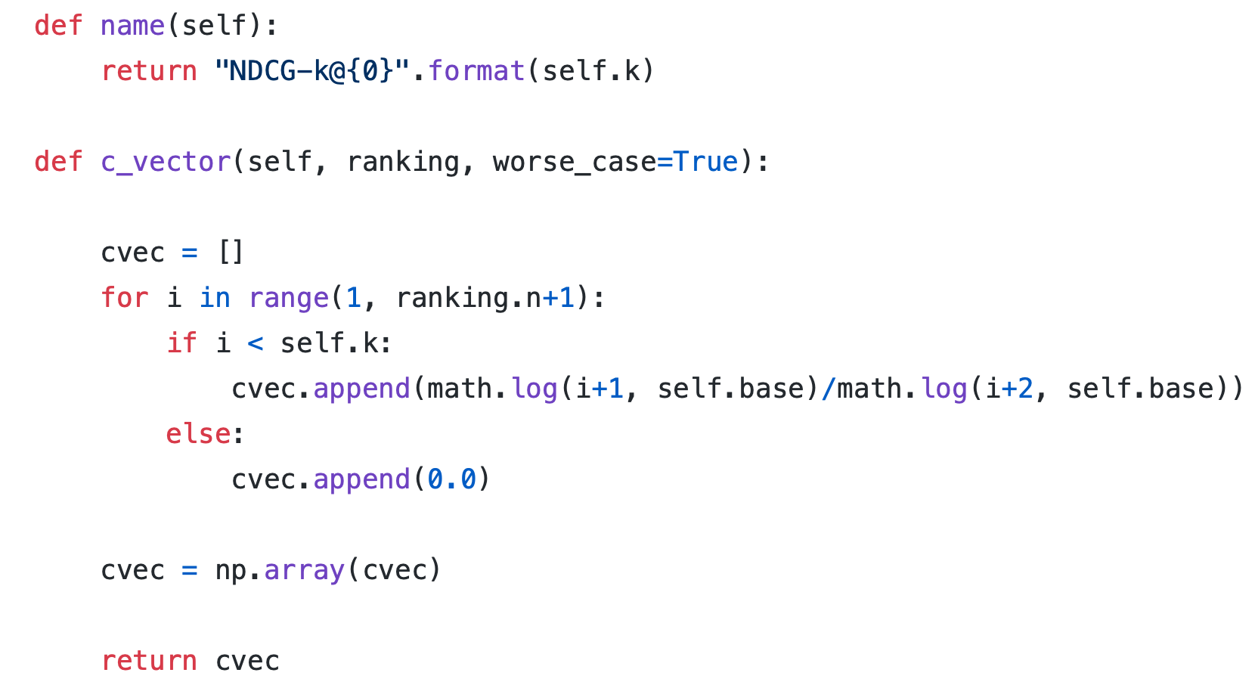
DCG - Example
Recall that C_DCG = log_{b}(i+1)/log_{b}(i+2)

Slide 14
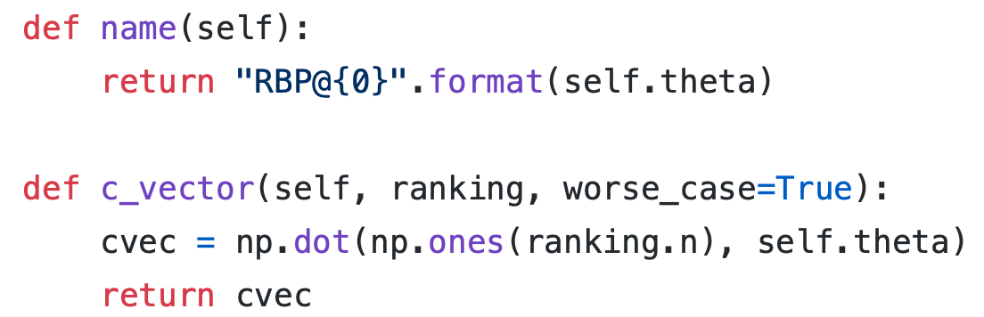
RBP - Example
Recall that C_RBP = theta

Slide 15
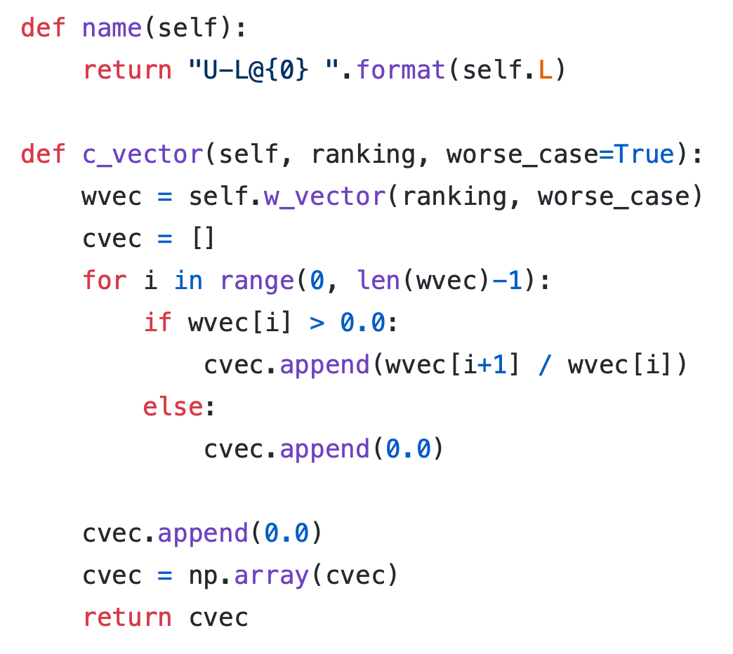
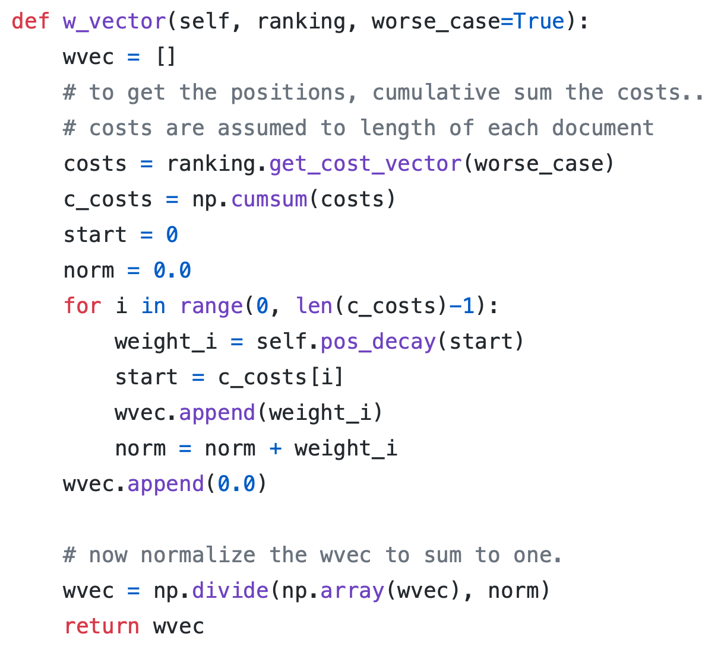
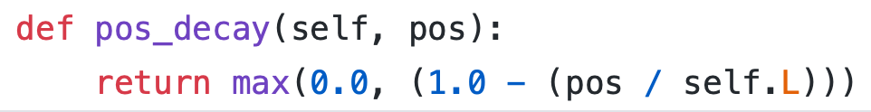
U-Measure Example
For the U-Measure I don’t know what the C vector is.
But I can define the W and transform it to the C

Slide 16
User Models, Metrics and Measures of Search: A Tutorial on the CWL Evaluation Framework ACM CHIIR UMMMS 2021
by
Leif Azzopardi, Alistair Moffat, Paul Thomas and Guido Zuccon

Slide 17
Inside CWL metrics
http://bit.ly/cwl-chiir-2021-notebook-demo

Slide 18
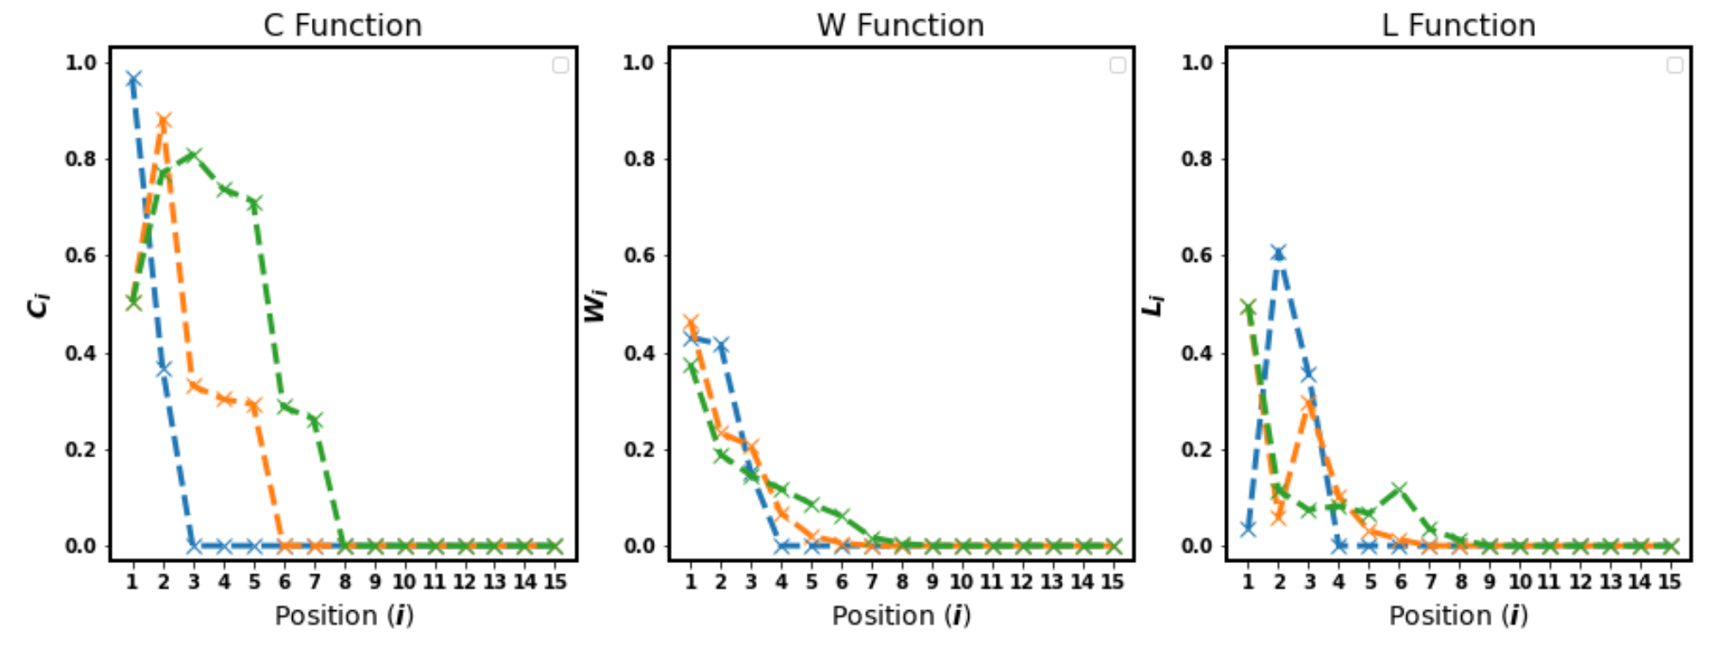
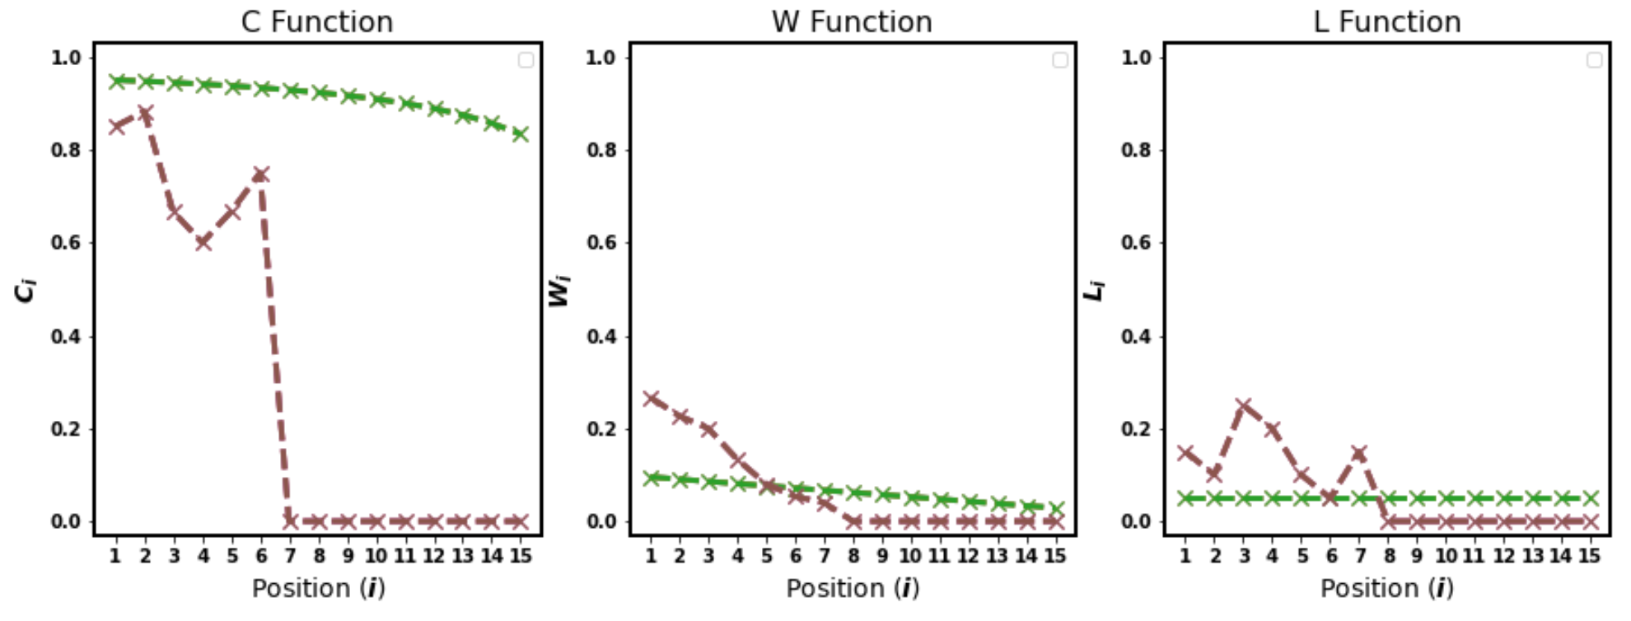
Check out the notebook to see CWL graphs like this!!!

