Slide 1
Data Tycoon
Elections Analysis
-Team 17

Slide 2
Modules:
Prepocessing the data and cleaning the data i.e, removing unwanted columns and etc..(over)
Filtering the data according to states to find ruling party in corresponding state(going on........over)
Understanding geopandas and showing the ruling parties in various states on India map with colouring of various parties (not over)
In future, representing various ruling parties in various districts on India map(not over)

Slide 3
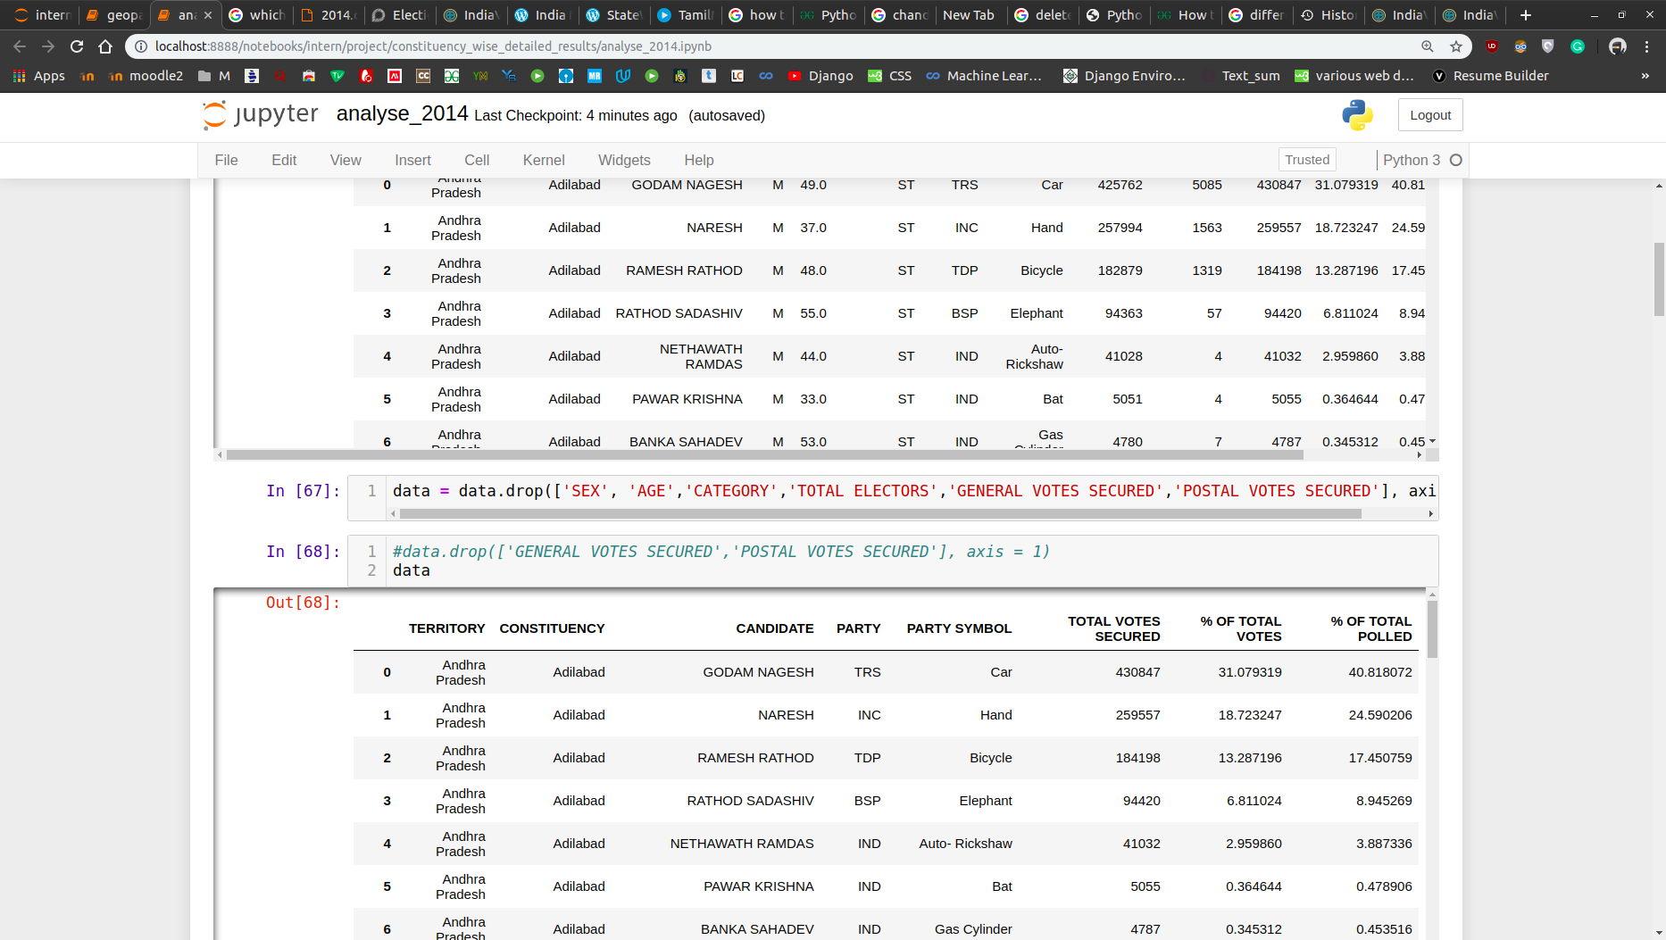
Screenshots:

Slide 4
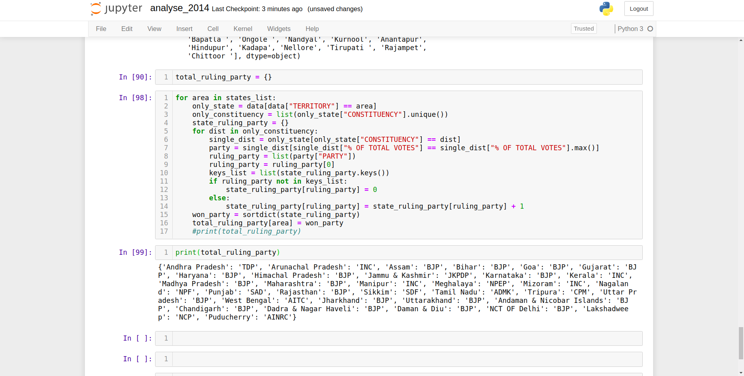
Screenshots:

Slide 5
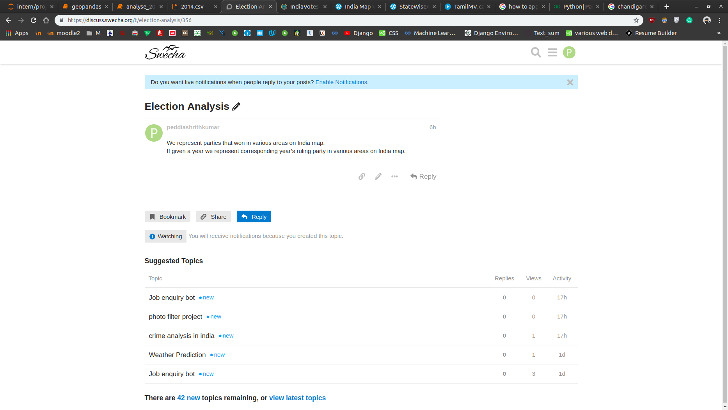
Screenshots:(discuss.swecha.org)

Slide 6
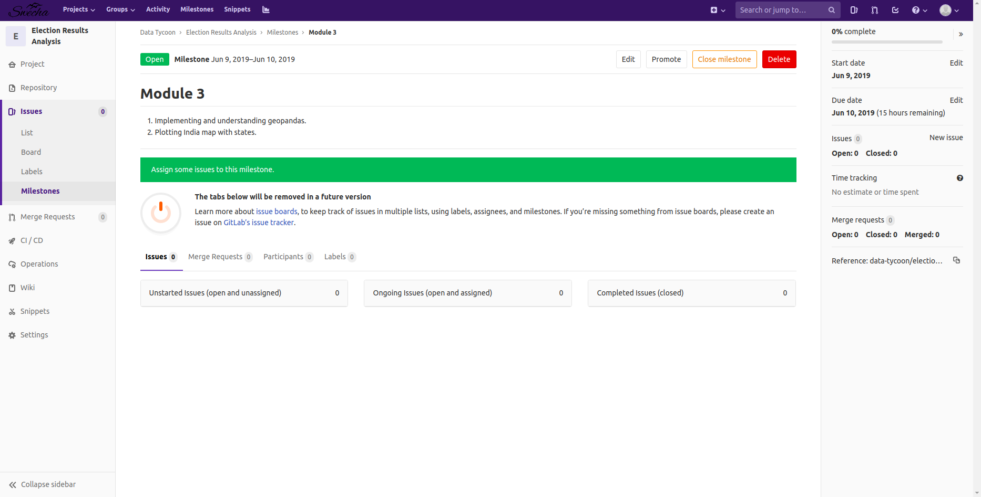
Screenshots:(code.swecha.org)

