Slide 1

Subtitle Viewer : Enhancing Search Engine Relevance for Video Subtitles
Submitted By :
G.Prashanth

Slide 2
About me
AKULA NIKHIL
B.TECH (CSE) - 2023
Why you want to learn Data Science
Data science is a field that involves scientific methods, processes, algorithms, and systems. It's a common platform for the unification of statistics, data analysis, and machine learning.
It powers everything from innovation and the customer experience to the future of health care. Data science has the potential to improve the way we live and work, and it can empower others to make better decisions, solve problems, discover new advancements, and address some of the world's most pressing issues.
linkedin.com/in/akula-nikhil-214974214/
github.com/NikhilAkula4511

Slide 3
Agenda
ABSTRACT
INTRODUCTION
MODULES
MODULE EXPLANATIONS

Slide 4
ABSTRACT
This study presents an advanced subtitle search algorithm integrating ChromaDB for efficient data storage and retrieval, alongside BERT and TF-IDF for contextual understanding and term importance assessment. The algorithm preprocesses subtitles, computes BERT embeddings and TF-IDF vectors, and calculates similarity scores between user queries and subtitles. Results are ranked, filtered, and presented to users with metadata. A feedback loop ensures algorithmic adaptation based on user interactions. This approach offers a streamlined method for retrieving accurate and relevant subtitles based on user queries.

Slide 5
INTRODUCTION
In the era of digital media consumption, subtitles serve as a vital aid for accessibility and comprehension. However, efficiently retrieving relevant subtitles remains a challenge.
Our proposed advanced subtitle search algorithm aims to tackle this issue by integrating ChromaDB for optimized data management and incorporating BERT and TF-IDF techniques to capture contextual understanding and term importance.
Through a systematic process of preprocessing, similarity calculation, and result presentation, our algorithm endeavors to streamline the retrieval of accurate subtitles tailored to user queries.
Additionally, a feedback loop mechanism ensures continual refinement based on user interactions, promising an enhanced user experience in accessing multimedia content.

Slide 6
MODULES
Data Collection
Data Preprocessing
Vectorization
ChromaDB
Retrieving Data
Web Application

Slide 7
DATA COLLECTION
Download the dataset and convert it from a .db file into a pandas DataFrame while we extract latin-1 to extract information from it.
Subsequently, select a representative subset comprising 30% of the data for analysis and processing.
This reduced dataset size ensures efficient computational handling while maintaining adequate data diversity for comprehensive exploration and modeling.

Slide 8
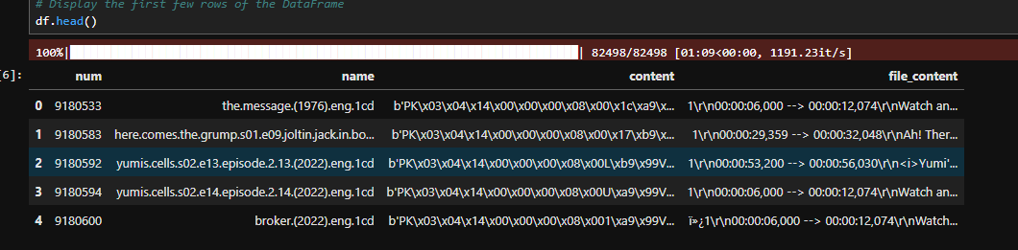
Sample Data :--

Slide 9
DATA PREPROCESSING
In the preprocessing stage, timestamps are removed, stop words and punctuations are eliminated, and all text is converted into lower case to ensure uniformity.
Additionally, lemmatization is applied to reduce words to their base forms, enhancing the text's consistency and interpretability.
These meticulous steps streamline the text data, preparing it for advanced analyses and modeling tasks.

Slide 10
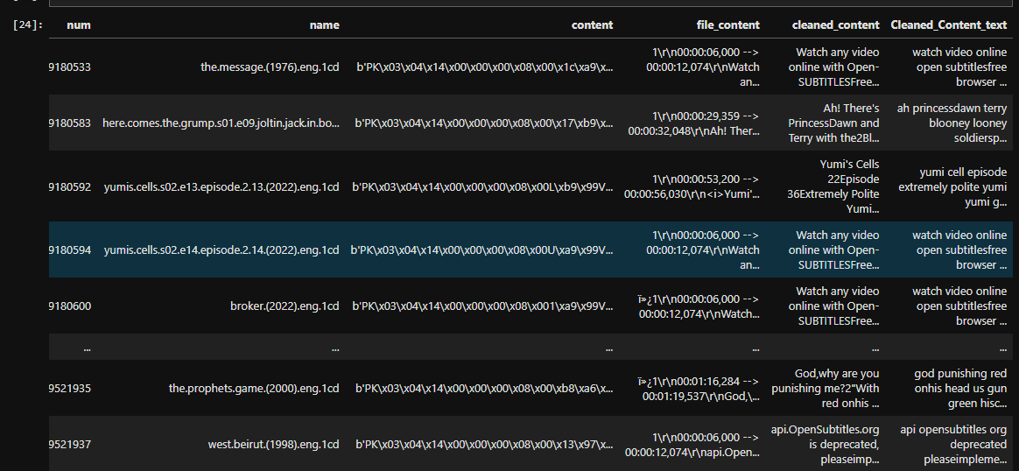
After Applying preprocessing steps with Sample Data

Slide 11
VECTORIZATION
Utilizing Bag-of-Words (BOW) or TF-IDF to generate sparse vector representations, primarily aiding in constructing a Keyword-Based Search Engine for efficient retrieval based on keyword matches.
Leveraging BERT-based "Sentence Transformers" to generate embeddings that encode semantic information. These embeddings are instrumental in developing a Semantic Search Engine, allowing for a deeper understanding of text context and meaning.
Prior to integrating BERT, preprocessing steps such as text normalization and chunking necessary to enhance the efficiency and effectiveness of semantic representation.

Slide 12
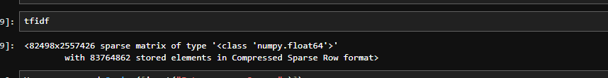
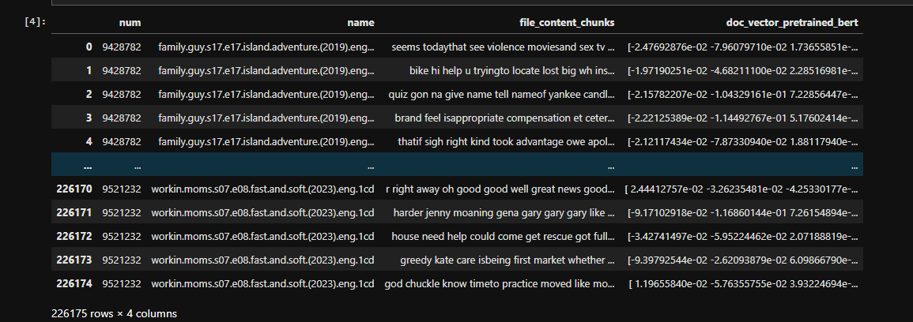
TfIdf Sparse Matrix : -
Bert Vector:-

Slide 13
CHROMADB
Incorporating ChromaDB, we store the generated embeddings efficiently to manage the substantial volume of data effectively.
By leveraging ChromaDB's capabilities, we ensure fast retrieval and storage of embeddings, enabling seamless integration with our search engine architecture.
This approach optimizes resource utilization and enhances scalability, laying a robust foundation for building advanced search functionalities based on semantic representations.

Slide 14
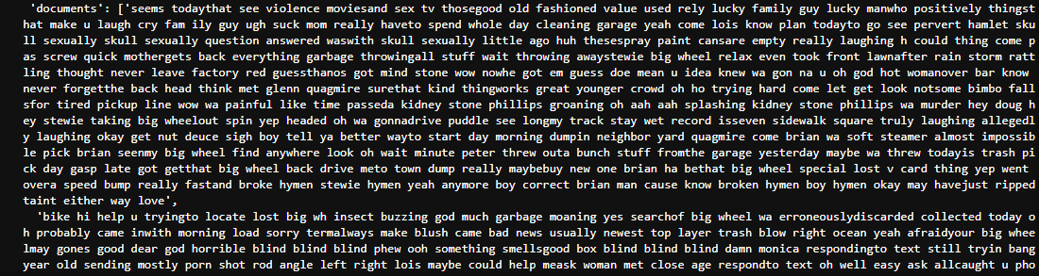
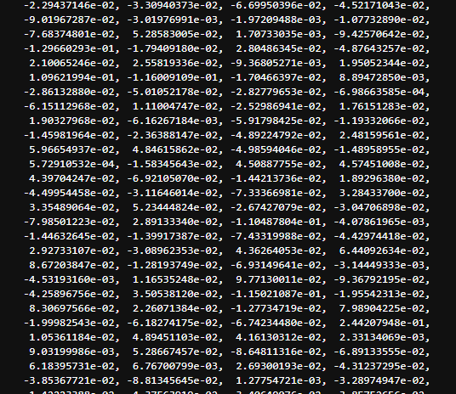
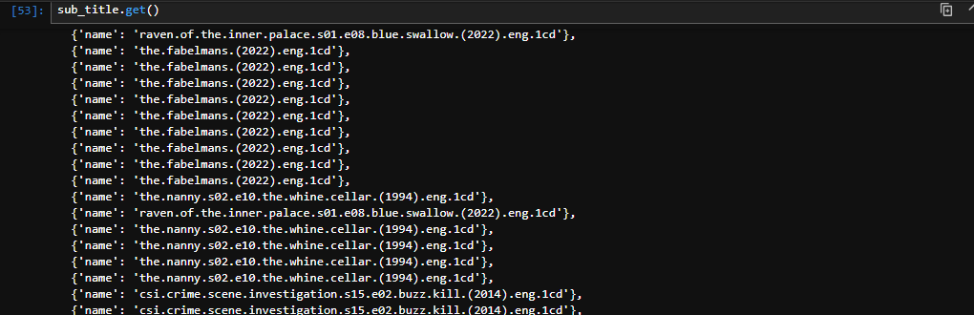
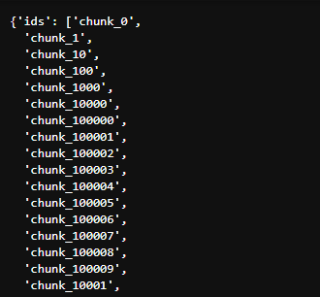

Slide 15
RETRIEVING
For document retrieval, the following steps are executed:
1. Receive the user's search query.
2. Preprocess the query if necessary, ensuring consistency with the document data.
3. Generate a query embedding using appropriate techniques like BERT-based Sentence Transformers.
4. Utilize cosine distance to compute the similarity score between the query embedding and embeddings of documents in the database.
5. Leverage cosine similarity scores to rank and retrieve the most relevant candidate documents according to the user's search query, ensuring optimal search result relevance and accuracy.

Slide 16
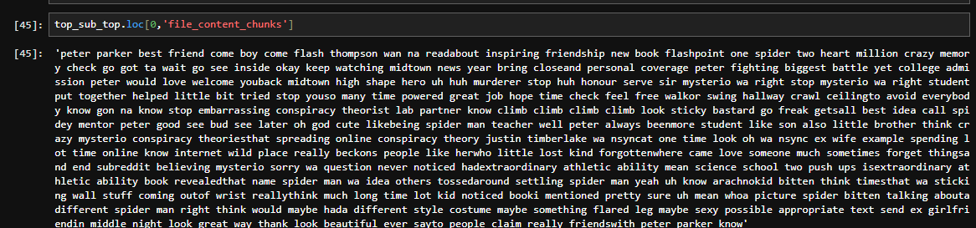

Slide 17
WEB APPLICATION
Create a Streamlit Application which Takes User’s Input
After Click on the submit button which will redirected to a page where all the top 10 Subtitled movies with Subtitles

Slide 18
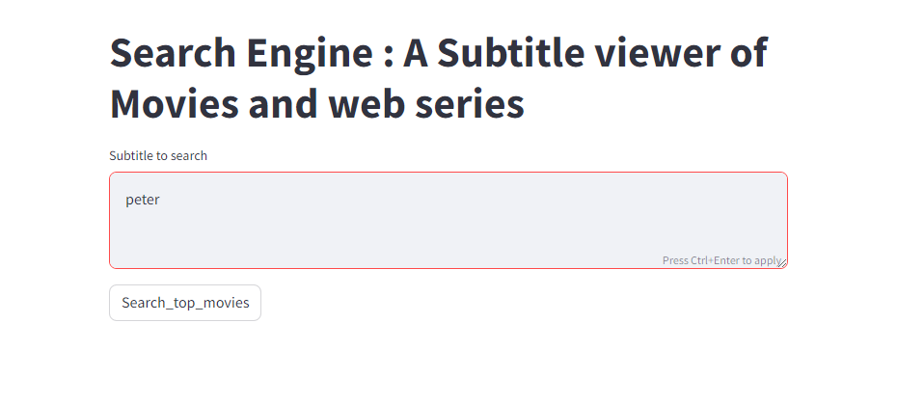
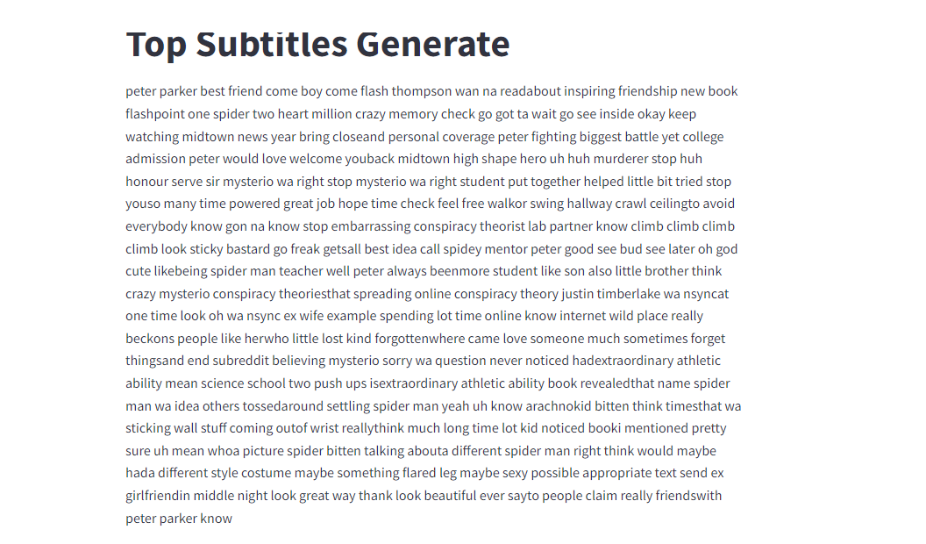
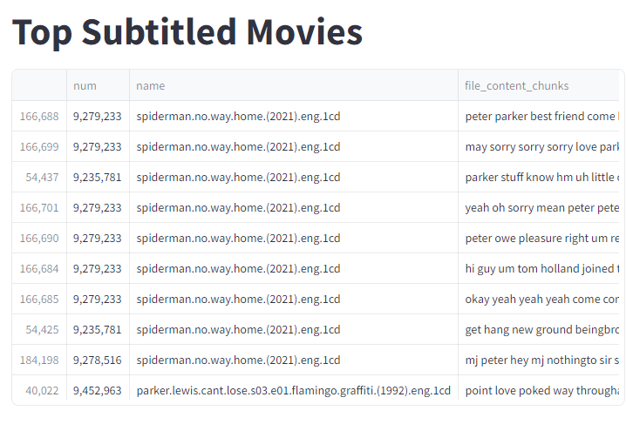

Slide 19

THANK YOU

