Slide 1
PROJECT NAME:
Sentiment Analysis: Leveraging ML flow for Experiment Tracking and Model Management, and Prefect for Workflow Orchestration in Analyzing Flipkart Product Reviews.
Presented By
G . Prashanth

Slide 2

OBJECTIVE OF THE PROJECT
Theobjectiveof thisproject is to introduce MLflowfor experimenttracking, model management, and reproducibility in machine learning projects forthe Sentimental Analysis Project.

Slide 3
ML FLOW
Mlflowis an open-source platform designed to manage the complete machine learning lifecycle.
It encompasses experiment tracking, reproducibility, model management ,and deployment.
Mlflow provides a unified interface that allows data scientists and machine learning engineers toeasilytrack experiments,collaborate on projects and reproduce results.
With Mlflow, we can effectivelymanage ML workflows, track model versions ,and deploy models to production environments seamlessly.
KEY FEATURES:
Experiment Tracking
Model Management
Deployment

Slide 4
ACCESSING THE MLFLOW DASHBOARD:
The code snippet is essential for Integrating Mlflow into our workflow, facilitating efficient management of machinelearning tasks.
!pip install mlflow import mlflow
mlflow.set_experiment("FILPKART_PRODUCT_REVIEWS_PREDICTION") mlflow.sklearn.autolog(max_tuning_runs=None)
with mlflow.start_run() as run:
%time grid_search.fit(X_train, y_train)

Slide 5
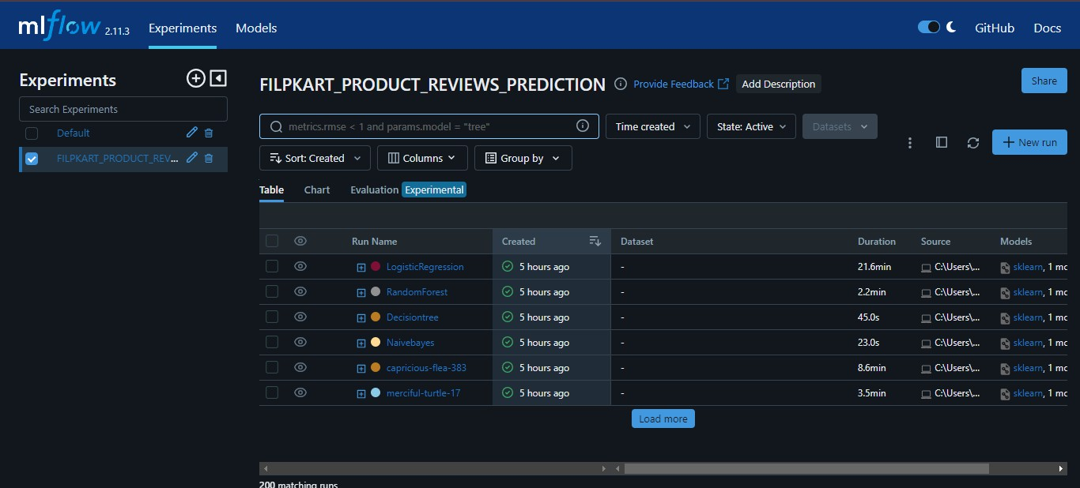
ML FLOW DASHBOARD:

Slide 6
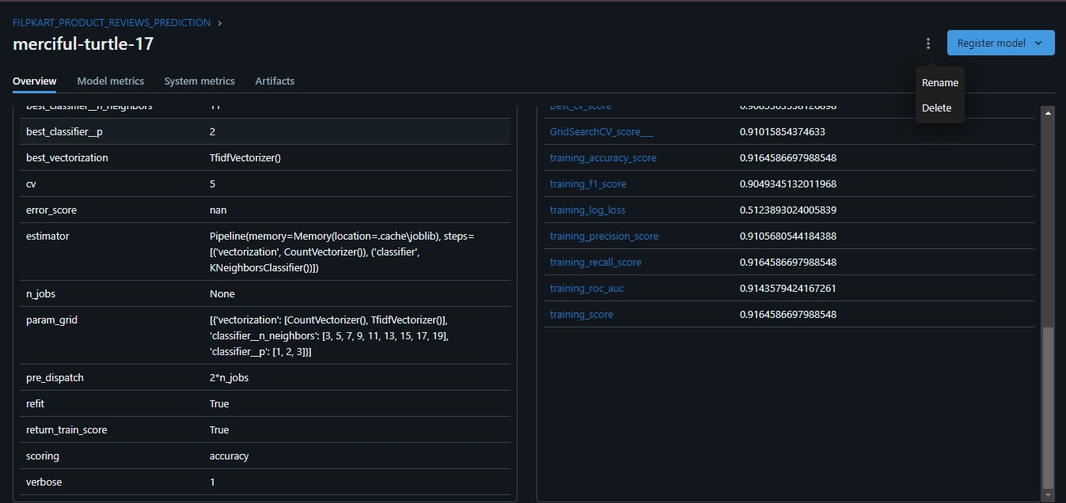
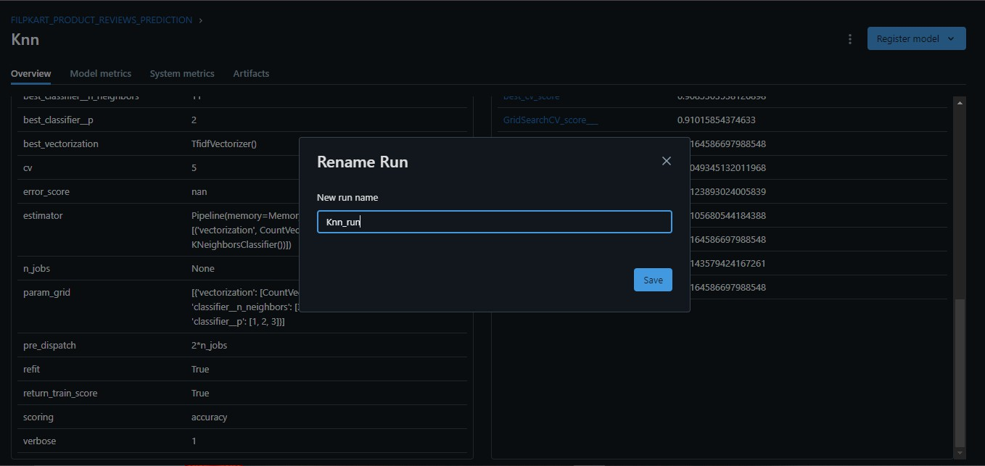
CUSTOMIZING MLFLOW UI WITH RUN NAMES:.
Renaming the run names with the appropriate model name using the Mlflowdashboard‘s interface.

Slide 7
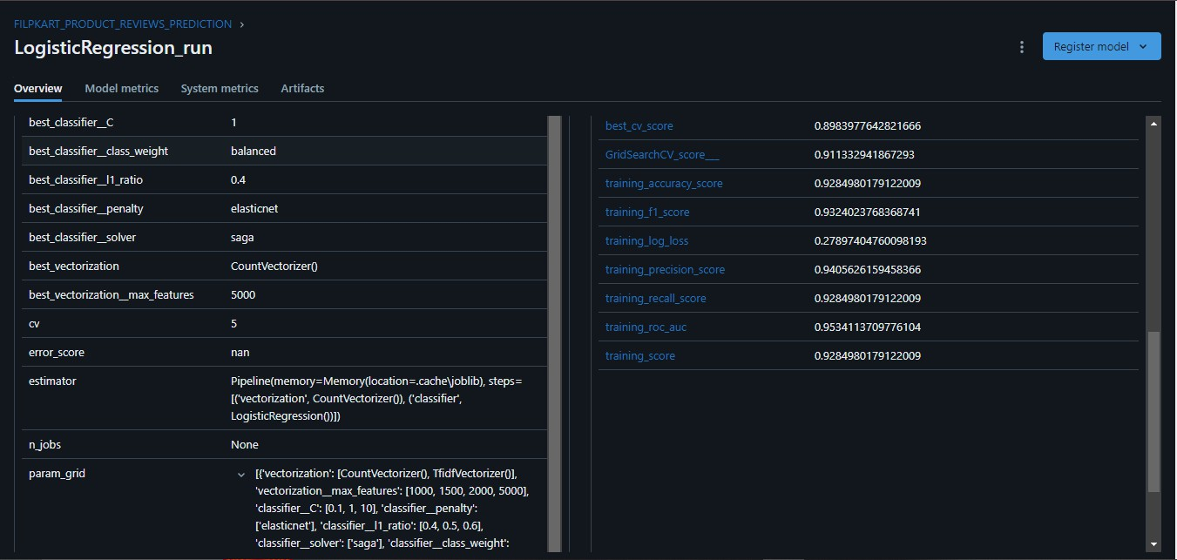
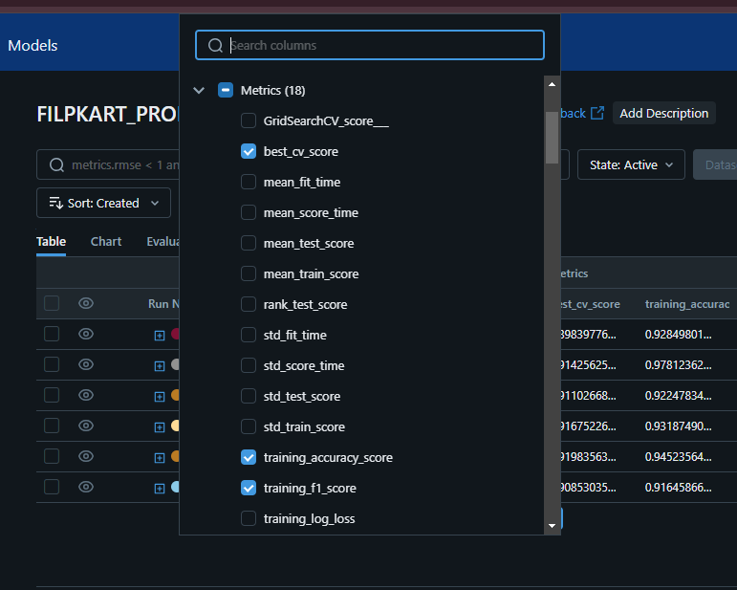
DEMONSTRATION OF THE LOG PARAMETERS, METRICS, AND ARTIFACTS USING MLFLOW TRACKING APIS.
Click 'Overview' in the MLflow dashboard for detailed hyperparameter info and best settings. It also shows model scores, aiding performance evaluation.
To identify the appropriate values of each model's parameters, select the 'Columns' option within the MLflow dashboard.

Slide 8
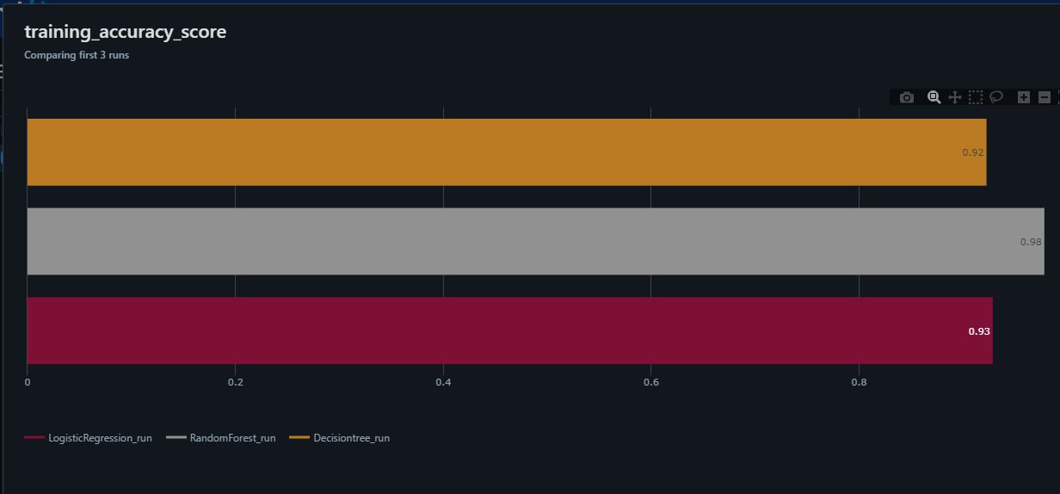
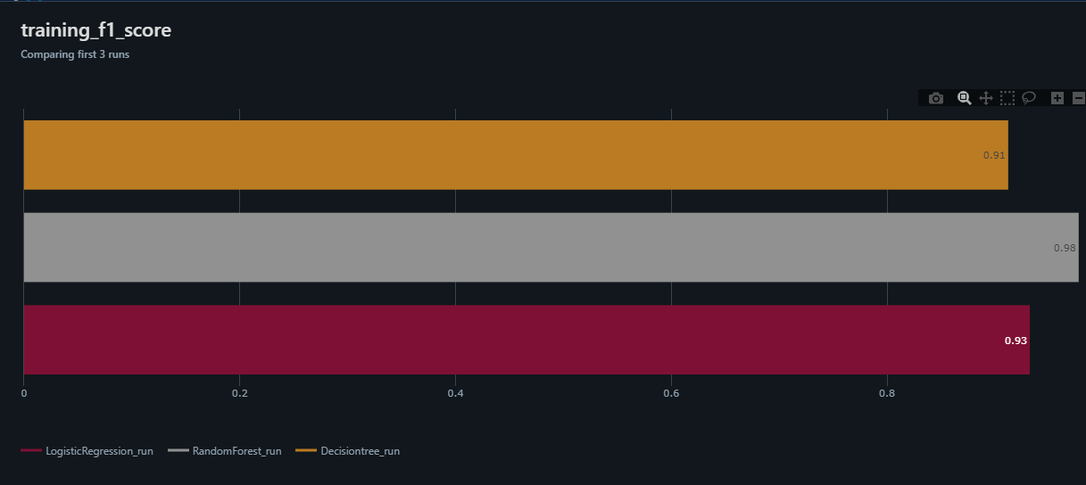
DEMONSTRATION OF METRIC PLOTS:
To access metric plots, click on the 'Charts' option in the MLflow dashboard. MLflow provides default metric plots, but we can also create custom plots for further analysis and visualization.

Slide 9
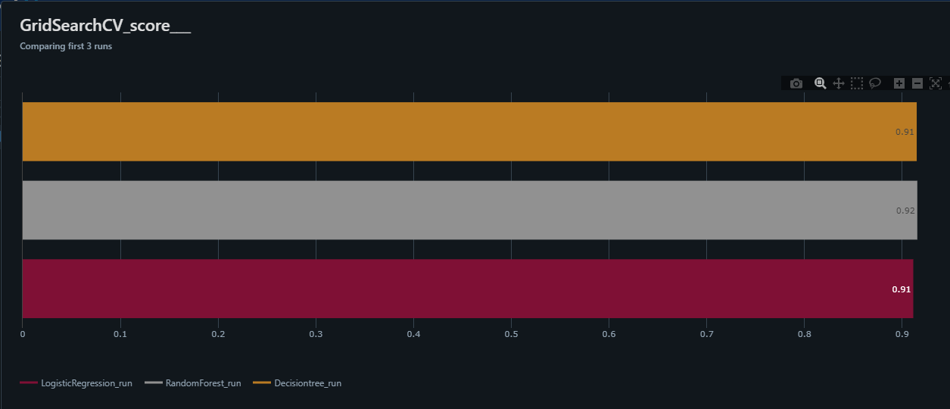
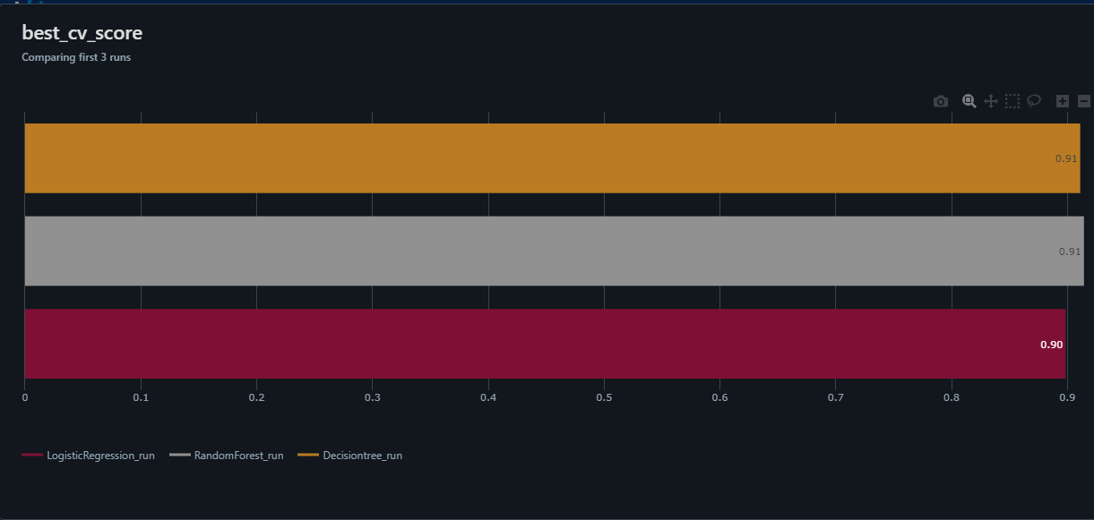

Slide 10
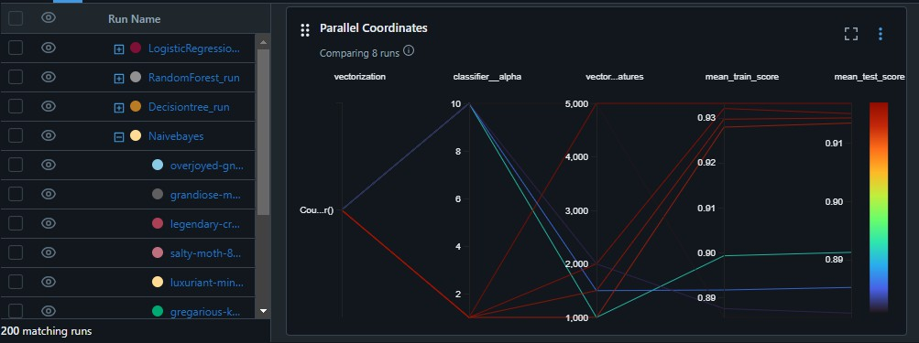
DEMONSTRATION OF HYPERPARAMETER PLOTS:
To plot hyperparameters, add a new section and select the 'Parallel Coordinates' plot option in the MLflow dashboard. A popup box will appear to select the appropriate hyperparameters. Once selected, the parallel coordinatesplotvisualizesthe hyperparameter interactionsand theirimpacton modelperformance.

Slide 11
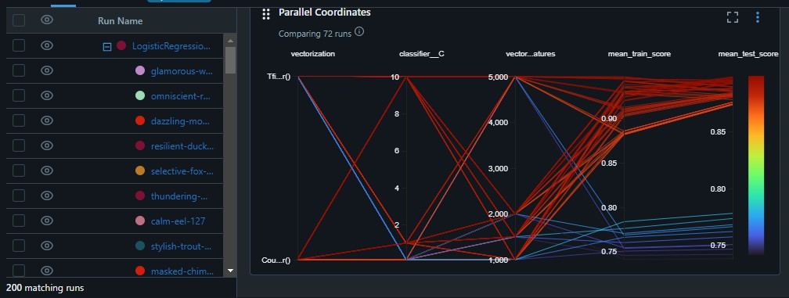
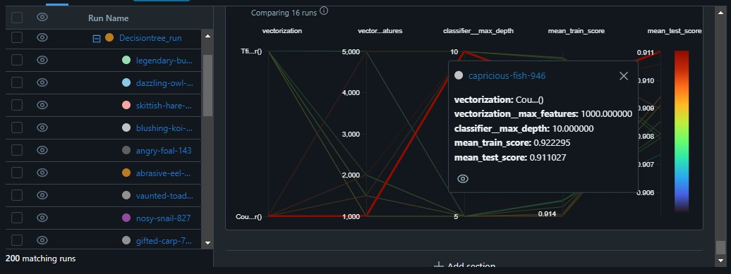

Slide 12
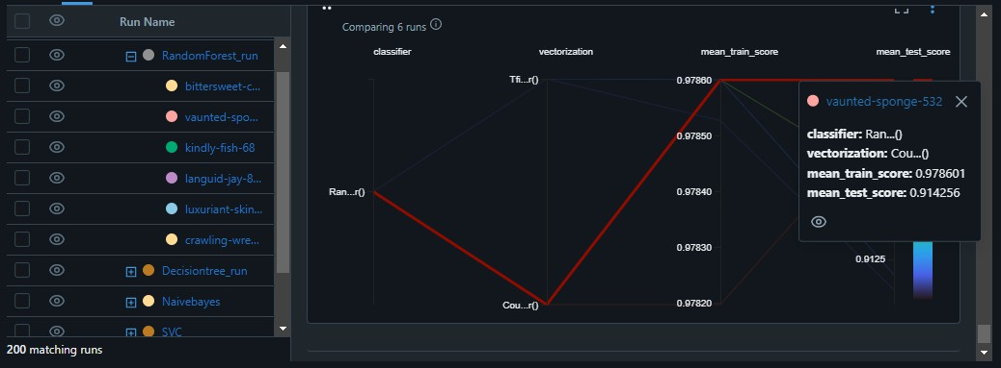

Slide 13
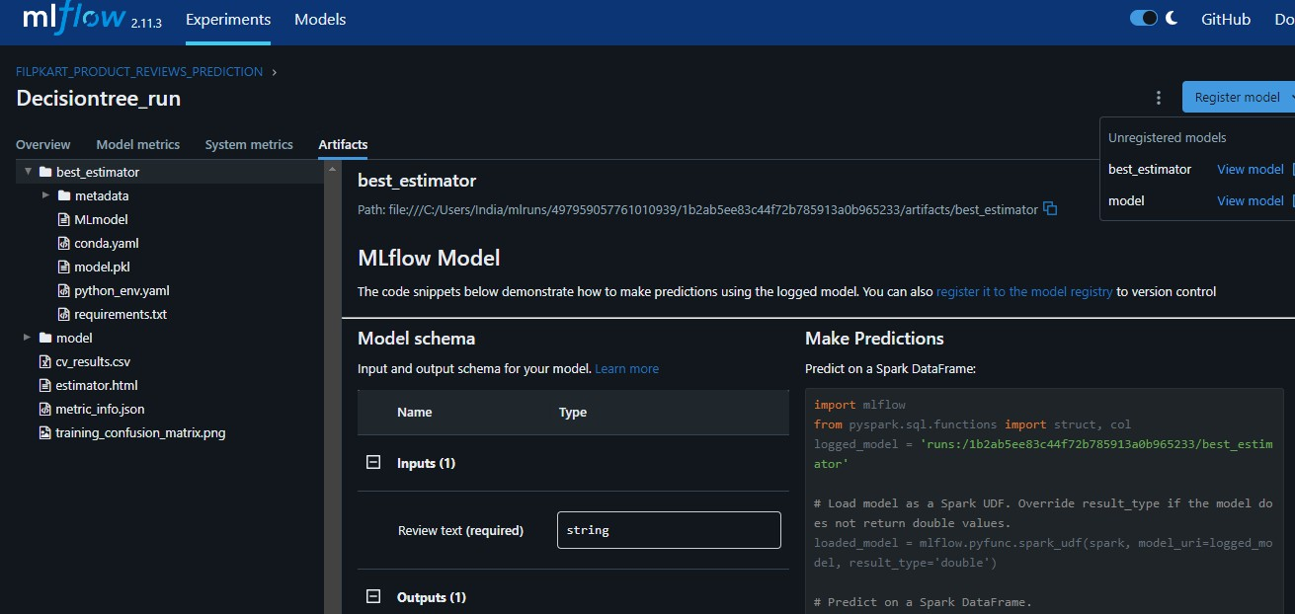
REGISTERING MODELS AND MANAGING WITH TAGS:
Registering a model in MLflow involves saving a trained machine learning model along with its metadata (such as version, parameters, metrics, etc.). This allows for easy management of machine learning models. When a model is registered, it becomes accessible through the MLflow dashboard and can be deployedto variousenvironmentsforinferenceor productionuse.

Slide 14
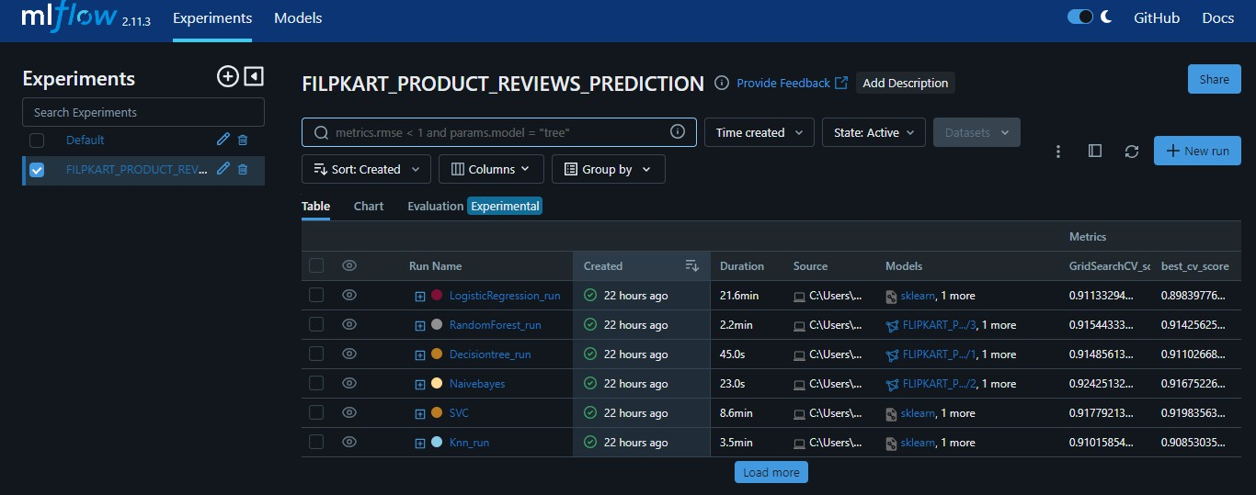
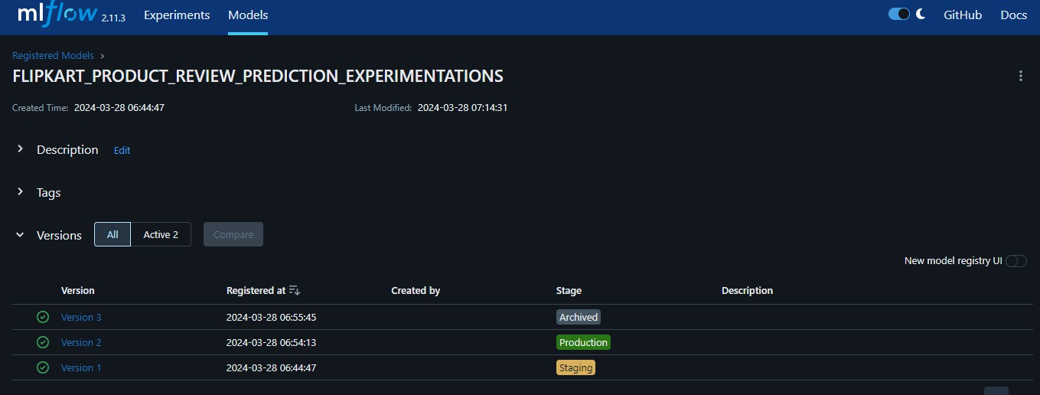

Slide 15
When comparing tree models (Decision Tree and Random Forest) with Naive Bayes, all three models exhibit good train and test scores. However, for the production stage, it's crucial to consider not just performance but also computational efficiency. In this case, Naive Bayes stands out as the model that has run in less time during training and inference, making it a suitable choice for the production stage. Its efficient computation can lead to faster deployment and real-time inference, ensuring optimal performance in production environments.

Slide 16
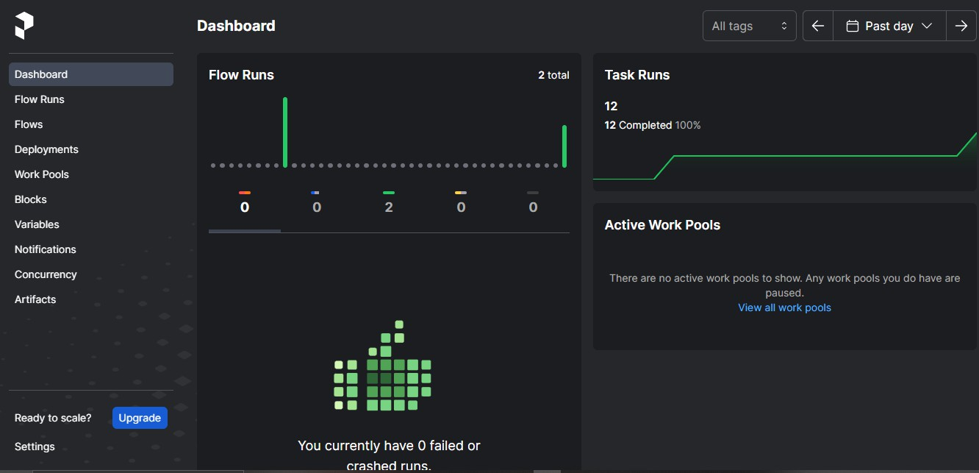
We can check out the dashboard at http://127.0.0.1:4200
This link allows us to access the Prefect dashboard.

Slide 17
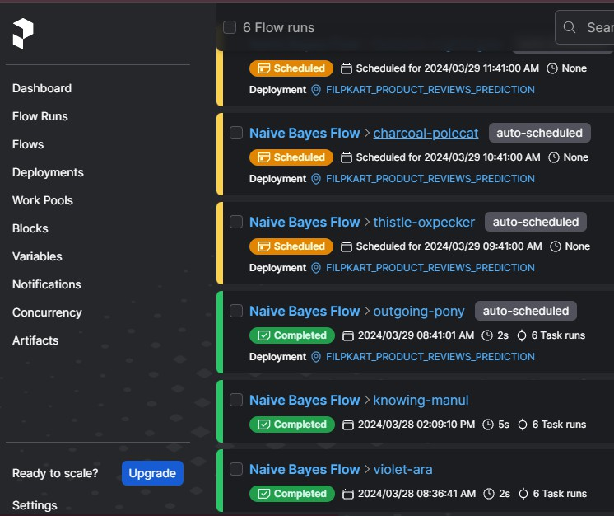
A list of Prefect runs sorted from newest to oldest. Each run is associated with a Naive Bayes Flow and has been auto-scheduled for deployment. The runs are scheduled at specific times, with the latest run scheduled for the future. The 'Completed' runs show the date and time of completion, along with the duration and number of task runs associated with each flow. The runs provide insights into the execution status and performance of the Naive Bayes Flow in processing Flipkart product reviews prediction tasks.

Slide 18
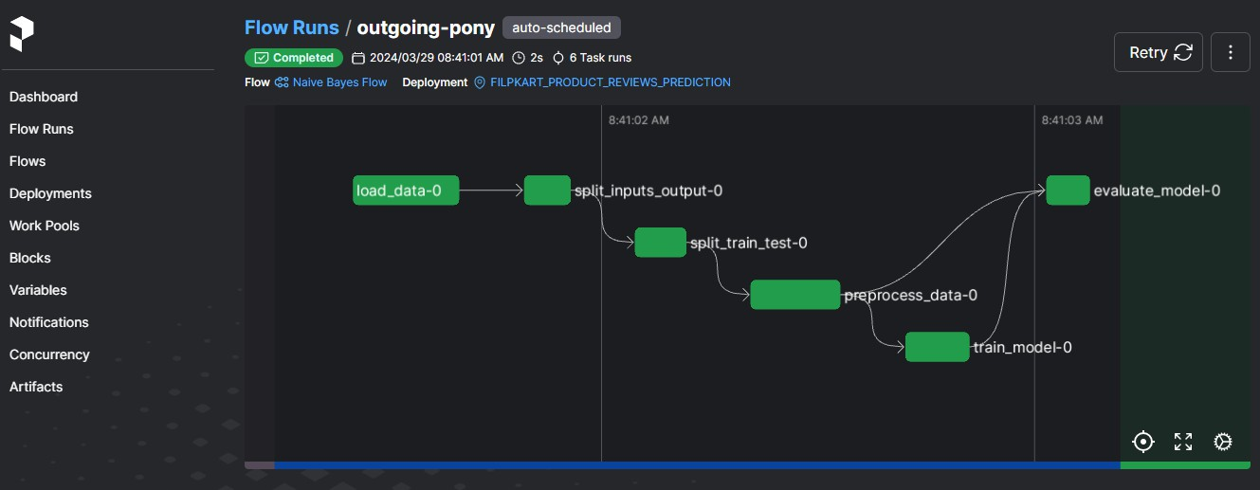
PREFECT-WORKFLOW

Slide 19
THANK YOU

