Slide 1

The K-Anonymity problem
Project by:
G.Raghava (212IS009)
M.Tech First Year (CSIS)
Computer Science and Engineering Department

Slide 2
Background
Large amount of person-specific data has been collected in recent years
Both by governments and by private entities
Data and knowledge extracted by data mining techniques represent a key asset to the society
Analyzing trends and patterns.
Formulating public policies
Laws and regulations require that some collected data must be made public
For example, Census data

Slide 3
Problem Statement
K-anonymity is a model requires that each record is identical to at least k − 1 other records in the anonymized dataset with respect to a set of privacy related attributes. Although it is easy to anonymize the original dataset to satisfy the requirement of k-anonymity, it is important to ensure that the anonymized dataset should preserve as much information as possible of the original dataset. To minimize the information loss due to anonymization, it is crucial to group similar data together and then anonymize each group individually.

Slide 4
What About Privacy?
First thought: anonymize the data
How?
Remove “personally identifying information” (PII)
Name, Social Security number, phone number, email, address… what else?
Anything that identifies the person directly
Is this enough?

Slide 5
Re-identification by Linking
Microdata
Voter registration data
ID
Name
Alice
Betty
Charles
David
Emily
Fred
QID |  |  | SA
Zipcode | Age | Sex | Disease
47677 | 29 | F | Ovarian Cancer
47602 | 22 | F | Ovarian Cancer
47678 | 27 | M | Prostate Cancer
47905 | 43 | M | Flu
47909 | 52 | F | Heart Disease
47906 | 47 | M | Heart Disease
Name | Zipcode | Age | Sex
Alice | 47677 | 29 | F
Bob | 47983 | 65 | M
Carol | 47677 | 22 | F
Dan | 47532 | 23 | M
Ellen | 46789 | 43 | F

Slide 6
Quasi-Identifiers
Key attributes
Name, address, phone number - uniquely identifying!
Always removed before release
Quasi-identifiers
(5-digit ZIP code, birth date, gender) uniquely identify 87% of the population in the U.S.
Can be used for linking anonymized dataset with other datasets

Slide 7
Classification of Attributes
Sensitive attributes
Medical records, salaries, etc.
These attributes is what the researchers need, so they are always released directly
Key Attribute
Quasi-identifier
Sensitive attribute
Name | DOB | Gender | Zipcode | Disease
Andre | 1/21/76 | Male | 53715 | Heart Disease
Beth | 4/13/86 | Female | 53715 | Hepatitis
Carol | 2/28/76 | Male | 53703 | Brochitis
Dan | 1/21/76 | Male | 53703 | Broken Arm
Ellen | 4/13/86 | Female | 53706 | Flu
Eric | 2/28/76 | Female | 53706 | Hang Nail

Slide 8
Project Requirements
Memory(RAM) – 4 Gigabyte
Processor – Intel / AMD
Architecture = 32(x86) bit or 64(x64) bit
Number of processors = 1
Operating System/Platform - Windows
Programming language -Python
Collected Data → http://archive.ics.uci.edu/ml/datasets/Adult

Slide 9
K-Anonymity: Intuition
The information for each person contained in the released table cannot be distinguished from at least k-1 individuals whose information also appears in the release
Example: you try to identify a man in the released table, but the only information you have is his birth date and gender. There are k men in the table with the same birth date and gender.
Any quasi-identifier present in the released table must appear in at least k records

Slide 10

K-Anonymity Protection Model
Private table
Released table: RT
Attributes: A₁, A₂, …, A_{n}
Quasi-identifier subset: A_{i}, …, A_{j}

Slide 11
Generalization
Goal of k-Anonymity
Each record is indistinguishable from at least k-1 other records
These k records form an equivalence class
Generalization: replace quasi-identifiers with less specific, but semantically consistent values
476**
2*
*
47677
47602
47678
29
22
27
Male
Female
ZIP code
Age
Sex

Slide 12
Achieving k-Anonymity
Generalization
Replace specific quasi-identifiers with less specific values until get k identical values
Partition ordered-value domains into intervals
Suppression
When generalization causes too much information loss
This is common with “outliers”

Slide 13
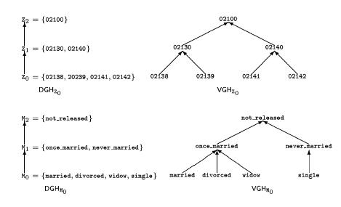
Generalization in Action

Slide 14
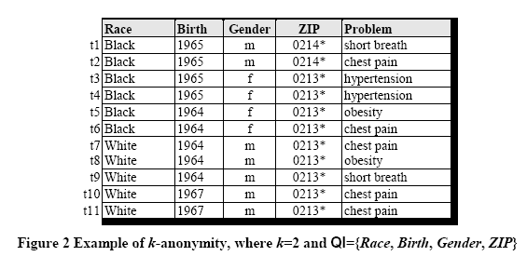
Example of a k-Anonymous Table

Slide 15
Example of Generalization (1)
Released table
External data Source
Name | Birth | Gender | ZIP | Race
Andre | 1964 | m | 02135 | White
Beth | 1964 | f | 55410 | Black
Carol | 1964 | f | 90210 | White
Dan | 1967 | m | 02174 | White
Ellen | 1968 | f | 02237 | White
By linking these 2 tables, you still don’t learn Andre’s problem

Slide 16
Example of Generalization (2)
Microdata
Generalized table
QID |  |  | SA
Zipcode | Age | Sex | Disease
47677 | 29 | F | Ovarian Cancer
47602 | 22 | F | Ovarian Cancer
47678 | 27 | M | Prostate Cancer
47905 | 43 | M | Flu
47909 | 52 | F | Heart Disease
47906 | 47 | M | Heart Disease
QID |  |  | SA
Zipcode | Age | Sex | Disease
476** 476** 476** | 2* 2* 2* | * * * | Ovarian Cancer Ovarian Cancer Prostate Cancer
4790* 4790* 4790* | [43,52] [43,52] [43,52] | * * * | Flu Heart Disease Heart Disease
!!
Released table is 3-anonymous
If the adversary knows Alice’s quasi-identifier (47677, 29, F), he still does not know which of the first 3 records corresponds to Alice’s record

Slide 17
Attacks on k-Anonymity
k-Anonymity does not provide privacy if
Sensitive values in an equivalence class lack diversity
The attacker has background knowledge
A 3-anonymous patient table
Homogeneity attack
Zipcode | Age | Disease
476** | 2* | Heart Disease
476** | 2* | Heart Disease
476** | 2* | Heart Disease
4790* | ≥40 | Flu
4790* | ≥40 | Heart Disease
4790* | ≥40 | Cancer
476** | 3* | Heart Disease
476** | 3* | Cancer
476** | 3* | Cancer
Bob
Zipcode | Age
47678 | 27
Background knowledge attack
Carl
Zipcode | Age
47673 | 36

Slide 18
Objective
The main objective is providing security to data without losing its privacy and also not damaging the utility (ease of use) nature of that data.

Slide 19
Our approach towards K-anonymity
To overcome these types of attacks and achieve a good trade off between utility and privacy we came up with the idea of using graph theory to solve this k-anonymity problem with a heuristic algorithm.
The algorithm is scalable for data set with more no.of records or even dimensions.

Slide 20
Anonymization & Clustering
Key Idea: k-anonymization => clustering problem
What is clustering?
->It is the problem of partitioning a set of objects into groups such that objects in the same group are more similar to each other than objects in other groups.
Optimal solution of the k-anonymization problem:
Each cluster should contain at least k records. This clustering problem is called k-member clustering problem.

Slide 21
K-Member Clustering Problem
Find a set of clusters from a given set of n records.
Each cluster -> at least k (k<=n) data points.
The sum of all intra-cluster distances is minimised
It captures the total information loss, which is the amount of data distortion caused due to the generalization.
we apply Elbow Method to find the Number of Optimal Clusters.

Slide 22
Implementation of k-Anonymity
We explored "Mondrian" algorithm, which uses a greedy search algorithm to partition the original data into smaller and smaller groups (if we plot the resulting partition boundaries in 2D they resemble the pictures by Piet Mondrian, hence the name).
Anonymization of sensitive Quasi- Identifiers for l-Diversity.

Slide 23


