Slide 1
HAWK HTML is All We Know
Jon Adelson, Ethan Benjamin, Justin Chang, Graham Gobieski, George Yu

Slide 2
Overview
Imperative Language
Pattern-action structure based on AWK
Handles CSS selectors and Regex for patterns
Full type inference

Slide 3
Tutorial
Compile source code: make
To run tests: make test
Write HAWK: *.hk
To Compile a Program: ./hawk <program-name> > Program.java
To Run a Program: javac Program.java && java -cp ./_hawk_lib/jsoup.jar: Program <args>

Slide 4
Demo

Slide 5
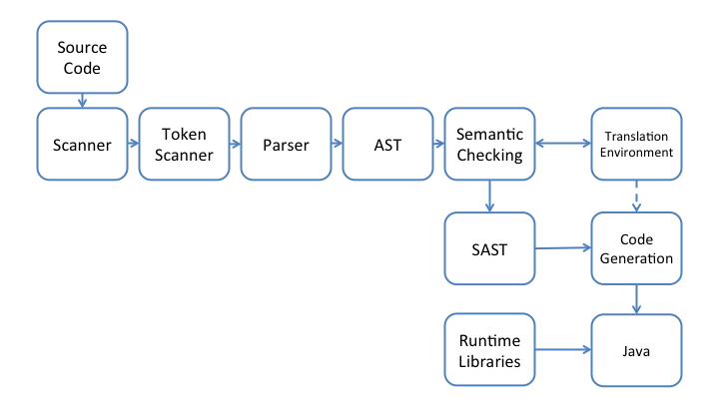
Language Implementation

Slide 6
Lessons Learned
Start early!
Know OCaml
Weekly group work sessions increase productivity

