Slide 1
Scalar Execution
Baseline Vector Execution
Fetch
Fetch
Decode
Decode
Vector Register
File
Execute
Execute
Vector
Instructions
Spin on Execute
Scalar Core
MANIC
Forwarded Value
Eliminate VRF Reads
v0 = vload(addr)
v0
Fetch
v0
v1 = v2 * v3
v1
v1
Decode
v2 = v1 + v0.k
Execute
Killed Registers
Eliminate VRF Writes
Index 0
Index 1
Vector Data-Flow Execution
Vector Register
File

Slide 2
Fetch
Renaming Table
MANIC Vector Unit
Decode
v0 | F
v1 | F
Execute
Issue Logic
Dotted –
Stateful elements
Main
Memory
Scalar Core
Cache
Data-flow
Forwarding
Buffer
Control-flow
VRF
op | dest | src1 | src2
vload | F1 | F0 | -
vadd | v2 | v0 | F1
Compute
Instruction
Buffer

Slide 3
Time/Cycles
Scalar
Iteration 1
Iteration 2
Iteration 3
r0 = load a[0]
r1 = r2 * r3
r2 = r1 + r0
Iter 1
Fetch: mul
Fetch: mul
Fetch: mul
Decode: add
Decode: add
Decode: add
…
r0 = load a[1]
r1 = r2 * r3
r2 = r1 + r0
Iter 2
Execute: load
Execute: load
Execute: load
…
All Iterations: execute vector load
All Iterations: execute vector add
Baseline Vector
Fetch: mul
Fetch: mul
Fetch
Fetch
v0 = vload a
v1 = v2 * v3
v2 = v1 + v0
…
…
…
Decode: add
Decode: add
Decode: mul
Decode: mul
Execute: load
Execute: load
Execute: add
Execute: add
MANIC
All Iterations
v0 = vload a
v1 = v2 * v3
v2 = v1 + v0.k
Index 0
Index 1
Index 2
v0[0] = load a[0]
v0[1] = load a[1]
v0[2] = load a[2]
Forward Values
Eliminate VRF Reads
v1[0] = v2[0] + v3[0]
v1[1] = v2[1] + v3[1]
v1[2] = v2[2] + v3[2]
…
v2[0] = v1[0] + v0[0]
Killed Registers
Eliminate VRF Writes
v2[1] = v1[1] + v0[1]
v2[2] = v1[2] + v0[2]

Slide 4
register
I0
register
I1
register
I2
register

Slide 5
Vector Register
I0:
v[0]
v[1]
v[2]
v[3]
Vector Register
I1:
v[0]
v[1]
v[2]
v[3]
Vector Register
I2:
v[0]
v[1]
v[2]
v[3]
Vector Register

Slide 6
Vector Register
I0:
v[0]
v[1]
v[2]
v[3]
I1:
v[0]
v[1]
v[2]
v[3]
I2:
v[0]
v[1]
v[2]
v[3]
…
…
…
…
Vector Register

Slide 7
Data-Flow
Code
a
Instruction Buffer
Renaming
Table
v2
v3
I0: v0 = vload &a
I1: v1 = v2 × v3.k
I2: v2 = v1 + v0.k
ld
I0: F0 = vload &a
×
v0 | F0, K
v1 | F1
v2 | VRF
v3 | -
I1: F1 = v2 × v3.k
+
I1: v2 = F1 + F0.k
Cache
a[0]
a[1]
I0:
ld[0]
ld[1]
Forwarding Buffer
Forwarding Buffer
I1:
F0
×[0]
v0
F0
×[1]
v0
Forwarding Buffer
Forwarding Buffer
Forwarding eliminates RF reads
F1
F1
F1
F1
I2:
F0
+[0]
v0
v1
F0
+[1]
v0
v1
Forwarding Buffer
Forwarding Buffer
v2
v2
Vector Register File
Dead values
eliminate RF writes

Slide 8
Xdata Buffer
I0: v0 = vload &a
I1: v1 = v2 × v3.k
I2: v2 = v1 + v0.k
Renaming
Table
Code
v0 | F0, K
v1 | F1
v2 | VRF
v3 | -
Data-Flow
a
v2
v3
ld
I0: F0 = vload &a
×
I1: F1 = v2 × v3.k
+
I1: v2 = F1 + F0.k
Instruction Buffer

Slide 9
Cache
a[0]
a[1]
I0:
ld[0]
ld[1]
Forwarding Buffer
Forwarding Buffer
I1:
F0
×[0]
v0
F0
×[1]
v0
Forwarding Buffer
Forwarding Buffer
F1
F1
F1
F1
I2:
F0
+[0]
v0
v1
F0
+[1]
v0
v1
Forwarding Buffer
Forwarding Buffer
v2
v2
Forwarding eliminates RF reads
Vector Register File
Dead values
eliminate RF writes

Slide 10
ASIC
ELM
Ideal
MANIC
Energy-
Efficiency
Classic Vector
Better
COTS MCU
Ease of Programming

Slide 11
Fetch
Renaming Table
MANIC Vector Unit
Decode
v0 | F
v1 | F
Dotted –
Stateful elements
Execute
Issue Logic
Main
Memory
Scalar Core
Data-flow
Cache
Control-flow
Forwarding
Buffer
Xdata
Buffer
VRF
op | dest | src1 | src2
vload | F1 | F0 | -
vadd | v2 | v0 | F1
Compute
Instruction Buffer

Slide 12
I0: v0 = vload &a
I1: v1 = v2 × v3.k
I2: v2 = v1 + v0.k
Xdata Buffer: idx 0
Rename Table
Insn Buffer
Code
Reg | Name | Insn Idx | F | K
v0 |  | 0 | 1 | 1
v1 |  | 1 | 1 | -
v2 |  | 2 | - | -
v3 | - | - | - | 1
Data-Flow
a
…
Opcode | VD | FD | VS1 | FS1 | VS2 | FS2 | Xdata idx
load | - | F0 | - | - | - | - | 0
mul | v1 | F1 | v2 | - | v3 | - | -
add | v2 | - | - | F1 | - | F0 | -
v2
v3
v0
F0
ld
v1
F1
×
v2
+

Slide 13
Decode & Rename
Execute
Rename
Scalar
Core
Vissue
VGate
VExecute
v0 | f0
v1 | f2
v2 | f1
v5 | f3
0
MUX
Mul
×
VMemory
VWriteback
VDecoder
Insn index
+1
MUX
MUX
Data
0
ALU
MUX
Vector index
+1
MUX
Insn Buffer
MUX
Address
4KB
VRF
16B
4KB
Forwarding Buffer
4KB D$

Slide 14

SRAM
Caches
MRAM
MANIC
Scalar

Slide 15
RISC-V
Scalar Core
Minergy
I2C
Arbiter
4KB
IO Bus
2KB
I$
4KB D$
GPIO
Arbiter
VRF
Boot ROM
64KB
SRAM
256KB
MRAM
Main
Memory

Slide 16
Vector
MANIC
RISC-V
Scalar Core
Vector
RISC-V
Scalar Core
MANIC
I2C
Arbiter
4KB
4KB
I2C
Arbiter
4KB
VRF
IO Bus
2KB
I$
4KB D$
IO Bus
2KB
I$
4KB D$
GPIO
Arbiter
VRF
GPIO
Arbiter
Boot ROM
64KB
SRAM
256KB
MRAM
Boot ROM
64KB
SRAM
256KB
MRAM
Main
Memory
Main
Memory

Slide 17
Vector
MANIC
VIssue
VExecute
VWriteback
Rename
Scalar
Core
Scalar
Core
VDecoder
v0 | f0
v1 | f2
v2 | f1
v5 | f3
VDecoder
MUX
ALU
Decode & Rename
Vector index
0
MUX
MUX
+1
MUX
4KB
VRF
4KB D$
Insn Buffer
4KB
Vissue
VGate
VExecute
VMemory
Insn index
0
MUX
Mul
×
VWriteback
+1
MUX
ALU
MUX
Data
Execute
Vector index
0
MUX
+1
MUX
MUX
4KB
VRF
16B
Address
4KB
Forwarding Buffer
4KB D$

Slide 18
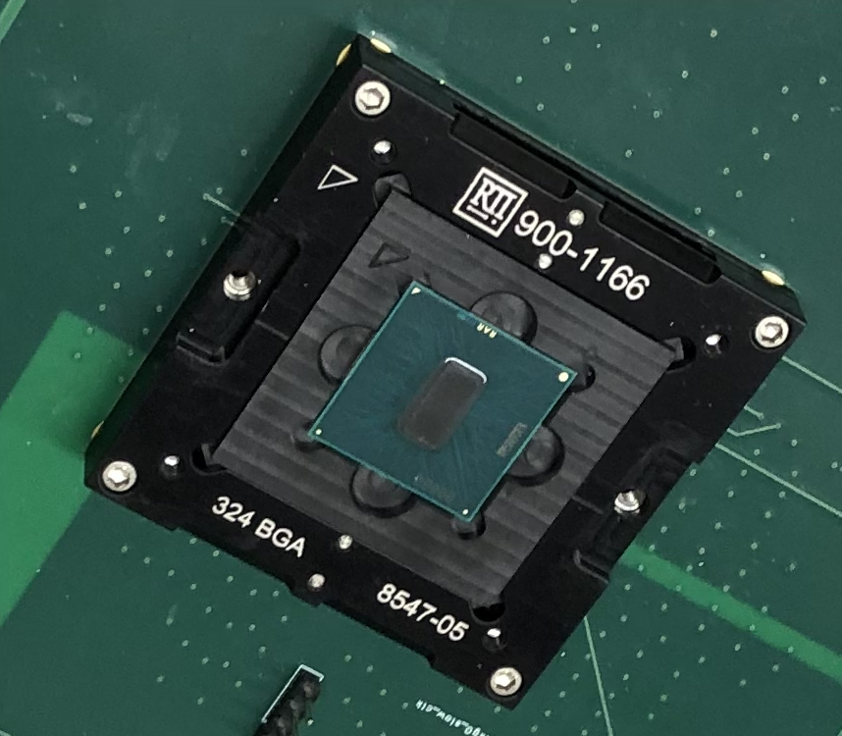

Slide 19
Core
Core
Vector
Core
MANIC
Core
Accel
Core
Vector
VRF
$
IO
$
IO
$
IO
$
IO
$
IO
Main
memory
Main
memory
Main
memory
Main
memory
Main
memory
Scalar
Vector
MANIC
Accelerator
FFT, Sort, DConv
Vector w/
custom VRF
Top-level control

Slide 20
Decode & Rename
Execute
Rename
Scalar
Core
Vissue
VGate
VExecute
v0 | f0
v1 | f1
v2 | f2
v5 | f5
0
MUX
Mul
×
VMemory
VWriteback
VDecoder
Insn index
+1
MUX
MUX
Data
xdata
0
Xdata
buffer
ALU
MUX
op dst src1 src2
Vector index
MUX
D&R
vload F1 F0 -
+1
MUX
Address
vmul v2 v0 F1
4KB
VRF
16B
Insn Buffer
4KB
Forwarding Buffer
4KB D$

Slide 21
Core
Core
Vector
Core
MANIC
RISC-V
Scalar Core
Vector/
MANIC
$
IO
$
IO
$
IO
I2C
Arbiter
4KB
IO Bus
2KB
I$
4KB D$
GPIO
Arbiter
VRF
Main
memory
Main
memory
Main
memory
Boot ROM
64KB
SRAM
256KB
MRAM
Scalar
Vector
MANIC
Main
Memory
Top-level control
Individual design
Test-chip

