Slide 1
performance
Completely different operating domain
Ideal
Existing
CGRAs
ASIC
SNAFU
MANIC
2-3 orders of magnitude
Classic
Vector
COTS
MCU
flexibility
energy
Ideal
Classic
Vector
COTS
MCU
MANIC
SNAFU
Existing
CGRAs
ASIC
energy

Slide 2
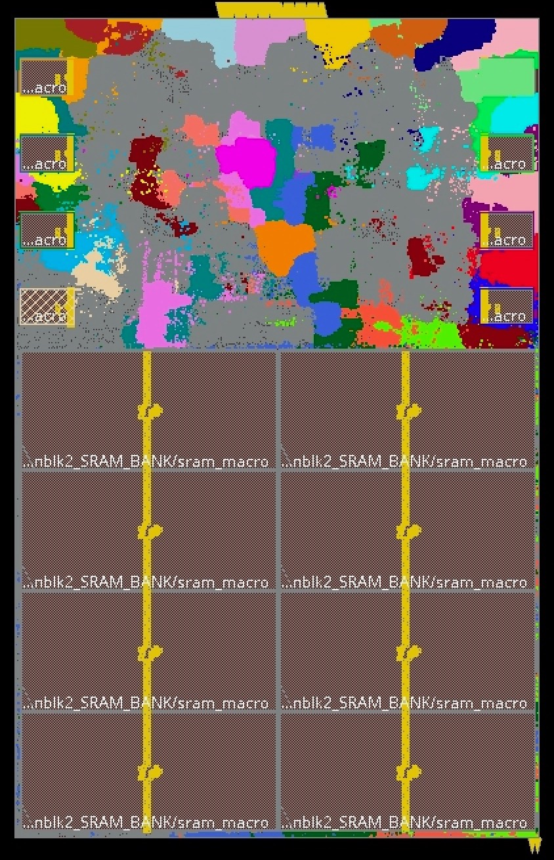
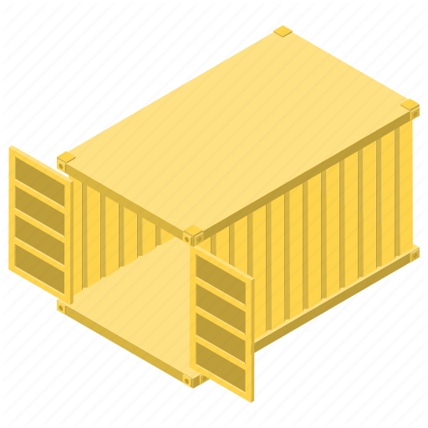
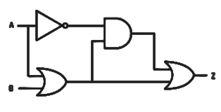
x
+/-
Framework
Generic topology
4
Standard PE Library
Standard
hardware
synthesis
and P&R
Vectorized C/C++ Code
vload v0, &a
vaddi v1, v0, 5
vstore &b, v1
3
module PE
(input clk,
input data);
Vectorized C/C++ Code
RTL
Generation
SystemVerilog
Description
vload v0, &a
vaddi v1, v0, 5
vstore &b, v1
1
Vectorized C/C++ Code
vload v0, &a
vaddi v1, v0, 5
vstore &b, v1
Extract
2
ILP
Synthesis
CGRA topology
Hardware
Library of vectorized kernels
Bring your own functional
unit
Standard
interface
Library of dataflow
graphs
Compilation
Your logic
Vectorized C/C++ Code
5
6
vload v0, &a
vaddi v1, v0, 5
vstore &b, v1
Extract
ILP
Scheduler
+
CGRA topology
Dataflow
graph

Slide 3
x
+/-
Framework
Generic topology
4
Standard PE Library
Standard
hardware
synthesis
and P&R
Vectorized C/C++ Code
vload v0, &a
vaddi v1, v0, 5
vstore &b, v1
3
module PE
(input clk,
input data);
Vectorized C/C++ Code
RTL
Generation
SystemVerilog
Description
vload v0, &a
vaddi v1, v0, 5
vstore &b, v1
1
Vectorized C/C++ Code
vload v0, &a
vaddi v1, v0, 5
vstore &b, v1
Extract
2
ILP
Synthesis
CGRA topology
Library of vectorized kernels
Bring your own functional
unit
Standard
interface
Hardware
Library of dataflow
graphs
Your logic

Slide 4
Vectorized C/C++ Code
vload v0, &a
vaddi v1, v0, 5
vstore &b, v1
Extract
CGRA topology
Dataflow
graph
ILP
Scheduler

Slide 5
SNAFU-A
r
r
r
r
r
r
r
r
r
r
r
r
Multi-hop,
bufferless NoC
M
M
M
M
M
M
r
r
r
r
r
r
r
r
r
r
r
r
r
r
r
r
r
r
r
r
r
r
r
r
1KB
S
C
B
B
C
S
1KB
r
r
r
r
r
r
r
r
r
r
r
r
r
r
r
r
r
r
r
r
Control
r
r
r
r
RV32
Scalar
Core
1KB
S
B
B
B
B
S
1KB
r
r
r
r
r
r
r
r
r
r
r
r
r
r
r
r
r
r
r
r
Configurator
r
r
r
r
1KB
S
B
B
B
B
S
1KB
r
r
insn
stream
r
r
r
r
r
r
r
r
r
r
r
r
r
r
r
r
r
r
data
1KB
r
r
r
r
S
C
B
B
C
S
1KB
r
r
r
r
r
r
r
r
r
r
r
r
r
r
r
r
r
r
r
r
r
r
r
r
M
M
M
M
M
M
r
r
r
r
r
r
r
r
r
r
r
r
Main memory
cgra memory interface
M
= Load/store PE
Bank Ctrl
Bank Ctrl
Bank Ctrl
S
= Scratchpad PE
B
= Basic ALU PE
32KB SRAM BANK
32KB SRAM BANK
…
32KB SRAM BANK
= Multiplier PE
C
8 banks = 256KB total memory

Slide 6
Configuration
signals
Handles
variable timing
On-chip
network signals
ien
ipr
oen
cenrow
in
opr
out
cencol
cdata
Control
signals
µcfg
µcore
ucore config
Intermediate buffer(s)
Data buffer
fen
fclear
fdone
Your config
Data buffer
Bufferless input Router
Configurable
number of inputs
ready
done
op
valid
m
d
a
b
z
FU-specific logic
Standardized
Interface
Processing Element

Slide 7
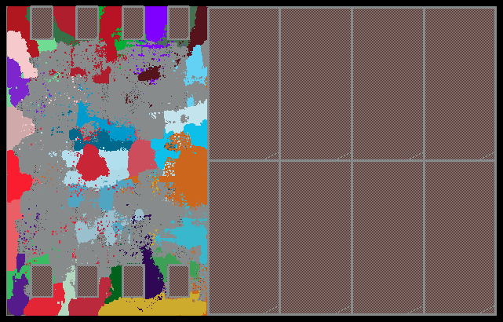
Main memory
Memory control logic
Scalar core
NoC incl. routers
Scratchpad units
Memory units
Basic-ALU units
Multiplier units

Slide 8
fclear
ien
ipr
oen
cenrow
fen
fdone
in
opr
out
cencol
cdata
op_cfg
ucfg
ucore
Input router
xdata
progress
xxdata
a
b
Output router
op
vl
valid
ready
en
z
FU-specific logic
Functional unit

Slide 9
SNAFUGen
Generic topology
Vectorized C/C++ Code
vload v0, &a
vaddi v1, v0, 5
vstore &b, v1
Vectorized C/C++ Code
vload v0, &a
vaddi v1, v0, 5
vstore &b, v1
1
Vectorized C/C++ Code
vload v0, &a
vaddi v1, v0, 5
vstore &b, v1
Extract
2
ILP
Synthesis
CGRA topology
Library of vectorized kernels
Library of dataflow
graphs

Slide 10
Bring your own functional
unit
module PE
(input clk,
input data);
Standard
interface
RTL
Generation
SystemVerilog
Description
Your logic
Synthesis
and P&R
x
+/-
Standard PE Library
Abstract CGRA topology
SNAFU-Arch

Slide 11
SNAFUGen
x
+/-
SNAFUFramework
Generic topology
4
Standard PE Library
Standard
hardware
synthesis
and P&R
Vectorized C/C++ Code
vload v0, &a
vaddi v1, v0, 5
vstore &b, v1
3
module PE
(input clk,
input data);
Vectorized C/C++ Code
RTL
Generation
SystemVerilog
Description
vload v0, &a
vaddi v1, v0, 5
vstore &b, v1
1
Vectorized C/C++ Code
vload v0, &a
vaddi v1, v0, 5
vstore &b, v1
Extract
2
ILP
Synthesis
CGRA topology
Library of vectorized kernels
Bring your own functional
unit
Standard
interface
Hardware
Library of dataflow
graphs
Your logic

Slide 12
1
SNAFUGen
3
C/C++
Code
SNAFUAccel
2
Topology
SNAFUFramework

Slide 13
SNAFU
Abstract
Specification
SNAFU-A
ULP CGRA RTL

Slide 14
Abstract
Specification
SNAFU
ULP CGRA RTL
Hardware

Slide 16
1
SNAFUGen
3
C/C++
Code
SNAFUAccel
2
Topology
SNAFUFramework

Slide 17
2-3 orders of magnitude
<1mW

Slide 18
dot_product():
r
r
r
r
1
2
r
1
r
2
5
r
r
Memory layout
1. vload v0, &a
2. vload v1, &b
3. vmul v2, v0, v1
4. vredsum v3, v2
5. vstore &c, v3
M
M
M
M
r
r
r
r
r
r
r
r
r
r
r
r
Extract
3
Compile
r
r
3
4
a[0]
b[0]
a[1]
b[1]
S
C
B
…
r
r
r
r
r
r
r
r
4
ILP Scheduler
r
S
r
B
…
r
r
r
r
r
Vector assembly
5
S
r
Bank conflict
Active PEs
Memory stall
r
r
0
= token/element #
r
r
r
r
r
r
r
r
r
r
r
r
r
r
r
r
r
r
r
r
r
r
r
r
r
r
r
r
r
r
r
r
r
r
r
r
0
0
1
0
2
1
r
r
r
r
4
3
0
2
5
1
2
5
1
2
5
3
2
2
5
1
M
M
M
M
M
M
M
M
M
M
M
1
2
5
1
Execute
M
M
M
M
M
M
M
M
M
r
r
r
r
r
r
r
r
r
r
r
r
r
r
r
r
r
r
r
r
r
r
r
r
r
r
r
r
r
r
r
r
r
r
r
r
r
r
r
r
r
r
r
r
r
r
r
r
r
r
r
r
r
r
r
r
r
r
r
r
r
r
r
r
r
r
r
r
4
3
4
0
4
r
r
1
0
2
1
3
C
B
3
3
4
3
4
S
C
B
S
S
C
B
S
C
B
S
C
B
…
r
r
…
…
…
…
r
r
r
r
r
r
r
r
r
r
r
r
r
r
r
r
r
r
r
r
r
r
r
r
r
r
r
r
r
r
r
r
r
r
r
r
r
r
r
r
r
r
r
r
r
r
r
S
B
S
B
S
B
S
r
B
S
B
r
Fires as soon inputs ready
r
r
r
r
r
r
r
r
r
r
r
r
r
r
r
r
r
r
r
r
r
r
r
r
r
S
S
S
r
S
r
r
S
r
r
r
r
r
r
r
r
r
r
r
…
Time:
1
2
3
4
5

Slide 19
masked_prodsum():
r
r
r
r
1
2
r
1
r
2
5
r
r
Memory layout
1. vload v1, &a
2. vload v0, &m
3. vmuli v1.m, v1, 5
4. vredsum v3, v1
5. vstore &c, v3
M
M
M
M
r
r
r
r
r
r
r
r
r
r
r
r
Extract
3
Compile
r
r
3
4
a[0]
m[0]
a[1]
m[1]
S
C
B
…
r
r
r
r
r
r
r
r
4
ILP Scheduler
r
S
r
B
…
r
r
r
r
r
Vector Assembly
5
S
r
Bank conflict
m[0]=0, m[1]=1
Active PEs
Memory stall
r
r
0
= token/element #
r
r
r
r
r
r
r
r
r
r
r
r
r
r
r
r
r
r
r
r
r
r
r
r
r
r
r
r
r
r
r
r
r
r
r
r
0
0
1
0
2
1
r
r
r
r
4
3
0
2
5
1
2
5
1
2
5
3
2
2
5
1
M
M
M
M
M
M
M
M
M
M
M
1
2
5
1
Execute
M
M
M
M
M
M
M
M
M
r
r
r
r
r
r
r
r
r
r
r
r
r
r
r
r
r
r
r
r
r
r
r
r
r
r
r
r
r
r
r
r
r
r
r
r
r
r
r
r
r
r
r
r
r
r
r
r
r
r
r
r
r
r
r
r
r
r
r
r
r
r
r
r
r
r
r
r
4
3
4
0
4
r
r
1
0
2
1
3
C
B
3
3
4
3
4
S
C
B
S
S
C
B
S
C
B
S
C
B
…
r
r
…
…
…
…
r
r
r
r
r
r
r
r
r
r
r
r
r
r
r
r
r
r
r
r
r
r
r
r
r
r
r
r
r
r
r
r
r
r
r
r
r
r
r
r
r
r
r
r
r
r
r
S
B
S
B
S
B
S
r
B
S
B
r
Fires as soon inputs ready
m[0]=0 →
op disabled → v1[0] unchanged
m[1]=1 →
op enabled →
v1[1] *= 5
r
r
r
r
r
r
r
r
r
r
r
r
r
r
r
r
r
r
r
r
r
r
r
r
r
S
S
S
r
S
r
r
S
r
r
r
r
r
r
r
r
r
r
r
…
Time:
1
2
3
4
5

Slide 20
12%
14%
35%
44%
15%
3%
18%

Slide 21
14%
20%
23%
64%
61%
3%

Slide 22
5%
10%
17%
28%
55%
70%
30%
47%

Slide 23
Compilation Pipeline
1. Extract DFGs
2. Synthesize fabric
1001100101010111010100101010010101000011110101010101010
links
1001100101010111010100101010010101000011110101010101010
Extract
CNF
file
0
0 0 0 1 0 0 1
0 0 1 0 0 0 1
0 1 0 0 0 0 0
0 0 0 1 0 0 1
1001100101010111010100101010010101000011110101010101010
Synthesize
SAT
~A, B, C, ~D
Convert
1
Variable
assignments
2
3
Status:
Can extract from C-like code
Status:
Redid SAT transform, bugs remain in formulation
Topology
adjacency matrix
Library of DAGs
Library of DAGs
3. Generate RTL
4. Schedule
0
1
2
3
0
1
2
3
0
1
2
links
0
1
2
1001100101010111010100101010010101000011110101010101010
0
0 0 0 1 0 0 1
0 0 1 0 0 0 1
0 1 0 0 0 0 0
0 0 0 1 0 0 1
Extract
ILP
4
5
6
7
Genus
4
5
6
7
6
7
1
8
6
7
8
2
8
9
10
11
3
8
9
10
11
12
13
14
Topology
adjacency matrix
12
13
14
Status:
Work in progress
12
13
14
15
12
13
14
15
Configurable Router
Input radix
000010001000100011100110000110101010
Status:
Genus accepts and synthesizes basic CGRA
Options:
Bitstream
X
Output radix
Mux

Slide 24
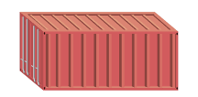
SNAFU overview
int a= 1
int b = 2
int c = b * a
C/C++
Application
x
+/-
ULP Verified
Reconfigurable
Fabric
Fabric
Scheduler
100010010100010010010
Bitstream
Standard PE Library
int a= 1
int b = 2
int c = b * a
Fabric
Synthesizer
C/C++
Application
int a= 1
int b = 2
int c = b * a
C/C++
Application
int a= 1
int b = 2
int c = b * a
C/C++
Application
OR
Library of target
applications
Standard
CAD Tools
Invoke accelerator
Driver
Standard
container
ULP Verified
Specialized
Accelerator
Accelerator?
Your logic/function
A lot of this is already built! But not fully tested
Bring you own function

