Slide 1

RL Jalappa institute of technology doddaballapura
Title:-Smart Healthcare: Revolutionizing Patient Care
Discover how smart healthcare systems are transforming patient care. This presentation will cover the overview of smart healthcare systems and the importance of technology. Our objective is to show how to enhance efficiency and personalization in healthcare through innovative technologies.
DA
by G uday kumar and team

Slide 2
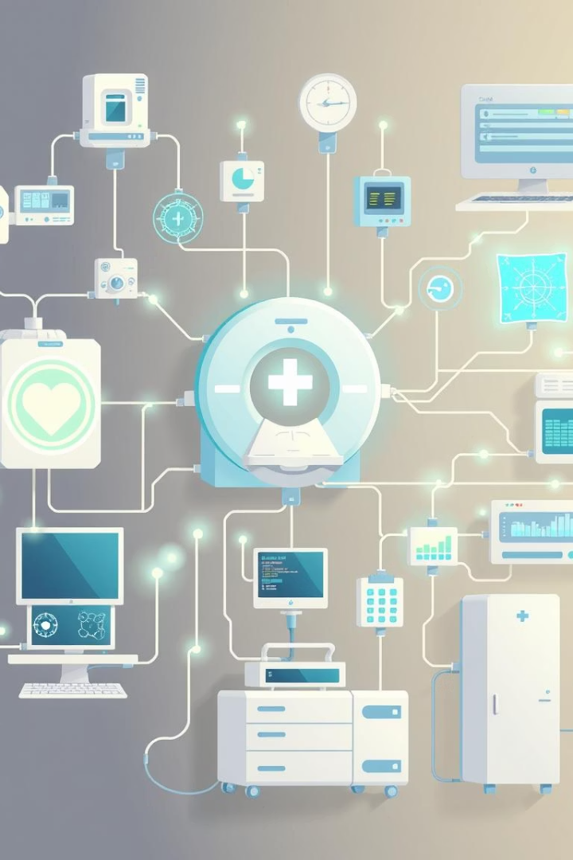
What is a Smart Healthcare System?
A smart healthcare system integrates AI, IoT, cloud computing, and big data. This concept was inspired by IBM's "Smart Planet".
Wearable Devices
Connected Systems
Smart Hospitals
Speech to Text

Slide 3




Key Technologies in Smart Healthcare
Smart healthcare leverages several key technologies to enhance patient care and improve efficiency. These technologies are revolutionizing how healthcare is delivered.
IoT
Real-time patient monitoring, resource management.
AI
Diagnosis support, predictive analytics.
Wearables
Monitoring vitals like heart rate and blood pressure.

Slide 4
Benefits for Patients and Providers
Smart healthcare offers numerous benefits for both patients and providers, enhancing the overall healthcare experience. These benefits range from personalized care to improved decision-making.
Personalized Care
Improved Efficiency
Customized delivery and monitoring
Reduced hospital visits through remote care
Remote chronic condition management
Enhanced provider decision-making

Slide 5
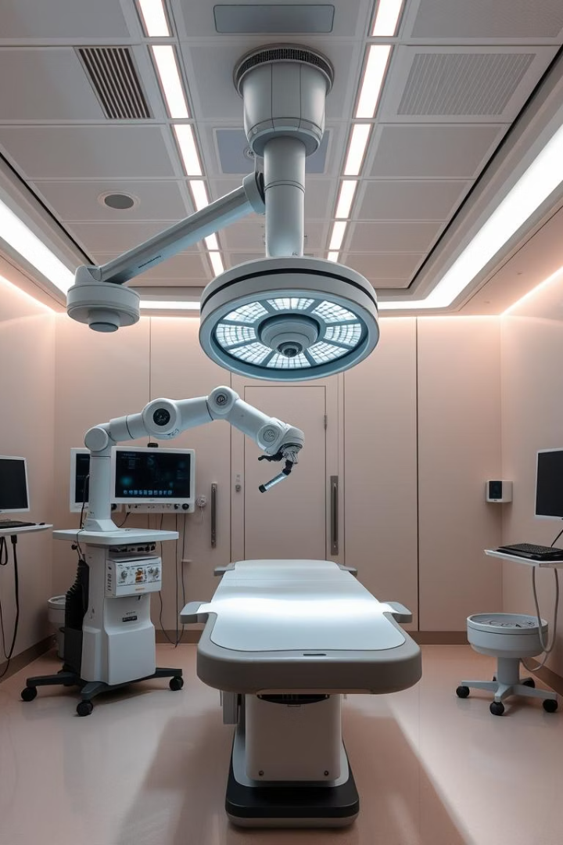
Innovations Driving Healthcare Transformation
Several innovations are at the forefront of transforming healthcare. From remote surgery to smart hospital systems, these advances are reshaping the industry.
Telesurgery
Smart Hospitals
Remote robotic surgical procedures.
Automated workflows and asset tracking.
Emergency Response
Faster data sharing for critical care.

Slide 6
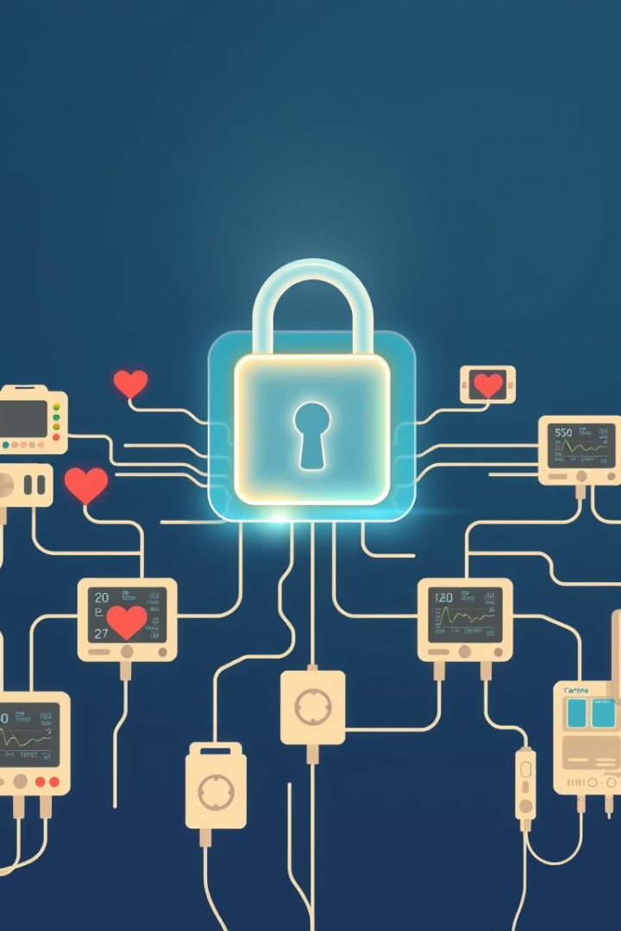



Addressing Challenges in Smart Healthcare
Smart healthcare faces several challenges that need to be addressed. Overcoming these hurdles is crucial for successful implementation.
Privacy
Address data security concerns.
Infrastructure
Meet 5G and device requirements.
Training
Educate healthcare staff.

Slide 7



Future Trends in Smart Healthcare
The future of smart healthcare is filled with exciting trends that promise to revolutionize patient care and healthcare delivery.
AI-Driven
Drug discovery and personalized treatments.
Telemedicine Expansion
Remote monitoring.
Smart Hospitals
AR/VR diagnostics.

Slide 8

Conclusion: A Healthier Tomorrow
Smart healthcare is a game-changer for global health, offering a path to a healthier tomorrow. Collaboration will be key to accelerating adoption.
Smart healthcare is transformative.
Collaboration accelerates adoption.
A data-driven ecosystem is our vision.

Slide 9
Thank you

