Slide 1
WELL BEING FOR ALL AT ALL AGES
“Prediction of the level of hypothyroidism hormones for the middle age group and prototype model of modified punch biopsy”

Slide 2
Team Members:
R. Seshu Vardhan Reddy-99210042076
R. Shiri Sai Chandana-99210041626
G. Srinivas Siddharath-9921004237
G. Shiva Chaitanya-99210042047
V. Sujay Sai Reddy-9921004768
Faculty Mentor: Dr.R.Murugeswari
PS No. :WB-PS30
Team No. :WB41

Slide 3
Introduction
A punch biopsy is a medical procedure commonly used to obtain a tissue sample for diagnostic purposes. It involves using a small, circular blade to remove a cylindrical tissue core, typically the skin, from the body. This method allows healthcare professionals to collect a tissue sample for examination under a microscope to diagnose various skin conditions, including infections, tumors, and inflammatory diseases. Punch biopsies are often performed in outpatient settings and are generally safe and minimally invasive. Moreover, we are designing a diet chart for middle-aged individuals utilizing Python.
Prediction of the level of hypothyroidism hormones for the middle age group using a dataset containing age, gender, thyroid-stimulating hormone (TSH) levels, triiodothyronine (T3), thyroxine (T4), and another pertinent medical history to make predictions.
.

Slide 4
Problem Statement and its evolution
.
•To implement precision Tissue sampling to ensure accuracy in obtaining high-quality punch biopsy.
•Prediction of the level of hypothyroidism hormones for the middle age group using a dataset containing age, gender, thyroid-stimulating hormone (TSH) levels, triiodothyronine (T3), and thyroxine (T4).
•Designing a diet chart for middle-aged group people using Python.

Slide 5
Literature Survey:

Slide 7
Proposed
We propose a new punch biopsy prototype to improve diagnostic accuracy and patient comfort. Additionally, we are working on a project for predicting hypothyroidism in middle-aged groups using Gradient Boosting, a powerful machine-learning technique. Moreover, we are designing a diet chart tailored for middle-aged individuals utilizing Python, ensuring nutritional balance and health optimization.

Slide 8
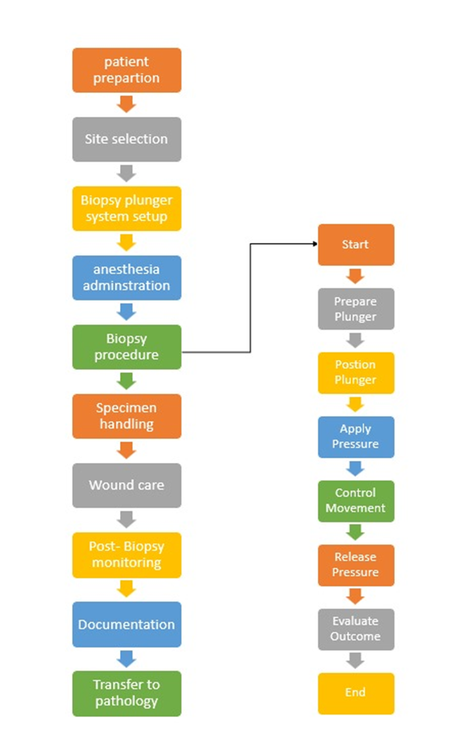
Flow Chart

Slide 9
Idea Matrix- identify, organize, and develop
-punch biopsy with a plunger system
-the user-friendly design
-one-time use product
Material Selection:
- so many of punch biopsies are made of steel which will cost more to make of product.
-we are doing it with simple plastic material which costs less than steel.
-there is no need to use costly material for a one-time use product.
Prototyping:
-after checking the existing punch biopsy.
-we are making the modifications from the existing prototype as a click pen model which is known as the plunger system.
Modification:
-spring will be inserted inside the body of the punch biopsy for easy movement of mm blade.
-after placing on the thyroid gland if we click once with our fingers on the top of the punch biopsy then the mm blade will come out and it will insert into the skin for removal of thyroid gland.
-if the punch biopsy is ready to remove then once again if we click the mm blade comes back.

Slide 10
Ergonomic Designs:
Improvements in the design of biopsy instruments may include features that enhance ergonomics for healthcare professionals, making the procedure more comfortable and efficient.
Biopsy Plunger Systems:
While the term "punch biopsy plunger system" may not be widely recognized, it's possible that it refers to a specific type of instrument or system designed to improve the ease and efficiency of obtaining tissue samples during a punch biopsy. This could include mechanisms for controlled sample retrieval.

Slide 11
Diet Chart
To illustrate the diet chart for thyroid health, the code defines lists for breakfast, lunch, dinner, and snacks, including healthy options and foods to avoid. It then creates a pie chart to represent the distribution of different food categories visually. The categories include "Low iodine foods" (60%), "Moderate iodine foods" (25%), "High iodine foods" (10%), and "Foods to avoid" (5%). Colors are assigned to each category: orange for low iodine, teal for moderate iodine, blue for high iodine, and gray for foods to avoid.
Display:
Pie chart showing the distribution of different food categories in the diet.
Use defined categories and colors for clear representation.

Slide 12
Hypothyroidism Prediction Analysis
The goal is to predict hypothyroidism using features like age, gender, and thyroid hormone levels (T3, T4, TSH) through a logistic regression model. The dataset, provided by the medical faculty at Kalasalingam University, contains 89 entries with key attributes: age, gender, T3, T4, TSH levels, and hypothyroidism status (HYP). The data undergoes preprocessing, including handling missing values and encoding categorical variables. The predictors are age, gender, T3, T4, and TSH, while the target variable is hypothyroidism status. To focus on middle-aged individuals (35-55) with hypothyroidism, the dataset is filtered, split into training (80%) and testing (20%) sets, and scaled using Standard Scaler. A logistic regression model is trained and evaluated using accuracy and a confusion matrix. Visualizations illustrate thyroid hormone distributions among middle-aged individuals with hypothyroidism.

Slide 13
Additionally, the performance of five machine learning algorithms—Logistic Regression, Decision Tree, Random Forest, SVM, and Gradient Boosting—are compared. After preprocessing and feature scaling, each model is trained and evaluated for accuracy. The model with the highest accuracy, Gradient Boosting, is identified as the best for hypothyroidism prediction.
Overall, the Gradient Boosting model emerged as the best-performing algorithm with the highest accuracy of 0.7222222222222222. This suggests that Gradient Boosting is the most effective algorithm among those tested for predicting hypothyroidism in this dataset. The subsequent analysis and visualizations focused on middle-aged individuals (ages 35-55) with hypothyroidism, highlighting the distribution of T3, T4, and TSH levels for males and females, further aiding in understanding the condition's demographic characteristics.

Slide 14
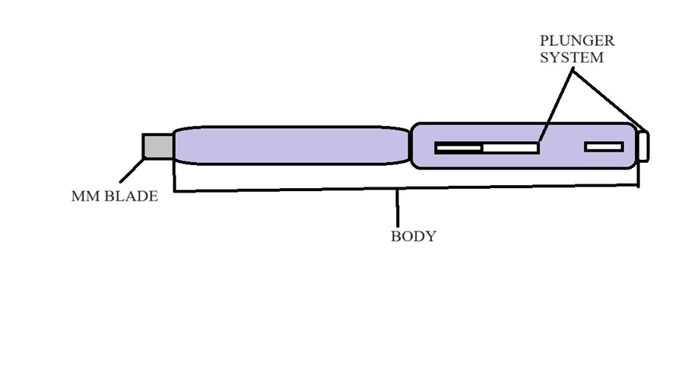
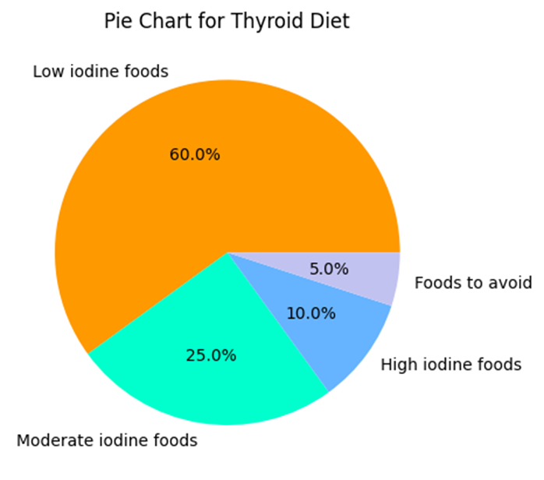
Outcome/Deliverables-Design
Pride Mobility Go Chair

Slide 15
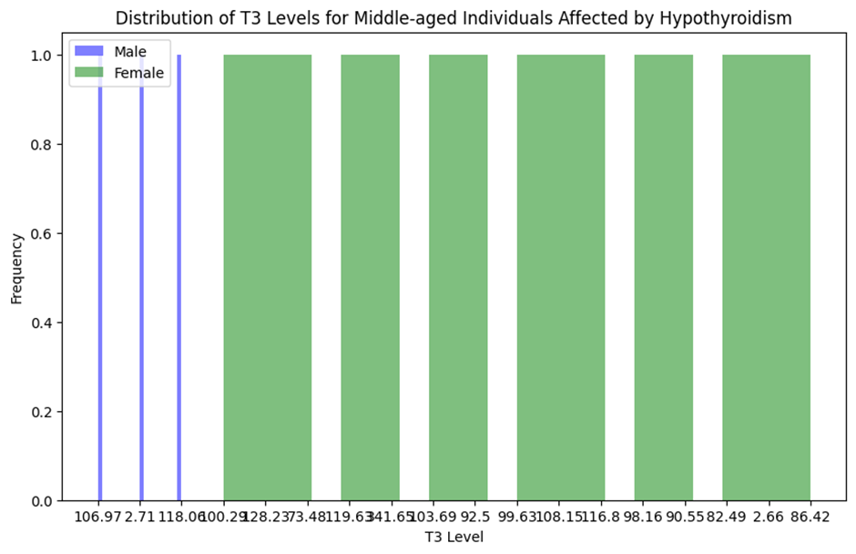
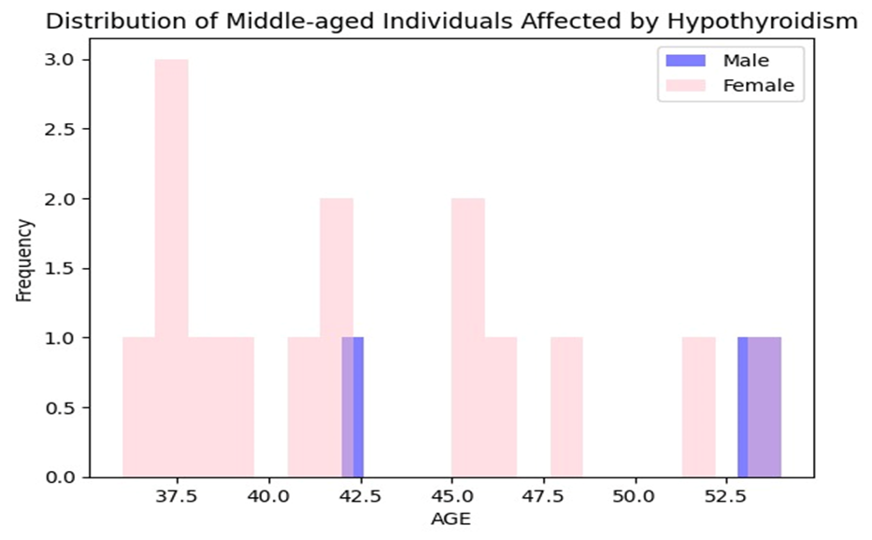

Slide 16
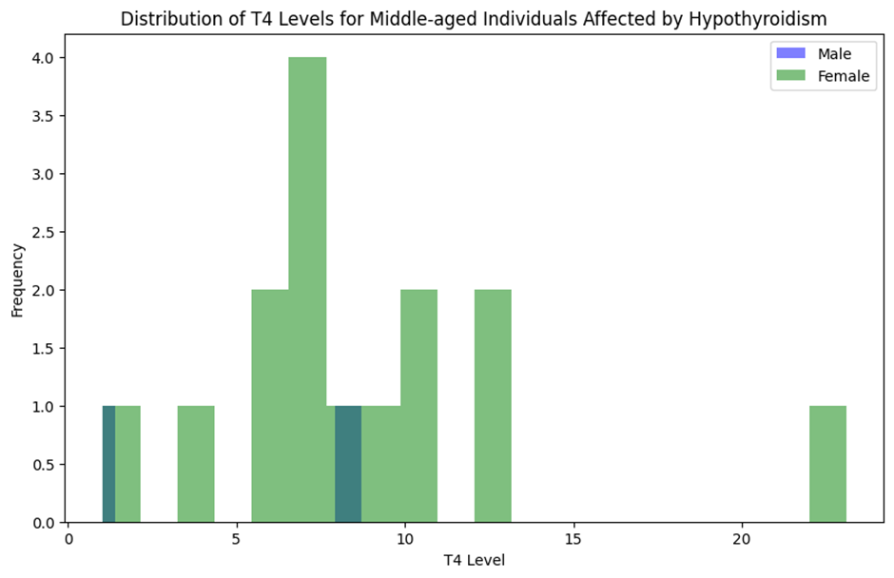
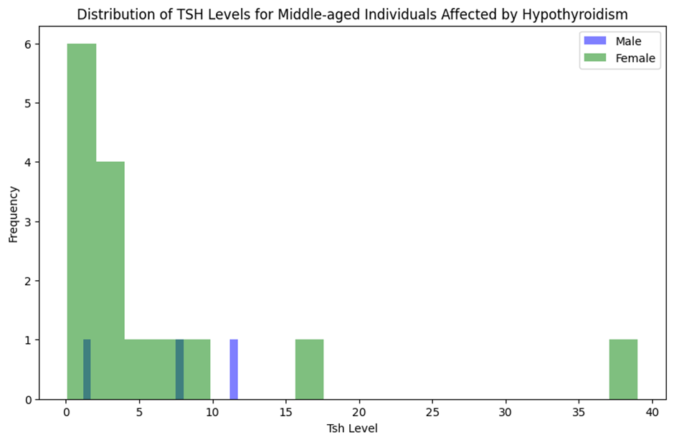

Slide 17
Conclusion
A comprehensive approach to thyroid disorder detection involves clinical assessments, laboratory tests, imaging studies, and advanced technologies like machine learning and AI algorithms. The double-click pen model for modified punch biopsy offers significant advantages, including customizable depth control, ergonomic design, procedural efficiency, and compatibility with standard biopsy needles. These features enhance diagnostic precision and patient satisfaction. Advanced technologies such as Logistic Regression, Decision Tree, Random Forest, Support Vector Machine (SVM), and Gradient Boosting algorithms improve diagnostic accuracy by analyzing factors like age, gender, and thyroid hormone levels. Among these, Gradient Boosting is identified as the best model for hypothyroidism prediction. Additionally, designing a balanced diet chart for middle-aged individuals, focusing on macronutrients and healthy foods, is essential for overall well-being and chronic disease prevention. This holistic approach underscores the importance of precision, efficiency, and advanced technology in improving patient outcomes.

Slide 18
Reference:
https://www.liebertpub.com/doi/abs/10.1089/thy.2009.0157
https://journals.lww.com/annalsofsurgery/fulltext/2020/03000/The_American_Association_of_Endocrine_Surgeons.28.aspx/
https://synapse.koreamed.org/articles/1516081383
https://www.liebertpub.com/doi/abs/10.1089/thy.2009.0157
https://onlinelibrary.wiley.com/doi/abs/10.1155/2019/6212759

