Slide 1

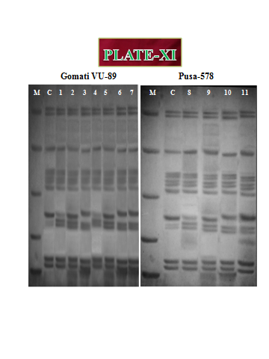
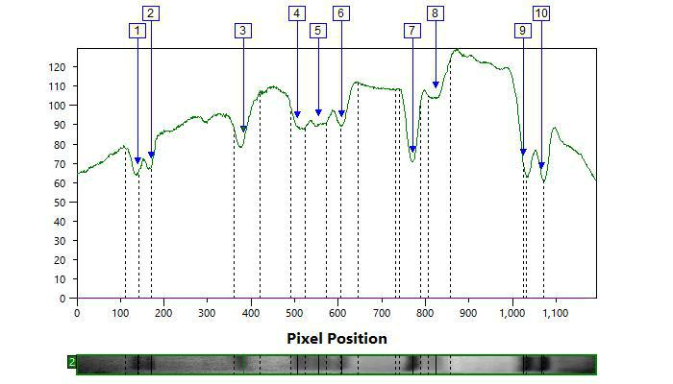
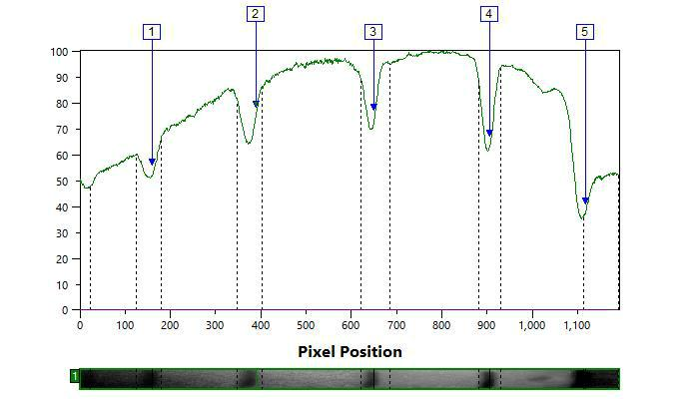
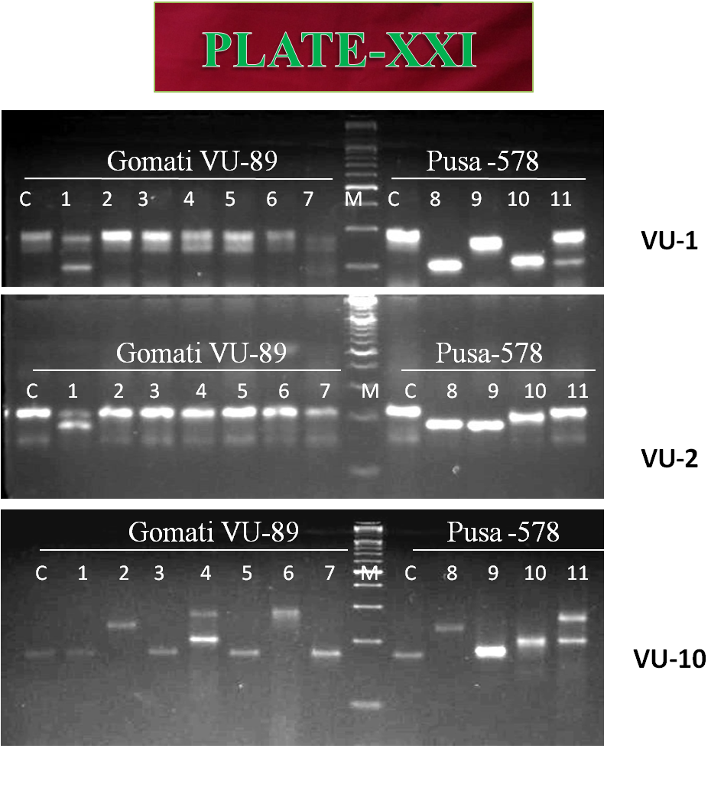
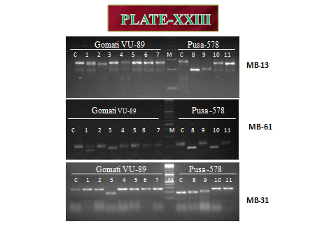
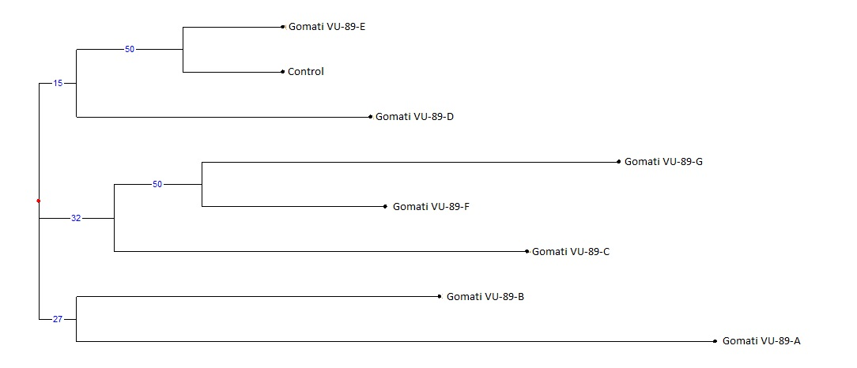
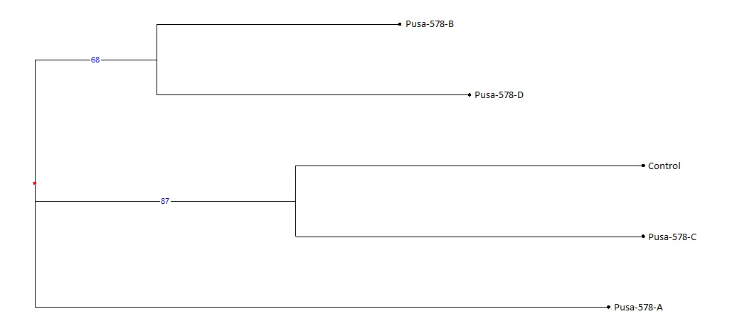
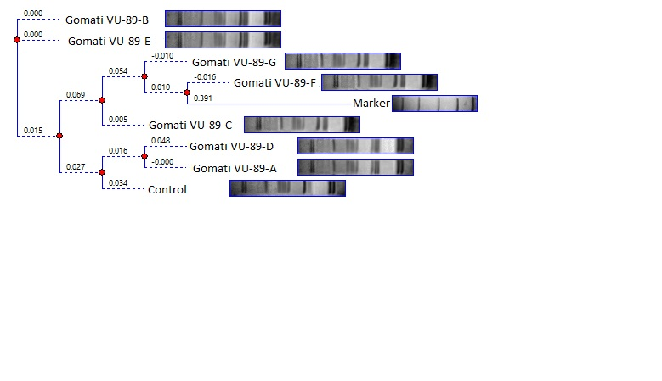
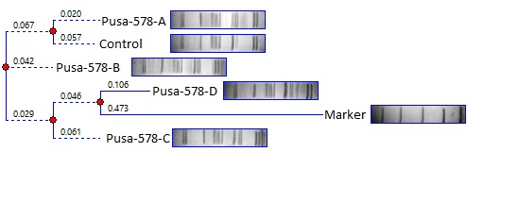
Gamma radiations and sodium azide induced high yielding cowpea mutant lines
Aamir Raina** and Samiullah Khan *
* Mutation Breeding Laboratory, Department of Botany, Aligarh Muslim University, Aligarh, U.P. 202002
**Botany Section, Women’s College, Aligarh Muslim University, Aligarh, U.P. 202002
Background and Introduction
Agriculture is the backbone of Indian economy contributing 13.7% of its GDP and employing around 55% of the total working population in India.
India is the worlds largest producer and consumer of pulses.
Induced mutagenesis generates macromolecular variations which ultimately alters the bio-physiological and morphological nature of the crop genotypes.
In the present study, molecular characterization of eleven M₄ high yielding cowpea mutant lines, developed from sodium azide (SA) and gamma rays mutagenesis, was carried out with SDS-PAGE and SSR markers.
SDS-PAGE profile of seed storage proteins showed 87 bands of different molecular weight, 54 bands were found to be polymorphic, which resulted total polymorphism percentage of 62.06% in the variety Gomati VU-89.
In the variety Pusa-578, 68 bands of different molecular weight were generated, 28 bands were found to be polymorphic, which resulted total polymorphism percentage of 41.17%
The selected genic-SSR primers amplified 76 bands with 16 bands being polymorphic in the var. Gomati VU-89 and 47 bands with 24 bands being polymorphic in the var. Pusa-578.
The values of polymorphism were between 37.50% (MB-38) and 11.00% (VU-27; VU-19) with an average of 20.19 in the var. Gomati VU-89 and 66.66% (VU-10) and 20.00% (MB-38) with an average of 50.74% in the var. Pusa-578.
The genetic dissimilarity coefficient of the mutants and controls ranged from 0.200 (between Gomati VU-89-A and Gomati VU-89-B) to 1.000 (between Gomati VU-89 and Gomati VU-89-E) in the var. Gomati VU-89, while it ranged from 0.125 (between Pusa-578 and Pusa-578-A) to 0.385 (between Pusa-578 and Pusa-578-B) in the var. Pusa-578.
Among the primers, VU-27 showed the highest polymorphism with significant PIC value. Genetic divergent analysis revealed that genome of variety Gomati VU-89 mutated relatively more than the variety Pusa-578 due to the mutagen treatments, while Gomati VU-89-E (1.000) and Pusa-578-B (0.385) were the most divergent mutants induced in the present study.
Fig. 1 .SDS PAGE profile showing bands of proteins of control and M₄ high yielding mutants of cowpea varieties Gomati VU-89 and Pusa-578. Fig. 2. SDS PAGE band intensity curves showing different resolved proteins of controls and M₄ high yielding mutants of cowpea.
Material and methods
The healthy and viable seeds (moisture 11.0%) of both the varieties were directly irradiated with 100(G1), 200(G2), 300(G3) and 400(G4) Gy of gamma rays with a radioisotope 60Co, Cobalt-60, source at the National Botanical Research Institute, Lucknow, Uttar Pradesh, India.
For chemical treatments, pre-soaked (6 hrs) seeds were treated with different doses (v/v) of sodium azide (SA) viz, 0.01%(S1), 0.02%(S2), 0.03%(S3) and 0.04%(S4) at room temperature of 25±2°C for 9 hrs.
Also, a combination treatment sets of seeds viz. 100Gyγrays+0.01%SA (S1+G1), 200Gyγrays+0.02%SA (S2+G2), 300Gyγrays+0.03%SA (S3+G3) and 400Gyγrays+0.04%SA (S4+G4), were prepared by directly treating the gamma treated seeds with sodium azide concentrations.
In M₄ generation, agro-economical traits viz., pod bearing branches/plant; pods/plant and seed yield/plant (g) were studied for the selected mutants from both the varieties. The genotypic coefficient of variation (GCV), heritability (h²) and genetic advance (GA as % of mean) was calculated to estimate the stability and expressivity of the yield and yield attributing traits.
SDS-PAGE analysis
The SDS-PAGE of total seed protein was carried out in the discontinuous buffer system according to the method of Laemmli (1970).
DNA isolation
The DNA was isolated from leaves of 10-days-old seedlings using optimized CTAB method according to Agbagwa et al. (2012) for legumes.
SSR analysis, DNA amplification and electrophoresis
For SSR analysis, nine primers that had produced polymorphic bands were considered after screening of 82 genic-SSR primers.
The PCR was optimized by varying the concentrations of template DNA, Taq DNA polymerase and annealing temperature.
Gel scoring and divergence analysis.
Data on visibly clear bands were recorded for SDS-PAGE and SSR as presence (1) or absence (0). The binary data were used to generate Jaccard’s similarity coefficients for both SDS-PAGE and SSR bands. The matrix of similarity coefficient was subjected to unweighted pair-group method (UPGMA) to generate a dendrogram using PAST 3 (Garcia-Vallve et al., 1999). The percentage of polymorphism was calculated based on the detected monomorphic and polymorphic bands.
Fig. 2.: Gel profiles of markers generated using Simple sequence repeat primers in M₄ high yielding mutants of cowpea varieties
.
Genotypic coefficient of variation, heritability and genetic advance for yield and yield attributing traits were also recorded to be higher in all such mutants isolated from the two varieties of cowpea.
In the var. Gomati VU-89, of the 87 bands of different MW, 54 bands were found to be polymorphic, which resulted total polymorphism percentage of 62.06% (Fig. 1).
In the var. Pusa-578, of the 68 bands of different MW, 28 bands were found to be polymorphic, which resulted total polymorphism percentage of 41.17% considering all the mutants and controls .
Out of 82 genic-SSR primers tried, 9 primers amplified 76 bands with 16 bands being polymorphic in the var. Gomati VU-89 and 47 bands with 24 bands being polymorphic in the var. Pusa-578 (Fig.2)
The dendrogram, developed from the similarity and dissimilarity matrix of Jaccard’s coefficient, showed mutant lines of Gomati VU-89 were arranged in five clusters i.e., (I) Gomati VU-89-E and Control, (II) Gomati VU-89-D, (III) Gomati VU-89-G and Gomati VU-89-F, (IV) Gomati VU-89-C, (V) Gomati VU-89-B and Gomati VU-89-A (Fig. 3 and 4).
In the var. Pusa-578 members were arranged in three clusters. A unique pattern was observed in both the dendrograms, i.e., (I) Pusa-578-B and Pusa-578-D, (II) Control and Pusa-578-C, (III) Pusa-578-A.
EXPERIMENTAL RESULTS
Fig.3. Dendrogram analysis of control and four M₄ high yielding mutants based on SSR profile of DNA sample of cowpea Gomati VU-89 var. Pusa-578.
Fig. 4: Dendrogram analysis of control and four M₄ high yielding mutants based on SDS PAGE profile of protein sample of cowpea varieties.
CONCLUSIONS
Cluster analysis separated the control plants of both the cowpea varieties in to separate clusters evidently confirmed that the employed mutagens successfully created heritable genetic changes with considerable genetic gains in the M₄ high yielding mutants compared to their respective control population.
The genetically diverged M₄ high yielding mutants developed can be used as mutant varieties directly or as parents in cross breeding programmes for further enhancement and fixation of the traits in cowpea.
The induced mutants harbour novel combinations of genes for yield and nutritional traits and therefore can be used as a source for developing elite farmer friendly varieties of cowpea. 000
The results of the assessment on induced micromutations for the yield trait indicated significant inter-population divergence have been created by the different mutagenic treatments.
Based on the mean quantitative trait data and genetic parameters, six mutagenized population, namely, 0.02% SA (S2); 100 Gy γ rays (G1); 200 Gy γ rays (G2); 200 Gy γ rays + 0.02% SA (S2+G2) in var. Gomti vu-89 and 0.02% SA (S2); 300 Gy (G3) in var. 578, was found to be superior for grain yield in the M₃ generation

