Slide 1


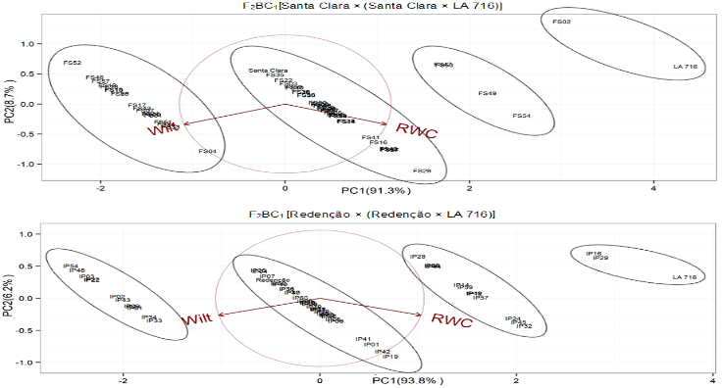
5th IMPB
INTERNATIONAL MEETING ON PLANT BREEDING
INTEGRATED DATA ANALYSIS AS A TOOL TO REVOLUTIONIZE PLANT BREEDING
SELECTION OF GENOTYPES F₂BC₁ TOLERANT TO WATER DEFICIT
Bruno Da Rocha Toroco¹*; Guilherme J. A. Oliveira¹; Joana N. M. de Oliveira¹; André R. Zeist¹
¹University of Oeste Paulista. *bruno-taroco@hotmail.com
.
Introduction
Results
Water is essential for the good development and productivity of tomato plants, so its scarcity is increasingly worrying. In its absence, productivity is compromised, thus more efficient plants in the use of this resource are desirable in an uncertain future. In breeding programs to obtain drought-tolerant plants, wild accessions are crossed with commercial plants.
The second-generation genotypes from the first backcrossing (F₂BC₁) were obtained from the self-fertilization of F1BC1 plants. From both segregating populations, 60 genotypes were evaluated using Federer’s augmented block design, in which the controls were equivalent to the common treatments and the segregating genotypes to the regular treatments.
The controls were the LA 716, Santa Clara, and Redenção genotypes. As for irrigation, all the plants were irrigated until 21 days after transplanting, using micro-drippers, then, irrigation was suspended. Relative water content was evaluated at 21 days after treatment imposition. Additionally, the plant wilt was evaluated based on the leaf aspect using a rating scale: 5 – 0% wilted leaves; 4 – 0 to 30% wilted leaves; 3 – > 30% wilted green leaves; 2 – > 30% wilted leaves beginning to dry; and 1 – completely dried leaves.
Objective
The objective was to perform the selection of F₁BC₁ segregating genotypes tolerant to water deficit.
Materials and methods
Fig. 1. Principal component analysis between leaf relative water content (RWC) and plant wilt based on leaf aspects (Wilt) of tomatoes from the second-generation of first backcrossing (F₂BC₁) with characteristics suitable for fresh consumption [Santa Clara × (Santa Clara × LA 716)] or for industrial processing [Redenção × (Redenção × LA 716)]
The experiment was carried out in a greenhouse with average temperature of 24.80 ºC ± 0.78, relative humidity of 77.83% ± 0.98 and 12 h of daily light. The F₁ hybrids Santa Clara × LA 716 and Redenção × RVTC 66 were backcrossed with the parents Santa Clara and Redenção, respectively, in order to obtain two populations F₁BC₁ [Santa Clara × (Santa Clara × LA 716)] and [Redenção × (Redenção × LA 716)].
Conclusion
Regarding characteristics for fresh consumption, the genotype FS02 stood out, whereas for characteristics for industrial processing the genotypes IP16 and IP29 were the most promising.

