Slide 1


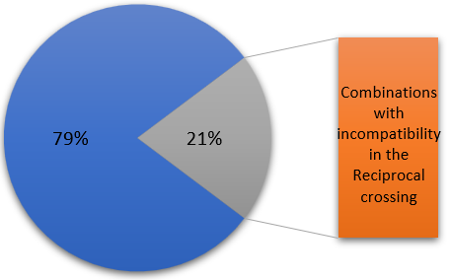
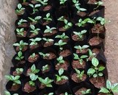
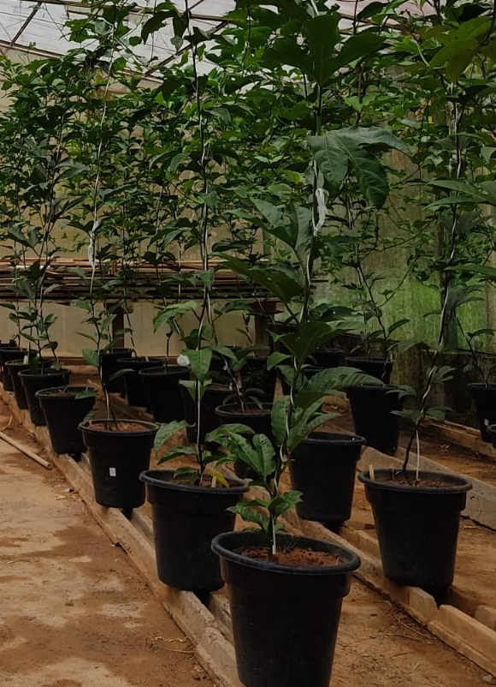
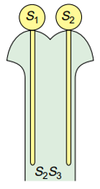
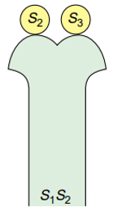
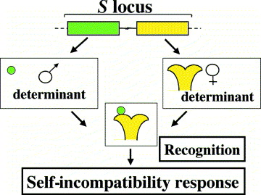
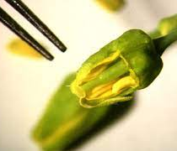
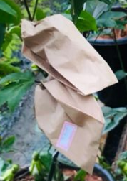
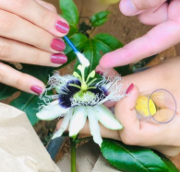

5th IMPB
INTERNATIONAL MEETING ON PLANT BREEDING
INTEGRATED DATA ANALYSIS AS A TOOL TO REVOLUTIONIZE PLANT BREEDING
SELF-INCOMPATIBILITY AND EVIDENCE OF DOMINANCE RELATIONSHIP BETWEEN S-ALELES IN PASSION FRUIT
Edilson Marques Junior¹; Lídia do Nascimento Cavalcante¹; Pedro Brandão Martino¹; Marcio Antônio Godoi Junior¹; Andressa Kamila Souza Alves¹; Carlos Eduardo Magalhães dos Santos¹
¹Universidade Federal de Viçosa, Department of Agronomy.
Difference between Hybrid and reciprocal compatibility
Introduction
Materials and methods
1) Plant formation
Cultivation of the 13 genotypes in a greenhouse
S₁S₂ x S₂S₃
S₂S₃ x S₁S₂
Passion fruit exhibits sporophytic self-incompatibility, which leads to several implications for plant breeding strategies.
(S₁ > S₂)
Emasculation process in the pre-anthesis
_{Hybrid}
_{(Fecundation)}
_{Reciprocal}
_{(Non fecundation)}
Figure 1: The process of self incompatibility determination in plants
2) Emasculation
Figure 2: Percentage of combinations with defference in hybrid and reciprocal crossing
Figure 3: Dominance relationship between the S-alleles
3) Crossing in
diallel scheme
Evaluation of compatibility by pollination.
Conclusion
Self-incompatibility is a widely known mechanism in hermaphrodite plants, which leads to the prevention of self-fertilization and cross between related plants, being one of the most important systems to prevent inbreeding
The information of compatibility between the genotypes and the understanding of the allelic relationships obtained will enable better establishment of the crossing strategies between these genotypes, with greater efficiency.
_{(5x pollination)}
Results and discussion
Table 1: Classification of the crossings obtained.
Objective
Classification | Number of genetic combinations | Percentage (%)
Compatible | 40 | 25.64
Incompatible | 55 | 35.26
Partially compatible | 61 | 39.10
Total | 156 | 100
This work aimed to evaluate the genetic compatibility among elite accessions of the Passionfruit Breeding Program of the Universidade Federal de Viçosa.
Acknowledgments
The authors thank CAPES, CNPQ and FAPEMIG for their support.

