Slide 1


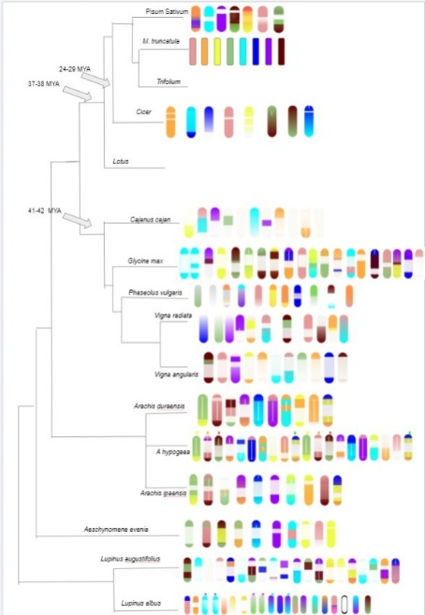
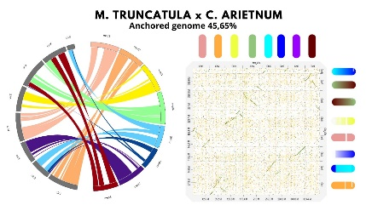
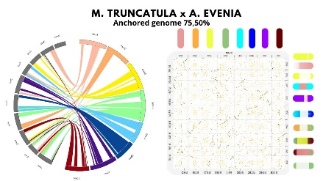
INTEGRATED DATA ANALYSIS AS A TOOL TO REVOLUTIONIZE PLANT BREEDING
RECONSTRUCTION OF THE ANCESTRAL KARYOTYPE OF THE SPECIES OF THE FABACEAE FAMILY FOR USE AS A TOOL OF GENETIC IMPROVEMENT AND AGRICULTURE
5th IMPB
COSTA, Gabriel¹; OLIVEIRA, Eduardo²; COMELATO, Julia³; SILVA, Gabriel⁴; MONDIN, Mateus⁵; Heslop-Harrison JS⁶
INTERNATIONAL MEETING ON PLANT BREEDING
^{1, 2, 3, 4, 5}Universidade de São Paulo - Escola Superior de Agricultura “Luiz de Queiroz”; ⁶University of Leicester.
¹ gabrielhdsc@usp.br; ² eduardovo@usp.br; ³ juliamcomelato@usp.br; ⁴gabriel.fernando.silva@usp.com; ⁵mmondin@usp.br; ⁶phh4@leicester.ac.uk
Introduction
Materials and methods
Based on the results on the images, it is possible to observe that the further away from the ancestor, M. truncatula, the species is, the more differences in the genomic composition are presented.
Fabaceae is a family composed by several economically important species, although these species are gathered phylogenetically in the same family, their respective genetic and physiological information has considerably different characteristics, ranging from autogamous diploid species to species with open reproduction and polyploids. The variations presented may be due to chromosomal changes that occur during evolution, acting through some mechanisms such as translocations, inversions, defficiences, duplications and polyploidy events. To locate these various mechanisms several types of analyses are used, among these, we highlighted the reconstruction of the ancestral karyotype from the mapping of the chromosomal rearrangements. Reconstruction can be an important analysis for understanding the evolution of the chromosomes and for locating the position of genes between genomes of different species of the family. In addition, reconstruction can be a useful tool for genetic improvement and agriculture.​
Materials:
Assembled genomes: Arachis duranensis (PRJNA258023), Arachis hypogaea (PRJNA419393), Cajanus cajan (PRJNA72815), Lupinus augustifolius (PRJNA575804), Vigna angularis cv Jingnong 6 (PRJNA261643), Arachis ipoensis (PRJNA258025), Aeschynomene evenia C. Wright (PRJNA448804), Cicer arietinum (PRJNA78951), Glycine max (PRJNA19861), Vigna radiata (PRJNA243847), Lupinus albus (PRJNA575804), Phaesoelus vulgaris (PRJNA41439), Pisum sativum (PRJEB31320) e Vigna angularis cv Kyungwonpat (PRJNA253346).
Methods:
Chromosomes download on the NCBI data base;
Grouping the chromosomes with the Bioedit software;
DotPlots creation;
Mapping anchor regions in the genomes of species the Fabaceae family;
Mapping chromosomal rearrangements along the genomes of species in the Fabaceae family;
Location of chromosomal changes;
Location of chromosomal painting probes.
Phylogenetic tree of the analyzed legumes genomes, created based on the dot and circos plots.
Conclusion
Results and discussion
From the results obtained it was possible to assemble a phylogenetic tree containing the information of the chromosomal rearrangements that occurred during the evolution, and we also intend to locate the genomic regions that can be used as probes for FISH experiments.
Objective
Perform the karyotype reconstruction of species of agricultural and ecological importance of the Fabaceae family through sequenced and assembled genomes, using M. truncatula as reference.​
Comparison between the genomes of M. truncatula and C. arietnum. Left: circos plot. Right: dotplot
Comparison between the genomes of M. truncatula and A. evenia. Left: circos plot. Right: dot plot

