Slide 1


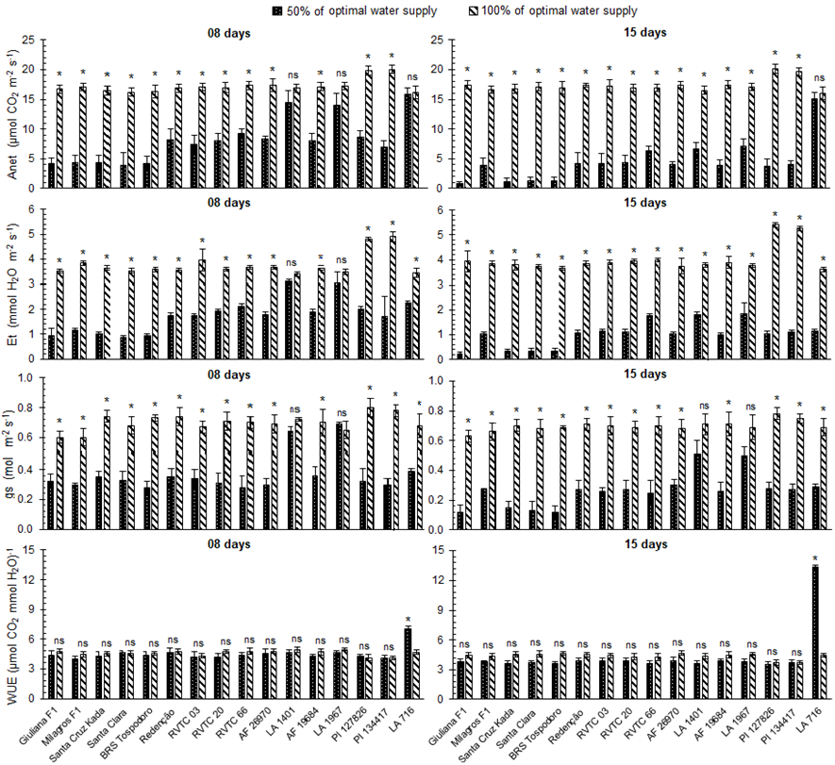
5th IMPB
INTERNATIONAL MEETING ON PLANT BREEDING
INTEGRATED DATA ANALYSIS AS A TOOL TO REVOLUTIONIZE PLANT BREEDING
INTRA AND INTERSPECIFIC VARIABILITY OF TOMATO GENOTYPES FOR WATER DEFICIT RESISTANCE
Guilherme J. A. Oliveira¹*; Joana N. M. Oliveira¹; Bruno Da R. Toroco¹; André R. Zeist¹
¹University of Oeste Paulista. *guilhermejaost@hotmail.com.
Introduction
Results
The tomato crop requires great demand for water, being susceptible to water deficit. With this finite resource increasingly scarce, there is a need to develop cultivars that are more efficient in the use of water.
Objective
The objective was to explore the intra and interspecific variability of wild accessions, hybrid and commercial genotypes regarding resistance to water deficit
Materials and methods
Seven wild tomato species genotypes were assessed, namely: S. pimpinellifolium accession AF 26970, S. galapagense accession LA 1401, S. peruvianum accession AF 19684, S. chilense accession LA 1967, S. habrochaites var. hirsutum accession PI 127826, S. habrochaites var. glabratum accession PI 134417, and S. pennellii accession LA 716; three S. lycopersicum var. cerasiforme genotypes, accession RVTC 03, RVTC 20, and RVTC 66; six commercial tomatoes (S. lycopersicum), including the four lines Santa Cruz Kada, Santa Clara I-5300, BRS Tospodoro, and Redenção and the two F₁ hybrids, Giuliana and Milagros. The experiment was carried out in a greenhouse with average temperature of 24.80 ºC ± 0.78, relative humidity of 77.83% ± 0.98 and 12 h of daily light. A randomized block design was used.
The accession LA716 was the genotype in which it showed a greater tolerance to water deficit, and may be indicated for breeding programs as a source of genetics for this characteristic.
Conclusion
Fig. 1 Net CO₂ assimilation rate (Anet), transpiration rate (Et), stomatal conductance (gs), and water use efficiency (WUE) of tomatoes after eight and 15 days with 50 and 100% of water requirement supplied. *indicates a significant difference between treatments at P < 0.05 level (t-test). Bars indicate standard deviation of the mean.

