Slide 1


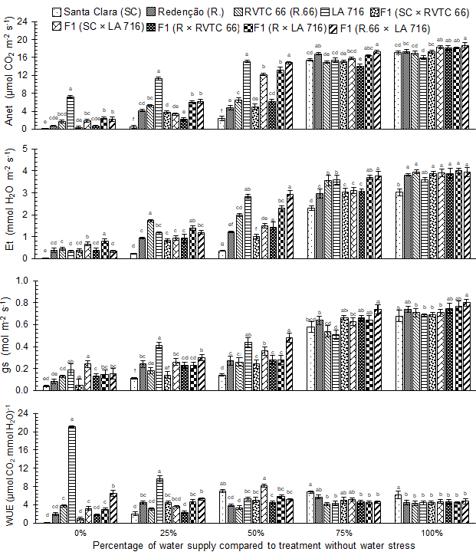
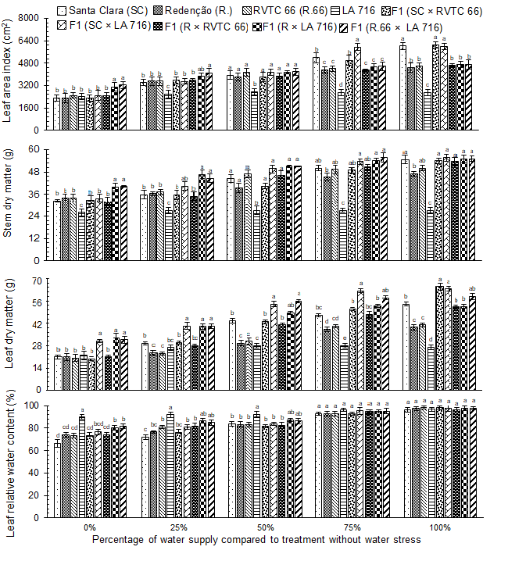
5th IMPB
INTERNATIONAL MEETING ON PLANT BREEDING
INTEGRATED DATA ANALYSIS AS A TOOL TO REVOLUTIONIZE PLANT BREEDING
TOLERANCE OF INTRA AND INTERSPECIFIC TOMATO HYBRIDS TO WATER DEFICIT
Joana N. M. de Oliveira¹*; Bruno Da Rocha¹; Guilherme J. A. Oliveira¹; André R. Zeist¹
¹University of Oeste Paulista. *ojoana140@gmail.com
Introduction
Results
The tomato is a plant that needs a constant supply of water, whether by rain or irrigation. With global warming this important resource tends to become scarce. To get around this, the selection of genotypes that remain productive even in the absence of water is essential.
Fig. 1. Net CO₂ assimilation rate (Anet), transpiration rate (Et), stomatal conductance (gs), water use efficiency (WUE), leaf area index, stem dry matter, leaf dry matter, and leaf relative water content of tomatoes after 16 days with 0, 20, 40, 60, 80 and 100% of water requirement supplied. Different letters indicate a significant difference between treatments at P < 0.05 level (Tukey HSD).
Objective
The objective was to evaluate the tolerance of intra and interspecific hybrids of tomato plants for water deficit.
Materials and methods
The genotypes included in this experiment were: Santa Clara I-5300, Redenção, LA 716, and RVTC 66, along with five hybrids, F₁(Santa Clara × RVTC 66), F₁(Santa Clara × LA 716), F₁(Redenção × RVTC 66), F₁(Redenção × LA 716), and F₁(RVTC 66 × LA 716). Plants were subjected to five levels of irrigation, 0, 20, 40, 60, 80, and 100% (control) of optimal water supply. All plants were irrigated until 21 days after transplanting, using micro-drippers. CO₂ assimilation rate (Anet), transpiration rate (Et), stomatal conductance (gs), and water use efficiency (WUE) were evaluated at 15 days and leaf area index (LAI), root dry matter (RDM), stem dry matter (SDM), and leaf dry matter (LDM) at 16 days after treatment imposition. Additionally, the leaf relative water content (RWC) was measured at 16 days after treatment.
Conclusion
The LA716 access and its descendants proved to be the most tolerant of water shortages. These are the ones that can serve as a source of genes of interest for tomato breeding programs.

