Slide 1


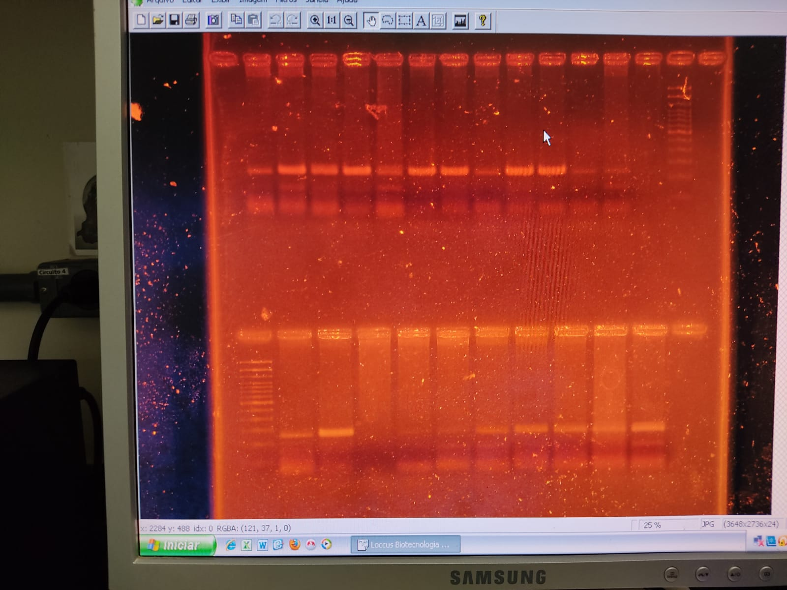
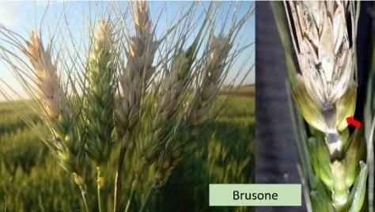
5th IMPB
INTERNATIONAL MEETING ON PLANT BREEDING
INTEGRATED DATA ANALYSIS AS A TOOL TO REVOLUTIONIZE PLANT BREEDING
TRANSLOCATION 2NS/AS IN WHEAT GENOTYPES SAMPLES FROM UFV BANK
Lídia do Nascimento Cavalcante¹; Claudio Magaton² Maicon Nardino³; Eveline Teixeira Caixeta4;
¹Genetic Improvement Master, Universidade Federal de Viçosa. E-mail: lidiancavalcant@gmail.com
²Forestry Engineering Department, Universidade Federal de Viçosa e-mail claudio.campos@ufv.br
³Adjunct Professor, Universidade Federal de Viçosa. e-mail: nardino@ufv.br
Researcher, Brazilian Agricultural Research Corporation (EMBRAPA/Café) * e-mail eveline.caixeta@embrapa.br
Introduction
Objective
Is to identify the presence of the 2NS/AS translocation in a panel of 10 cultivars from UFV Wheat Program Bank.
Wheat blast is caused by the fungus Magnaporthe oryzae, which has a great impact on the yield and quality of wheat grains.
There is a chromosomal segment that confers resistance to blast:
From Triticum ventricosum (2NS) which was translocated to chromosome 2AS of the common wheat lineage VPM1.
Materials and methods
Figure 1. Amplification of 10 individuals in the VENTRIUP/LN2 primer.
Author: Cavalcante, LN
2NS/ AS translocation
DNA from 10
genotypes were extracted
VENTRIUP and LN2 primers were used to identify the translocation.
However, although most breeding programs use translocation as a source of resistance, it has shown susceptibility in certain environments.
Conclusion
Amplification was performed in a thermocycler, with 60 ng of DNA; 2.0 mM MgCl2; 0.25 µM dNTP; 0.35 µM primer; 1 U of Taq DNA polymerase (Invitrogen).
The amplification product was analyzed on a 2% agarose gel.
It is necessary to improve the mapping, searching for new sources of resistance, as the durability of 2NS/2AS translocation resistance is not fully effective since the aggressiveness of the fungus becomes increasingly greater over the years.
Results and discussion
Acknowledgments
This study was financed in part by the Coordenação de Aperfeiçoamento de Pessoal de Nível Superior - Brasil (CAPES) - Finance Code 001. We would like to thank the Conselho Nacional de Desenvolvimento Científico e Tecnológico (CNPq) for the financial aid and the scholarships granted.
All tested genotypes showed amplification of the 259 base pair fragment indicating the presence of the 2NS/AS chromosome segment in their genome (Figure 1.)

