Slide 1

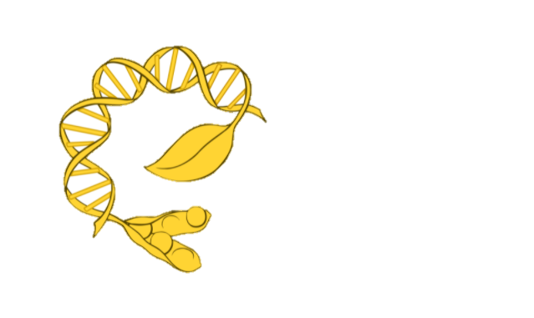
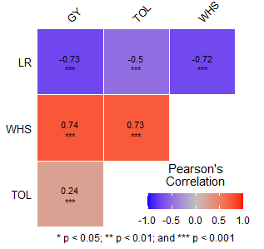
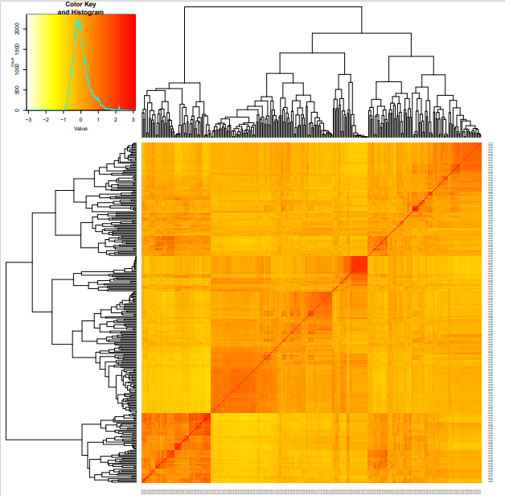

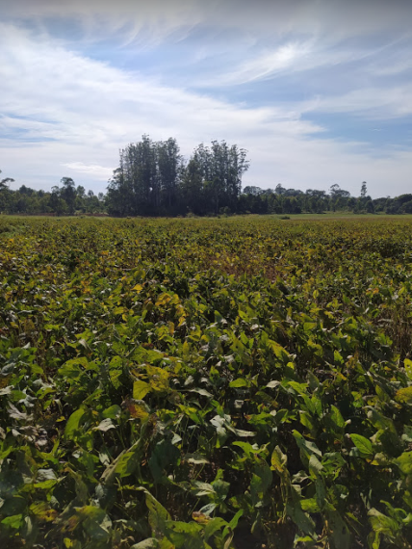
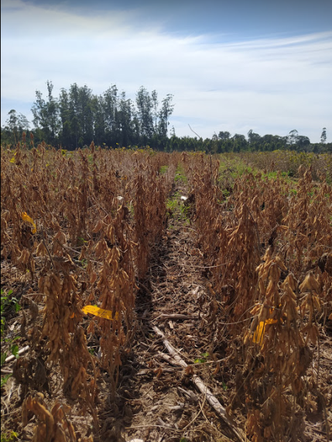
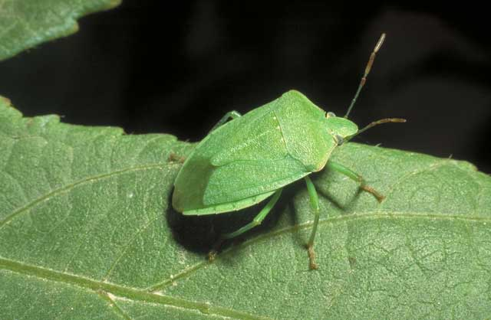
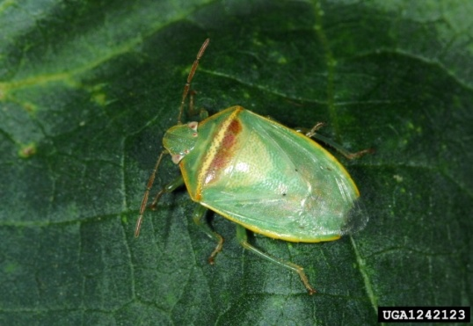
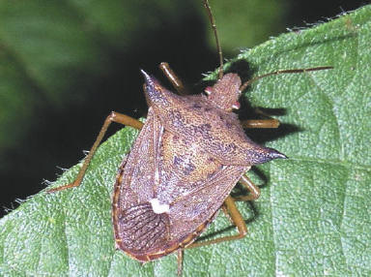
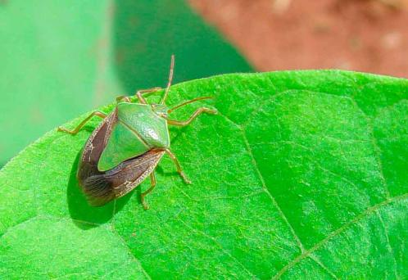
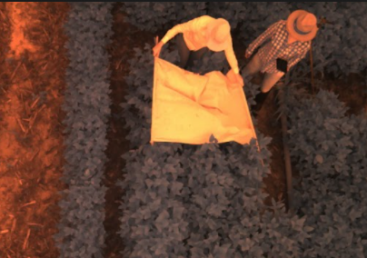









5th IMPB
INTERNATIONAL MEETING ON PLANT BREEDING
INTEGRATED DATA ANALYSIS AS A TOOL TO REVOLUTIONIZE PLANT BREEDING
POTENTIAL USE OF PREDICTION FOR SELECTION OF SOYBEAN GENOTYPES WITH RESISTANCE TO THE STINK BUG COMPLEX
Maiara de Oliveira¹; Patricia Braga¹; Emanoel Sanches Martins^{2,} Adriano Abreu Moreira¹; Felipe Augusto Krause¹; Fernanda Smaniotto Campion¹; José Baldin Pinheiro¹.
¹University of São Paulo – College of Agriculture “Luiz de Queiroz”; ²Corteva Agriscience *maiaraoliveira@usp.br
Introduction
Materials and methods
$$TOL=\left(1−\left(\frac{GY−HSW}{GY}\right)\right) x 100$$
One of the main factors that compromise soybean productivity in Brazil.
Use of resistant cultivars.
The resistance is quantitative and difficult to be implemented in breeding programs.
The challenge is revealing the genetic mechanisms related to this trait and selecting superior genotypes using genomic tools that allow the reduction of the time needed to obtain a cultivar.
290 soybean genotypes and 14 checks.
16x19 design alpha-lattice, three replications;
Crops 2018/2019, 2019/2020 and 2020/2021;
GBLUP
Cross-validation: 5-fold
Genotyping-by-sequencing: 7231 SNPs.
Weight of healthy seeds (WHS), leaf retention (RF), tolerance (TOL) and grain yield (GY).
Figure 1: Additive genetic correlations obtained from GBLUP models
Figure 2: Heatmap of pairwise kinship matrix values, based on a 7231 SNPs, according with VanRaden algorithm.
Table 2: Means predicted by GEBV
 | Xo | Xs | GS
GY | 2068.57 | 2295.26 | 226.68
LR | 2.59 | 2.27 | -0.32
TOL | 0.36 | 0.43 | 0.075
WHS | 846.84 | 1151.27 | 304.42
$$TOL=\left(1−\left(\frac{GY−HSW}{GY}\right)\right) x 100$$
A
B
C
D
Xo: original population mean; Xs: selected population mean; GS: selection gain.
Conclusion
(A) Nezara viridula; (B) Piezodorus guildinii; (C) Euschistus heros; e
(D) Edessa meditabunda
Although the evaluation of other models is indispensable, these results show that the use of genomic selection becomes a promising tool for the selection of superior genotypes. Furthermore, these genotypes can be included in future crosses, aiming to obtain offspring with greater resistance.
Results and discussion
Objective
Table 1: Variance components, PA e H² to evaluated traits in a soybean breeding panel.
Trait | Variance Components |  |  | ^{c} PA | ^{d} H²
 | ª G | ^{b} GxY | Residual
TOL | 0.0057 | 0.0027 | 0.0038 | 0.59 | 0.75
WHS | 51404.3 | 60021.9 | 103142.2 | 0.54 | 0.46
LR | 0.2097 | 0.0950 | 0.3570 | 0.57 | 0.63
GY | 88756.7 | 64134.4 | 245802.6 | 0.54 | 0.32
Evaluate the predictive abilities (PA) of genomic selection (GS) targeting at resistance to the stink bug complex and yield in soybean crop and to identify superior genotypes based on genomic estimated breeding values (GEBVs).
Acknowledgments
ª G: genetic variance component; ^{b} GxY: variance component of interaction genotype by year; ^{c} PA: predictive abilities; ^{d} H²: Heritability.

