Slide 1
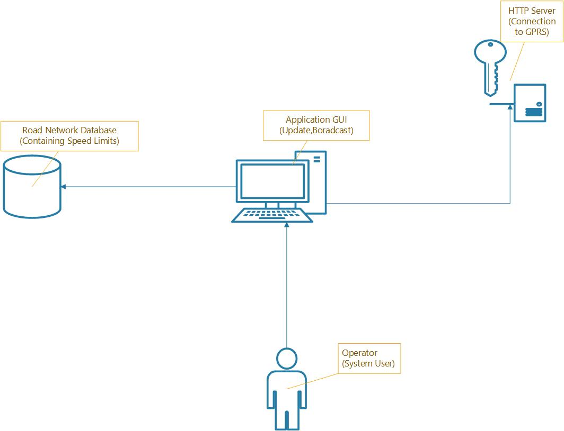
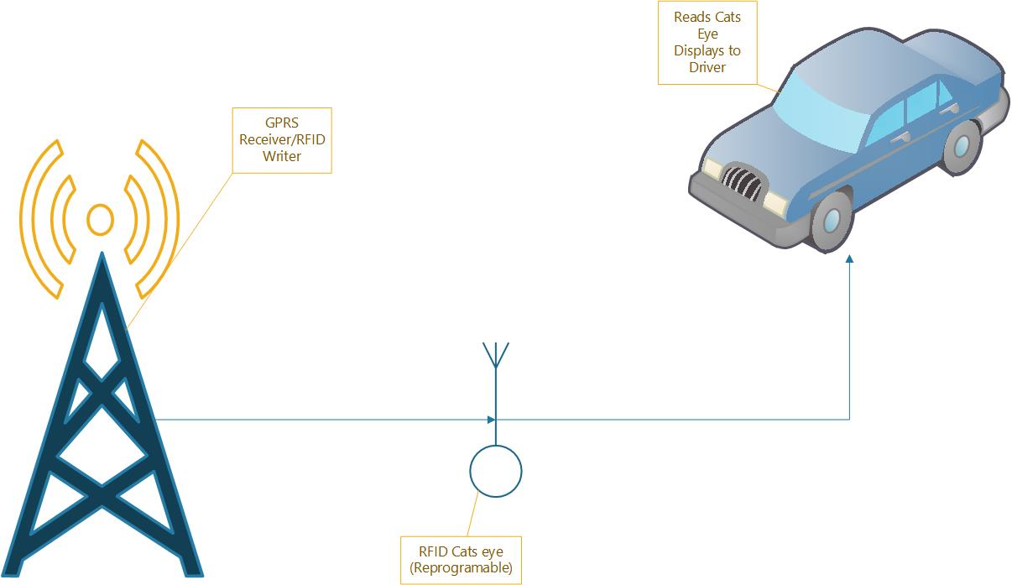
Visual Diagram
Aonghus Conneely
BEng(Hons) Computer & Electronic Engineering

