Slide 1


ABDOS - AI-Based Dermatological Observation System
An advanced platform using deep learning for early skin cancer detection and patient management.
by Emeka Adimora

Slide 2

Project Overview
Purpose
Provide accessible tools for early skin cancer detection with medical guidance.
Features
Image-based skin lesion classification
Risk assessment and recommendations
User authentication and profile management
API for frontend integration

Slide 3

System Architecture
Frontend
Backend
Machine Learning Model
User interface built with React for uploading skin images, displaying classification results, and interacting with risk assessments and recommendations.
RESTful API developed using Node.js and Express.js, handles user authentication, profile management, and serves machine learning model inference requests securely.
Deep convolutional neural network trained on diverse skin lesion datasets to classify multiple lesion types with high accuracy and reliability.

Slide 4
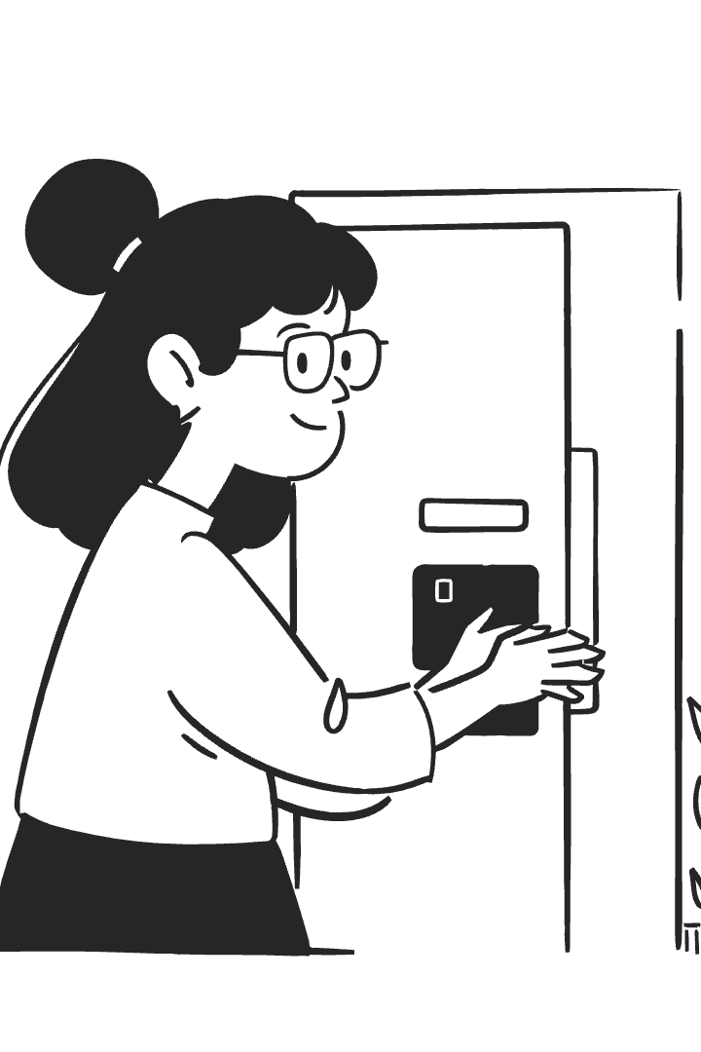
User Authentication (Backend)
Technologies
Node.js, Express, MongoDB, JWT for secure authentication.
Features
User registration and login
JWT-based secure authentication
Password hashing and validation
Profile retrieval and cookie sessions

Slide 5

Authentication API Endpoints
POST /api/auth/register
Register a new user
POST /api/auth/login
User login and token generation
POST /api/auth/logout
User logout and token invalidation
GET /api/auth/profile
Retrieve user profile information

Slide 6





Slide 6: Machine Learning Model
Model Architecture:
MobileNetV2 backbone (transfer learning)
Custom dense layers for classification
7 output classes (softmax)
Custom Preprocessing Layer:
Normalizes images to [-1, 1] range
Training Data:
Ham10000
Data augmentation for robustness
Model File:
Saved as .h5 file, loaded at runtime

Slide 7
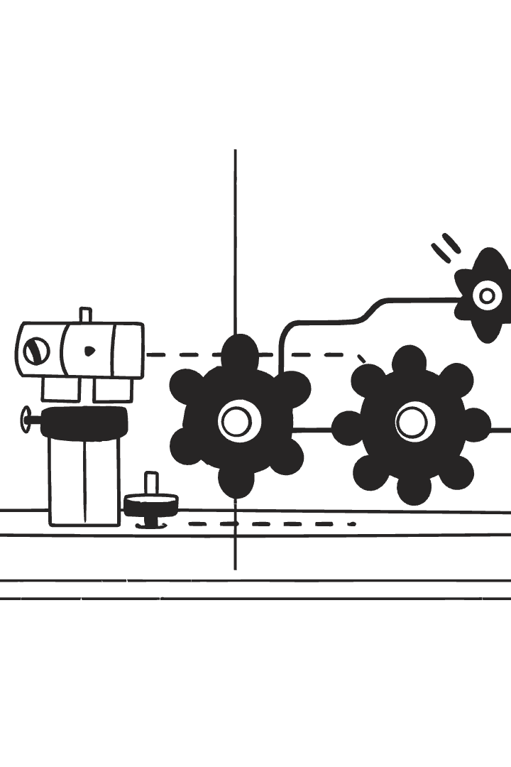
Skin Cancer Model Integration
Model
Prediction Pipeline
Keras/TensorFlow deep learning model with MobileNetV2 backbone.
Image upload and preprocessing
Model inference
Classifies 7 types of skin lesions.
Outputs: predicted class, confidence, risk, action

Slide 8
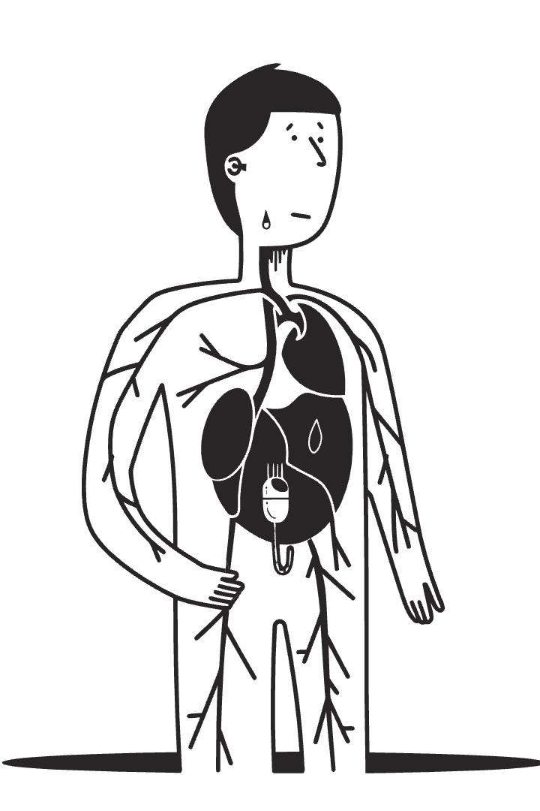
Skin Lesion Classes
Index
Code
Condition
Risk Level
0
akiec
Actinic Keratoses
Moderate
1
bcc
Basal Cell Carcinoma
High
2
bkl
Benign Keratosis
Low
3
df
Dermatofibroma
Low
4
mel
Melanoma
Very High
5
nv
Melanocytic Nevi
Low
6
vasc
Vascular Lesions
Low

Slide 9
Prediction Output Example
Predicted Condition
Confidence
Risk Level
Melanoma
92.3%
Very High
This is a malignant tumor of melanocytes, the cells that produce pigment. Early detection is critical for effective treatment.
The model is highly confident in this prediction, reflecting strong evidence from the input image features.
Melanoma is considered the most dangerous type of skin cancer due to its tendency to spread rapidly if untreated.
Description
Recommended Action
Most serious form of skin cancer.
Urgent medical attention required.
It often appears as a new or changing mole and requires prompt diagnosis by a dermatologist.
Immediate consultation with a healthcare professional is advised to confirm diagnosis and start treatment.

Slide 10

Testing & Validation
Model Loading Test
API Test
Verifies model loads and predicts correctly with sample input.
Sends images to API, checks response accuracy and latency.
Manual Testing
Uploads via frontend UI, reviews prediction results and UX.

Slide 11

Security & Privacy
Data Protection
Password Security
User data is securely protected through JWT authentication and encrypted cookies.
Passwords are securely hashed and never stored in plain text.
Privacy
Patient images and prediction data are never stored without explicit user consent.

