Slide 1


Slide 2
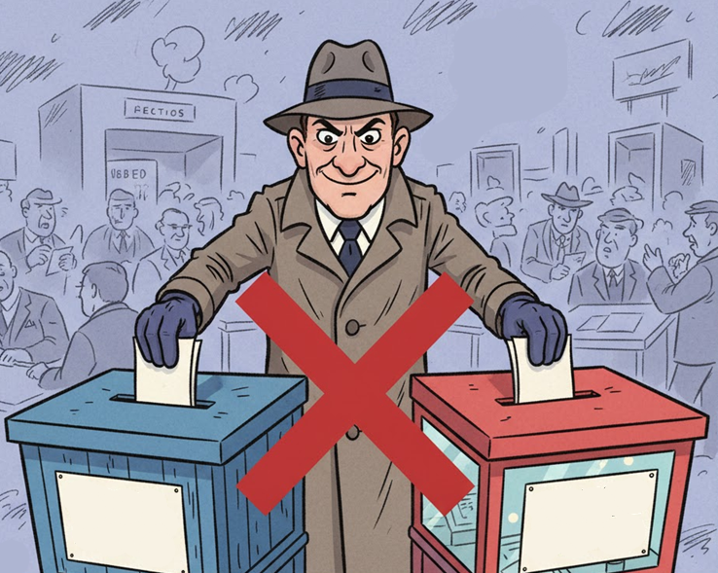
Votes Can’t Lie… But Voters Sometimes Can
Traditional EVMs allow impersonation & duplicates.
Weak ID verification can causes fake voting.
Also, paper systems can cause delays & human error.

Slide 3
Motivation
It eliminates proxy & duplicate voting.
It builds trust through verifiable authentication.
It is designed for scalability & transparency.
“Secure. Transparent. One Finger, One Vote.”

Slide 4
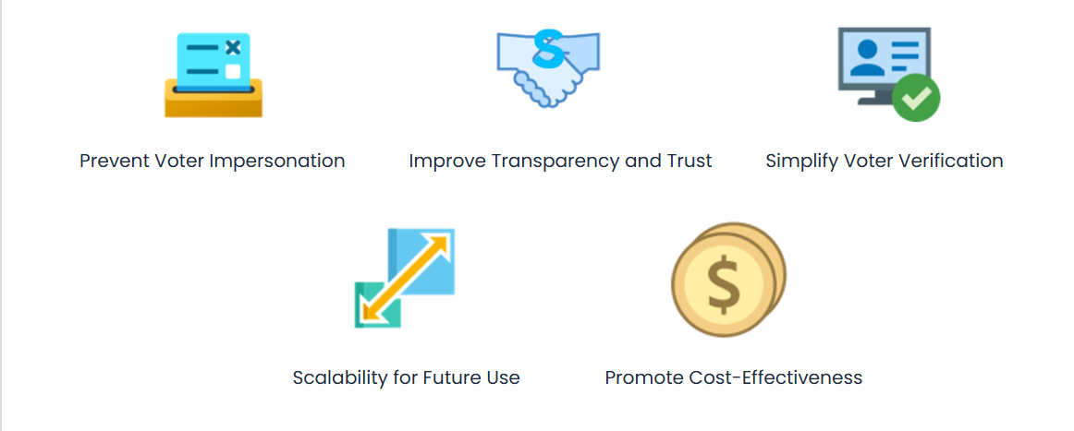
Objectives

Slide 5
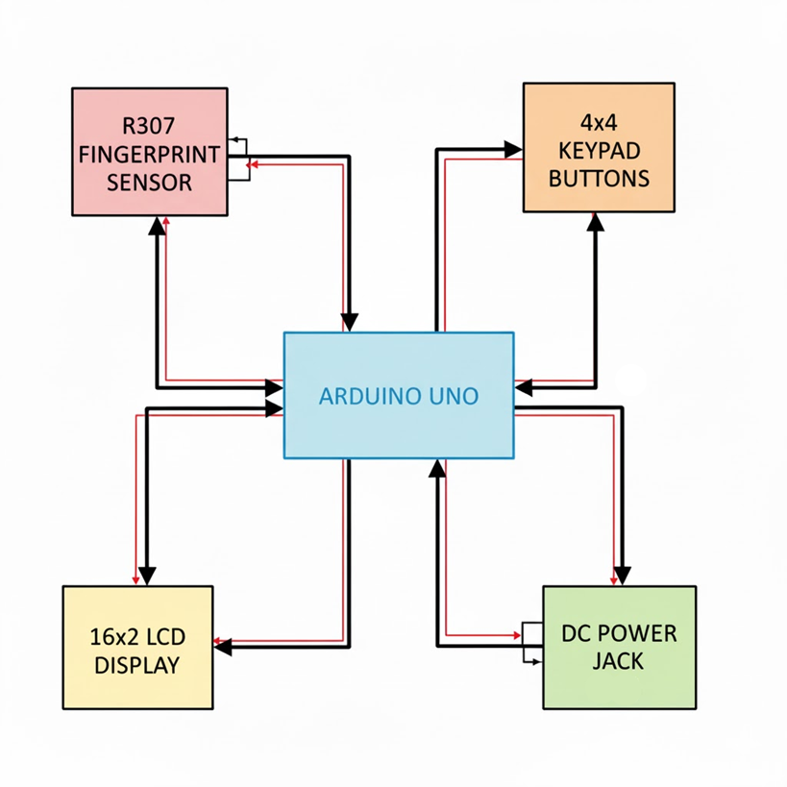
System Overview

Slide 6
Central Processing Through Arduino Uno The Arduino Uno functions as the main controller, coordinating all input and output operations within the voting system.
Biometric Authentication via R307 Sensor The fingerprint sensor captures and sends biometric data to the Arduino, ensuring that only authorized and enrolled voters can access the voting interface.
User Interaction Through Button Inputs Push buttons serve as the primary user interface, enabling key operations such as enrollment, verification, deletion, and vote casting.

Slide 7
Real-Time Feedback Through LCD Display A 16×2 I²C LCD module provides instant system messages, instructions, and voting results to guide the voter and admin during operation.
Stable Operation Powered Through DC Input A regulated DC power supply feeds the Arduino, which further distributes the required voltage to all connected modules for reliable system performance.

Slide 8
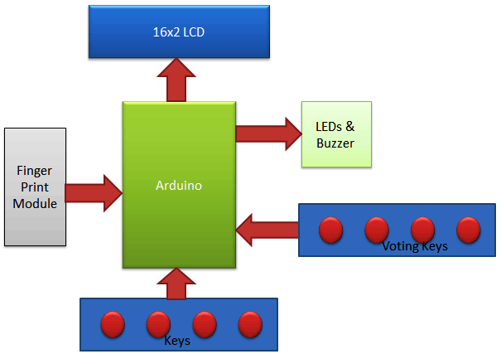
Block Diagram

Slide 9
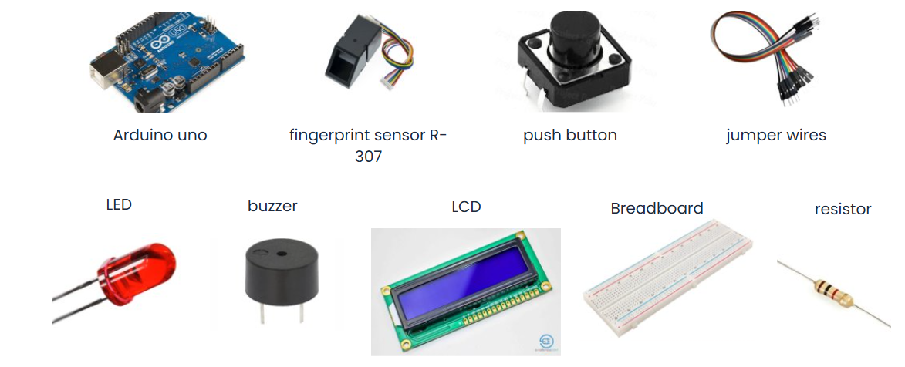
Hardware Components

Slide 10
Software Architecture
Technologies & Methods Used:-
Programming Language: C++ using the Arduino IDE
Biometric Processing: Onboard DSP (Digital Signal Processing) of the R307 for image processing & template matching
Data Storage: Internal EEPROM for vote counts and voting status
I/O Handling: Interrupt-like button polling for user operations
Display Interface: I²C LCD for user feedback and result visualization

Slide 11
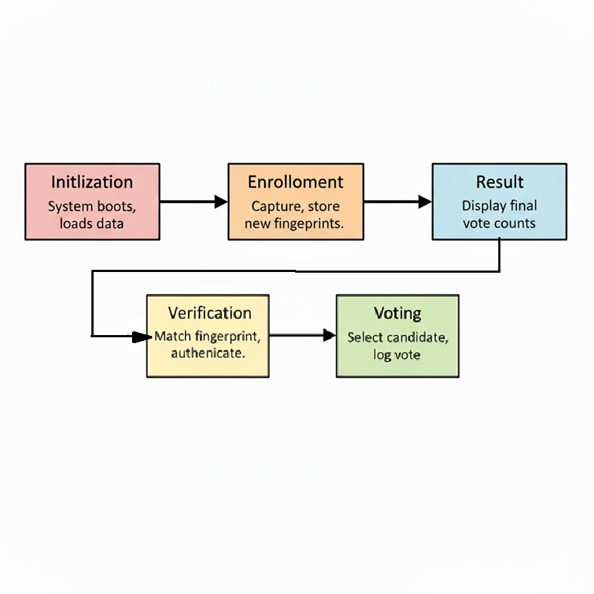

Slide 12
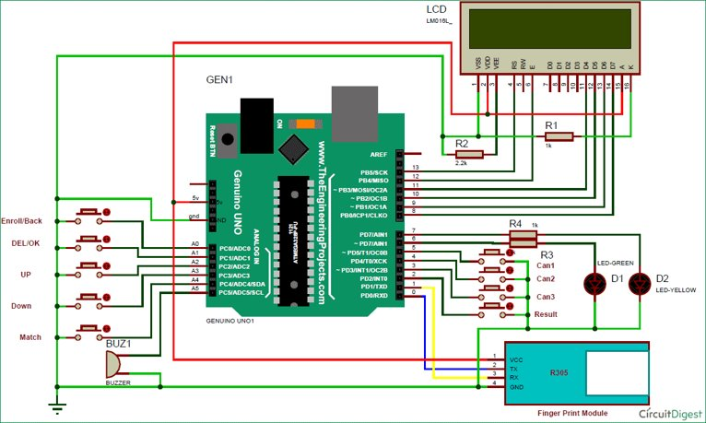
Circuit Description

Slide 13
Working Principle
Initialization: The Arduino Uno boots, initializes the fingerprint sensor, LCD display, and loads stored data from EEPROM.
Enrollment: New voter fingerprints are captured, processed using the sensor’s internal DSP algorithm, and stored in both the R307 module and the EEPROM for tracking who has/has not voted.
Verification: Fingerprint images are matched against stored templates using the R307’s onboard DSP matching engine. Only authenticated voters proceed.

Slide 14
4. Voting: Verified users select their desired candidate via push buttons. The Arduino logs each vote and updates the EEPROM securely.
5. Result: The system retrieves cumulative vote counts from EEPROM and displays the final results on the LCD when triggered by the admin.

Slide 15
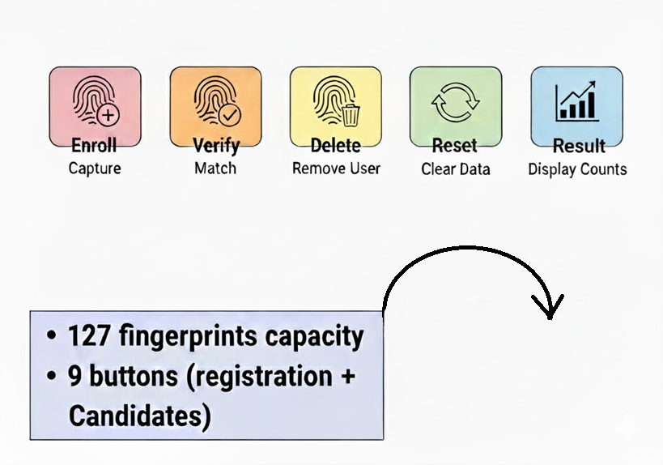
Key Features
BUTTONS
3 for the candidates
5 for the registration
1 for initialization

Slide 16
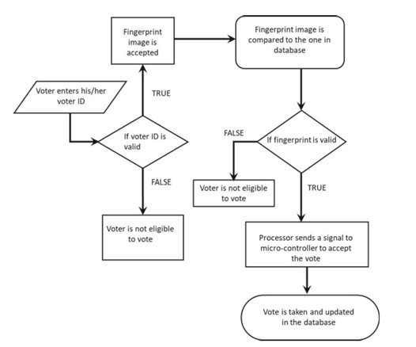
Algorithm / Workflow

Slide 17
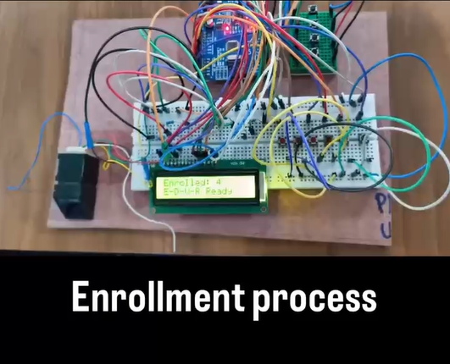
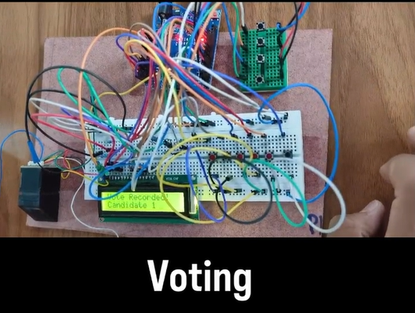
Result & Output

Slide 18
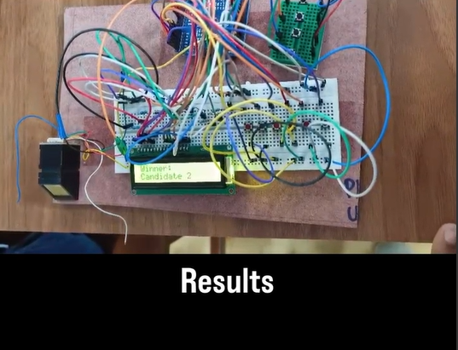
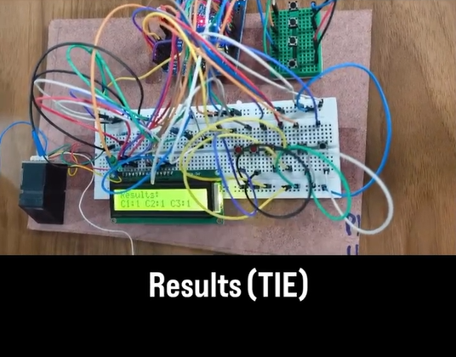

Slide 19
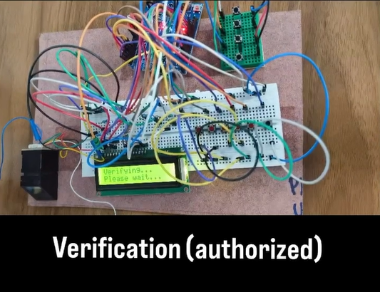
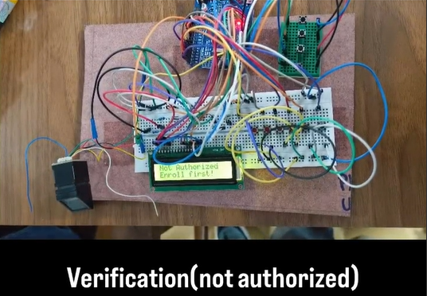

Slide 20


Slide 21
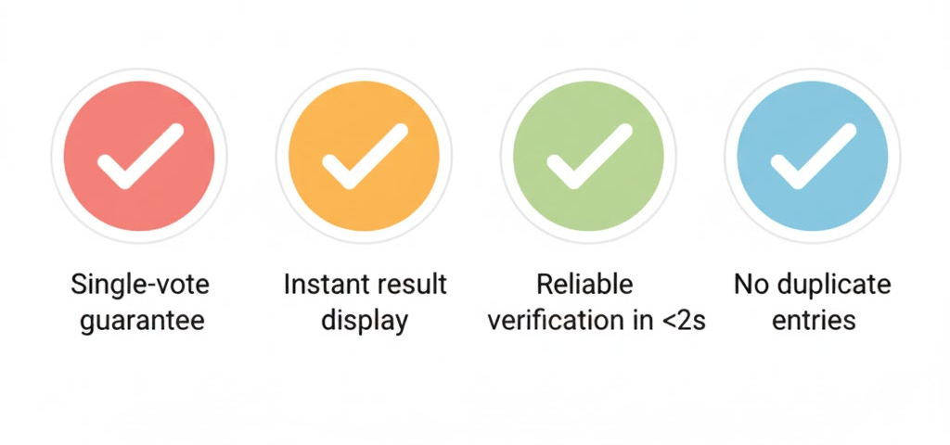
Key Findings

Slide 22
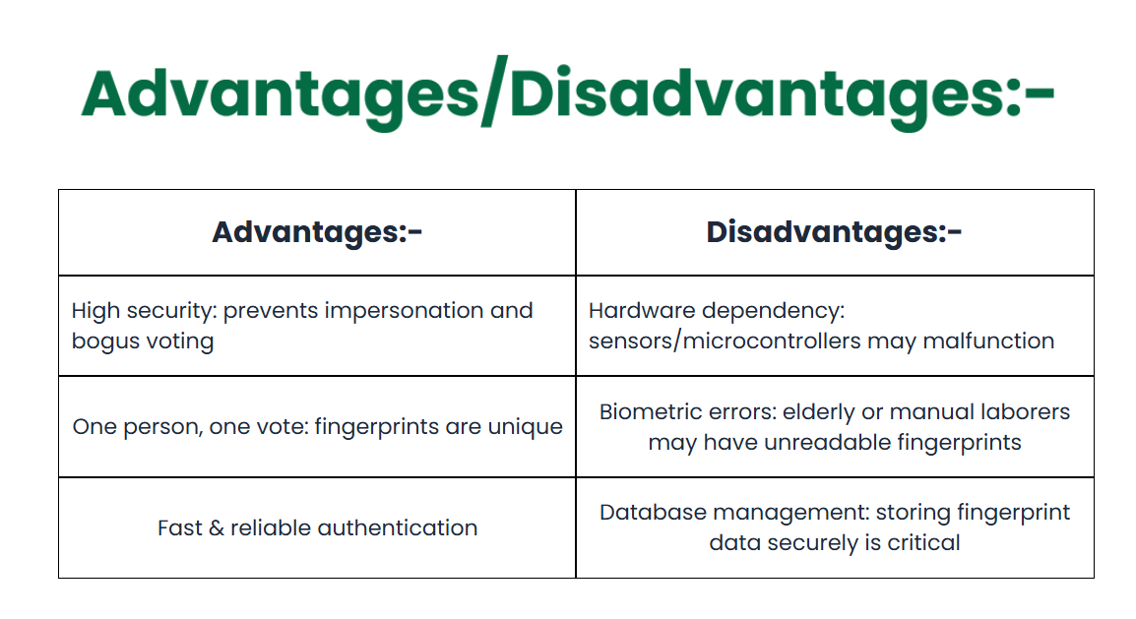

Slide 23
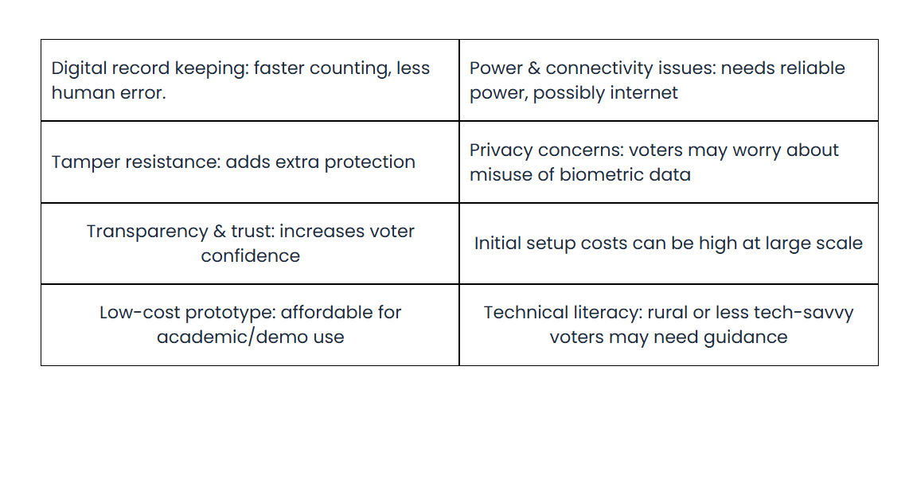

Slide 24
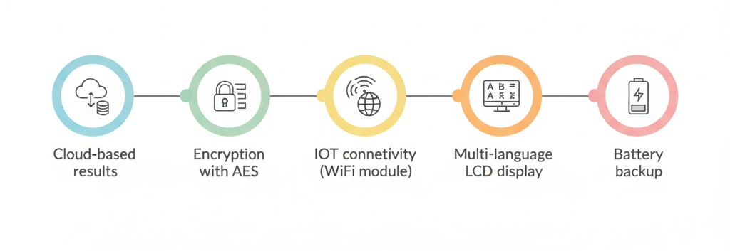
Future Enhancements

Slide 25
Conclusion
The prototype demonstrates scalable, secure voting
Enhances election transparency
Ready for real-world adaptation and improvement

Slide 26
THANK YOU

