Slide 1

B.Tech 6th Semester Minor project Presentation
“BookHive - Online Book Club”
Presented by:
Abhinav Pankajakshan (2203051240002)
Chinmay Joshi (2203051240022)
Gourang Menaria (2203051240125)
Lakshay Dave (2203051050901)
Supervisors:
PARUL INSTITUTE OF TECHNOLOGY, PARUL UNIVERSITY
PARUL INSTITUTE OF TECHNOLOGY, PARUL UNIVERSITY

Slide 2
Content of Presentation
Abstract
Introduction
Problem Statement
Literature Review
Proposed Methodology
Project Module
Use case diagram/ER diagram/Flow diagram
Hardware and software Requirement
Excepted Outcome of the Project
Limitation
Conclusion and Future Work
References
PARUL INSTITUTE OF TECHNOLOGY, PARUL UNIVERSITY
PARUL INSTITUTE OF TECHNOLOGY, PARUL UNIVERSITY

Slide 3
Abstract
The Online Book Club Platform is a web application that connects book lovers globally. It allows users to explore books, join virtual book clubs, participate in discussions, and track their reading progress.
Key features include personalized recommendations, reviews, ratings, and virtual events like author Q&A sessions.
The platform fosters community engagement through interactive forums, promoting a shared love for reading in a modern digital space.
PARUL INSTITUTE OF TECHNOLOGY, PARUL UNIVERSITY
PARUL INSTITUTE OF TECHNOLOGY, PARUL UNIVERSITY

Slide 4
Introduction
The Online Book Club Platform is a web-based application aimed at connecting readers globally to explore, share, and discuss books. The platform features personalized recommendations, book clubs, interactive forums, and virtual events.
Technologies Used:
Frontend: React.js for a dynamic user interface.
Backend: Node.js with Express for server-side logic.
Database: MongoDB for storing user data and book details.
Aim and Objective: To create a scalable and user-friendly platform that fosters community engagement, promotes reading, and enhances the literary experience through digital innovation.
PARUL INSTITUTE OF TECHNOLOGY, PARUL UNIVERSITY
PARUL INSTITUTE OF TECHNOLOGY, PARUL UNIVERSITY

Slide 5
Literature Review
Online book clubs enhance social reading by connecting readers and fostering discussions (Thomas, 2018).
Personalized recommendation systems, like those on Goodreads, improve user engagement and satisfaction (Zhang et al., 2020).
Gamification elements, such as badges and reading challenges, boost motivation and retention (Hamari et al., 2019).
Discussion forums promote knowledge sharing and critical thinking, while features like spoiler alerts enhance user experience (Brown & Smith, 2017).
Virtual events, including author Q&A sessions, deepen reader engagement (Johnson, 2021).
PARUL INSTITUTE OF TECHNOLOGY, PARUL UNIVERSITY
PARUL INSTITUTE OF TECHNOLOGY, PARUL UNIVERSITY

Slide 6
Proposed Methodology
Requirement Analysis:
Define the scope, target audience, and technical requirements.
System Design:
Create wireframes and UI/UX designs to define the user journey and layout of the platform.
Plan the database schema to handle user data, book details, and club activities.
Frontend Development:
Use React.js to build a dynamic and responsive user interface.
Integrate design elements like book lists, user profiles, and discussion forums.
Backend Development:
Use Node.js with Express to handle server-side operations and API requests.
Integrate third-party APIs (e.g., Google Books) for book information.
PARUL INSTITUTE OF TECHNOLOGY, PARUL UNIVERSITY
PARUL INSTITUTE OF TECHNOLOGY, PARUL UNIVERSITY

Slide 7
Proposed Methodology
Database Setup:
Use MongoDB to store user profiles, book clubs, discussions, and user-generated content.
Testing:
Perform unit and integration tests to ensure functionality and user experience.
Conduct user testing to gather feedback and refine features.
Deployment:
Host the platform on a cloud service (e.g., AWS or Heroku).
Set up continuous integration/continuous deployment (CI/CD) pipelines for updates and maintenance.
Launch and Evaluation:
Launch the platform, gather user feedback, and continuously improve based on user engagement and suggestions.
PARUL INSTITUTE OF TECHNOLOGY, PARUL UNIVERSITY
PARUL INSTITUTE OF TECHNOLOGY, PARUL UNIVERSITY

Slide 8
Project Module
User Authentication and Profile Management
Book Discovery and Search
Users can browse and search for books based on titles, authors, or genres
Book Club Management
Users can join or create book clubs based on their interests and track reading progress
Discussion and Interaction
Virtual Events and Author Interactions
Admin Panel and Moderation
Allows administrators to manage users, approve/disapprove content, and moderate discussions.
PARUL INSTITUTE OF TECHNOLOGY, PARUL UNIVERSITY
PARUL INSTITUTE OF TECHNOLOGY, PARUL UNIVERSITY

Slide 9
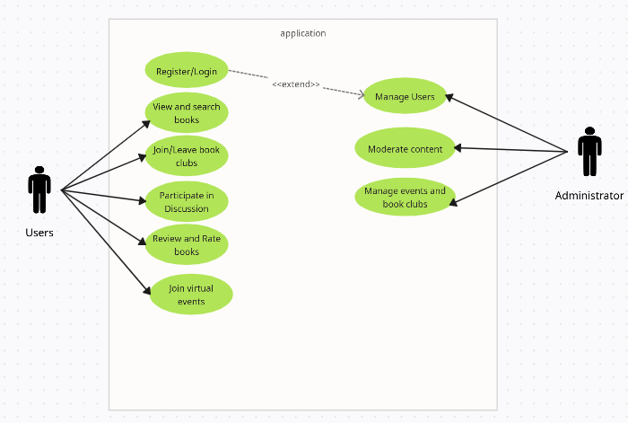
Use Case Diagram
PARUL INSTITUTE OF TECHNOLOGY, PARUL UNIVERSITY
PARUL INSTITUTE OF TECHNOLOGY, PARUL UNIVERSITY

Slide 10
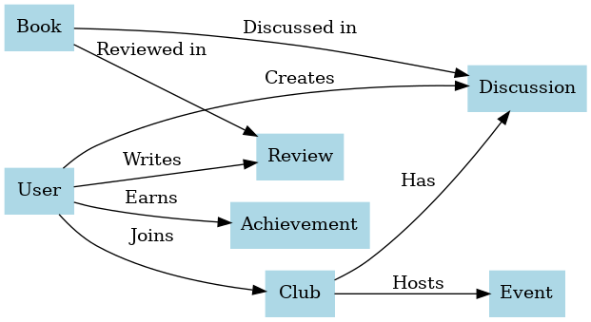
ER Diagram
PARUL INSTITUTE OF TECHNOLOGY, PARUL UNIVERSITY
PARUL INSTITUTE OF TECHNOLOGY, PARUL UNIVERSITY

Slide 11
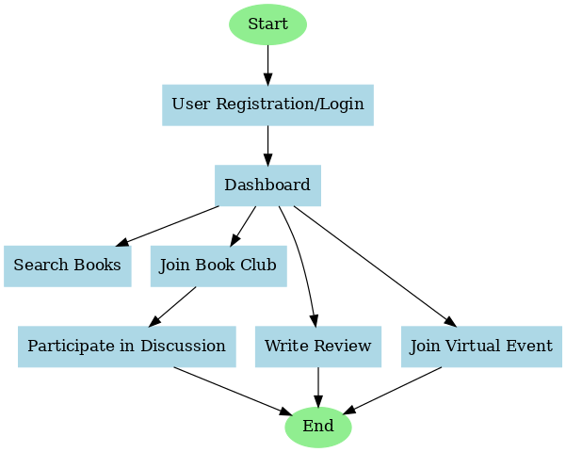
Flow Diagram
PARUL INSTITUTE OF TECHNOLOGY, PARUL UNIVERSITY
PARUL INSTITUTE OF TECHNOLOGY, PARUL UNIVERSITY

Slide 12
Hardware Requirements
Client (User Side):
Processor: Intel i3 or equivalent
RAM: 4GB or more
Storage: 10GB or more
Display: 1366x768 resolution or higher
Internet: Broadband connection for browsing and streaming virtual events
PARUL INSTITUTE OF TECHNOLOGY, PARUL UNIVERSITY
PARUL INSTITUTE OF TECHNOLOGY, PARUL UNIVERSITY

Slide 13
Software Requirements
Frontend Technologies:
React.js
HTML/CSS/JavaScript
Bootstrap/Tailwind CSS
Axios or Fetch API
Backend Technologies:
Node.js
Express.js
Socket.io
JWT (JSON Web Tokens)
Database:
MongoDB
Version Control:
Git
GitHub/GitLab
PARUL INSTITUTE OF TECHNOLOGY, PARUL UNIVERSITY
PARUL INSTITUTE OF TECHNOLOGY, PARUL UNIVERSITY

Slide 14
Software Requirements
Deployment and Hosting:
Heroku/AWS
Nginx
Docker
Other Tools:
Postman
VS Code or IntelliJ
Figma/Adobe XD
PARUL INSTITUTE OF TECHNOLOGY, PARUL UNIVERSITY
PARUL INSTITUTE OF TECHNOLOGY, PARUL UNIVERSITY

Slide 15
Expected Outcomes
A global platform for book lovers to connect and discuss books.
Personalized book recommendations and engaging reading experiences.
Efficient management of virtual book clubs and events.
Improved access to authors via live Q&A sessions.
A scalable, user-friendly system that promotes a reading culture.
PARUL INSTITUTE OF TECHNOLOGY, PARUL UNIVERSITY
PARUL INSTITUTE OF TECHNOLOGY, PARUL UNIVERSITY

Slide 16
Limitations
Requires a stable internet connection.
Performance may decline with a large user base.
No offline access to content.
Risk of data security breaches.
Dependency on third-party APIs.
Challenges in moderating user content at scale.
PARUL INSTITUTE OF TECHNOLOGY, PARUL UNIVERSITY
PARUL INSTITUTE OF TECHNOLOGY, PARUL UNIVERSITY

Slide 17
Conclusion
The Online Book Club Platform connects readers worldwide, offering features like personalized recommendations, forums, and virtual events to enhance the reading experience.
Future Work:
Develop a mobile app.
Implement AI-based recommendations.
Add offline access and multilingual support.
Enhance security measures.
Introduce gamification and more collaboration tools.
PARUL INSTITUTE OF TECHNOLOGY, PARUL UNIVERSITY
PARUL INSTITUTE OF TECHNOLOGY, PARUL UNIVERSITY

Slide 18
References
Thomas, J. (2018). The Role of Online Communities in Promoting Reading Habits. Journal of Digital Learning, 12(4), 45-52.
Zhang, L., et al. (2020). Recommendation Systems for Digital Libraries: A Case Study. International Journal of Computer Science, 34(2), 78-85.
Hamari, J., Koivisto, J., & Sarsa, H. (2019). Gamification: A Study on Engagement and Retention. Proceedings of the 52nd Hawaii International Conference on System Sciences, 1187-1196.
Brown, A., & Smith, R. (2017). Discussion Forums as a Tool for Collaborative Learning. Education and Technology Review, 25(3), 89-101.
Johnson, K. (2021). Virtual Events: Engaging Readers in the Digital Age. Book Club Insights, 18(1), 33-40.
PARUL INSTITUTE OF TECHNOLOGY, PARUL UNIVERSITY
PARUL INSTITUTE OF TECHNOLOGY, PARUL UNIVERSITY

