Slide 1
BookHive Software Requirements Specification
An Online Book Club Social Media Platform
MERN Stack Project

Slide 2
1. Introduction
• Purpose: Outline the software requirements for BookHive.
• Scope: A web-based platform for book lovers to connect.
• Overview: Covers functional, non-functional requirements, design, and system architecture.

Slide 3
1.1 Purpose
The purpose of this document is to detail the requirements for BookHive, an online social media platform designed for book lovers to interact, share, and connect over books, authors, and genres.

Slide 4
1.2 Scope
BookHive is a MERN stack web application enabling users to:
• Create profiles
• Join groups
• Post reviews
• Comment on discussions
• Receive book recommendations
• Connect with like-minded readers.

Slide 5
2. Functional Requirements
• User Authentication and Authorization
• Profile Management
• Book and Genre Management
• Group Creation and Membership
• Posting, Commenting, and Liking
• Book Recommendations
• Follow/Unfollow Users

Slide 6
3. Non-Functional Requirements
• Scalability
• Security with JWT Authentication
• Responsive Design
• High Performance
• Usability and Accessibility

Slide 7
4. System Design
The system uses a MERN stack architecture:
• MongoDB for database
• Express.js for backend API
• React.js for frontend UI
• Node.js for server runtime

Slide 8
4.1 ER Diagram
The ER diagram defines entities like User, Book, Post, Comment, Group, etc., and their relationships to ensure seamless data flow and integration.

Slide 9
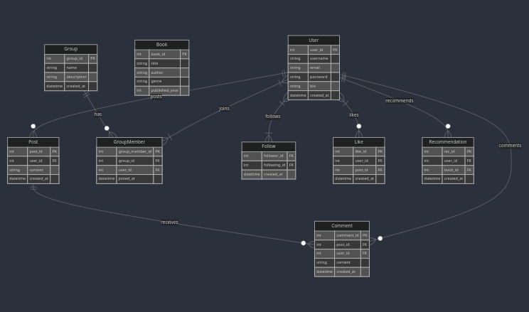
ER Diagram

Slide 10
5. Conclusion
BookHive is designed to provide a vibrant community for book lovers, offering seamless interaction, personalized book recommendations, and an engaging user experience.

Slide 11
ER Diagram

