Slide 1
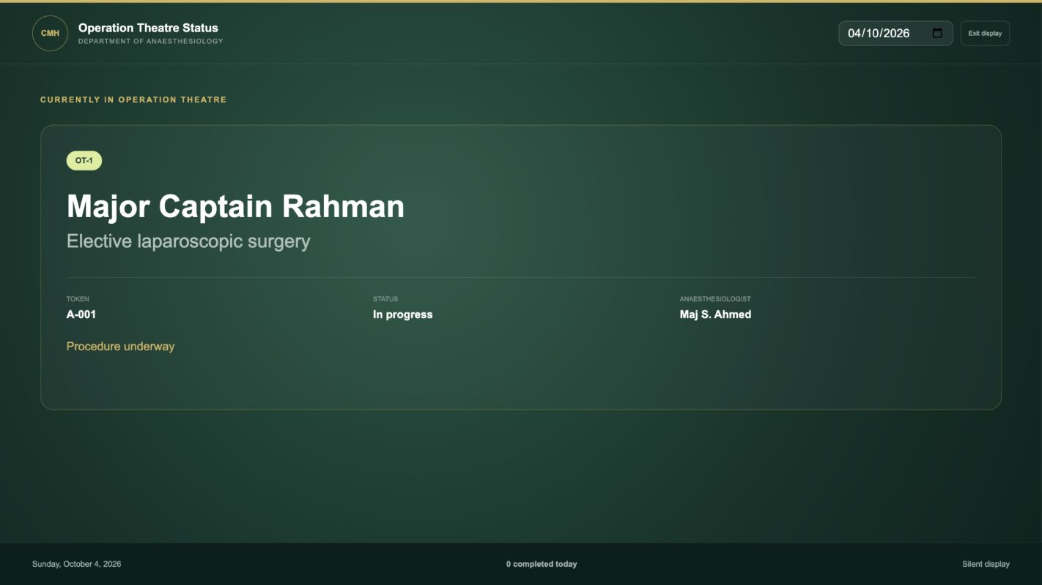
CMH ANAESTHESIA
LIVE OT DISPLAY
A clearer patient journey
Reception, doctor scheduling and operation theatre coordination in one simple system
Proposal for the Department of Anaesthesiology
Current patient • live status • visible across the waiting area
Notes:
Open with the operational problem, not the technology. Explain that the proposal gives patients and staff one visible journey from reception to the operation theatre. Keep the opening under one minute.

Slide 2
The coordination challenge
02
Reception, doctors and the OT desk currently depend on separate paper steps and verbal updates.
01
Reception
Records the patient and prepares a paper token and form
02
Doctor
Reviews the patient and decides a future operation date
03
OT desk
Runs tomorrow's list and updates the live status
04
Waiting area
Needs a clear, silent view of current and upcoming patients
The proposal keeps the clinical decision on paper and in the doctor's hands while simplifying coordination.
Notes:
Describe the handoffs that create confusion: reception creates a record, the doctor later chooses an OT date, and the OT desk must know who is waiting or inside. The system connects those handoffs without changing clinical judgment.

Slide 3
One patient record from reception to completion
03
1
2
3
4
5
6
Register
Issue token
Doctor review
Create roster
Update status
Inform patients
Essential details only
Barcode and paper form
Schedule a future OT date
Patient appears on that date
Waiting to completed
Silent TV rotation
Every OT patient begins with an authorised reception record. No duplicate typing and no image recognition are required.
Clinical examination and handwritten notes remain on the printed anaesthesia form.
Notes:
Walk left to right. Emphasise that the doctor still chooses the date and clinical plan. The software only carries the approved patient record forward and keeps the list visible.

Slide 4
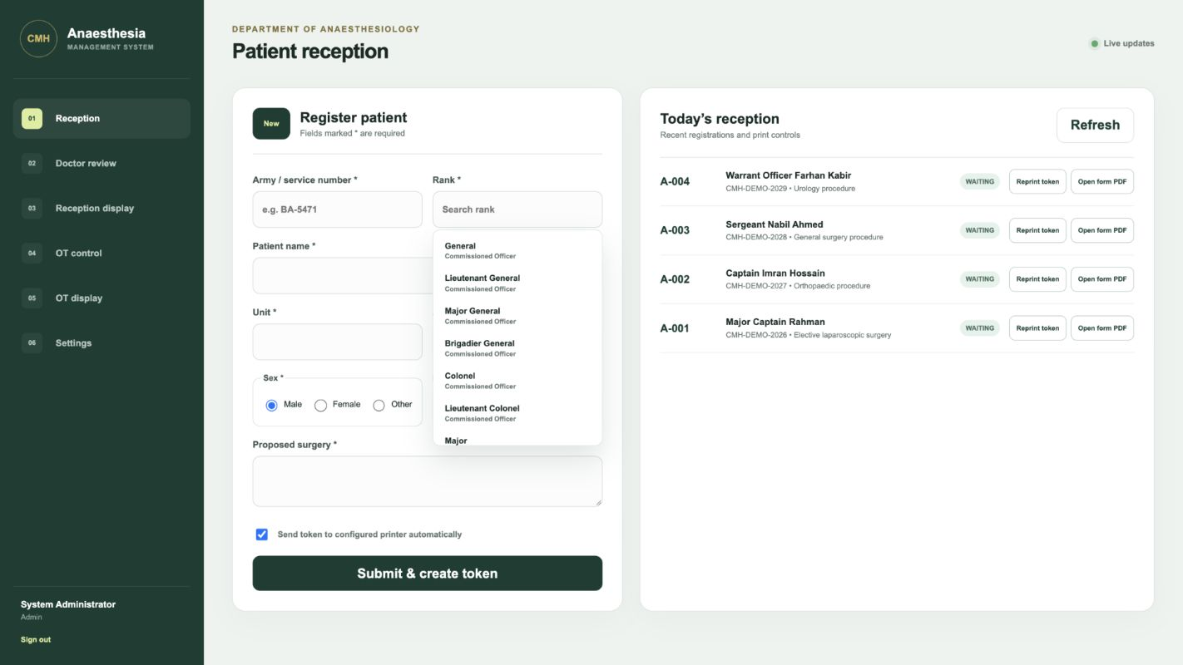
Reception entry stays short and familiar
04
Only essential information
Army or service number remains unique
Rank is searchable from a controlled list
Name, unit, age and sex
Proposed surgery and anaesthetic
Illustrative demonstration using synthetic patient records
Notes:
Point to the open rank list. Reception staff do not have to remember abbreviations or type the same details in several places. The patient record begins with a unique service number.

Slide 5
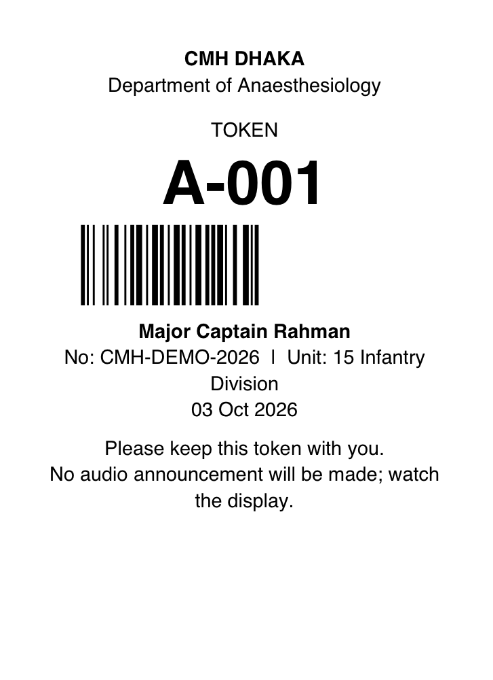
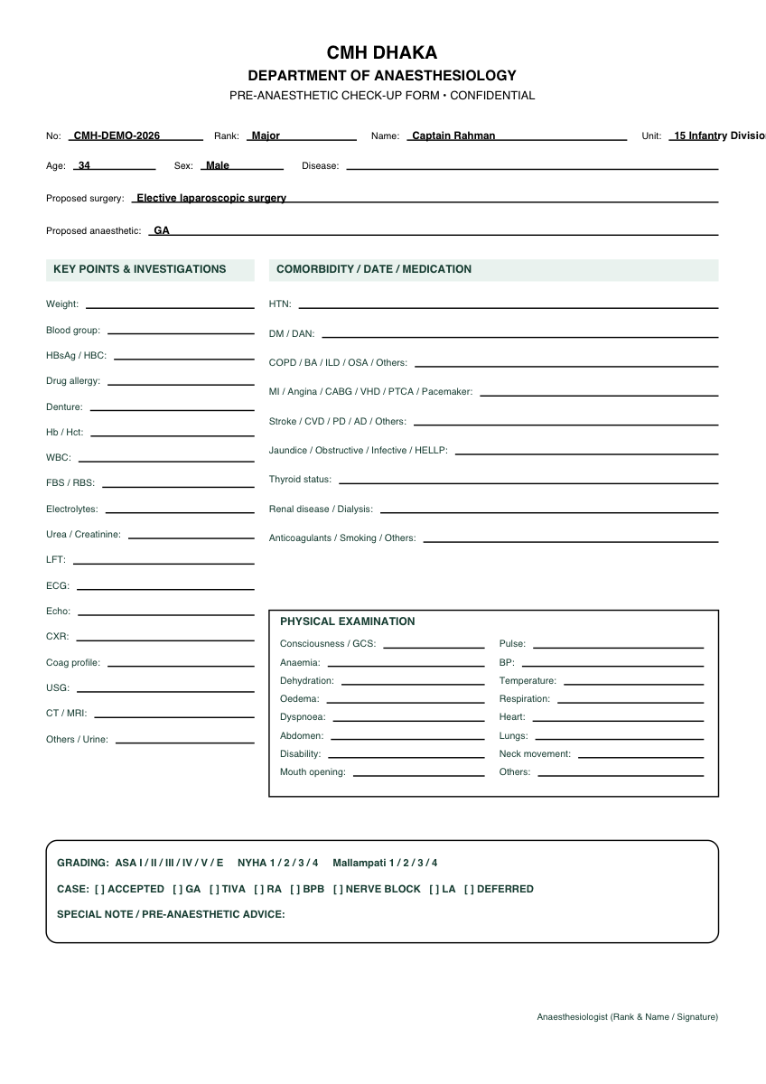
One submission produces the patient documents
05
Token
The patient receives a compact barcode token with a large visible number.
Anaesthesia form
Reception keeps the two-page form. Patient details are pre-filled and clinical sections remain blank for handwriting.
Thermal paper dimensions and both printer queues remain configurable until hardware selection.
Notes:
Show the two physical outputs. The token goes to the patient. The A4 form stays with reception and the doctor. Printing happens from the server, so staff do not use a browser print dialogue.

Slide 6
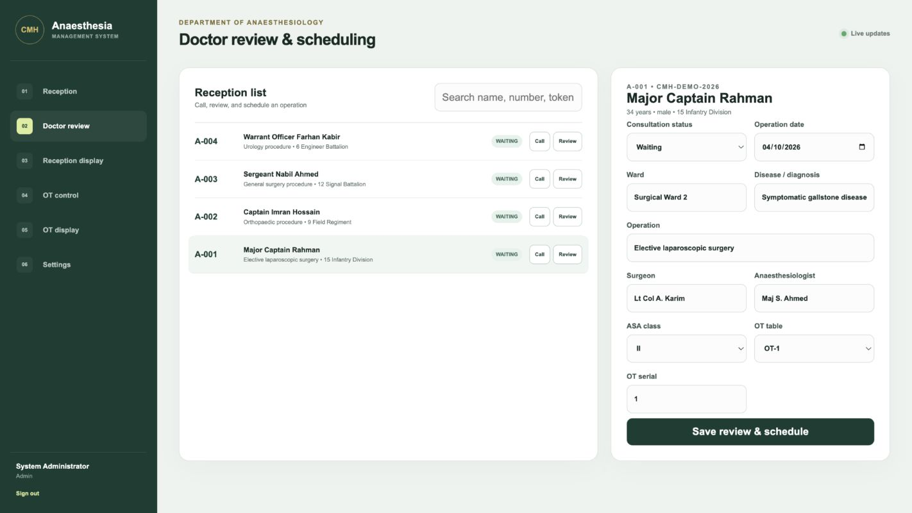
The doctor controls the operation date
06
The system never decides who will receive surgery or when it will happen.
Review
Open the original reception record
Decide
Select the future OT date and clinical details
Schedule
Create that day's OT entry automatically
Illustrative demonstration using synthetic patient records
Notes:
Make the governance point clearly. The doctor remains responsible for the decision. The software records that decision and makes the approved list available to OT control.

Slide 7
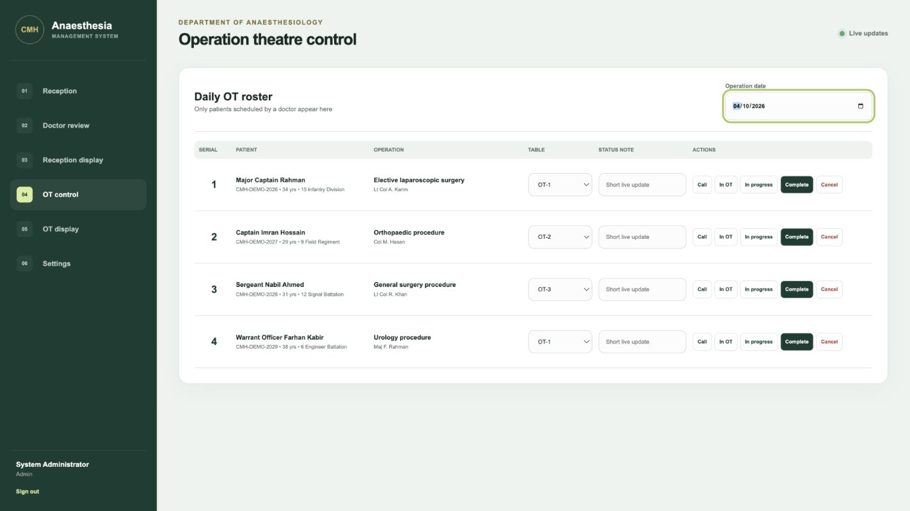
Tomorrow's OT roster is ready from the same records
07
Simple status controls
01
Waiting
02
Called
03
In OT
04
In progress
05
Completed
06
Cancelled
The next three waiting patients feed the television display automatically.
Illustrative demonstration using synthetic patient records
Notes:
Explain that the OT desk changes one status at a time. The wall display updates immediately. Completed and cancelled patients leave the upcoming queue without anyone preparing another list.

Slide 8
The room can see the current OT case
08
Large type for a 43-inch television
Silent by design
Notes:
Pause on this screen. The current token, patient, operation, status and anaesthesiologist are visible at a distance. There is no sound cue in the proposed workflow.

Slide 9
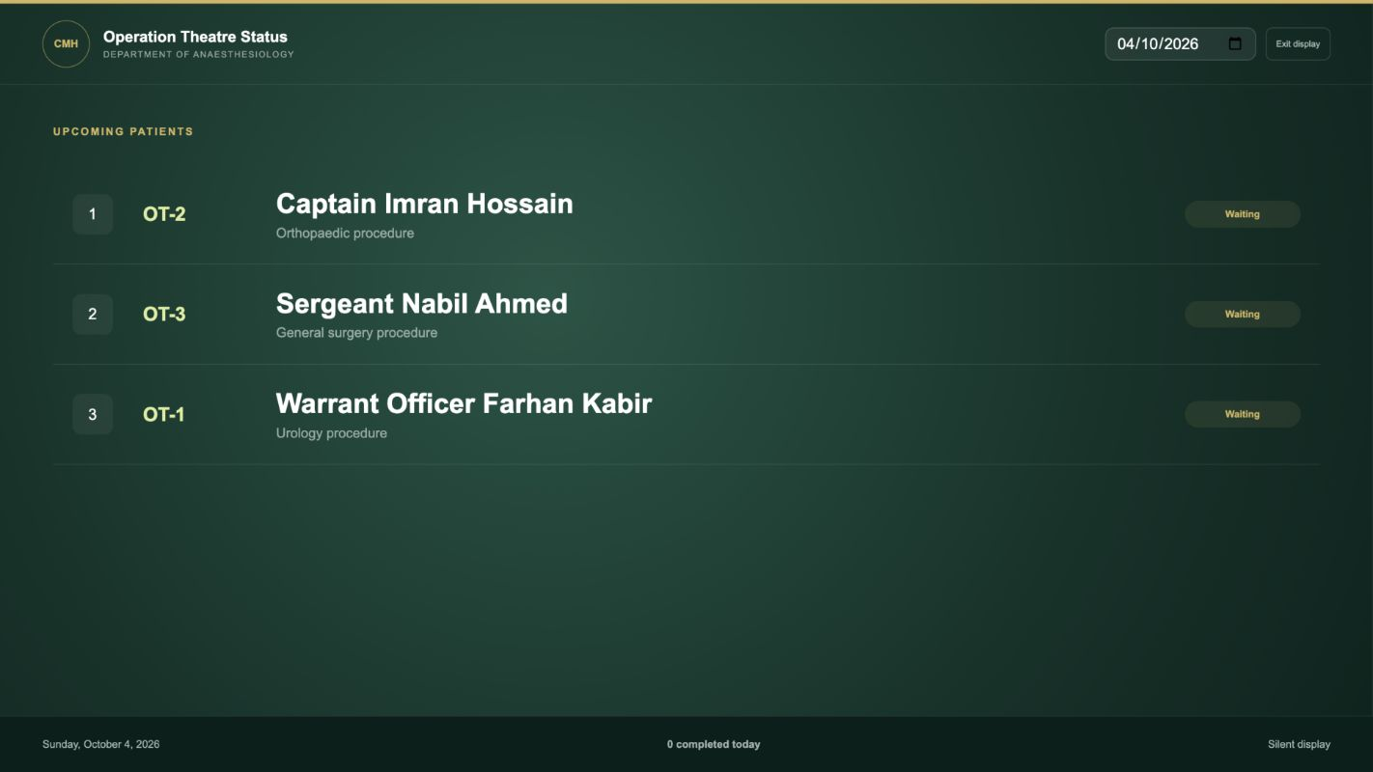
The display then shows the next three patients
09
Current case: 10 seconds
Upcoming list: 15 seconds
Notes:
Explain the silent rotation. The current case stays visible for ten seconds, then the next three patients stay visible for fifteen seconds. Both times can be changed in settings.

Slide 10
What improves for each group
10
1
2
3
4
Patients
Reception
Doctors
OT team
A clear token and visible queue reduce uncertainty while waiting.
One short entry creates the record, token and paper form.
The original record stays available when the operation date is chosen.
The live roster and wall display follow the same status update.
The software supports the existing clinical process. It does not replace professional judgment.
Benefits shown are operational expectations for a controlled pilot, not measured results.
Notes:
Keep this practical. Discuss the daily experience for each group. Avoid technical language and do not promise numerical savings before the pilot measures them.

Slide 11
Deployment inside the CMH network
11
Reception PC
OT control PC
CMH SERVER PC
Database and application
Doctor PC
Windows for daily deployment
Wall television
Mac and Windows supported for development and demonstration
Designed for the approved private LAN. Internet access is not required for normal daily use.
Notes:
Describe one Windows server PC on the approved private network. Staff PCs open the system through a simple address. The television uses the same network. The proposal does not require a public cloud connection for daily work.

Slide 12
Operational safeguards
12
Controlled access
Separate roles for reception, doctor, OT control, display and administration
Traceable changes
Audit records preserve who changed important information and when
Printing continuity
A printer problem never removes the patient record. Staff can reprint later
Data protection
Local deployment, secure passwords and daily approved backups
Before production use: confirm the CMH network, backup location, user list and HTTPS policy with the IT head.
Security controls require CMH IT approval and production configuration before launch.
Notes:
This is the governance slide. Explain that every role sees only the tools it needs. Backups and secure network settings must follow CMH policy before any real patient information enters the system.

Slide 13
PROPOSED NEXT STEP
Approve a controlled departmental pilot
Decision requested
Permission to run a staff-reviewed pilot using synthetic records
The pilot can confirm the workflow with staff before any production rollout.
1
Nominate the reception, doctor and OT representatives
2
Confirm the private network and Windows server location
CMH Anaesthesia Management System
3
Select the token printer, paper size and A4 printer queues
4
Test with demonstration records before live patient use
Notes:
Close with a small, safe request. Ask for permission to demonstrate the workflow with synthetic records, confirm the network and printer choices, and gather staff feedback before live use.

