Slide 1
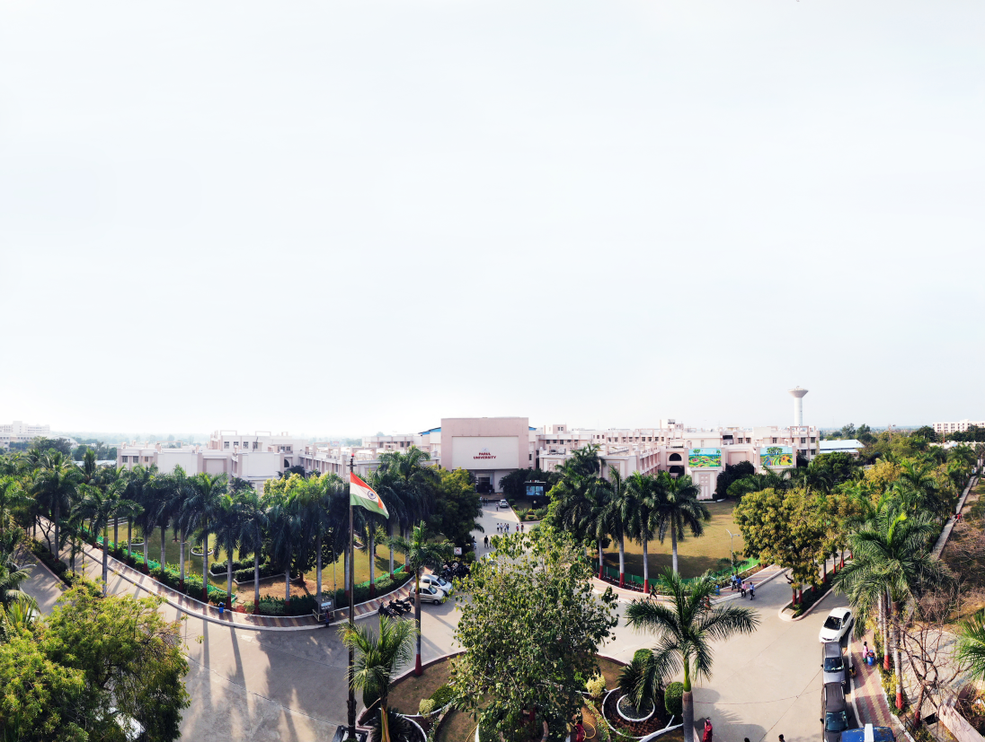



IOT Based Health Care Card
Presented By:
Govind Jha (190303105239)
Jaynesh Mehta (190303105245)
Harshal Patil (190303105258)
Dhaval Parmar (190303105250)
Dharm Patel (190303105221)
Supervised by:
Muskan Kumari

Slide 2
OUTLINE
Introduction
Objectives of Project Work
Literature Survey
Problem Statement
Scope of Project
Application UI
Conclusion & Future Work
Reference

Slide 3
Introduction
IOT based is Health Care Card .
Application is used to track health status .
Keeping important documents safe.
Chatting facility with AI Chatbot .
E-Prescription System.

Slide 4
Objectives of PROJECT Work
Help in health Sector .
Help in making digital india .
Unconsciously sharing of information .
Protect from communicable disease .

Slide 5
Literature Review
Sl. No. | Paper Title | Journal Name | Publishing Year | Author Name
1 | Design and implementation of a smart card based healthcare information system | International Computer Institute, Ege University. | May, 2005 | E. Turhan Tunali
2 | NFC based Smart Healthcare Services System | International Journal for Innovative Research in Science & Technology | Jan, 2018 | Sandeep Kumar Polu
3 | Evaluation of Chatbot Prototypes for Taking the Virtual Patient’s History | GECKO Institute, Heilbronn University of Applied Sciences | June, 2019 | Andreas REISWICH, Martin HAAG

Slide 6
Literature Review
Sl. No. | Paper Title | Journal Name | Publishing Year | Author Name
4 | The Impact Of Health Card On Citizens’ Quality Of Life | University of Dhaka, Bangladesh | Feb, 2016 | Md. Rakibul Hoque
5 | Managing Medical and Insurance Information Through a Smart-Card-Based Information System | Journal of Medical Systems | Jan, 2000 | C. Lambrinoudakis1 and S. Gritzalis
6 | Patient Healthcare Smart Card System: A Unified Medical Record for Access and Analytics | Management Information Systems Xavier University Cincinnati, Ohio 45207 | Oct, 2016 | Sadath Hussain, Thilini Ariyachandra & Mark Frolick

Slide 7
Literature Review
Sl. No. | Paper Title | Journal Name | PublishingYear | Author Name
7 | Experiencing NFC-based Touch for Home Healthcare | Cristina Cruces, Nuria Gomez de Segura Ikerlan-IK4 | Sept, 2009 | Rosa Iglesias, Jorge Parra
8 | Chatbot for Healthcare System Using Artificial Intelligence | ICRITO | March, 2020 | Vinod Kumar Shukla, Ajay Rana, Nitin Pandey
9 | Personal Health Card: Use of QR Code to Access Medical Data | Kamran Imam University of Rhode Island | July, 2018 | KAMRAN IMAM
10 | The Emergency Data Set for the German Electronic Health Card | Health Informatics Meets eHealth D. Hayn et al | Feb, 2015 | D. Hayn et al

Slide 8
Problem Statement
Problem of maintaining patient medical reports and prescriptions.
Sharing information of unconscious patients.
No virtual consultancy and Appointment with doctor.
Increase in crowd in the hospital.
Problem of getting proper doctor .
Lack of information of newly come diseases & seasonal diseases.

Slide 9
Scope OF Project
HCC is useful for :
Hospitals & laboratories
Doctors
Patients
Chemist
Insurance
HCC is available for 24 X 7

Slide 10
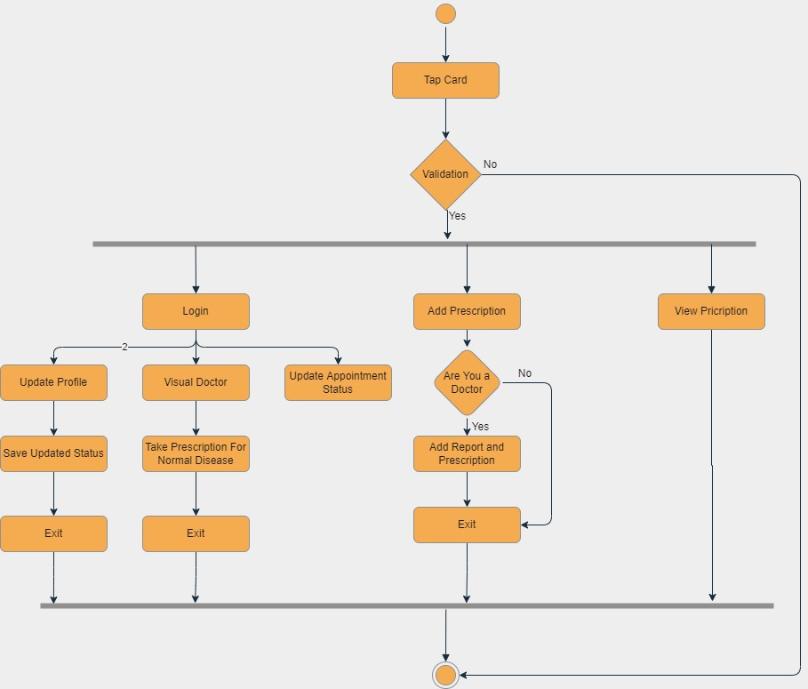
Working Flowchart

Slide 11
Tools and Technology
Software & Algorithm
Database
Tools
Java
Xml
HTML
CSS
Tailwind
Bootstrap
PHP
JavaScript
XAMPP Server
Visual Studio
Android Studio
Arduino IDE
MySQL
Firebase

Slide 12
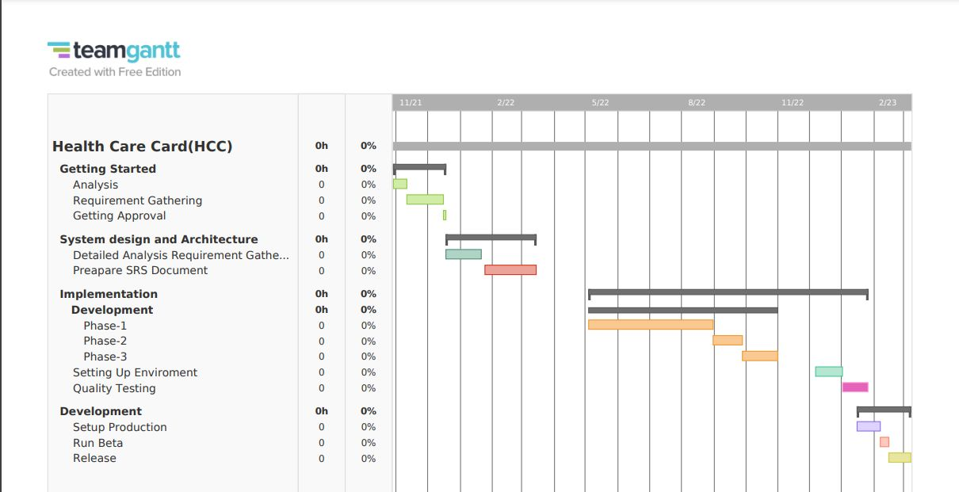
Gantt Chart

Slide 13
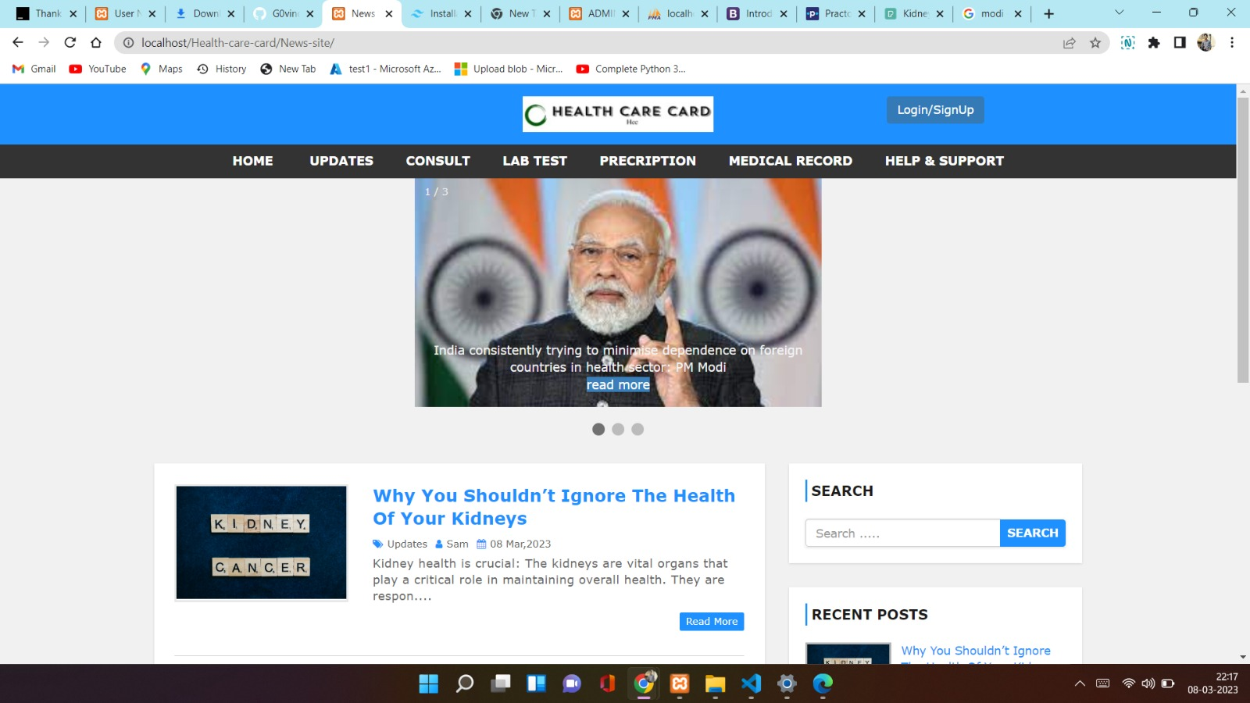
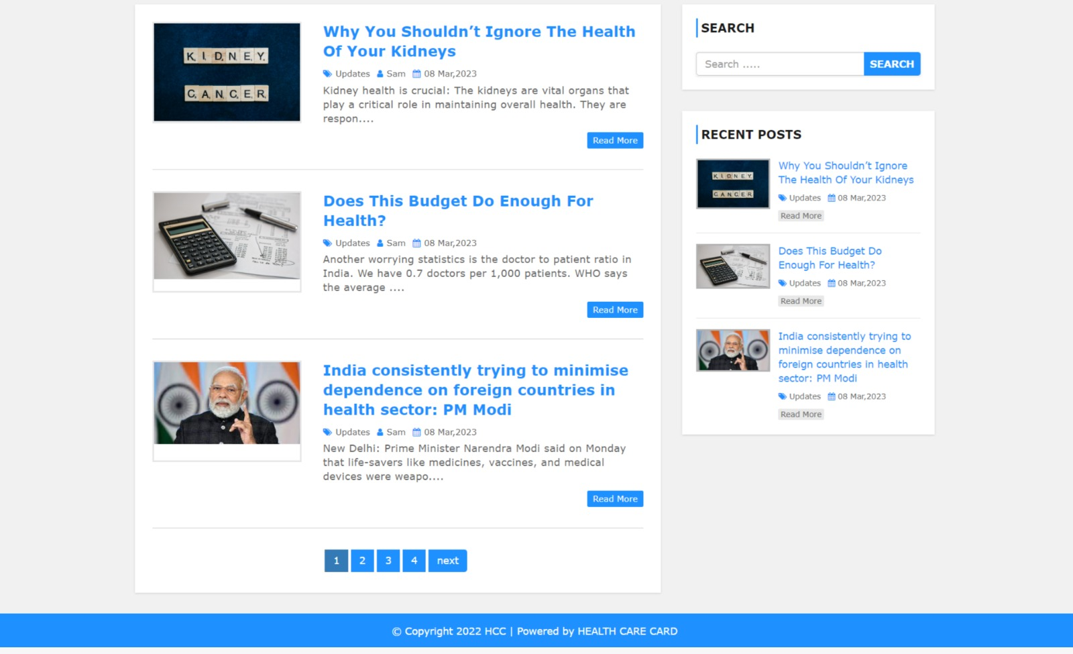
Initial interface of website

Slide 14
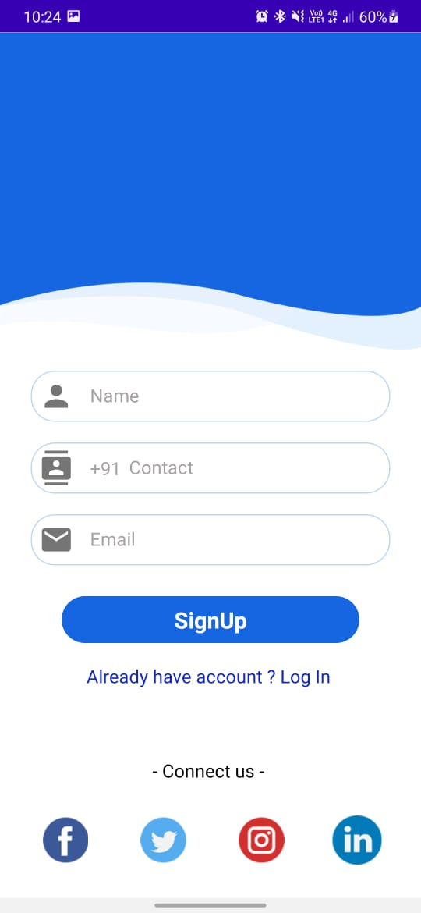
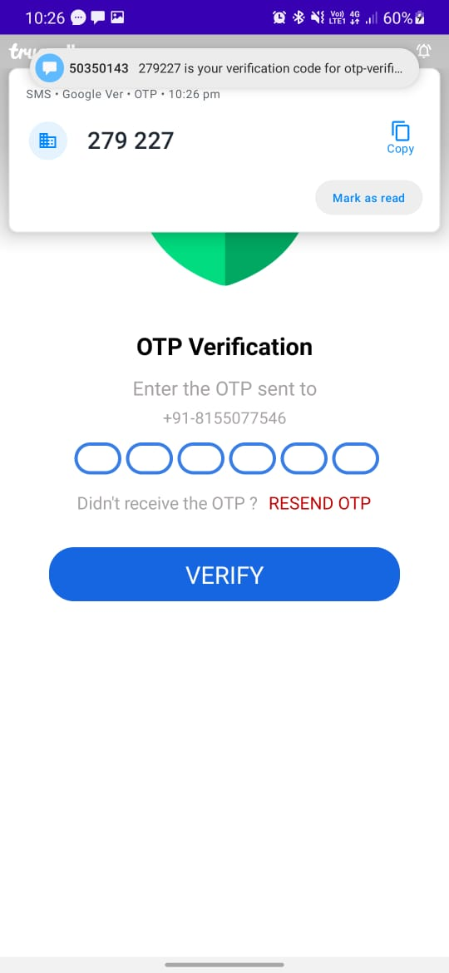
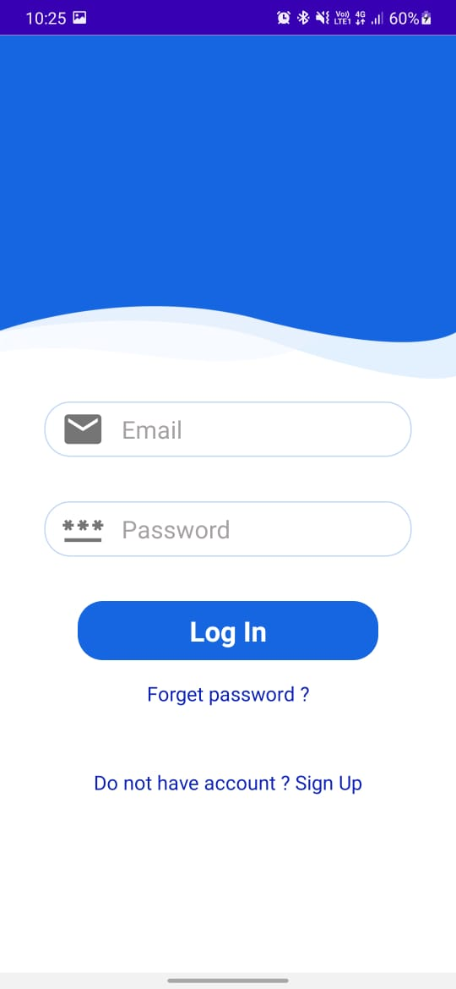
Application UI
-

Slide 15
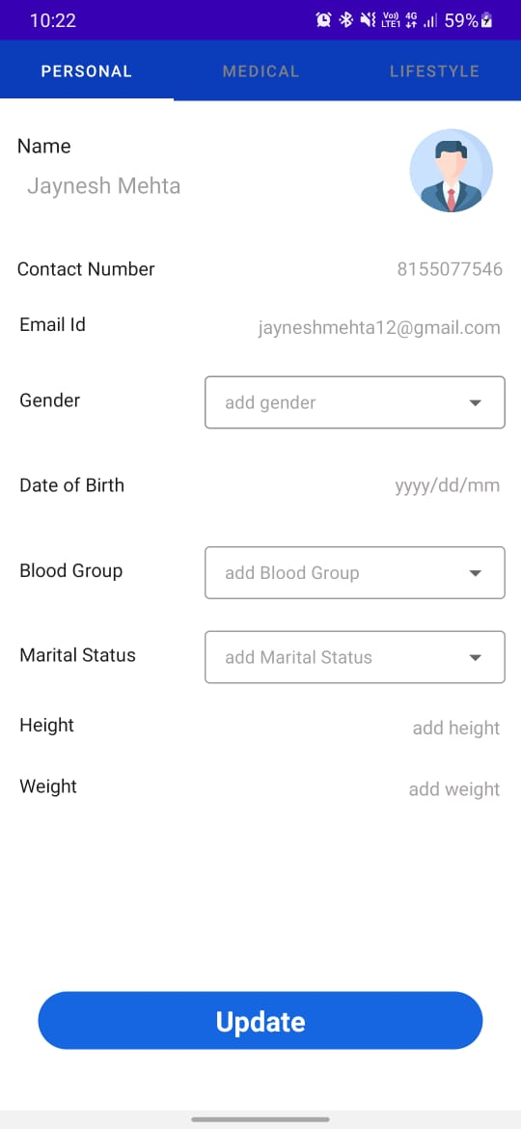
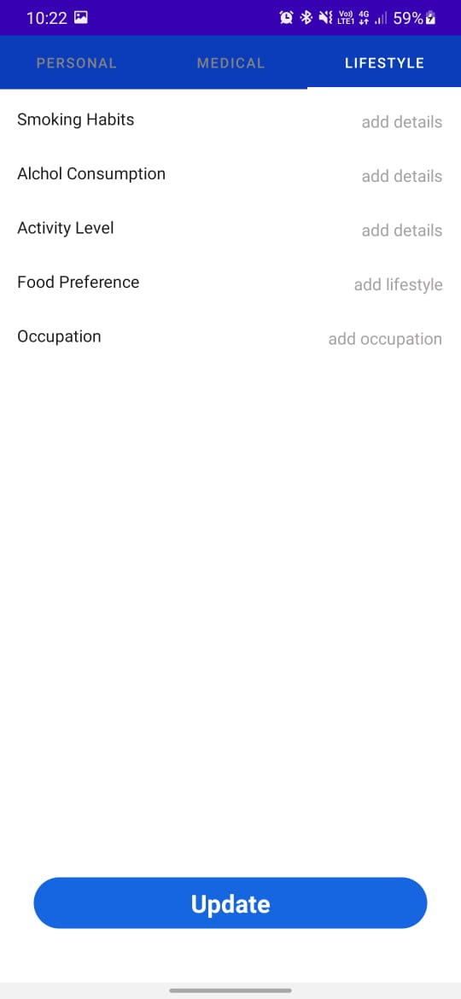
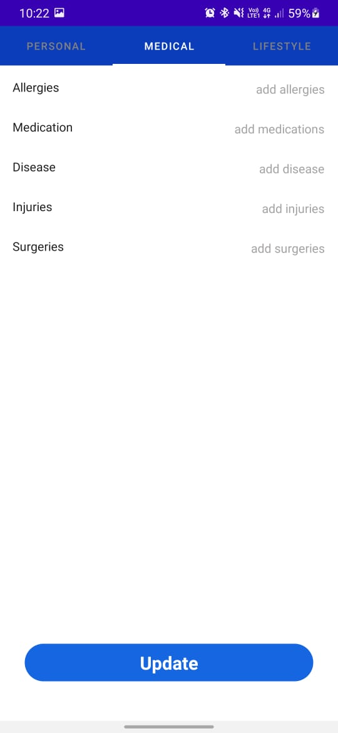
Application UI

Slide 16
Comparison Of Existing algorithms
Applications similar to us :
Mfine docs app.
Practo consulting app.
My fitnesspal app etc.
How we are different :
we provide physical card .
Update you by informing the latest disease .
Also provide preferable cure .
Chat bot, booking an Appointment .
Organ donation channel .

Slide 17
Conclusion
Using IOT we are creating a card that if we tap in the hospital, Doctor's Clinic or in medical store they will able to see the profile of user.
If we tap our card in the hospital then for hospital’s record purpose then will store some information of user and pass further information to the appointed doctor.
Doctor will able provide prescription digitally in card only if he is certified.
Chemist have access of only for recent prescribed medicine by doctor.
All the Lab reports of user will directly upload in card for further use.
By using chatbot user will able to get cure of normal disease if there is something serious in analatical report by chatbot then chatbot suggest specialist doctor of that disease in near by hospital and provide appointment with that doctor.
Project can Updated in near future as and when requirement arries as it is very flexible in terms of expansion.

Slide 18
Future Work
Practical implementation would be directed towards it’s actual platform in future(i.e. android ,iOS etc).
More Efficient work of HCC
Project can be updated in near future as and when requirement for the same arises, as it is very flexible in terms of expansion.

Slide 19
References
[1] T. Tunali, S. Yildirim, T.Dalbasti, The use of smart card sin health care, Hermes ProjectWorkshop,2002, pp
[2] C. Pagetti, C. Mazini, M. Pierantoni, G. Gualandi, H. Schepel, A European Health Card Final Report, European Parliament, Directorate General for Research, Document for STOA Panel, 2001, pp. 16–29.
[3] Z. Chen, Java Card TM Technology for Smart Cards Architecture and Programmer’s Guide, AddisonWesley, MA, USA, 2000.
[4] Deng, Z., Mo, X., & Liu, S. (2014). Comparison of the middle-aged and older users’ adoption of mobile health service sin China. International journal of medical informatics,83(3), 210-224
[5] Dorland,W. A.N.(1980). Dorland’s medical dictionary. Saunders Press. Dünnebeil, S.,Sunyaev, A.,Blohm, I., Leimeister, J. M., & Krcmar, H. (2012).
[6] Determinants of physicians’ technology acceptance for e-health in ambulatory care. International journal of medical informatics, 81(11), 746- 760.
[7] Ernstmann, N., Ommen, O., Neumann, M., Hammer, A., Voltz, R., & Pfaff, H. (2009).Primary care physician's attitude towards the GERMAN e-Health Card Project— Determinants and Implications. Journal of medical systems,33(3), 181-188
[8] Hage, E., Roo, J. P., van Offenbeek, M. A., & Boonstra, A. (2013). Implementation factors and their effect on e-Health service adoption in rural communities: a systematic literature review. BMC health services research, 13(1), 19.
[9] E. Smith and J.H.P. Eloff, “Security in health-care information systems,” International Journal of Medical Informatics, vol. 54, pp. 39–54, 1999.
[10] Favela, J., Tentori, M., Castro, L. A., Gonzalez, V. M., Moran, E. B., and Martínez- García, A. I. 2007. Activity recognition for context-aware hospital applications: issues and opportunities for the deployment of pervasive networks. Mob. Netw. Appl. 12, 2- 3 (Mar. 2007).

Slide 20
Thank you

