Slide 1
deeptools PGT coolpup 相关
日期： 2024.12.5

Slide 2
deeptools

Slide 3
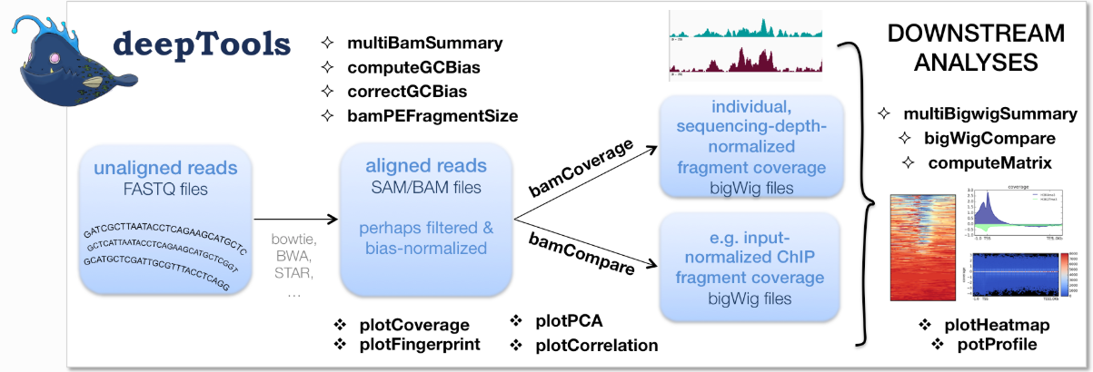
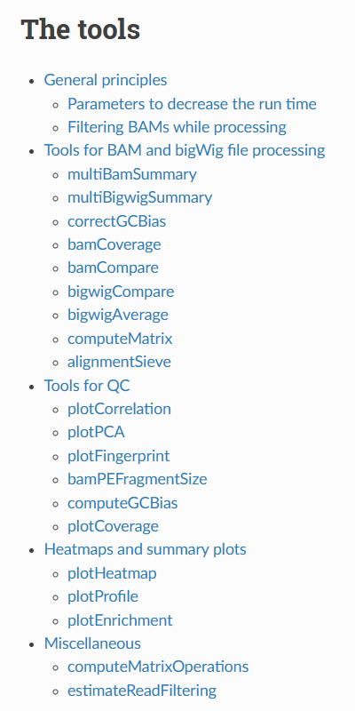
说明文档
https://deeptools.readthedocs.io/en/develop/
https://deeptools.readthedocs.io/en/latest/content/list_of_tools.html

Slide 4
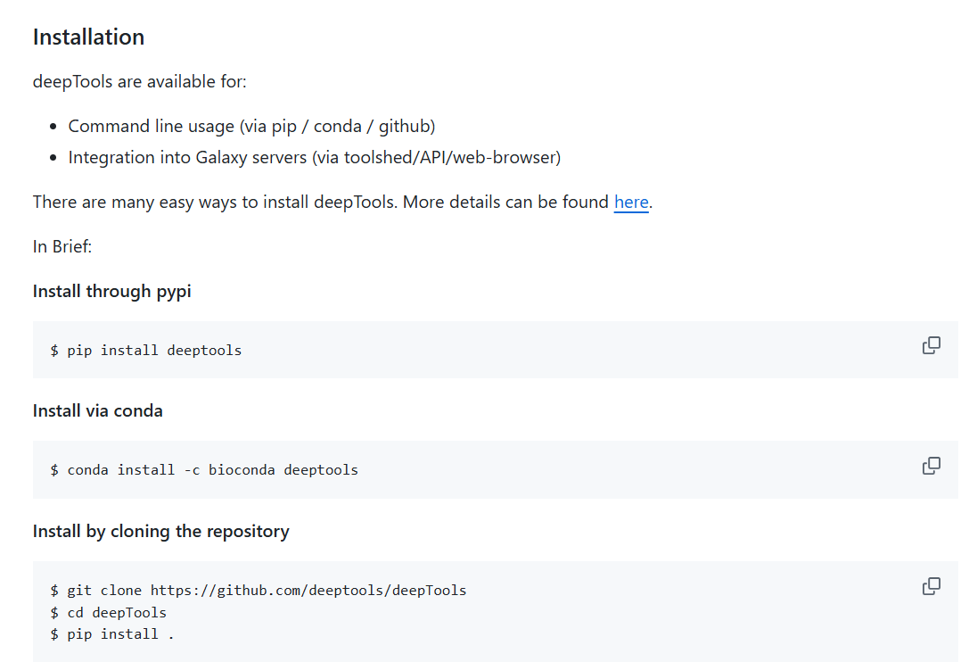
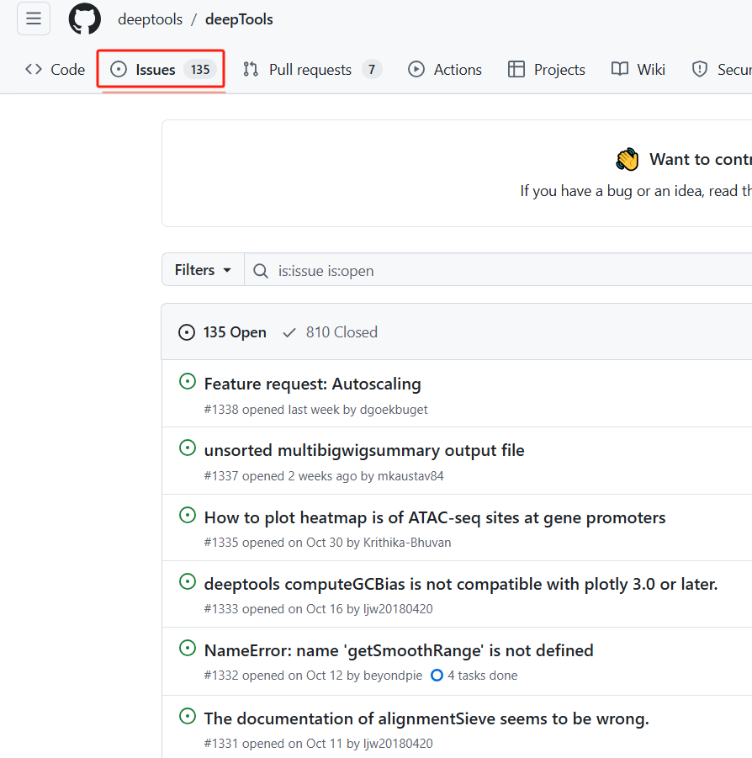
https://github.com/deeptools/deepTools

Slide 5
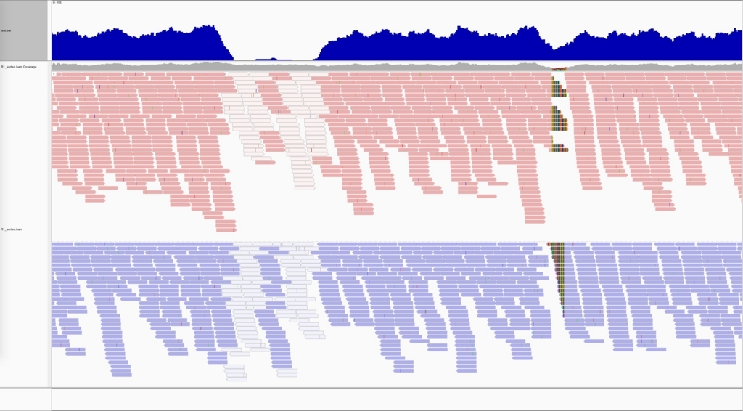
主要功能
cp -r /public/fscourse/3d/Interactome/deeptools/last_lesson ./
处理 bam 和 bigwig 文件
bamCoverage
bigwigCompare/bigwigAverage
multiBamSummary/multiBigwigSummary
computeMatrix
QC 可视化
plotCoverage
plotCorrelation
plotPCA
区域可视化
plotHeatmap
plotProfile
plotEnrichment
bamCoverage -p 10 -of bigwig -o C1.bw \
-b C1.bam --normalizeUsing CPM \
--binSize 1000000

Slide 6
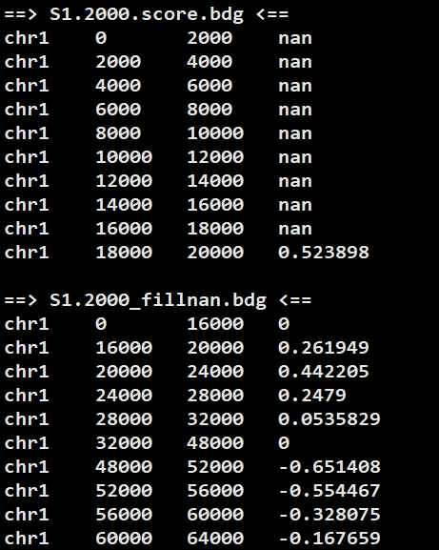
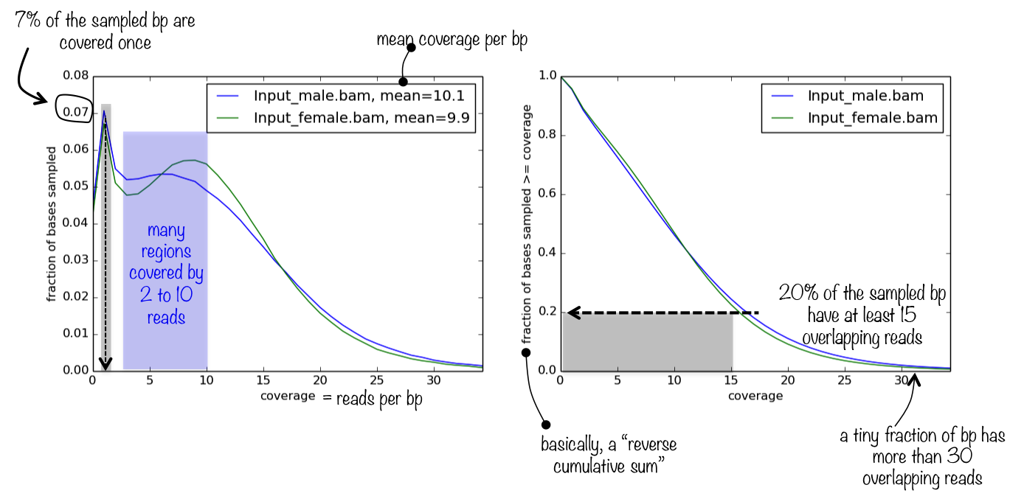
plotCoverage
bigwigCompare -p 10 -b1 C1.bw -b2 C1.bw -bs 2000000 \
-of bedgraph -o C1_2m.bdg --operation mean

Slide 7
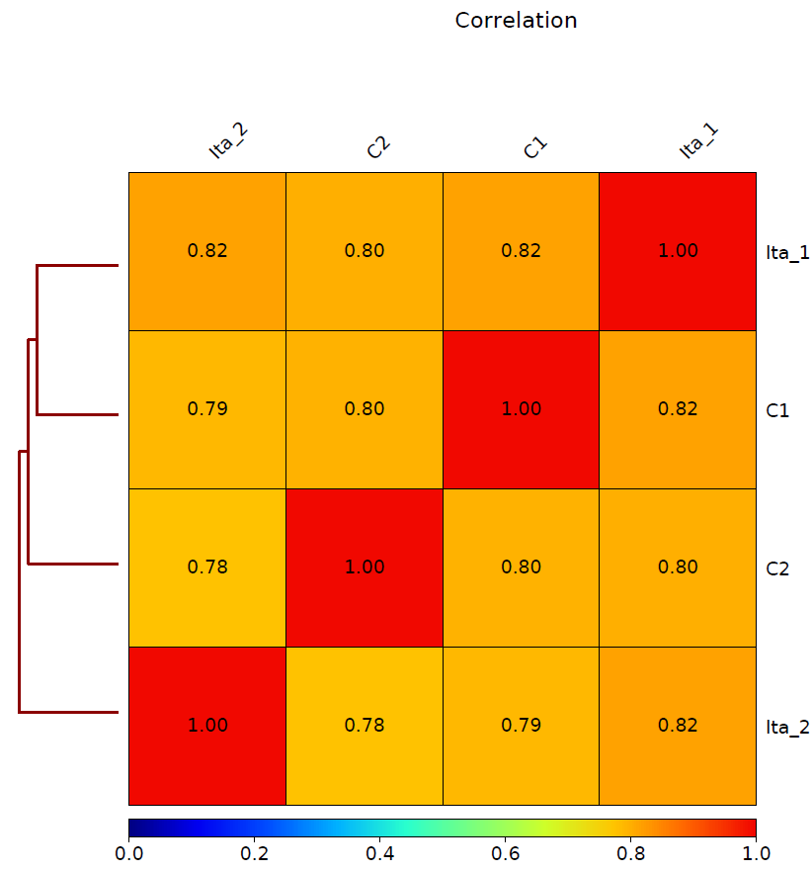
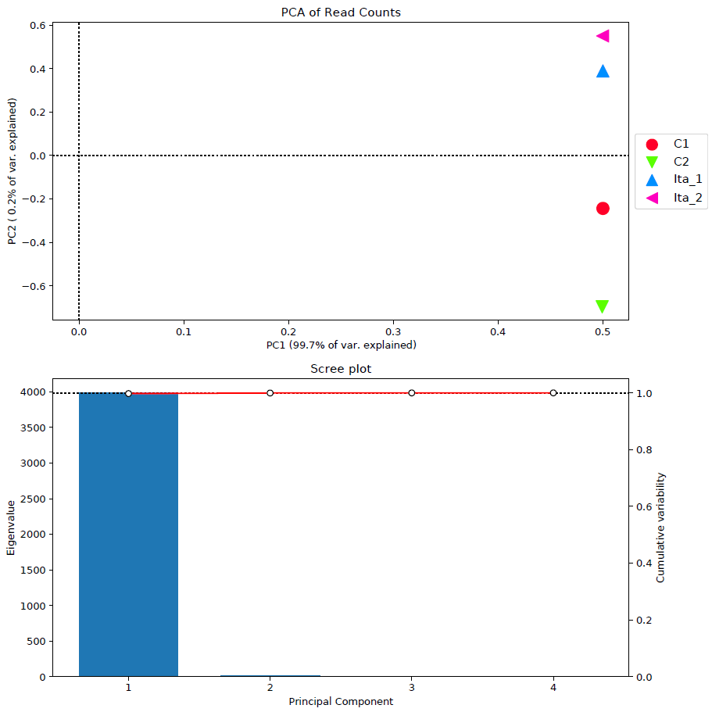
multiBamSummary bins -p 10 \
-b T1.bam T2.bam C1.bam C2.bam \
--labels T1 T2 C1 C2 -bs 1000000\
-o All_samples.multiBamSummary.npz &&\
plotPCA -in All_samples.multiBamSummary.npz \
-T PCA -o All_samples.PCA.pdf &&\
plotCorrelation -in All_samples.multiBamSummary.npz \
-T Correlation -o All_samples.corr.pdf \
-c spearman -p heatmap --plotNumbers

Slide 8
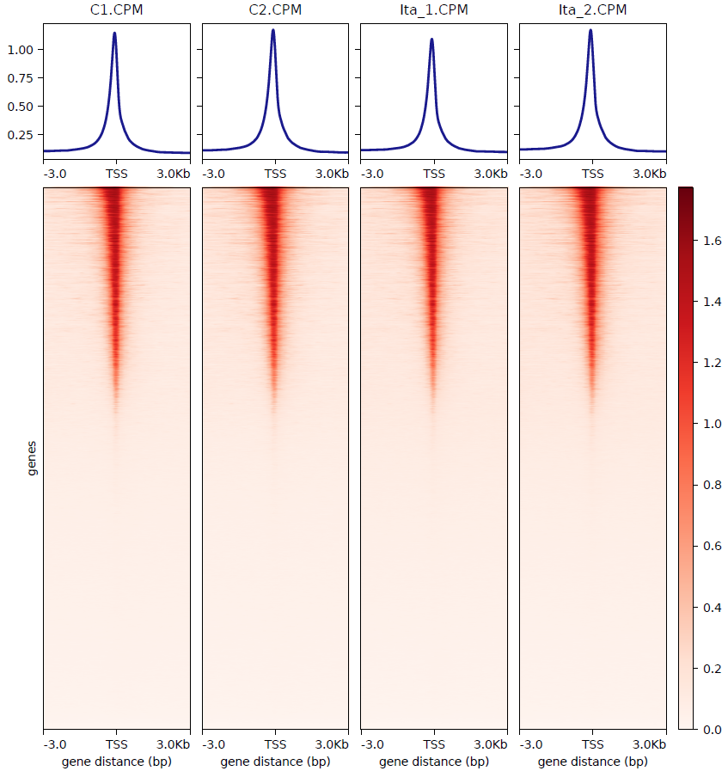
computeMatrix reference-point \
-p 10 --skipZeros --missingDataAsZero \
--referencePoint TSS -R xiaoshu.tss.bed \
-o multi_sample.TSS.matrix.gz \
-S T1.CPM.bw T2.CPM.bw C1.CPM.bw C2.CPM.bw \
-a 3000 -b 3000 -bs 1000 &&\
plotHeatmap --heatmapHeight 16 --heatmapWidth 4 \
--legendLocation none --colorMap Reds \
-m multi_sample.TSS.matrix.gz \
--outFileName multi_sample.TSS.pdf

Slide 9
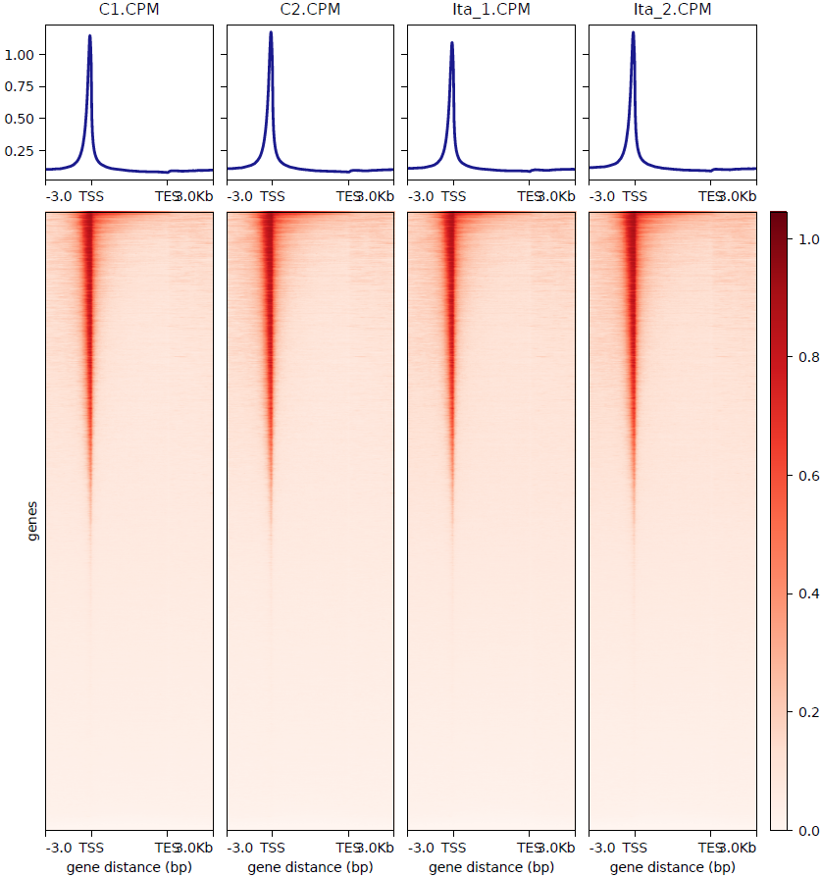
computeMatrix scale-regions \
-p 10 --skipZeros --missingDataAsZero \
-o multi_sample.genebody.matrix.gz \
-R xiaoshu.genebody.bed \
-S T1.CPM.bw T2.CPM.bw C1.CPM.bw C2.CPM.bw \
-a 3000 -b 3000 --regionBodyLength 5000 -bs 1000 &&\
plotHeatmap --heatmapHeight 16 --heatmapWidth 4 \
--legendLocation none --colorMap Reds \
-m multi_sample.genebody.matrix.gz \
--outFileName multi_sample.genebody.pdf

Slide 10
pygenometrack(PGT)

Slide 11
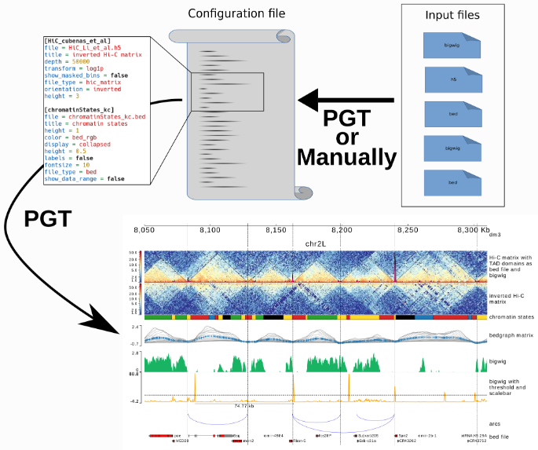
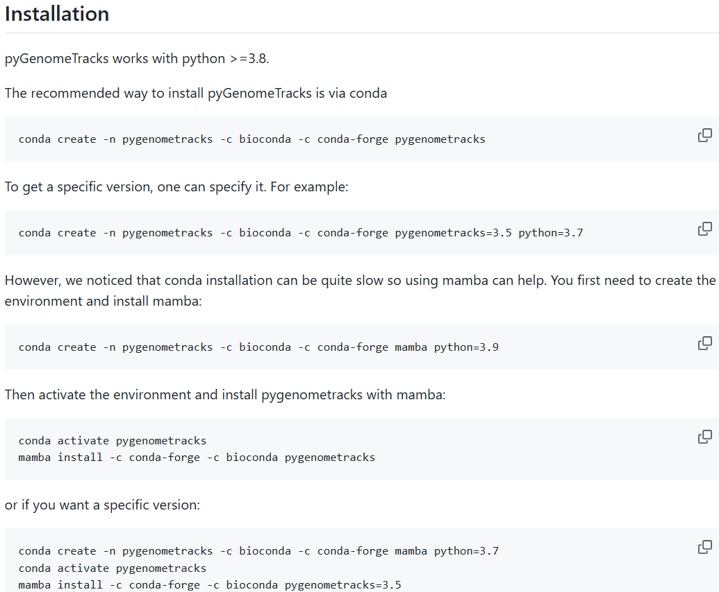
说明文档
https://github.com/deeptools/pyGenomeTracks
https://pygenometracks.readthedocs.io/en/latest/

Slide 12
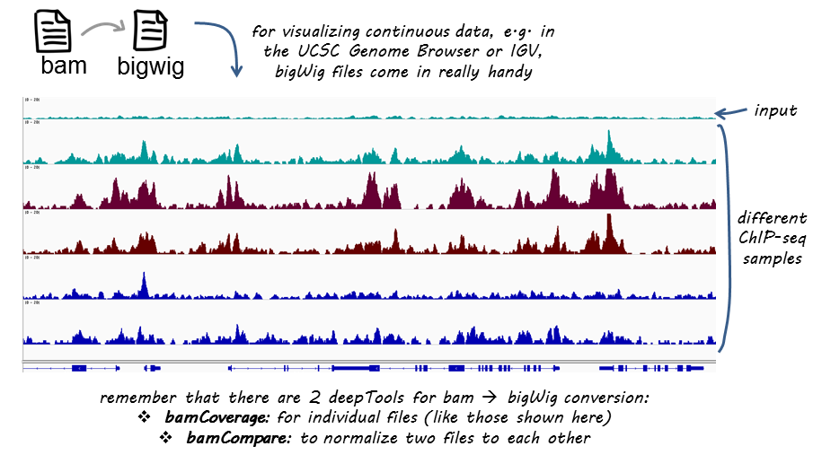

Slide 13
[hicmatrix]
file = sample.cool
depth = 1400000
title = Hi-C Matrix
transform = log
file_type = hic_matrix
show_masked_bins = false
colormap = RdYlBu_r
height = 8
[tad]
file = sample_40kb_TAD.bed
display = triangles
border_color = black
color = none
line_width = 1.5
overlay_previous = share-y
height = 8
[spacer]
[compartment]
file = sample_compartment.bed
height = 1.5
title = comparment A/B
min_value = -1
max_value = 1
color = #99000d
negative_color = #084594
file_type = bedgraph
[spacer]

Slide 14
[loops]
file = sample_loop.arcs
title = contacts
height = 5
color = RdYlBu
line_width = 1.5
use_middle = true
[spacer]
[atac]
file = sample_ATAC_CPM.bw
height = 1.5
title = ATAC
min_value = 0
max_value = 8
color = #dfc27d
file_type = bigwig
[spacer]
[rna]
file = sample_RNA_RPKM.bw
height = 1.5
title = RNA
min_value = 0
max_value = 80
color = #dfc27d
file_type = bigwig
[spacer]
[gff]
file = genome.gtf
height = 5
fontsize = 10
merge_transcripts = true
prefered_name = gene_name
file_type = gtf
max_labels = 70
style = flybase
[vlines]
file = sample_40kb_TAD.bed
type = vlines
[x-axis]

Slide 15
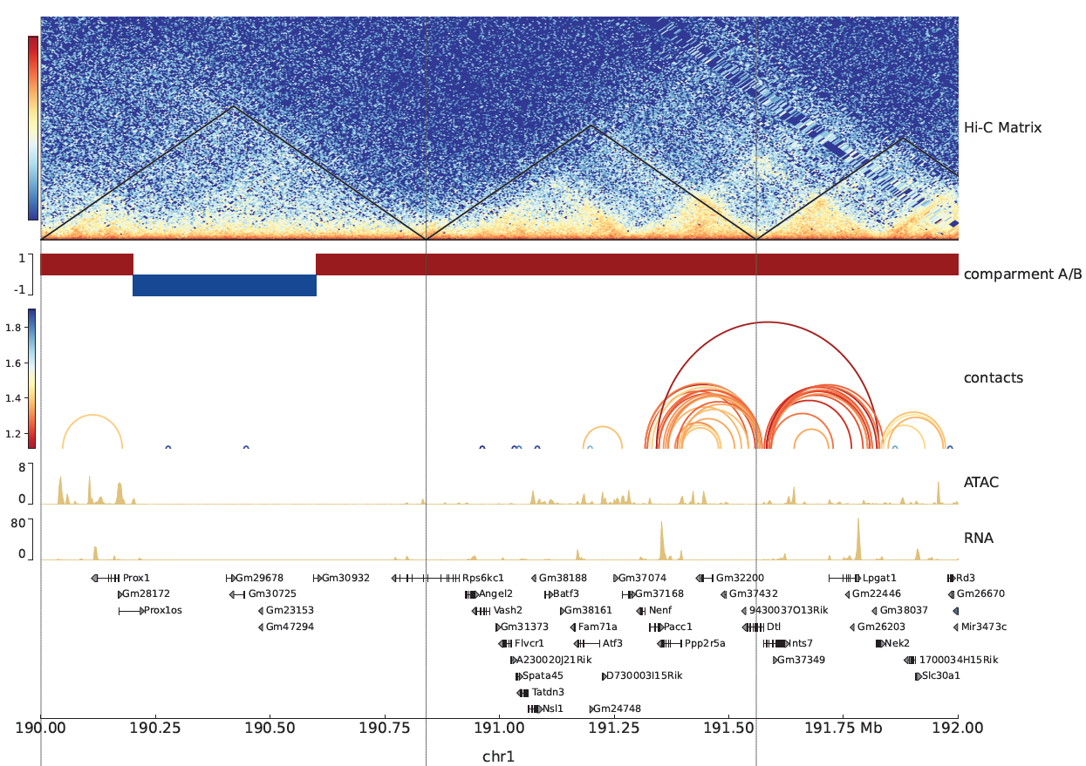
/work/fscourse/software/pyGenomeTracks/pyGenomeTracks_3.8/bin/pgt \
--tracks example.ini --region chr1:190000000-192000000 \
--outFileName example.pdf --dpi 300

Slide 16
coolpuppy

Slide 17
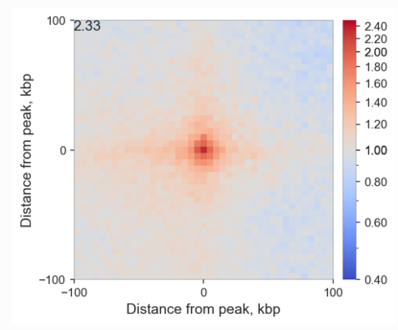
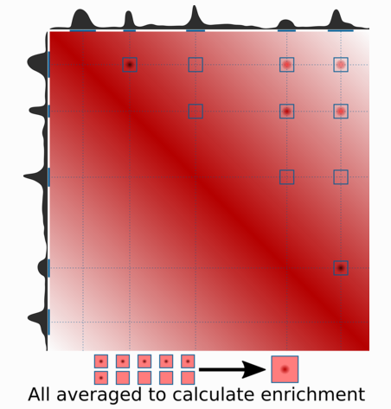
说明文档
https://coolpuppy.readthedocs.io/en/latest/walkthrough.html
https://github.com/open2c/coolpuppy

Slide 18
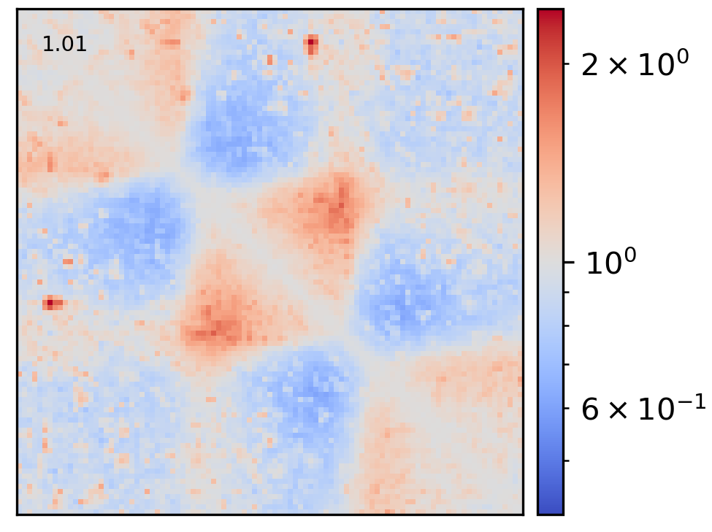
Aggregate TAD analysis
以 cooltools 检出的 TAD 为例，绘制 ATA 图.
step1. 将 cooltools boundaries 表格取前三列，生成bed文件
step2. 采用coolpup.py工具，以boundaries作为参考，提取cool矩阵中对应位置的互作情况作aggregate
/work/fscourse/software/coolpuppy/coolpuppy_0.9.5/bin/coolpup.py --local --n_proc 10 \
--outname sample.cooltools.ata --seed 100 --rescale --minsize 60000 --maxsize 3000000 \
sample.cool sample_40kb_TAD.bed
step3. 再采用coolpup.py自带绘图工具plotpup.py，以coolpup.py生成的aggregate矩阵为输入绘制heatmap
/work/fscourse/software/coolpuppy/coolpuppy_0.9.5/bin/plotpup.py --scale log \
--output sample.cooltools.ata.pdf --dpi 300 sample.cooltools.ata
做domain ATA需要加
--rescale将TAD
大小做压缩

Slide 19
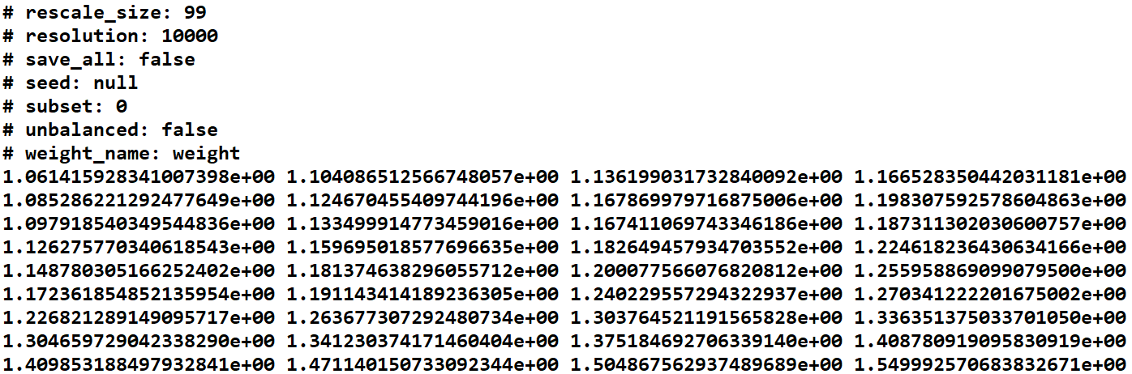
Aggregate loops analysis
/work/fscourse/software/coolpuppy/coolpuppy_0.9.5/bin/coolpup.py --n_proc 10 \
sample.cool sample_5kb_mustache.bedpe --outname sample.5k.pileup
运行完生成的pileup文件，它是做聚集分析之后生成的最终矩阵，在矩阵前会打印输出所有参数

Slide 20
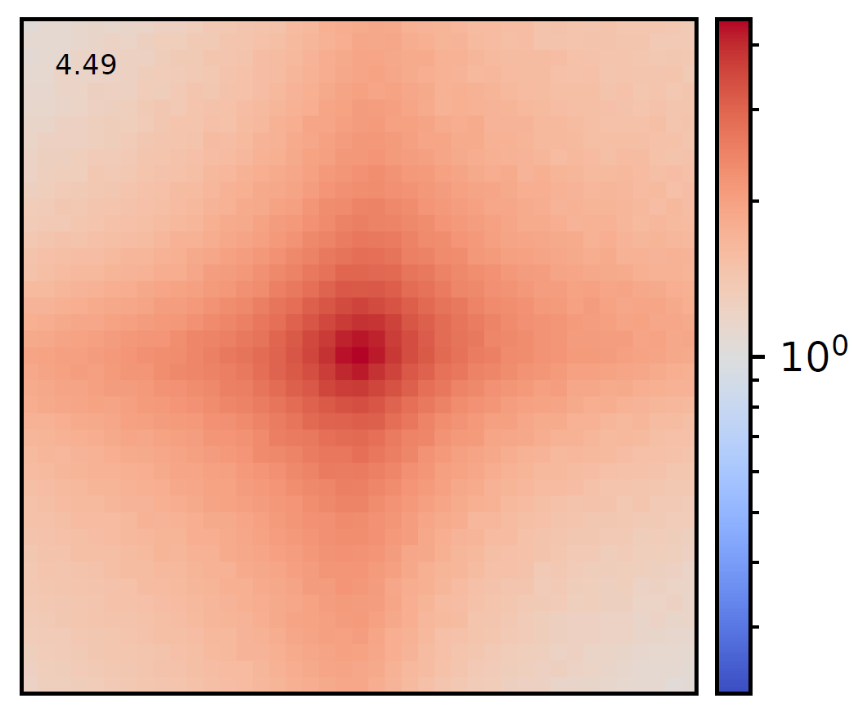
mustache call loops
再采用coolpup.py自带绘图工具生成图片
/work/fscourse/software/coolpuppy/coolpuppy_0.9.5/bin/plotpup.py \
sample.5k.pileup --output sample.5k.APA.pdf
如果有多个样本，可以将多个样本绘到一张图中
plotpup.py sampleA.pileup sampleB.pileup sample.pileup --output all_sample.APA.png

