Slide 1

LexScan — AI Contract Risk Highlighter
A Full-Stack Legal-Tech SaaS Application
"Spot Hidden Risks Before You Sign"
Live at: https://ai-contract-risk-highlighter.vercel.app

Slide 2

The Problem
Most people sign contracts they don't understand.
Hidden Dangerous Clauses
Contracts contain dangerous clauses buried in legal language: IP forfeiture, unlimited liability, 90-day payment delays, termination without notice
Unaffordable Legal Review
Hiring a lawyer for routine review costs $300–$500/hour — unaffordable for most
No Accessible Tool
No accessible tool exists for quick, intelligent contract review
The Result
Financial loss, legal disputes, unfair obligations

Slide 3

Our Solution — LexScan
An AI legal assistant that reads contracts for you.
Upload Any Contract
Instant AI Risk Analysis
PDF, DOCX, TXT, or scanned image
Get instant AI risk analysis in under 15 seconds
Highlighted Risky Clauses
Plain-English Explanations
See risky clauses highlighted directly in the contract text
Receive plain-English explanations + suggested fixes
Natural Language Q&A
All Free, In Your Browser
Ask questions about the contract in natural language
All free, in your browser, with no lawyer required

Slide 4
CORE FEATURES
Core Features
10 production-grade capabilities:
Multi-format upload: PDF, DOCX, TXT, PNG, JPG
OCR for scanned documents and images (Tesseract.js)
Real-time streaming AI analysis via SSE
Color-coded clause highlights: Red (High) / Amber (Medium) / Blue (Low)
Risk score ring 0–100 with animated SVG fill
Actionable risk cards: title, severity, clause quote, why risky, real-world impact, suggested fix, AI confidence
Conversational AI chatbot grounded in the uploaded contract
Smart suggested questions generated from detected risks
Cloud history with Supabase authentication — save and revisit every analysis
Fully responsive: desktop side-by-side panels + mobile bottom tab navigation

Slide 5
How It Works — Architecture
User uploads → Text extracted → AI analyzes → Results stream → Clauses highlighted → User asks questions → Analysis saved to cloud
Step 1: Upload
Step 3: Analyze
Step 5: Display
Step 7: Save
PDF, DOCX, TXT, or image file
Groq LLM processes contract with structured prompt, outputs JSONL
Risk cards animate in; exact clauses highlighted in contract text
Analysis saved to Supabase cloud history automatically
1
2
3
4
5
6
7
Step 2: Parse
Step 4: Stream
Step 6: Interact
PDF.js / Mammoth.js / Tesseract.js extract text
Risk data streams to frontend via Server-Sent Events in real-time
User asks questions; AI answers using contract as context

Slide 6
Tech Stack
Frontend
Backend
React 18 + TypeScript + Vite + Framer Motion
Node.js + Vercel Serverless Functions + Server-Sent Events (SSE)
AI Engine
Document Parsing
Groq API — llama-3.3-70b-versatile with structured JSONL prompt engineering
PDF.js, Mammoth.js, Tesseract.js (OCR)
Database & Auth
Deployment & Typography
Supabase — PostgreSQL + GoTrue authentication
Vercel global CDN · Lora (serif, contracts) + Inter (sans-serif, UI)

Slide 7

Risk Cards — Actionable Insights
Each flagged clause includes:
Clear title (4–6 words)
Severity badge: HIGH / MEDIUM / LOW
Verbatim quote from the contract
Plain-English explanation of the legal danger
Real-world impact — specific financial or legal consequence
Suggested fix — actionable alternative clause or negotiation point
AI confidence score — animated progress bar
Example Risk Card
Title: "IP Forfeiture Risk"
Level: HIGH | Section 3
Quote: "All work product shall become the exclusive property of Company upon creation."
Impact: You permanently lose all rights to code, designs, and inventions created during the engagement — including pre-existing tools.
Fix: Limit IP assignment to work specifically created for this client under this agreement.

Slide 8
Technical Innovations
LexScan delivers precision and performance that generic AI tools simply cannot match, setting a new standard for contract analysis:
5-Level Text Matching Cascade
Structured LLM Prompting
Streaming Architecture
We eliminate hallucinations by enforcing rigid, audit-ready data structures. Every analysis is constrained by strict JSONL formatting and verifiable, verbatim quoting, ensuring that every identified risk is anchored in the actual contract text with six structured diagnostic fields.
We prioritize your workflow with a near-instant user experience. By streaming analysis and risk identification in real-time, we slash perceived wait times by 80%, providing you with immediate, actionable insights rather than forcing you to wait for a full document render.
Our proprietary cascade engine navigates complex document formats with surgical precision. By layering five distinct matching techniques—from exact phrasing to advanced OCR noise correction—we achieve near-100% highlight accuracy, even on low-quality or heavily scanned files.

Slide 9

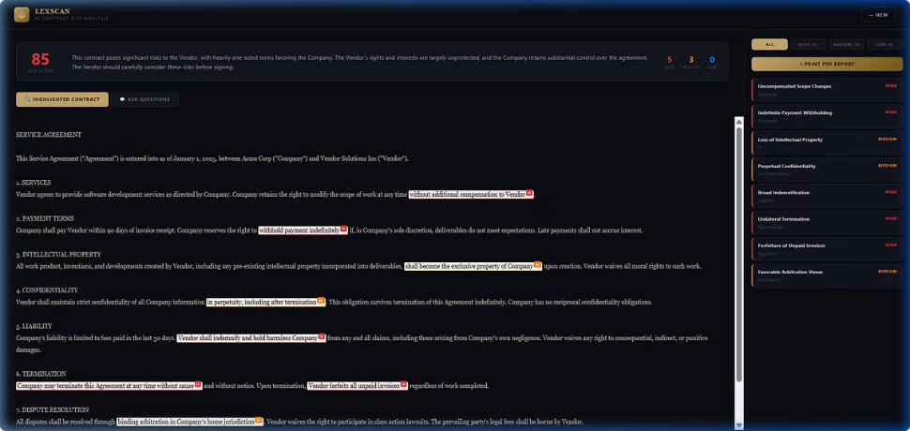
Mobile & UI Design
Premium legal-tech aesthetic across all devices.
Design System
Mobile Features
Loading States
Dark theme: Deep navy + gold accent (#C8A96E)
Light theme: Warm parchment (#F5F3EE) + rich gold
Typography: Lora serif for contract text, Inter for UI
Hamburger → spring-animated slide-in drawer
Bottom tab navigation: Contract / Risks (count) / Ask AI
Score banner always visible on mobile
Touch-optimized: 16px+ inputs prevent iOS zoom
Safe area support for iPhone notch (viewport-fit=cover)
Shimmer skeleton for contract text, risk cards, score banner
Animated SVG ring fills as score is revealed
Progressive risk card animation (spring physics)

Slide 10
CONCLUSION
ROADMAP
Conclusion & Roadmap
LexScan — Built to protect people before they sign.
"LexScan gives everyone access to the kind of contract intelligence that used to require a lawyer."
Live Demo: https://ai-contract-risk-highlighter.vercel.app/
Current Capabilities
Future Roadmap
Full-stack production app deployed on Vercel
Streaming AI analysis with structured risk intelligence
OCR, multi-format parsing, cloud auth, mobile-ready
PDF report export
Multi-page PDF and multi-contract comparison
Jurisdiction-aware analysis (US, UK, India, EU)
Clause library with pre-approved alternatives
Team collaboration and shared history
API access for enterprise integrations
Browser extension for in-page contract analysis

