Slide 1
Velociraptor

Slide 2
What is Velociraptor
Velociraptor is an open-source endpoint visibility and digital forensic tool.
It acts as a host-based agent that allows security teams to collect, monitor, and query forensic artefacts across endpoints in real time.
By deploying Velociraptor agents across systems, organizations can quickly investigate incidents, detect malicious activity, and feed telemetry back into a Security Information and Event Management (SIEM) system.

Slide 3
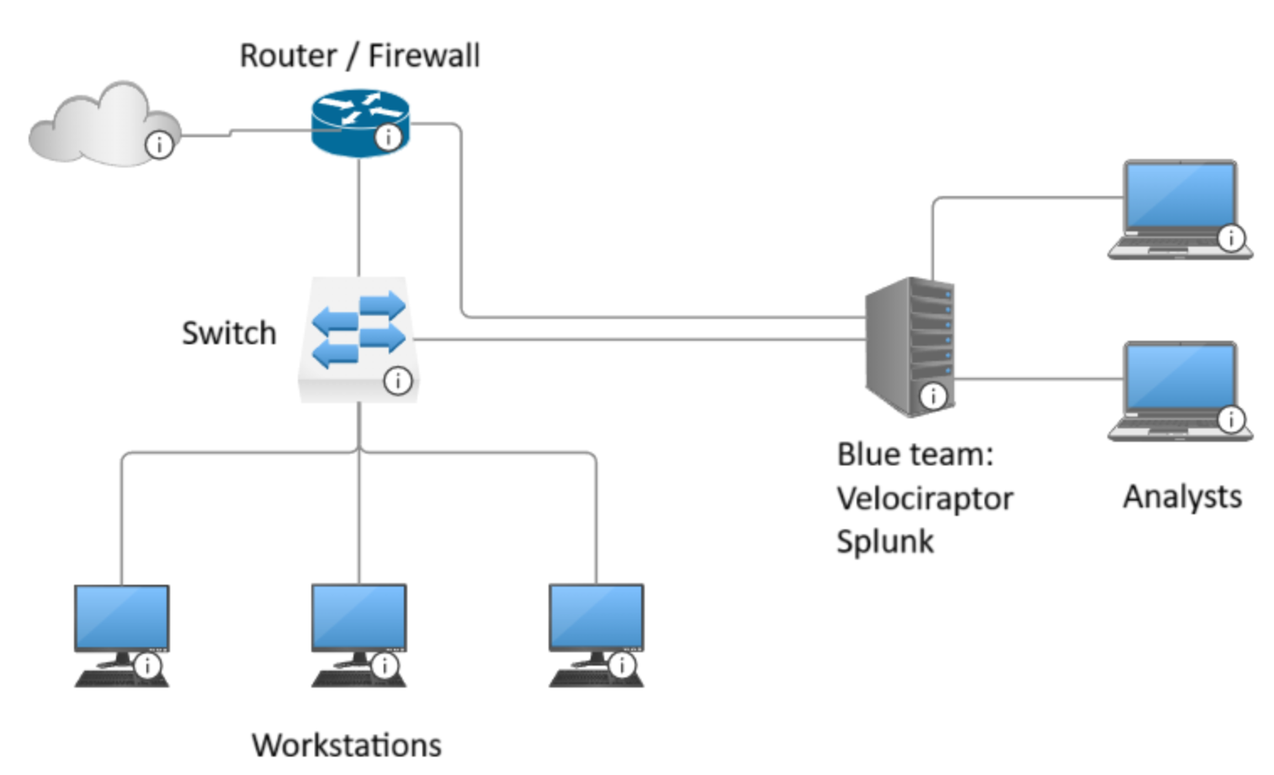
Scenario
Put velociraptor on the host machines to collect data which we use to analyse and determine malicious behaviour.

Slide 4
Velociraptor Setup
Document setup on git hub page

Slide 5
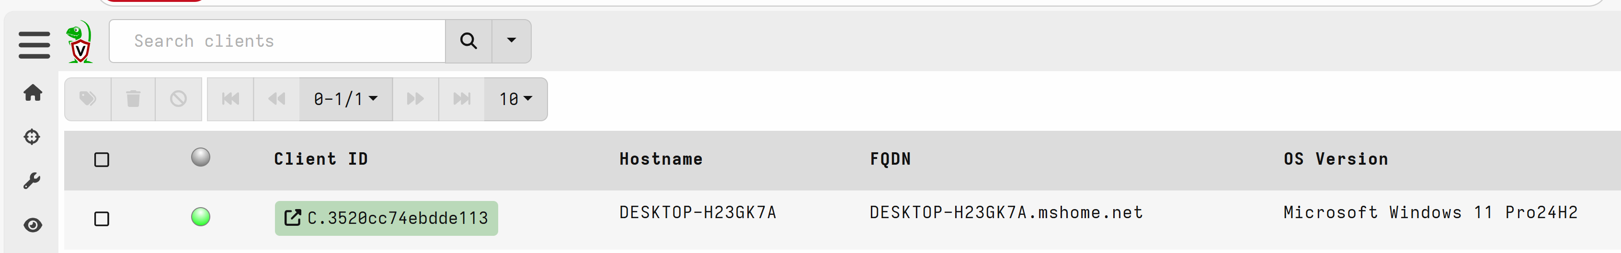
Check how many clients you have
Click the magnifying glass to check how many clients.

Slide 6
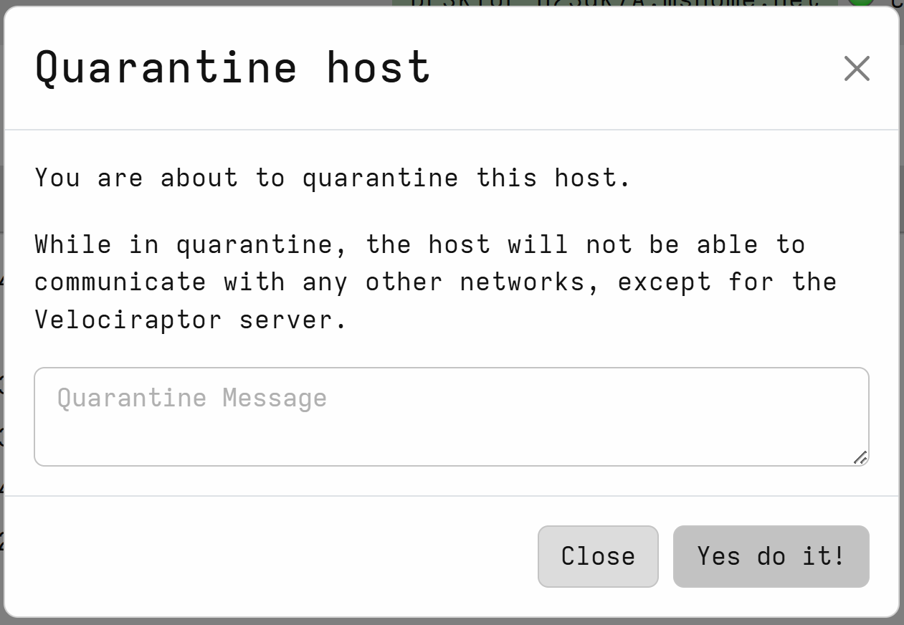
Quarantine Host Machine
If a malicious behaviour is seen on one machine you are able to stop any communication to that machine and only your Velociraptor can communicate with it.

Slide 7
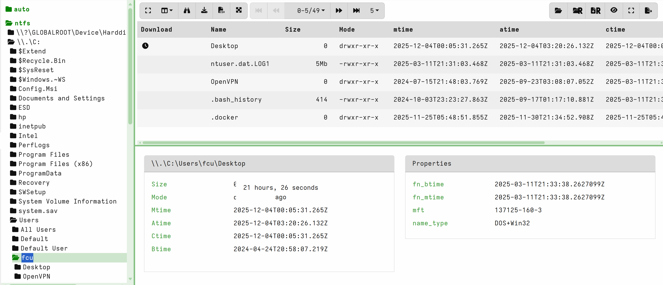
Virtual File System
Can view the directory and the MAC time of files
Able to extract files and get hashes and do further malware analyse.

Slide 8
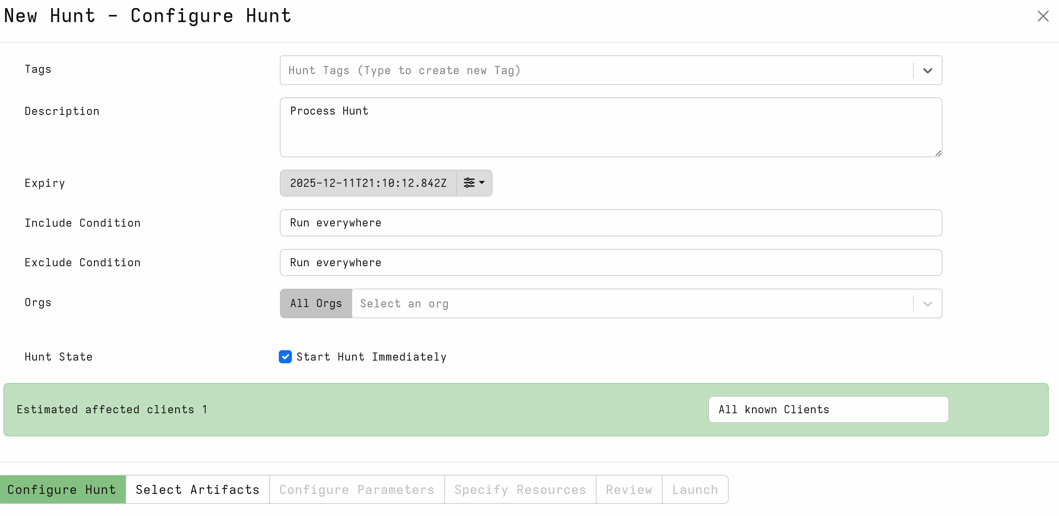
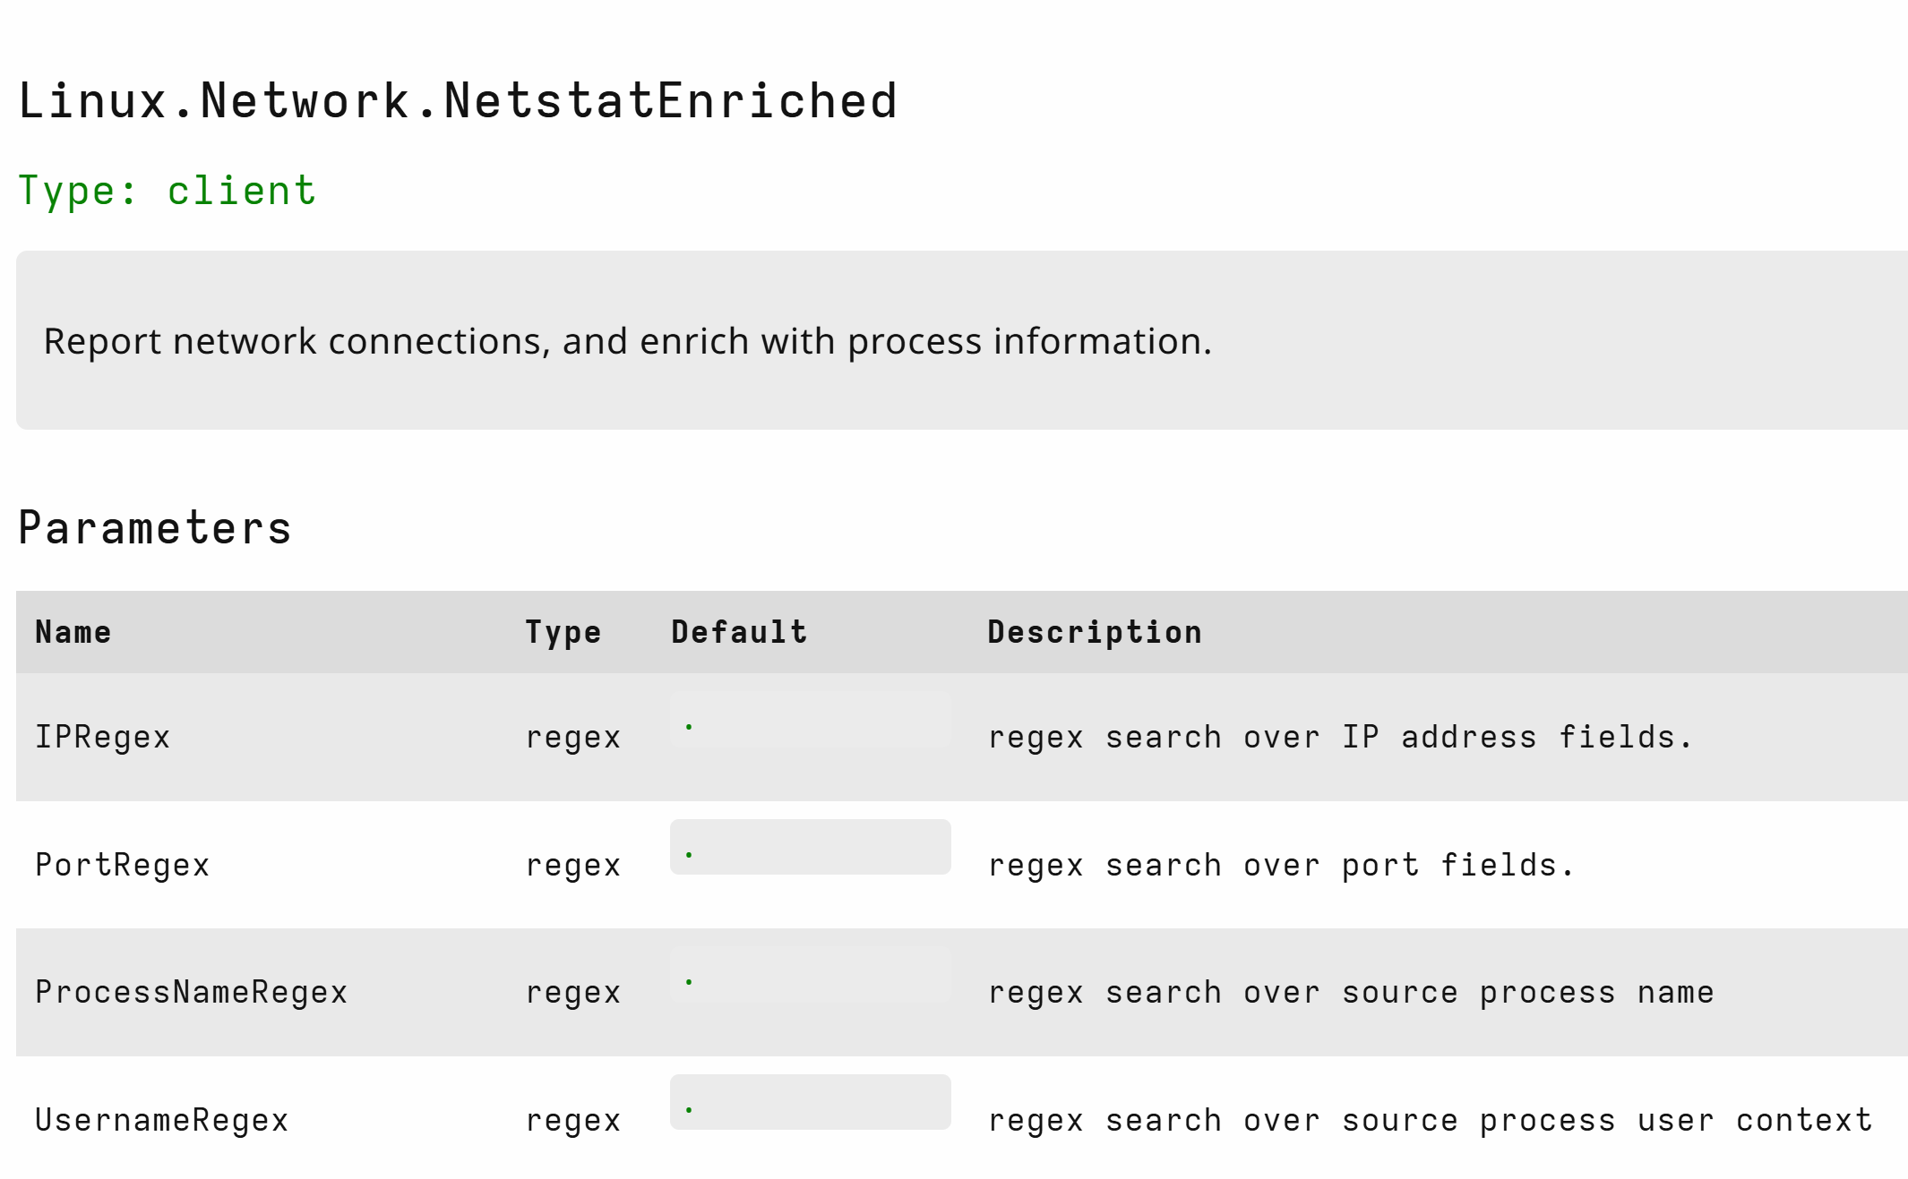
Running Hunt Part 1
Able to run hunts such as process, files, netstat and other hunts

Slide 9
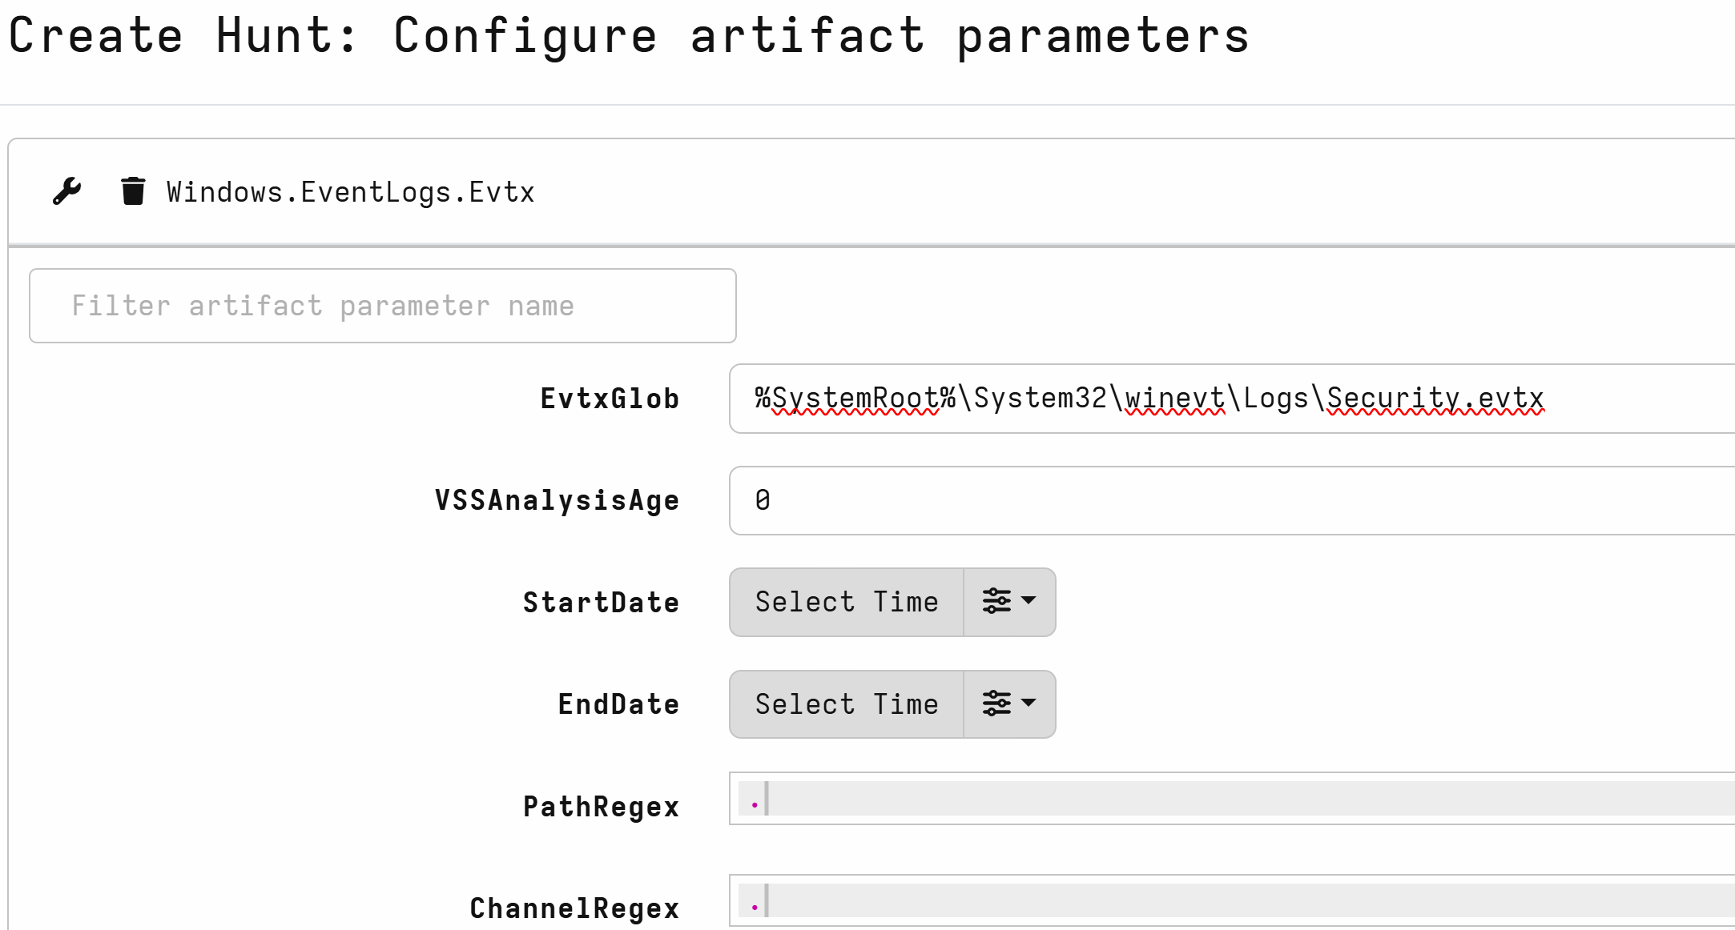
Running Hunt Part 2
Able to configure parameters such as evtx hunt get only Security logs.

Slide 10
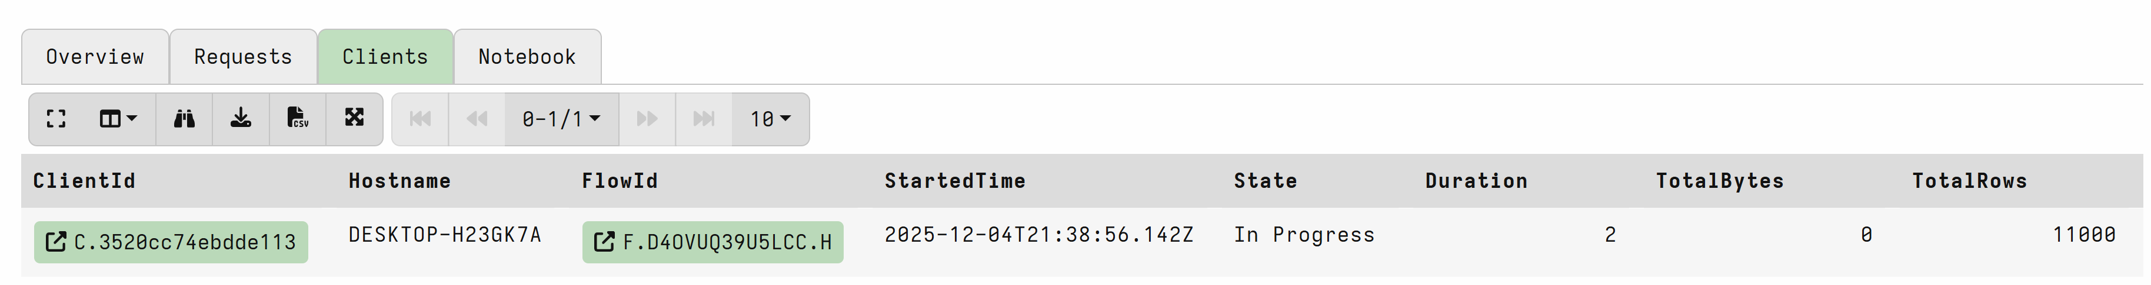
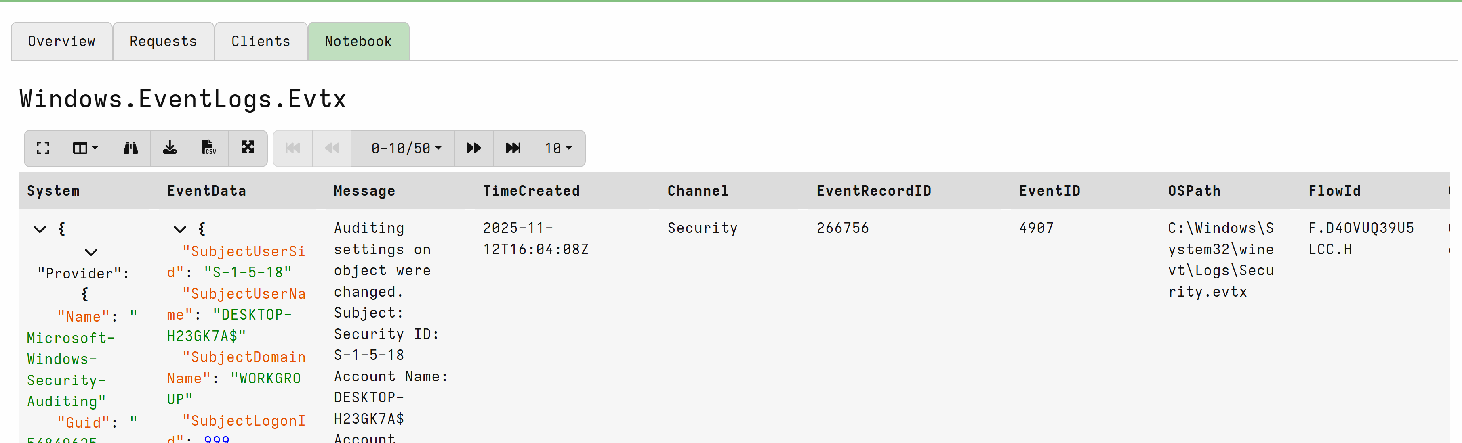
View your Hunt output
Check your hunt has finished running
View your output

Slide 11
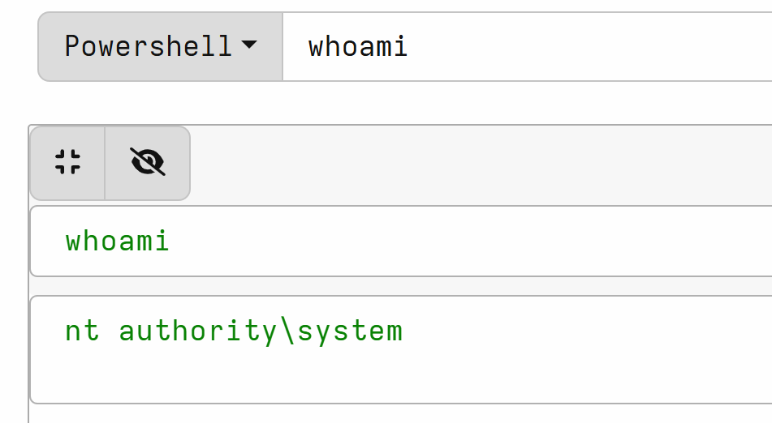
Run Powershell on remote machines
Can run powershell commands on individual boxes

Slide 12
Get use to Velociraptor
Run hunts
Run Powershell Commands
Figure out which hunts you would run in a DCI scenario
Immersive labs exercise if possible

