Slide 1
Velociraptor

Slide 2
What is Velociraptor?
Velociraptor is an open-source endpoint visibility and digital forensic tool - What does that mean?
Notes:
Teacher Notes:
Velociraptor is an open-source endpoint visibility and digital forensic tool meaning it acts as a host-based agent that allows security teams to collect, monitor, and query forensic artefacts across endpoints in real time.
By deploying Velociraptor agents across systems, organizations can quickly investigate incidents, detect malicious activity, and feed telemetry back into a Security Information and Event Management (SIEM) system.

Slide 3
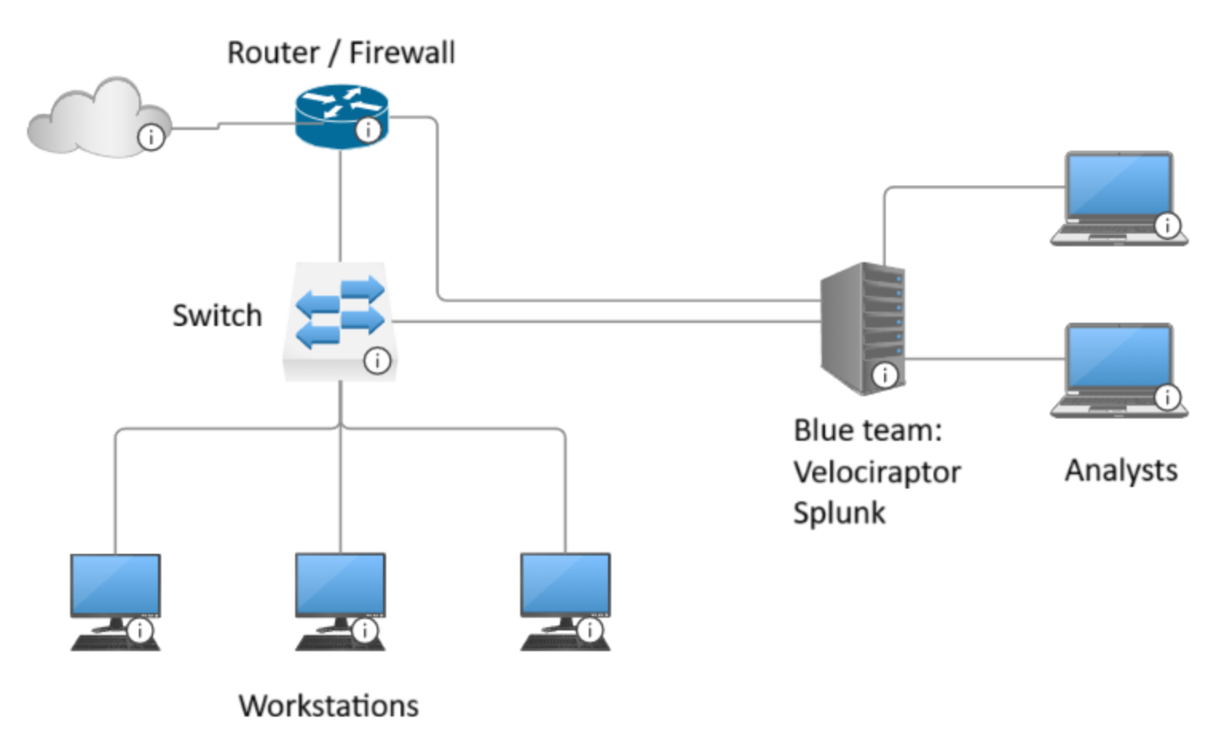
Scenario – Deploying Velociraptor
Notes:
Teacher Notes:
When Velociraptor is deployed on a network the host machines to collect data and send back to velociraptor server which we use to analyse and use to determine malicious behaviour.

Slide 4
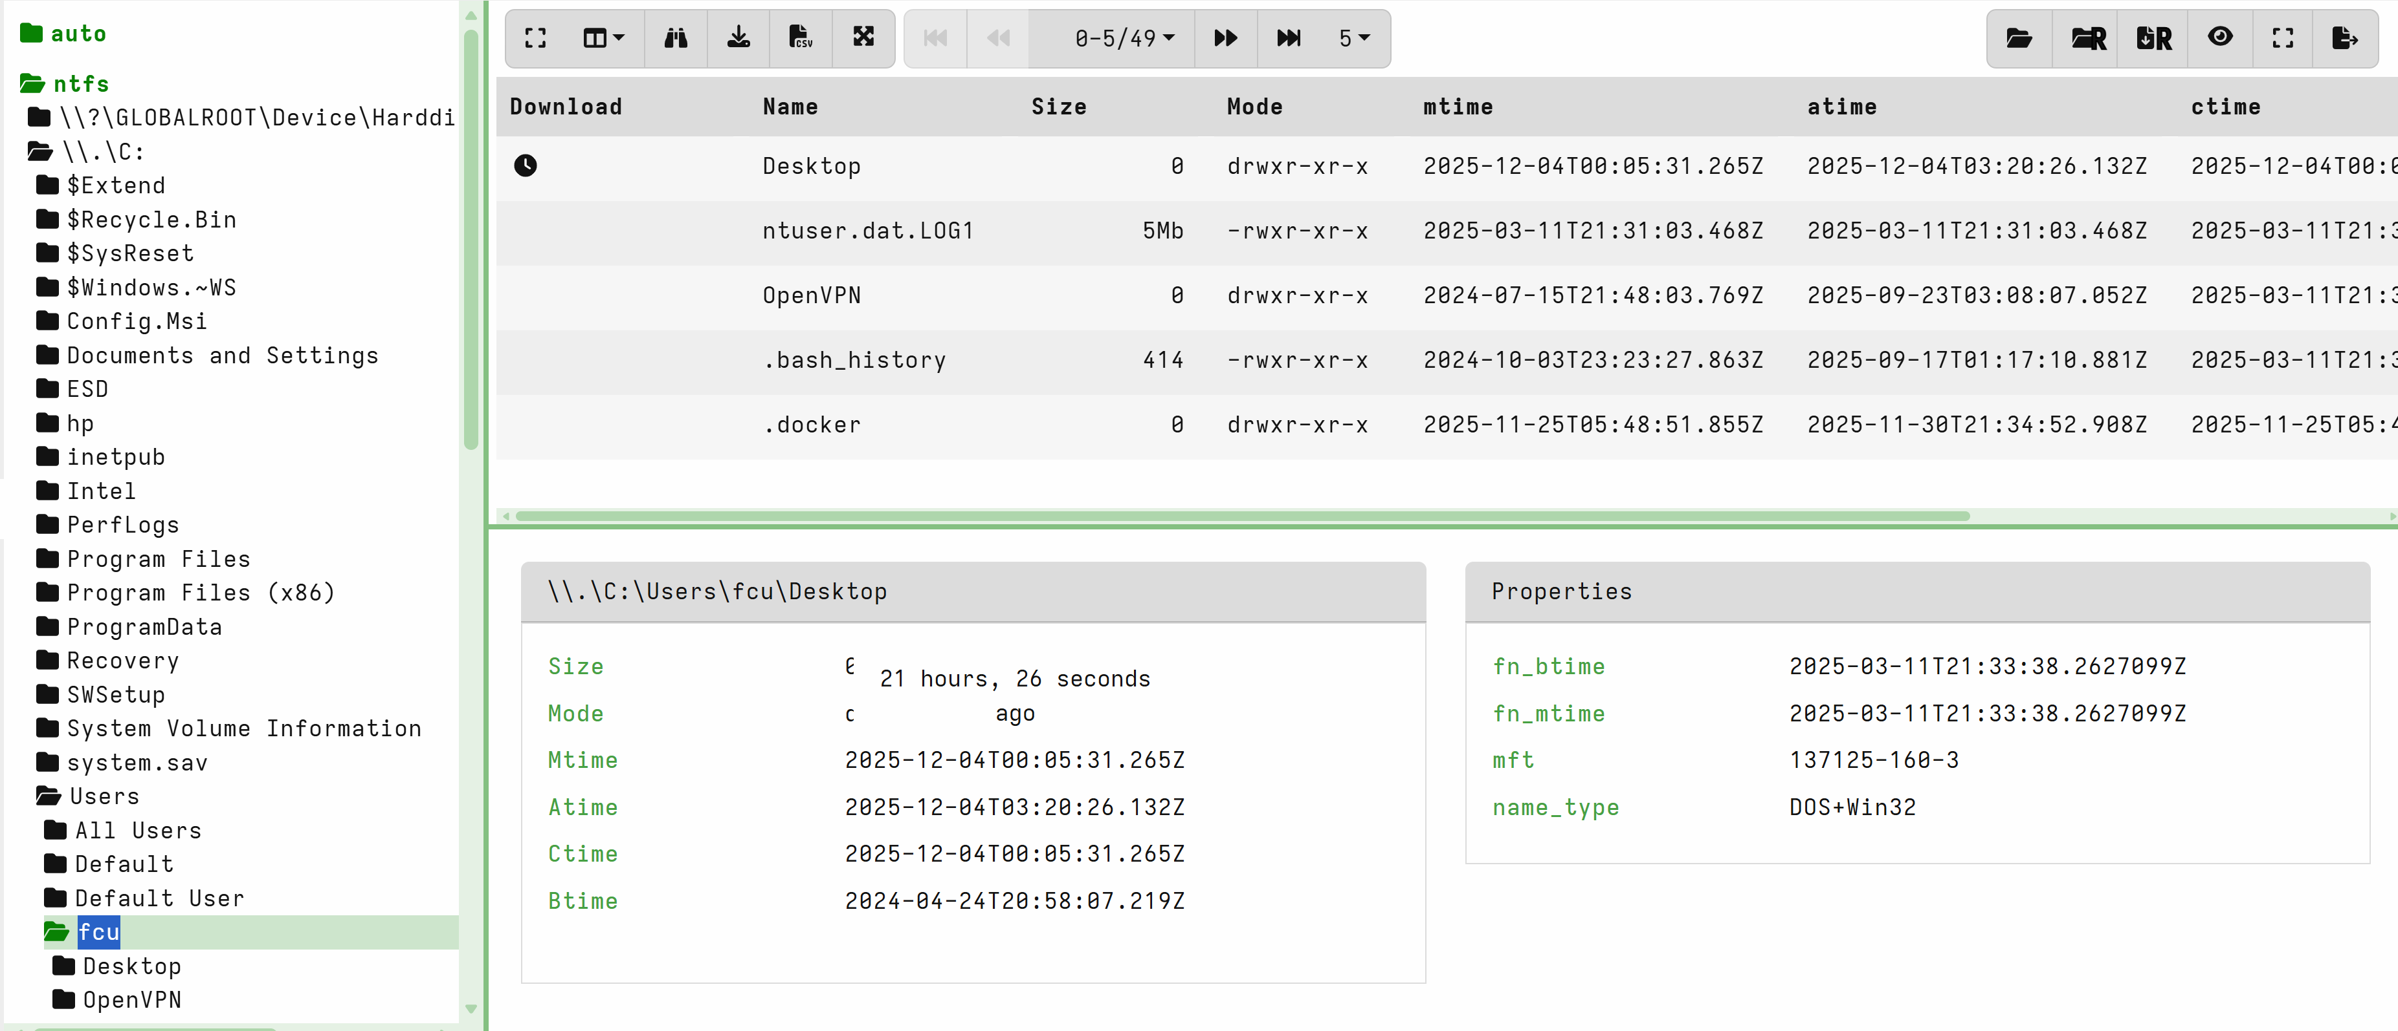
Virtual File System
Can view the directory and the MAC time of files
Able to extract files and get hashes and do further malware analyse.
Notes:
Teacher Notes:
Searching the VFS can be heavily taxing on the SIEM, searching recursively should be used when what's in the directory is know.

Slide 5
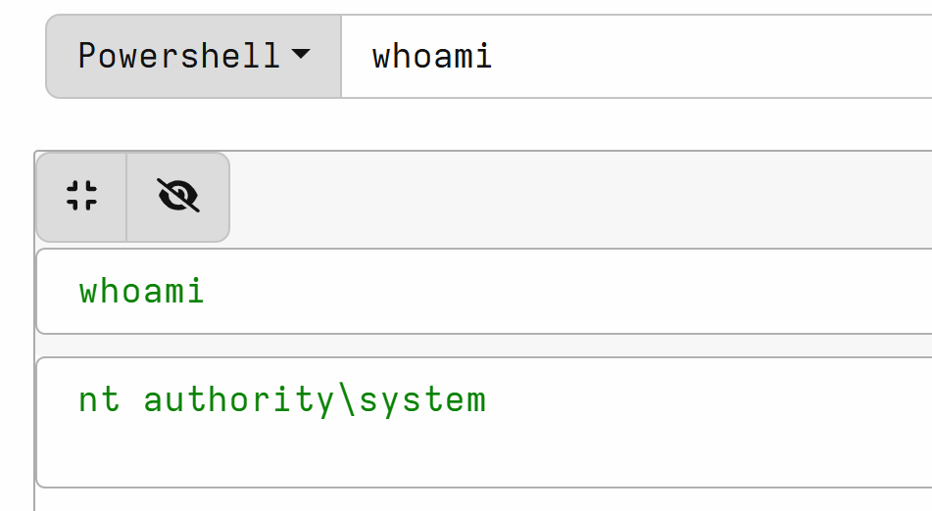
Run powershell on remote machines through velociraptor
Can run powershell commands on individual boxes

Slide 6
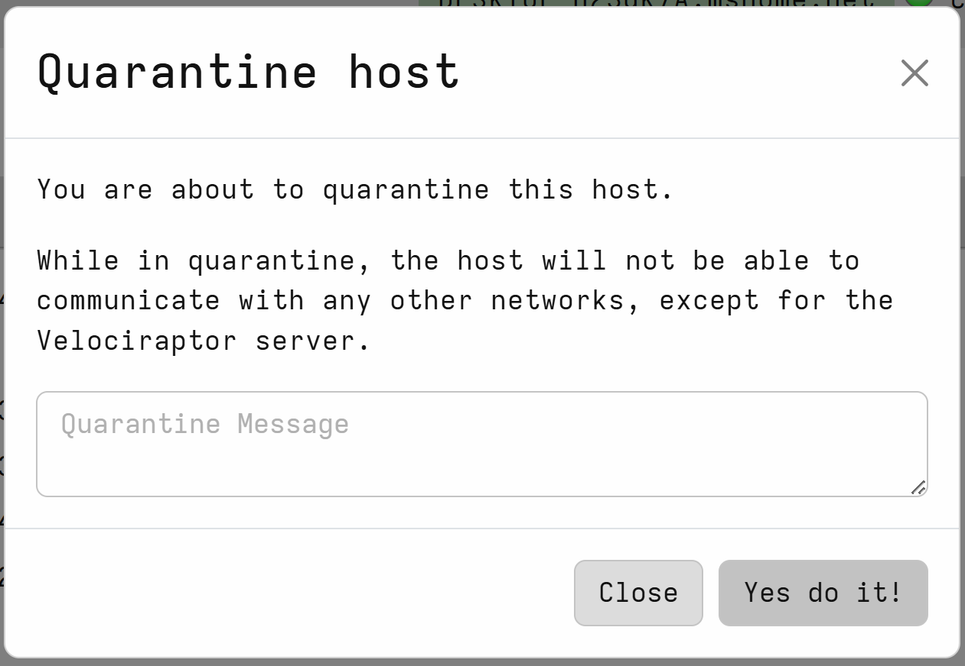
Quarantine Host Machine
If a malicious behaviour is seen on one machine you are able to stop any communication to that machine and only your Velociraptor can communicate with it.

Slide 7
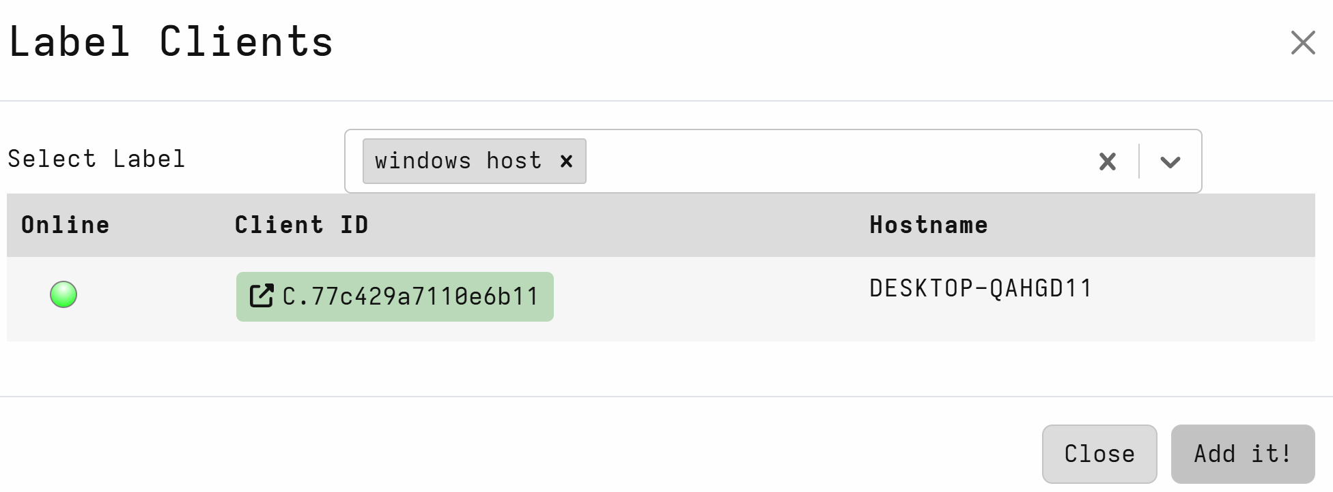
Labels
Labels let you group hosts together and then run hunts targeted only at those grouped hosts.
i.e - Adding all windows hosts to a group to run windows specific hunts

Slide 8
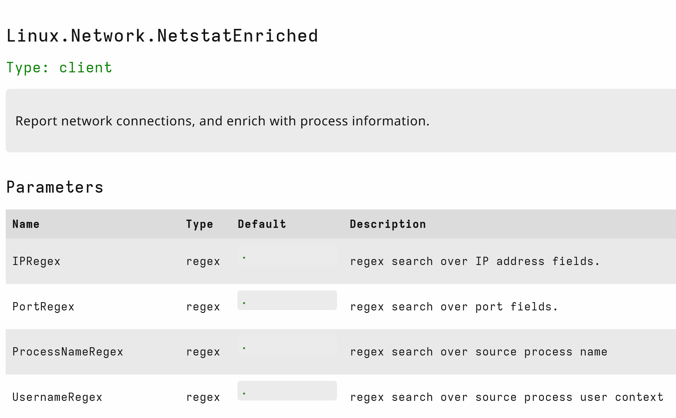
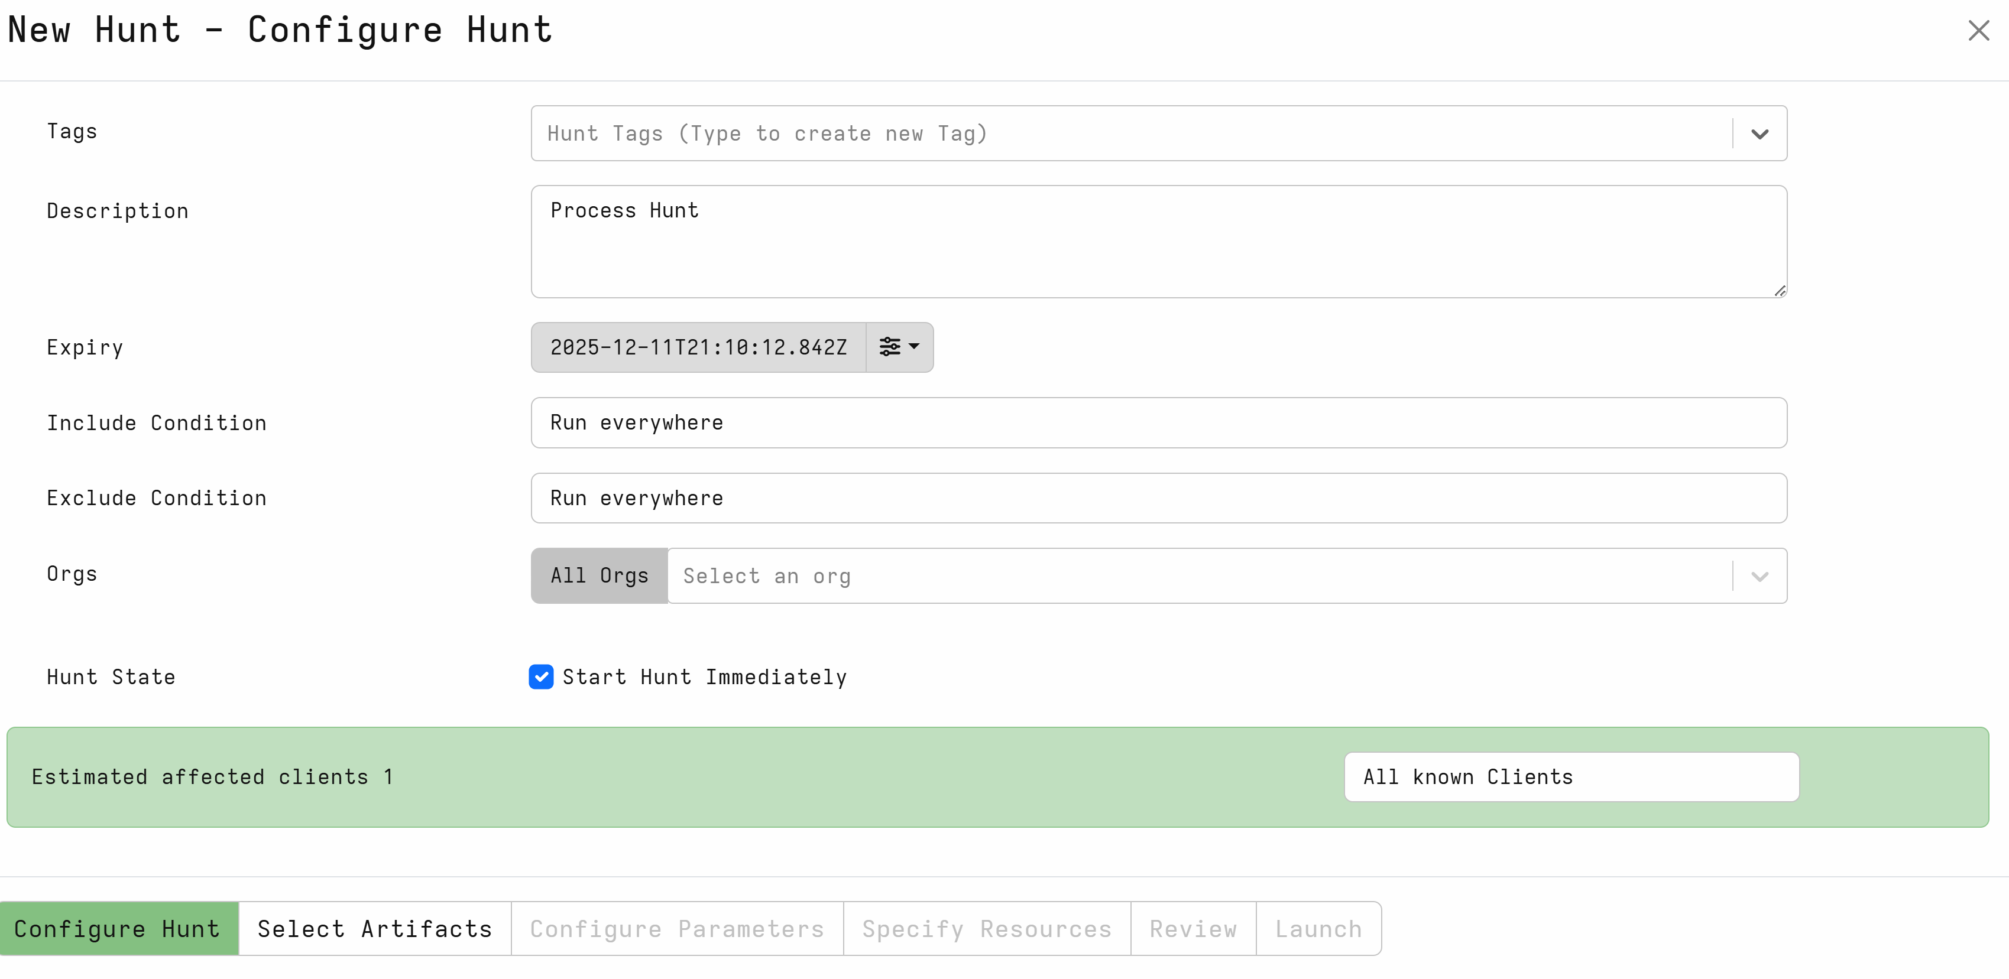
Running a hunt
Running hunts allows us to query connected clients for data.
i.e running processes, files, network connections
Notes:
Teacher Notes:
Hunts can be very resource intensive depending on the hunt and should be ran with caution to not overload SIEM

Slide 9
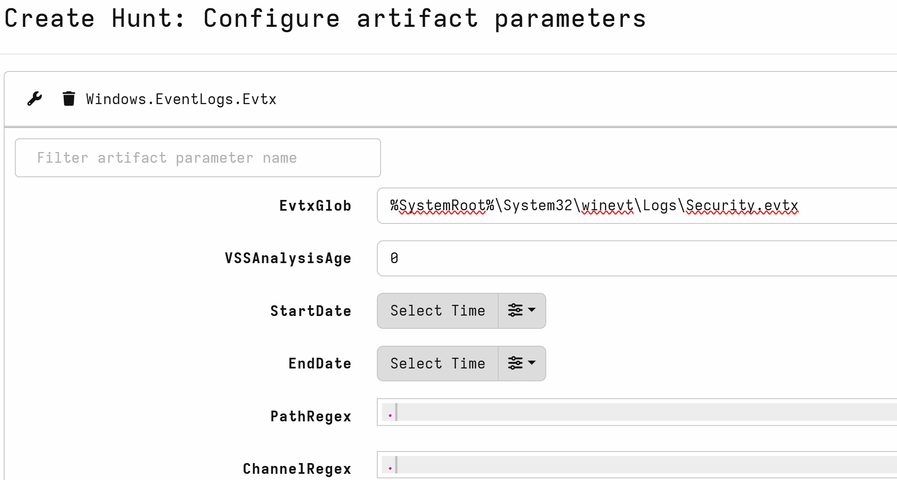
Running a hunt
Able to configure parameters in hunts, such as evtx hunt to get only Security logs in stead of the whlole evtx file.
Notes:
Teacher Note:
This is important to look at as some hunts are very broad by default and could impact your SIEM if unchecked

Slide 10
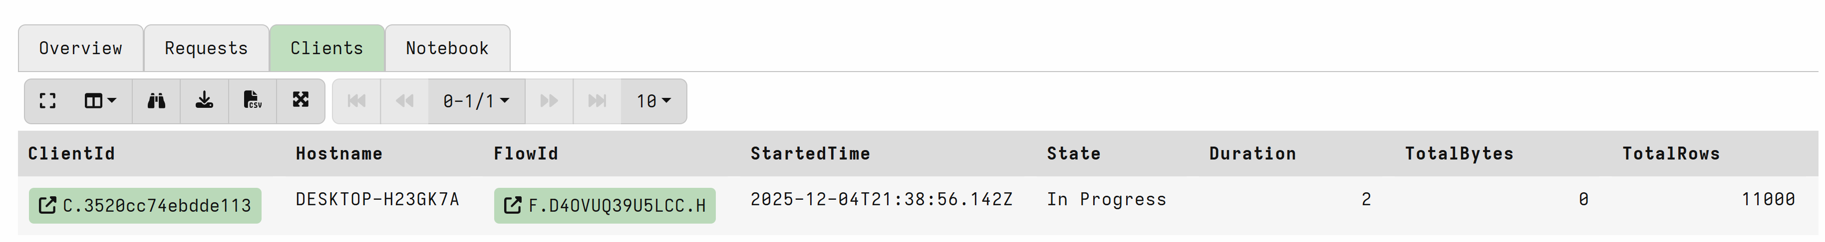
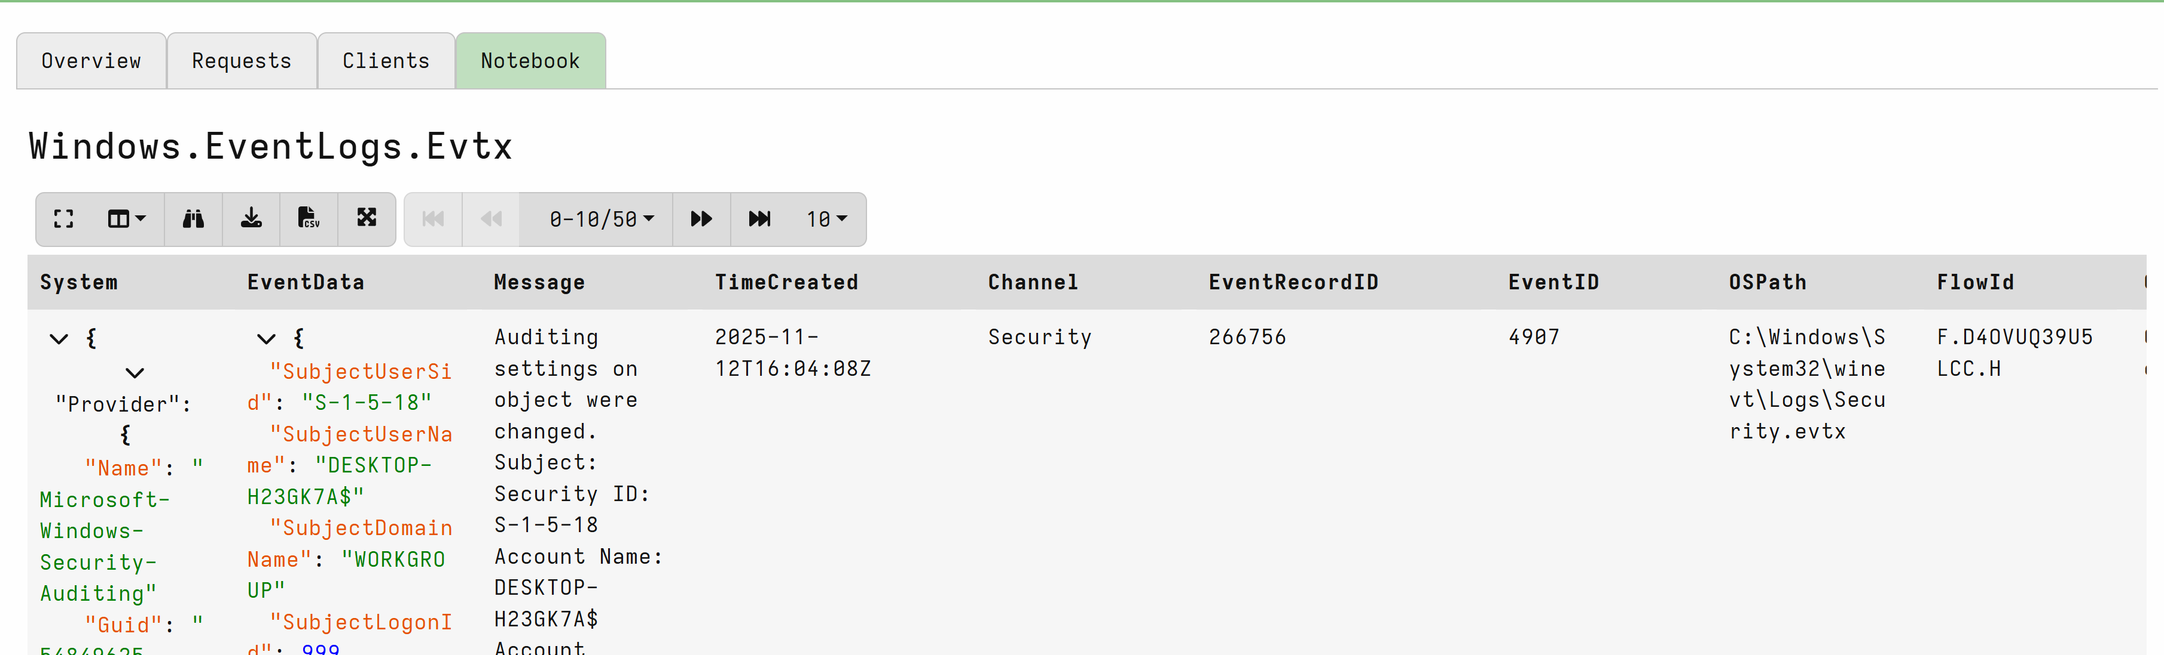
View your Hunt output
Check your hunt has finished running
View your output
Notes:
Teacher Notes:
You can check the status of your hunt by viewing the state column.
When viewing your output you would generally view it in the SIEM but you can quickly check in velociraptor to confirm that you are getting data from the hunt first.

Slide 11
Velociraptor Exercise
Create a hunt, figure out what artifacts pertaining to the following:
Services
Scheduled Tasks
Computer Information
Startup Run Keys
Notes:
Teacher Note:
Use velociraptor series immersive labs.

