Slide 1
MATLAB PRESENTATION
GROUP 3

Slide 2
S/No. | NAME | REG No.
1 | KAKONYA GERALD | BU/UG/2024/2603
2 | RUBANGAKENE GERALD OYET | BU/UG/2024/2594
3 | ALINDA MASIKA ROLPHINE | BU/UP/2024/4329
4 | NANTABA PATRICIA | BU/UG/2024/2601
5 | SEMAKULA GODFREY | BU/UP/2024/3258
6 | AYEBALE ELIAS | BU/UP/2024/0826
7 | Sikoria Aggrey Joshua | BU/UP/2024/ 1070
8 | ACHOM PEACE | BU/UP/2024/4811
9 | AMONGIN MIRIAM | BU/UP/2024/4448

Slide 3
QUESTION ONE
Mat lab code for number one
NUMBER ONE
%reading an excell sheet into matlab
clc; clear;
%reading of the table
B=readtable('C:\Users\Administrator\Desktop\archive (6)\BMW_Car_Sales_Classification.xlsx','Sheet','BMW_Car_Sales_Classification','Range','A1:K50001')
% extraction of unique years(2024)
T2024=B(B.Year==2024, : );%extraction of unique years(2024)
T2023=B(B.Year==2023, : );%extraction of unique years(2023)
T2022=B(B.Year==2022, : );%extraction of unique years(2022)
T2021=B(B.Year==2021, : );%extraction of unique years(2021)
T2020=B(B.Year==2020, : );%extraction of unique years(2020)
T2019=B(B.Year==2019, : );%extraction of unique years(2019)
T2018=B(B.Year==2018, : );%extraction of unique years(2018)
T2017=B(B.Year==2017, : );%extraction of unique years(2017)
T2016=B(B.Year==2016, : );%extraction of unique years(2016)
T2015=B(B.Year==2015, : );%extraction of unique years(2015)
T2014=B(B.Year==2014, : );%extraction of unique years(2014)
T2013=B(B.Year==2013, : );%extraction of unique years(2013)
T2012=B(B.Year==2012, : );%extraction of unique years(2012)
T2011=B(B.Year==2011, : );%extraction of unique years(2011)
T2010=B(B.Year==2010, : );%extraction of unique years(2010)

Slide 4
% %coversion of tables into struct
%for T2024
S2024=table2struct(T2024);
%for T2023
S2023=table2struct(T2023);
%for T2022
S2022=table2struct(T2022);
%for T2021
S2021=table2struct(T2021);
%for T2020
S2020=table2struct(T2020);
%for T2019
S2019=table2struct(T2019);
%for T2018
S2018=table2struct(T2018);
%for T2017
S2017=table2struct(T2017);
%for T2016
S2016=table2struct(T2016);
%for T2015
S2015=table2struct(T2015);
%for T2014
S2014=table2struct(T2014);
%for T2013
S2013=table2struct(T2013);
%for T2012
S2012=table2struct(T2012);
%for T2011
S2011=table2struct(T2011);
%for T2010
S2010=table2struct(T2010);
%
% %generation of a workbook
outputFile = 'C:\Users\Administrator\Desktop\archive (6)\ALL_TABLES.xlsx’;
The above code we wrote was written with addition of comments for example, part (i) of question one

Slide 5
% extraction of unique years(2024)
T2024=B(B.Year==2024, : );%extraction of unique years(2024)
T2023=B(B.Year==2023, : );%extraction of unique years(2023)
T2022=B(B.Year==2022, : );%extraction of unique years(2022)
T2021=B(B.Year==2021, : );%extraction of unique years(2021)
T2020=B(B.Year==2020, : );%extraction of unique years(2020)
T2019=B(B.Year==2019, : );%extraction of unique years(2019)
T2018=B(B.Year==2018, : );%extraction of unique years(2018)
T2017=B(B.Year==2017, : );%extraction of unique years(2017)
T2016=B(B.Year==2016, : );%extraction of unique years(2016)
T2015=B(B.Year==2015, : );%extraction of unique years(2015)
T2014=B(B.Year==2014, : );%extraction of unique years(2014)
T2013=B(B.Year==2013, : );%extraction of unique years(2013)
T2012=B(B.Year==2012, : );%extraction of unique years(2012)
T2011=B(B.Year==2011, : );%extraction of unique years(2011)
T2010=B(B.Year==2010, : );%extraction of unique years(2010)
The code was to check the column having a variable name Year and choose that specific year and display it separately from other years

Slide 6
Part (ii) of question one
% %coversion of tables into struct
%for T2024
S2024=table2struct(T2024);
%for T2023
S2023=table2struct(T2023);
%for T2022
S2022=table2struct(T2022);
%for T2021
S2021=table2struct(T2021);
%for T2020
S2020=table2struct(T2020);
%for T2019
S2019=table2struct(T2019);
%for T2018
S2018=table2struct(T2018);
%for T2017
S2017=table2struct(T2017);
%for T2016
S2016=table2struct(T2016);
%for T2015
S2015=table2struct(T2015);
%for T2014
S2014=table2struct(T2014);
%for T2013
S2013=table2struct(T2013);
%for T2012
S2012=table2struct(T2012);
%for T2011
S2011=table2struct(T2011);
%for T2010
S2010=table2struct(T2010);

Slide 7
In the code above we commanded matlab to convert the above tables into structural arrays using x=table2struct(valuable of the table)
Part (iii)
% %generation of a workbook
outputFile = 'C:\Users\Administrator\Desktop\archive (6)\ALL_TABLES.xlsx';
%writing each table to a different sheet
writetable(T2024,outputFile,'Sheet','T2024');
writetable(T2023,outputFile,'Sheet','T2023');
writetable(T2022,outputFile,'Sheet','T2022');
writetable(T2021,outputFile,'Sheet','T2021');
writetable(T2020,outputFile,'Sheet','T2020');
writetable(T2019,outputFile,'Sheet','T2019');
writetable(T2018,outputFile,'Sheet','T2018');
writetable(T2017,outputFile,'Sheet','T2017');
writetable(T2016,outputFile,'Sheet','T2016');
writetable(T2015,outputFile,'Sheet','T2015');
writetable(T2014,outputFile,'Sheet','T2014');
writetable(T2013,outputFile,'Sheet','T2013');
writetable(T2012,outputFile,'Sheet','T2012');
writetable(T2011,outputFile,'Sheet','T2011');
writetable(T2010,outputFile,'Sheet','T2010');

Slide 8
QUESTION TWO
%creation of table
clc; clear;
T= table('Size',[0 9],'VariableTypes',{'string','string','double','string’,'string','string','string’,
'string','string'},'VariableNames',{'NAME','TRIBE','AGE','INTERESTS’,
'VILLAGE','DISTRICT','RELLIGION','COURSES','FACIAL_REPRESENTATION'});
%number of group members
n=input('How many members are you in your group: ');
for k=1:n
NAME=input('Enter name: ','s');
TRIBE=input('Enter tribe: ','s');
AGE=input('Enter age: ');
INTERESTS=input('Enter interests: ','s');
VILLAGE=input('Enter village: ','s');
DISTRICT=input('Enter home district: ','s');

Slide 9
RELLIGION=input('Enter relligion: ','s');
COURSES=input('Enter course offered: ','s');
FACIAL_REPRESENTATION=input('Enter facial representation: ','s');
%storing into table
T(k,:)={string(NAME),string(TRIBE),AGE,string(INTERESTS),string(VILLAGE),string(DISTRICT),string(RELLIGION),string(COURSES),string(FACIAL_REPRESENTATION)};
end
%showing final table
disp(T);

Slide 10
ASSIGNMENT TWO A)
2D Plots.
%1 . Linegraph, Scatterplots, Bargraph.
figure("Name", 'Lineplots, Scater plots, and bargraph' , 'Position',[100,100,1200,800]);
Sub-plot 1: line-plots
%subplot 1; Lineplots showing climate change from year 1983 to year 1987
subplot(2,2,1)
plot(T1983.Year, T1983.CO2 , "b *");
hold on;
plot(T1984.Year, T1984.CO2 , "g-o");
plot(T1985.Year, T1985.CO2 ,"c--s");
plot(T1986.Year, T1986.CO2 , "r--s");
plot(T1987.Year, T1987.CO2 , "b--*");
legend("T1983","T1984","T1985","T1986","T1987");
hold off;
xlabel('year');
ylabel('CO2');
title('Climate change per year');
grid on;

Slide 11
Sub-plot 2: Scatter plots
%subplot 2; Scater plots showing climate change from year 1983 to year 1987
subplot(2,2,2)
plot(T1983.Month, T1983.MEI, "b*");
hold on;
scatter(T1984.Month, T1984.MEI , "ks");
scatter(T1985.Month, T1985.MEI ,"go");
scatter(T1986.Month, T1986.MEI , "rs");
scatter(T1987.Month, T1987.MEI , "b*");
legend("T1983","T1984","T1985","T1986","T1987");
hold off;
xlabel('Month');
ylabel('MEI');
title('Climate change per month');
grid on;

Slide 12
PLOTS
Sub-plot 3: Bar graph
%subplot 3; Bargraph showing climate change from year 1983 to year 1987
subplot(2,2,3)
x = categorical(T1983.CH4);
y = (T1983.N2O);
bar(x,y);
xlabel('CH4');
ylabel('N2O');
title('BAR GRAPH');
grid on;
Sub-plot 4: Line-plots showing relationship
%subplot 4; Lineplots showing relationship between Temp and TSI
subplot(2,2,4)
plot(T1983.Temp, T1983.TSI , LineWidth=2);
xlabel('Temp');
ylabel('TSI');
title('TEMP AGAINST TSI');
grid on;
hold off

Slide 13
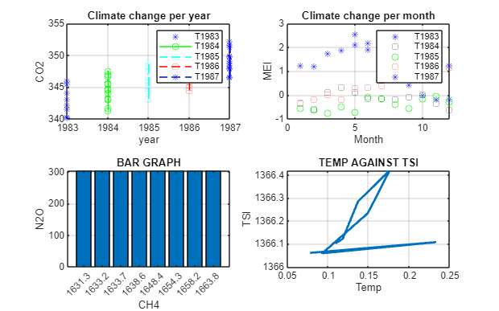

Slide 14
3D GRAPHS
3D Stem3 Plot
% 3D stem3 plot.
figure("Name","3D stem3 plot");
stem3(T1987.Temp,T1987.MEI,T1987.N2O, "filled");
xlabel("Temp");
ylabel("MEI");
zlabel("N20");
title("3Dstem3 plot");
grid on
As shown in the diagram below;

Slide 15
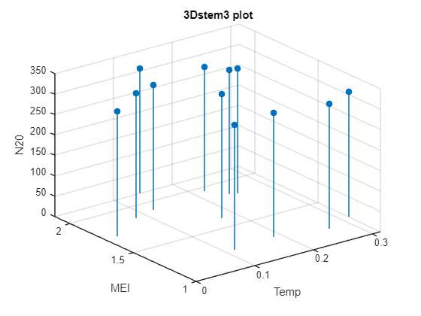

Slide 16
B)
REPRESENTATION OF THE DATA ON A BAR GRAPH
bar(GroupB.name,GroupB.age);
xlabel("name");
ylabel("age");
title("Bar graph");

Slide 17
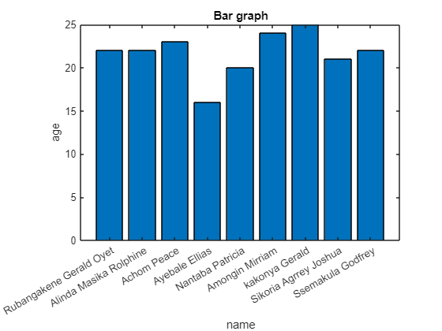

Slide 18
PLOT3
%Plot3
figure("name","plot3");
x = (age);
y = sin(age);
z = cos(age);
plot3(x,y,z);
xlabel("x");
ylabel("y");
zlabel("z");
title("Plot3");
grid on

Slide 19
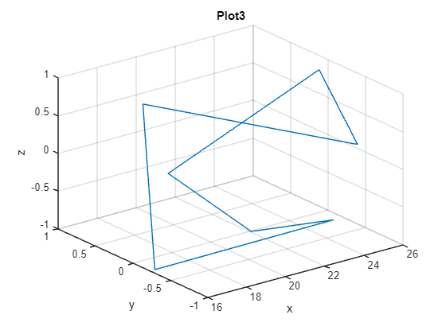

Slide 20
CONCLUSION The assignment was successful since there was maximum cooperation among group D members. It exposed us to the different computation skills on how to import, retrieve and to compile large sums of data using MATLAB. It also exposed us to use different websites like Kaggle.com where we obtained our excel dataset for number one

