Slide 1
Throughline
Cross-Channel Journey Stitching — the visibility layer every other AmEx agent theme's data flows through

Slide 2
The Problem
A dispute starts on the app, escalates through a call, resolves in-branch
Today: four disconnected systems, zero unified view of that one journey
No way to see where it broke down, or that it broke down at all

Slide 3
Why This Theme
Not a 7th agent competing with the other 6 CodeStreet themes
It's the visibility layer that makes any of those journeys traceable end to end
Every other theme generates cross-channel data; none of it is stitched today

Slide 4
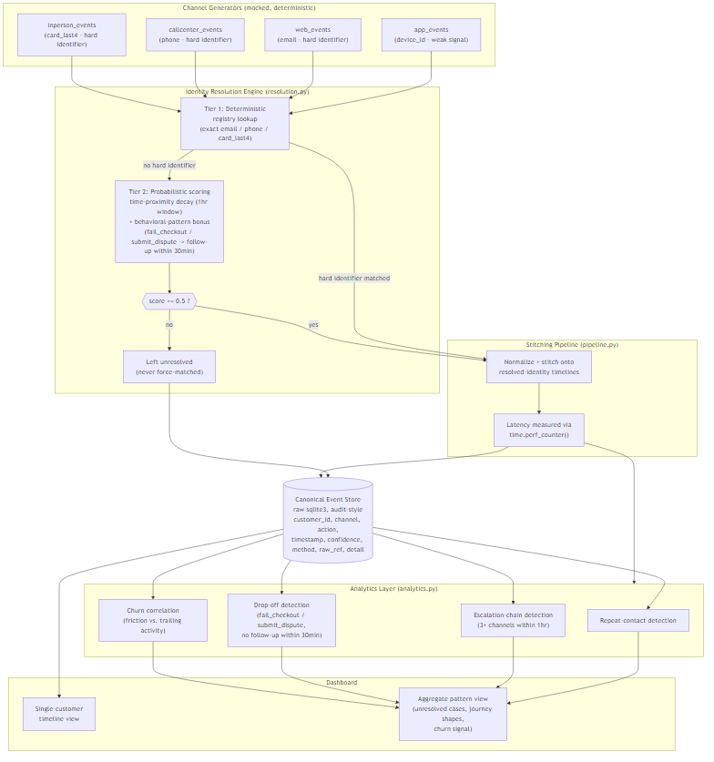
Architecture

Slide 5
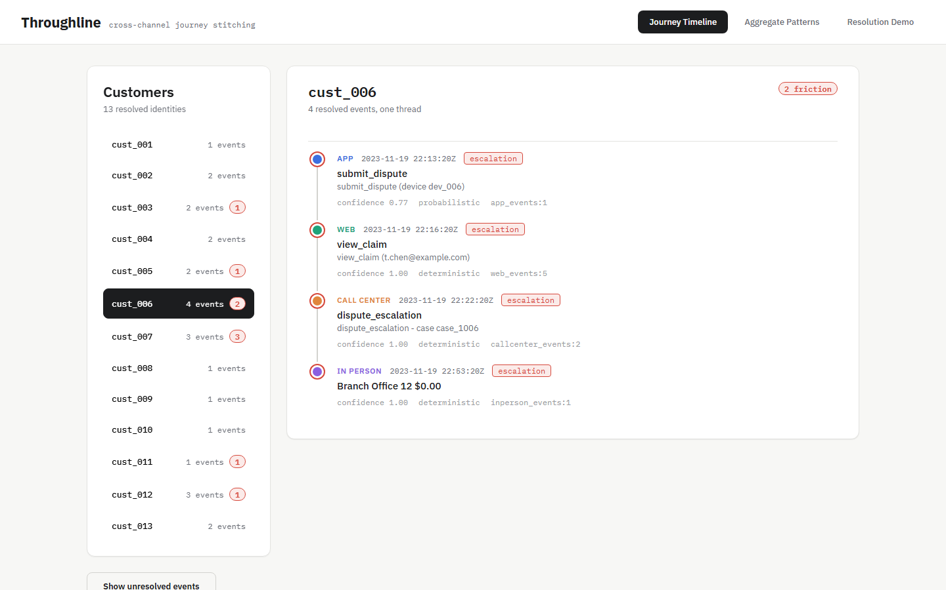
Live Demo — Journey Timeline

Slide 6
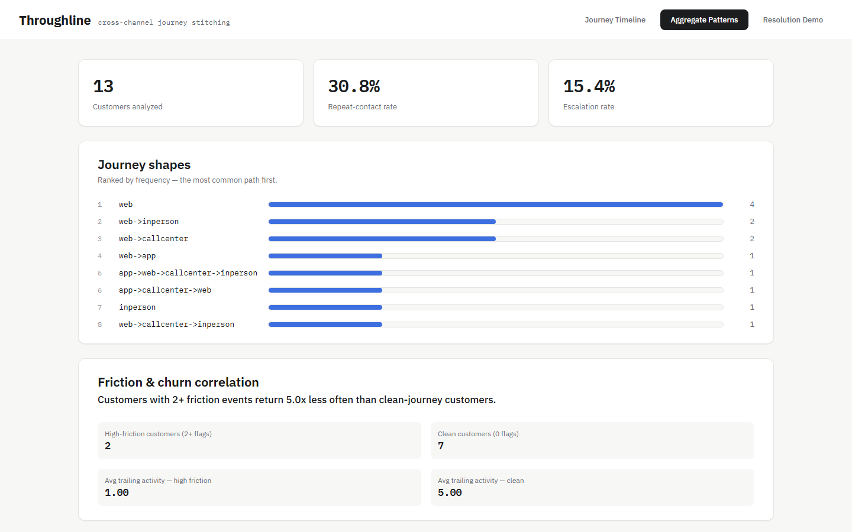
Live Demo — Aggregate Patterns

Slide 7
Measured Results
100% identity resolution accuracy on the seeded set (incl. ambiguous cases correctly left unresolved)
6.28ms average pipeline latency per event, ingestion to resolved timeline
High-friction customers return 5x less often, measured against our seeded synthetic dataset

Slide 8
Business Impact
Turns four blind systems into one traceable customer story
Surfaces churn risk from journey friction before the customer leaves
Honest by design: low-confidence links are flagged, never force-matched

Slide 9
Scalability & What's Next
Event generators -> real Kafka/Spark streaming ingestion at scale
SQLite -> Snowflake/BigQuery for the event store
Analytics layer output feeds a downstream tool like Amplitude/Mixpanel

