Slide 1
Governance Layer for Financial Agents
The safety layer every other AmEx agent theme needs before deployment

Slide 2
The Problem
2026: an autonomous airline booking agent misrouted 1,000+ passengers
nothing checked its actions before it executed them
the same failure mode applies to card & payments agents

Slide 3
Why This Theme
not a 7th agent competing with the other 6 themes
it's the control plane the other 6 need to be deployable at all

Slide 4
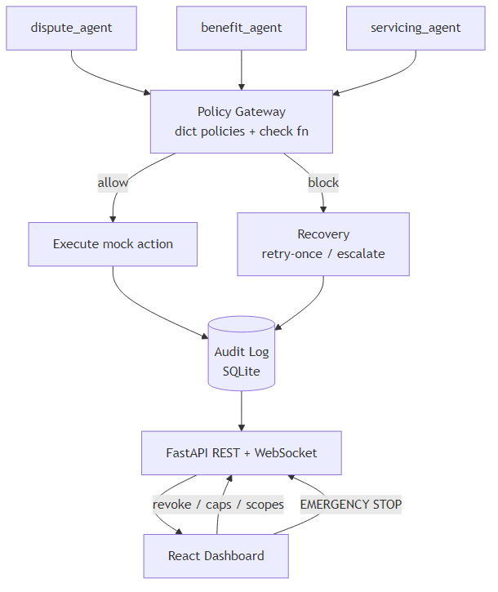
Architecture

Slide 5
Live Demo
agents flow through the policy gateway in real time
over-cap action blocked live, exact reason shown inline
fleet-wide EMERGENCY STOP halts every agent instantly

Slide 6
Business Impact
prevents a misrouted-agent incident before it reaches a customer
full audit trail for every agent decision, allow or block
operator can reconfigure policy live, no redeploy needed

Slide 7
Scalability & What's Next
SQLite -> Postgres, dict-policy engine -> rules service as fleet grows
add per-action-type risk scoring on top of static caps/scopes
pluggable connectors for real agent frameworks

