Slide 1
Chapter 6
Parallel Processors from Client to Cloud

Slide 2
Introduction
§6.1 Introduction
Goal: connecting multiple computers to get higher performance
Multiprocessors
Scalability, availability, power efficiency
Task-level (process-level) parallelism
High throughput for independent jobs
Parallel processing program
Single program run on multiple processors
Multicore microprocessors
Chips with multiple processors (cores)

Slide 3
Hardware and Software
Hardware
Serial: e.g., Pentium 4
Parallel: e.g., quad-core Xeon e5345
Software
Sequential: e.g., matrix multiplication
Concurrent: e.g., operating system
Sequential/concurrent software can run on serial/parallel hardware
Challenge: making effective use of parallel hardware

Slide 4
What We’ve Already Covered
§2.11: Parallelism and Instructions
Synchronization
§3.6: Parallelism and Computer Arithmetic
Subword Parallelism
§4.11: Parallelism via Instructions
§5.10: Parallelism and Memory Hierarchies
Cache Coherence

Slide 5
Parallel Programming
Parallel software is the problem
Need to get significant performance improvement
Otherwise, just use a faster uniprocessor, since it’s easier!
Difficulties
Partitioning
Coordination
Communications overhead
§6.2 The Difficulty of Creating Parallel Processing Programs

Slide 6
Amdahl’s Law
Sequential part can limit speedup
Example: 100 processors, 90× speedup?
T_{new} = T_{parallelizable}/100 + T_{sequential}
Solving: F_{parallelizable} = 0.999
Need sequential part to be 0.1% of original time

Slide 7
Scaling Example
Workload: sum of 10 scalars, and 10 × 10 matrix sum
Speed up from 10 to 100 processors
Single processor: Time = (10 + 100) × t_{add}
10 processors
Time = 10 × t_{add} + 100/10 × t_{add} = 20 × t_{add}
Speedup = 110/20 = 5.5 (55% of potential)
100 processors
Time = 10 × t_{add} + 100/100 × t_{add} = 11 × t_{add}
Speedup = 110/11 = 10 (10% of potential)
Assumes load can be balanced across processors

Slide 8
Scaling Example (cont)
What if matrix size is 100 × 100?
Single processor: Time = (10 + 10000) × t_{add}
10 processors
Time = 10 × t_{add} + 10000/10 × t_{add} = 1010 × t_{add}
Speedup = 10010/1010 = 9.9 (99% of potential)
100 processors
Time = 10 × t_{add} + 10000/100 × t_{add} = 110 × t_{add}
Speedup = 10010/110 = 91 (91% of potential)
Assuming load balanced

Slide 9
Strong vs Weak Scaling
Strong scaling: problem size fixed
As in example
Weak scaling: problem size proportional to number of processors
10 processors, 10 × 10 matrix
Time = 20 × t_{add}
100 processors, 32 × 32 matrix
Time = 10 × t_{add} + 1000/100 × t_{add} = 20 × t_{add}
Constant performance in this example

Slide 10
Instruction and Data Streams
An alternate classification
 |  | Data Streams
 |  | Single | Multiple
Instruction Streams | Single | SISD: Intel Pentium 4 | SIMD: SSE instructions of x86
 | Multiple | MISD: No examples today | MIMD: Intel Xeon e5345
§6.3 SISD, MIMD, SIMD, SPMD, and Vector
SPMD: Single Program Multiple Data
A parallel program on a MIMD computer
Conditional code for different processors

Slide 11
Vector Processors
Highly pipelined function units
Stream data from/to vector registers to units
Data collected from memory into registers
Results stored from registers to memory
Example: Vector extension to RISC-V
v0 to v31: 32 × 64-element registers, (64-bit elements)
Vector instructions
fld.v, fsd.v: load/store vector
fadd.d.v: add vectors of double
fadd.d.vs: add scalar to each element of vector of double
Significantly reduces instruction-fetch bandwidth

Slide 12
Example: DAXPY (Y = a × X + Y)
Conventional RISC-V code:
fld f0,a(x3) // load scalar a
addi x5,x19,512 // end of array X
loop: fld f1,0(x19) // load x[i]
fmul.d f1,f1,f0 // a * x[i]
fld f2,0(x20) // load y[i]
fadd.d f2,f2,f1 // a * x[i] + y[i]
fsd f2,0(x20) // store y[i]
addi x19,x19,8 // increment index to x
addi x20,x20,8 // increment index to y
bltu x19,x5,loop // repeat if not done
Vector RISC-V code:
fld f0,a(x3) // load scalar a
fld.v v0,0(x19) // load vector x
fmul.d.vs v0,v0,f0 // vector-scalar multiply
fld.v v1,0(x20) // load vector y
fadd.d.v v1,v1,v0 // vector-vector add
fsd.v v1,0(x20) // store vector y

Slide 13
Vector vs. Scalar
Vector architectures and compilers
Simplify data-parallel programming
Explicit statement of absence of loop-carried dependences
Reduced checking in hardware
Regular access patterns benefit from interleaved and burst memory
Avoid control hazards by avoiding loops
More general than ad-hoc media extensions (such as MMX, SSE)
Better match with compiler technology

Slide 14
SIMD
Operate elementwise on vectors of data
E.g., MMX and SSE instructions in x86
Multiple data elements in 128-bit wide registers
All processors execute the same instruction at the same time
Each with different data address, etc.
Simplifies synchronization
Reduced instruction control hardware
Works best for highly data-parallel applications

Slide 15
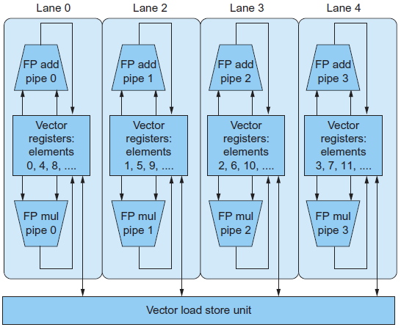
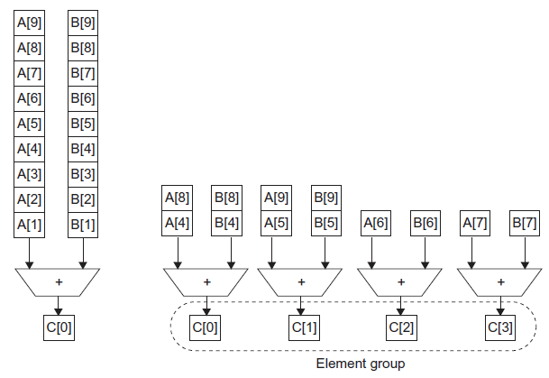
Vector vs. Multimedia Extensions
Vector instructions have a variable vector width, multimedia extensions have a fixed width
Vector instructions support strided access, multimedia extensions do not
Vector units can be combination of pipelined and arrayed functional units:

Slide 16
Multithreading
Performing multiple threads of execution in parallel
Replicate registers, PC, etc.
Fast switching between threads
Fine-grain multithreading
Switch threads after each cycle
Interleave instruction execution
If one thread stalls, others are executed
Coarse-grain multithreading
Only switch on long stall (e.g., L2-cache miss)
Simplifies hardware, but doesn’t hide short stalls (eg, data hazards)
§6.4 Hardware Multithreading

Slide 17
Simultaneous Multithreading
In multiple-issue dynamically scheduled processor
Schedule instructions from multiple threads
Instructions from independent threads execute when function units are available
Within threads, dependencies handled by scheduling and register renaming
Example: Intel Pentium-4 HT
Two threads: duplicated registers, shared function units and caches

Slide 18
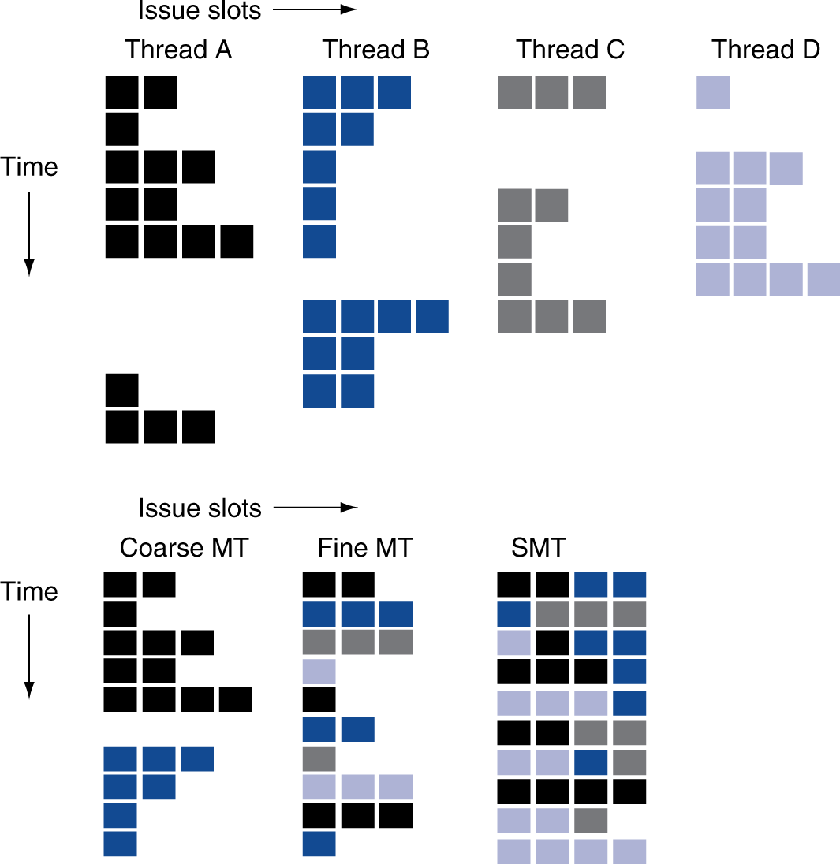
Multithreading Example

Slide 19
Future of Multithreading
Will it survive? In what form?
Power considerations ⇒ simplified microarchitectures
Simpler forms of multithreading
Tolerating cache-miss latency
Thread switch may be most effective
Multiple simple cores might share resources more effectively

Slide 20
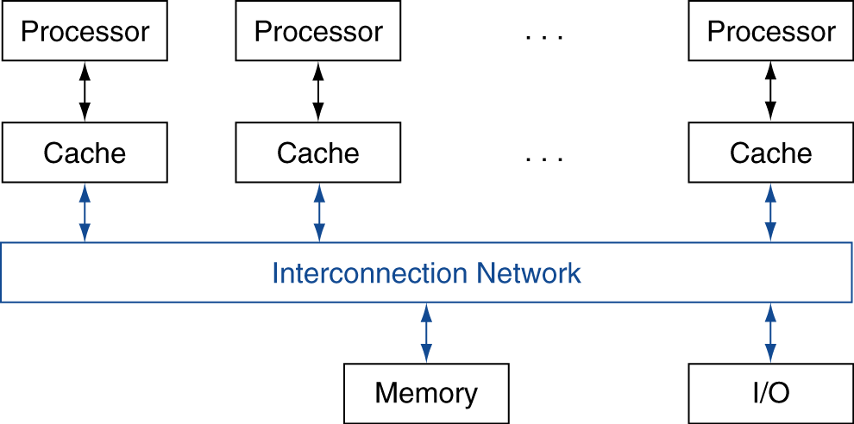
Shared Memory
SMP: shared memory multiprocessor
Hardware provides single physical address space for all processors
Synchronize shared variables using locks
Memory access time
UMA (uniform) vs. NUMA (nonuniform)
§6.5 Multicore and Other Shared Memory Multiprocessors

Slide 21
Example: Sum Reduction
Sum 64,000 numbers on 64 processor UMA
Each processor has ID: 0 ≤ Pn ≤ 63
Partition 1000 numbers per processor
Initial summation on each processor
sum[Pn] = 0; for (i = 1000*Pn; i < 1000*(Pn+1); i += 1) sum[Pn] += A[i];
Now need to add these partial sums
Reduction: divide and conquer
Half the processors add pairs, then quarter, …
Need to synchronize between reduction steps

Slide 22
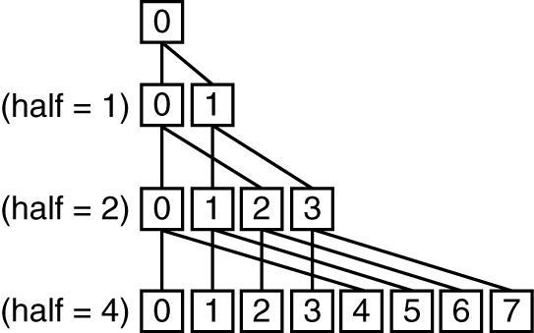
Example: Sum Reduction
half = 64;
do
synch();
if (half%2 != 0 && Pn == 0)
sum[0] += sum[half-1];
/* Conditional sum needed when half is odd;
Processor0 gets missing element */
half = half/2; /* dividing line on who sums */
if (Pn < half) sum[Pn] += sum[Pn+half];
while (half > 1);

Slide 23
History of GPUs
Early video cards
Frame buffer memory with address generation for video output
3D graphics processing
Originally high-end computers (e.g., SGI)
Moore’s Law ⇒ lower cost, higher density
3D graphics cards for PCs and game consoles
Graphics Processing Units
Processors oriented to 3D graphics tasks
Vertex/pixel processing, shading, texture mapping, rasterization
§6.6 Introduction to Graphics Processing Units

Slide 24
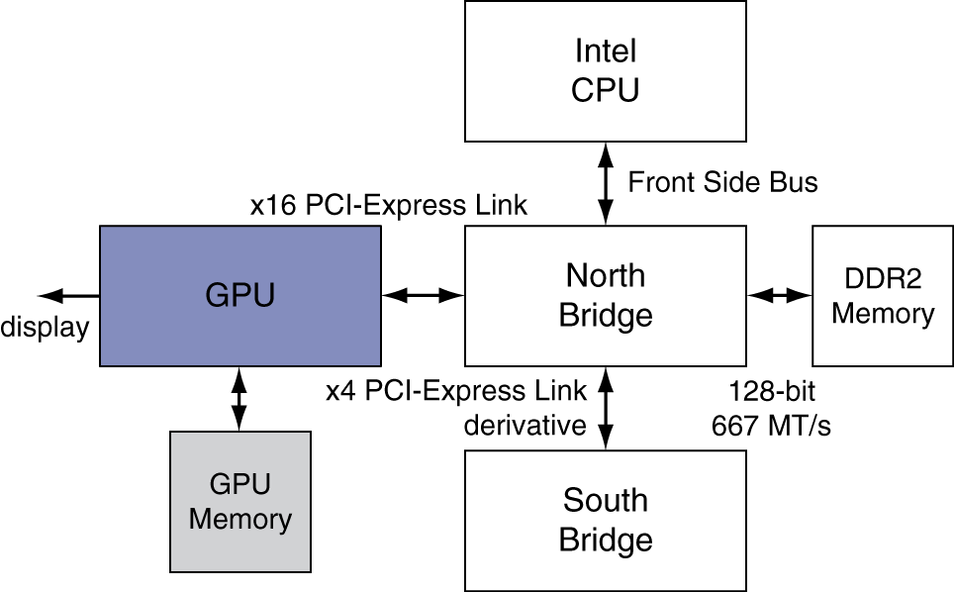
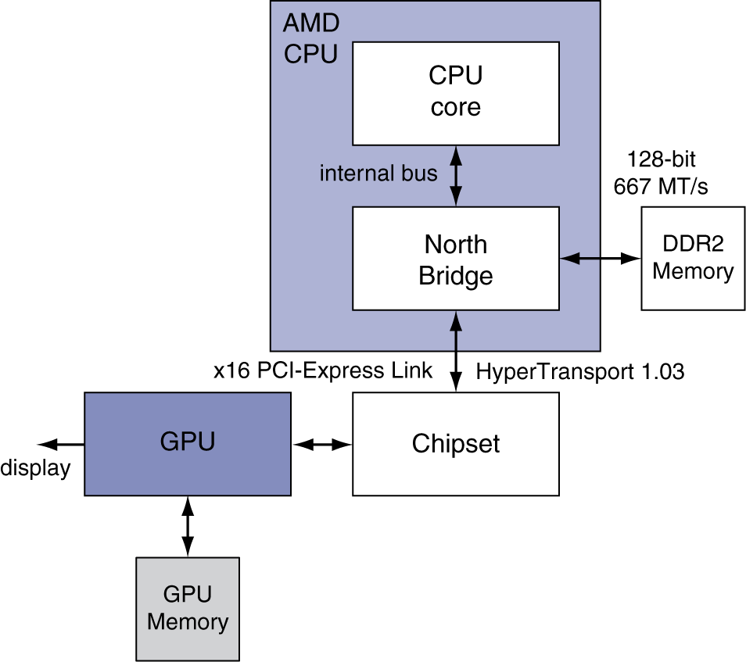
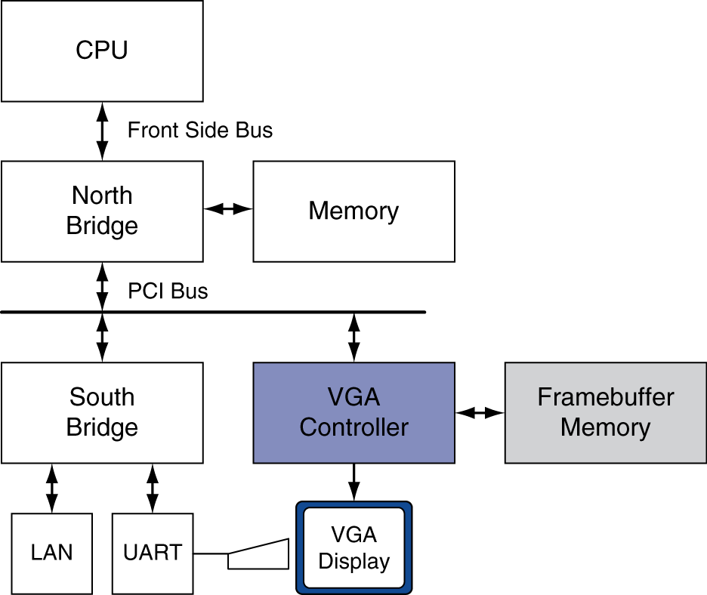
Graphics in the System

Slide 25
GPU Architectures
Processing is highly data-parallel
GPUs are highly multithreaded
Use thread switching to hide memory latency
Less reliance on multi-level caches
Graphics memory is wide and high-bandwidth
Trend toward general purpose GPUs
Heterogeneous CPU/GPU systems
CPU for sequential code, GPU for parallel code
Programming languages/APIs
DirectX, OpenGL
C for Graphics (Cg), High Level Shader Language (HLSL)
Compute Unified Device Architecture (CUDA)

Slide 26
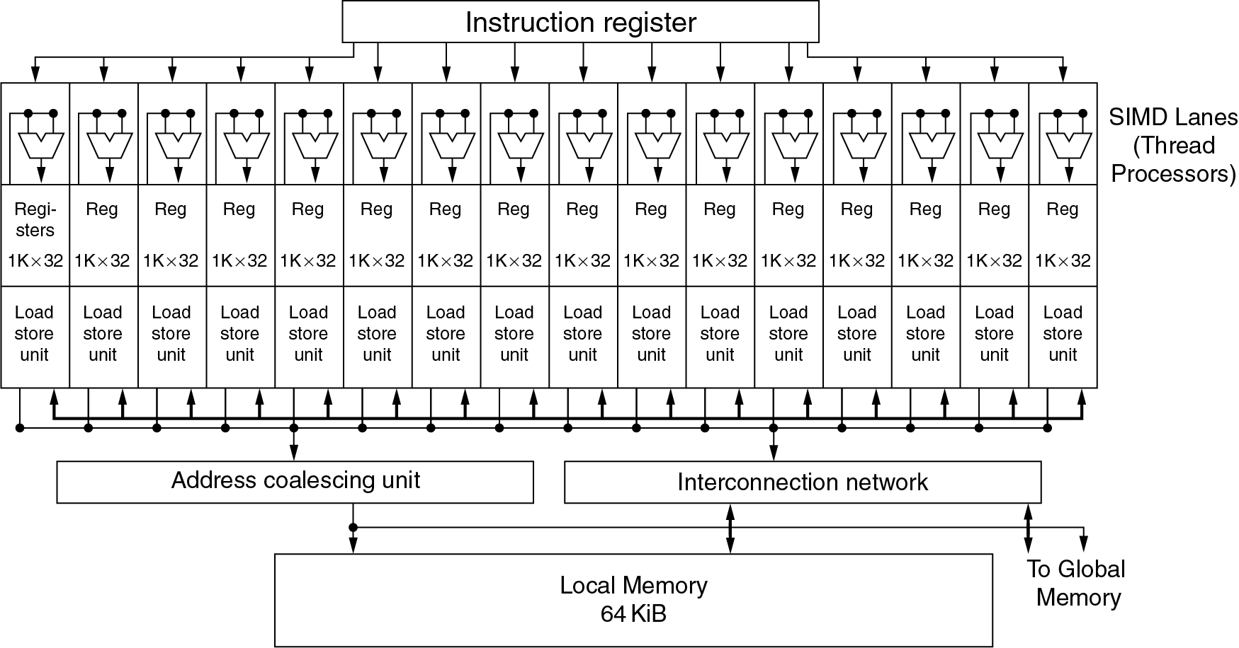
Example: NVIDIA Tesla
Multiple SIMD processors, each as shown:

Slide 27
Example: NVIDIA Tesla
SIMD Processor: 16 SIMD lanes
SIMD instruction
Operates on 32 element wide threads
Dynamically scheduled on 16-wide processor over 2 cycles
32K x 32-bit registers spread across lanes
64 registers per thread context

Slide 28
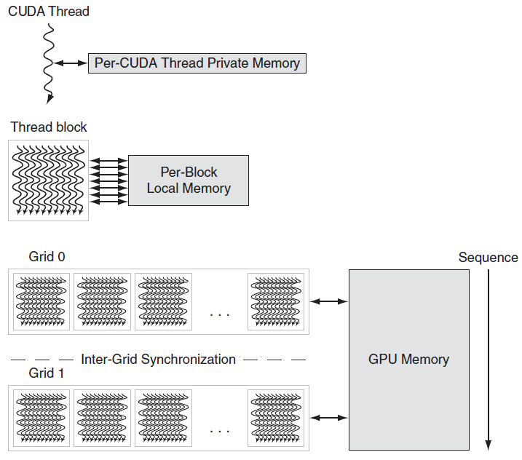
GPU Memory Structures

Slide 29
Classifying GPUs
Don’t fit nicely into SIMD/MIMD model
Conditional execution in a thread allows an illusion of MIMD
But with performance degredation
Need to write general purpose code with care
 | Static: Discovered at Compile Time | Dynamic: Discovered at Runtime
Instruction-Level Parallelism | VLIW | Superscalar
Data-Level Parallelism | SIMD or Vector | Tesla Multiprocessor

Slide 30
Putting GPUs into Perspective
Feature | Multicore with SIMD | GPU
SIMD processors | 8 to 24 | 15 to 80
SIMD lanes/processor | 2 to 4 | 8 to 16
Multithreading hardware support for SIMD threads | 2 to 4 | 16 to 32
Typical ratio of single precision to double-precision performance | 2:1 | 2:1
Largest cache size | 48 MB | 6 MB
Size of memory address | 64-bit | 64-bit
Size of main memory | 64 GB to 1024 GB | 4 GB to 16 GB
Memory protection at level of page | Yes | Yes
Demand paging | Yes | No
Cache coherent | Yes | No

Slide 31
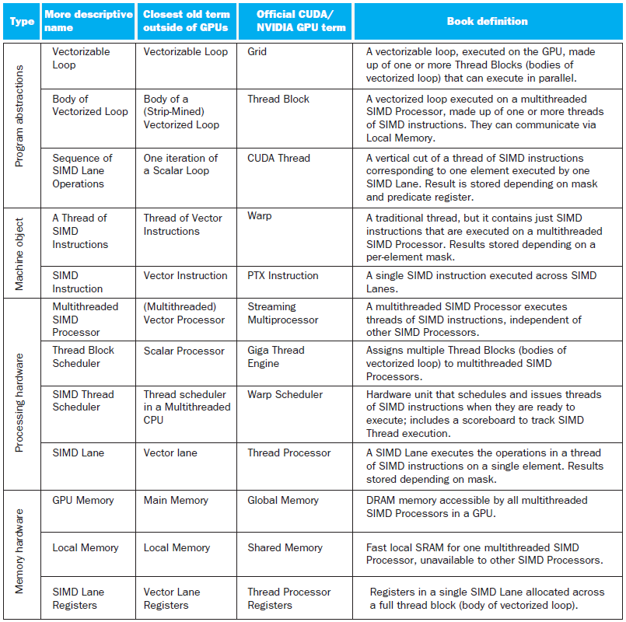
Guide to GPU Terms

Slide 32
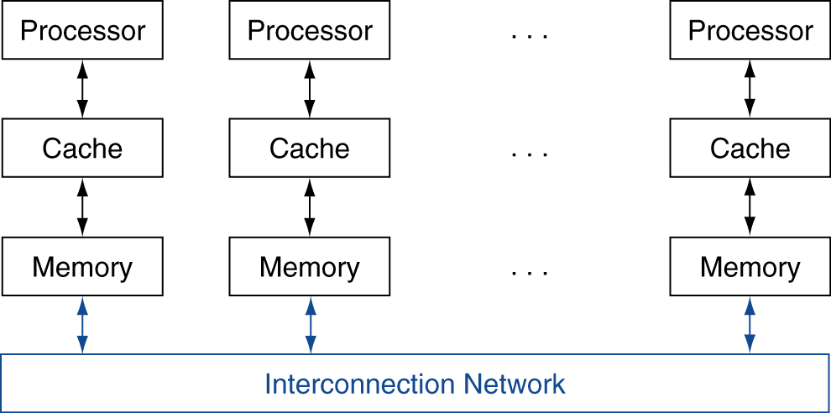
Message Passing
Each processor has private physical address space
Hardware sends/receives messages between processors
§6.8 Clusters, WSC, and Other Message-Passing MPs

Slide 33
Loosely Coupled Clusters
Network of independent computers
Each has private memory and OS
Connected using I/O system
E.g., Ethernet/switch, Internet
Suitable for applications with independent tasks
Web servers, databases, simulations, …
High availability, scalable, affordable
Problems
Administration cost (prefer virtual machines)
Low interconnect bandwidth
c.f. processor/memory bandwidth on an SMP

Slide 34
Sum Reduction (Again)
Sum 64,000 on 64 processors
First distribute 1000 numbers to each
The do partial sums
sum = 0; for (i = 0; i<1000; i += 1) sum += AN[i];
Reduction
Half the processors send, other half receive and add
The quarter send, quarter receive and add, …

Slide 35
Sum Reduction (Again)
Given send() and receive() operations
limit = 64; half = 64;/* 64 processors */ do half = (half+1)/2; /* send vs. receive dividing line */ if (Pn >= half && Pn < limit) send(Pn - half, sum); if (Pn < (limit/2)) sum += receive(); limit = half; /* upper limit of senders */ while (half > 1); /* exit with final sum */
Send/receive also provide synchronization
Assumes send/receive take similar time to addition

Slide 36
Grid Computing
Separate computers interconnected by long-haul networks
E.g., Internet connections
Work units farmed out, results sent back
Can make use of idle time on PCs
E.g., SETI@home, World Community Grid

Slide 37


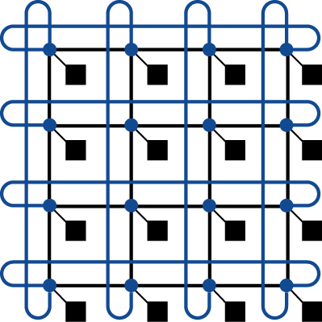
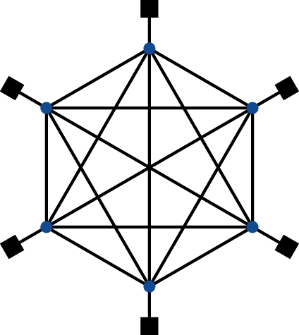
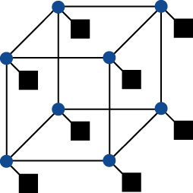
Interconnection Networks
Network topologies
Arrangements of processors, switches, and links
§6.9 Introduction to Multiprocessor Network Topologies
Bus
Ring
N-cube (N = 3)
2D Mesh
Fully connected

Slide 38
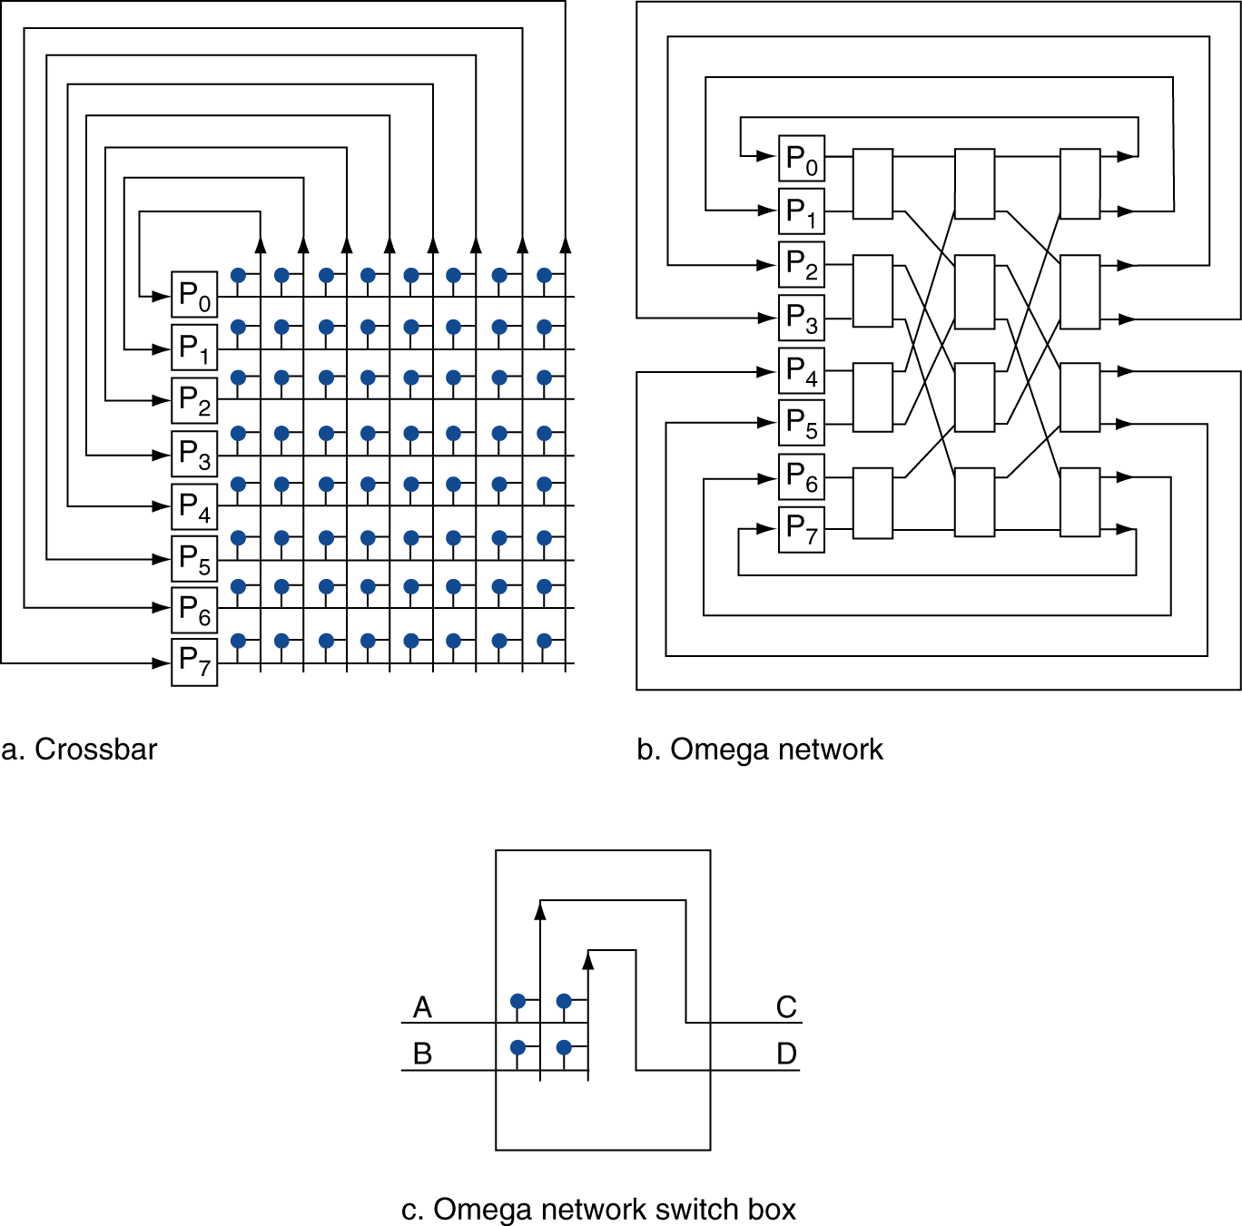
Multistage Networks

Slide 39
Network Characteristics
Performance
Latency per message (unloaded network)
Throughput
Link bandwidth
Total network bandwidth
Bisection bandwidth
Congestion delays (depending on traffic)
Cost
Power
Routability in silicon

Slide 40
Parallel Benchmarks
Linpack: matrix linear algebra
SPECrate: parallel run of SPEC CPU programs
Job-level parallelism
SPLASH: Stanford Parallel Applications for Shared Memory
Mix of kernels and applications, strong scaling
NAS (NASA Advanced Supercomputing) suite
computational fluid dynamics kernels
PARSEC (Princeton Application Repository for Shared Memory Computers) suite
Multithreaded applications using Pthreads and OpenMP
§6.11 Multiprocessor Benchmarks and Performance Models

Slide 41
Code or Applications?
Traditional benchmarks
Fixed code and data sets
Parallel programming is evolving
Should algorithms, programming languages, and tools be part of the system?
Compare systems, provided they implement a given application
E.g., Linpack, Berkeley Design Patterns
Would foster innovation in approaches to parallelism

Slide 42
Modeling Performance
Assume performance metric of interest is achievable GFLOPs/sec
Measured using computational kernels from Berkeley Design Patterns
Arithmetic intensity of a kernel
FLOPs per byte of memory accessed
For a given computer, determine
Peak GFLOPS (from data sheet)
Peak memory bytes/sec (using Stream benchmark)

Slide 43
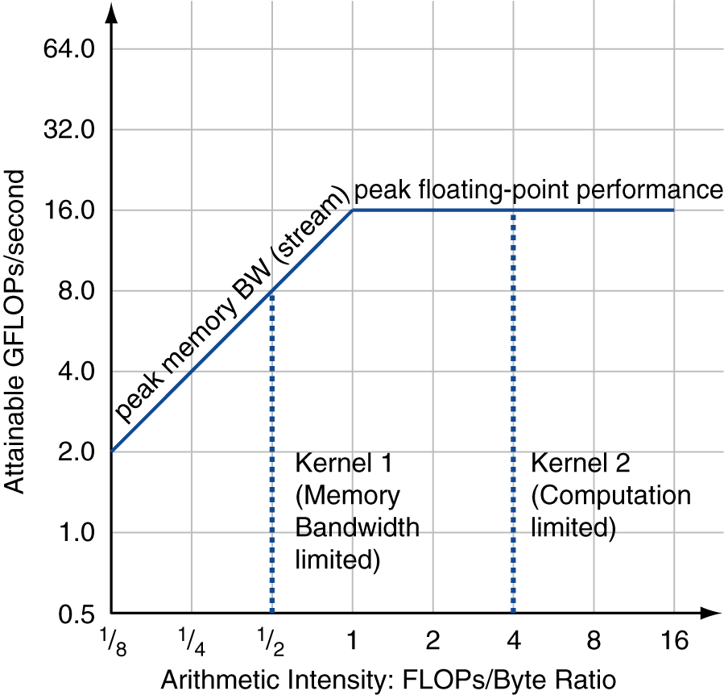
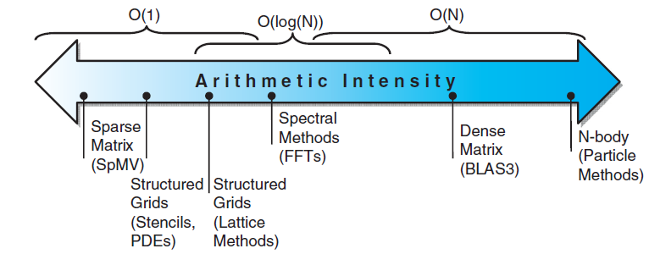
Roofline Diagram
Attainable GPLOPs/sec
= Max ( Peak Memory BW × Arithmetic Intensity, Peak FP Performance )

Slide 44
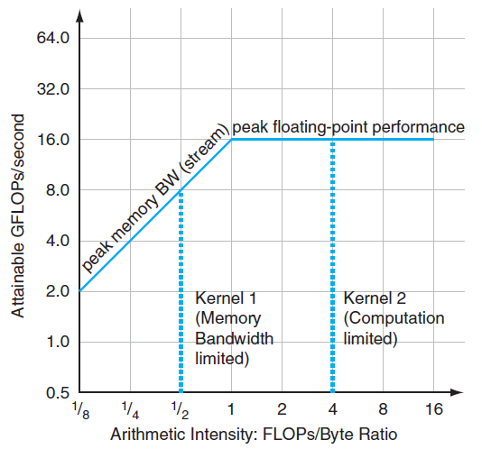
Roofline Diagram
Attainable GPLOPs/sec
= Max ( Peak Memory BW × Arithmetic Intensity, Peak FP Performance )

Slide 45
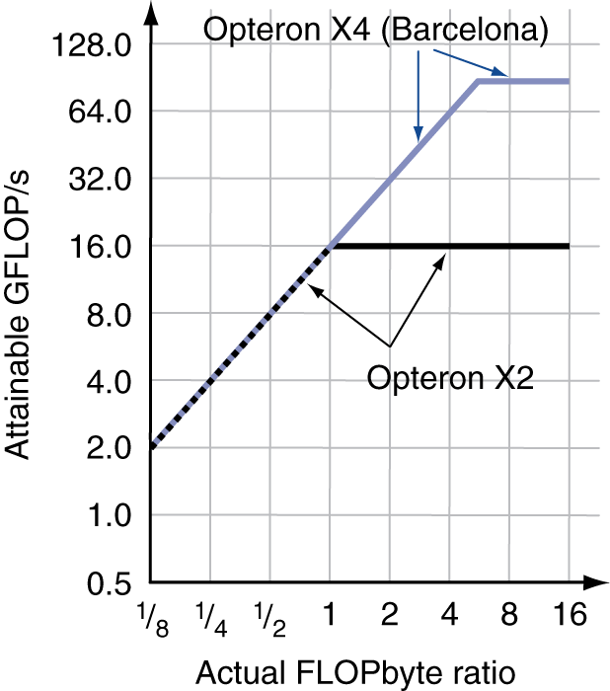
Comparing Systems
Example: Opteron X2 vs. Opteron X4
2-core vs. 4-core, 2× FP performance/core, 2.2GHz vs. 2.3GHz
Same memory system
To get higher performance on X4 than X2
Need high arithmetic intensity
Or working set must fit in X4’s 2MB L-3 cache

Slide 46
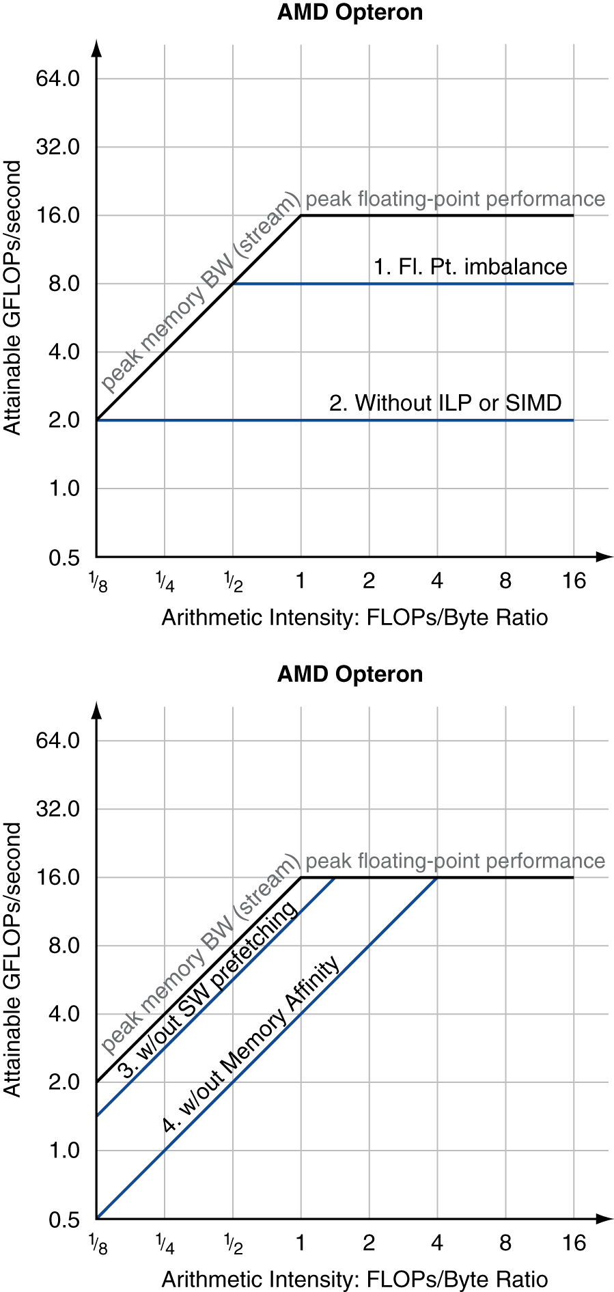
Optimizing Performance
Optimize FP performance
Balance adds & multiplies
Improve superscalar ILP and use of SIMD instructions
Optimize memory usage
Software prefetch
Avoid load stalls
Memory affinity
Avoid non-local data accesses

Slide 47
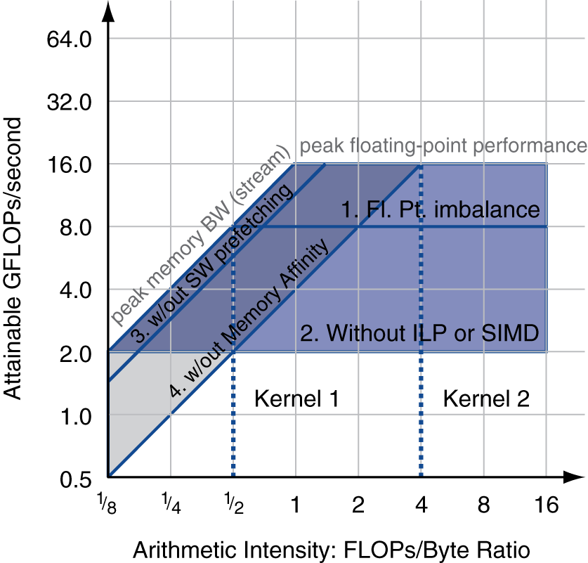
Optimizing Performance
Choice of optimization depends on arithmetic intensity of code
Arithmetic intensity is not always fixed
May scale with problem size
Caching reduces memory accesses
Increases arithmetic intensity

Slide 48
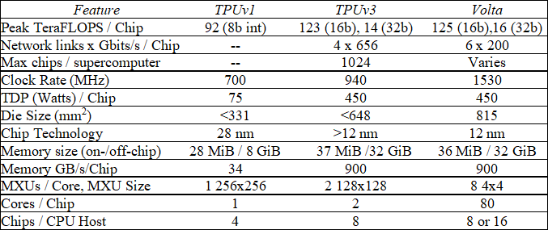
TPUv3 vs Volta for DNN

Slide 49
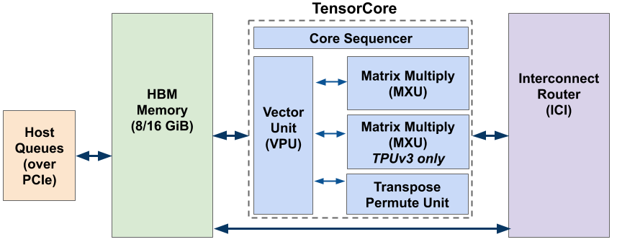
TPUv3
Core Sequencer:
VLIW with software-managed memory
322-bit VLIW w/8 operations:
2 x scalar ALU, 2 x vector ALU, vector load and store, 2 x queue operations for matrix multiply/transpose unit

Slide 50
TPUv3
Vector Processing Unit (VPU)
Uses data-level parallelism (2D matrix and vector functional units) and instruction-level parallelism (8 operations per instruction)
Uses on-chip vector memory (Vmem) with 32K 128 x 32-bit elements (16 MiB)
32 2D vector registers (Vregs) that each contain 128 x 8 32-bit elements (4 KiB)
MXU
Produces 32-bit FP products from 16-bit FP inputs that accumulate in 32 bits
Two MXUs per TensorCore
The Transpose Reduction Permute Unit
128x128 matrix transposes, reductions, and permutations

Slide 51
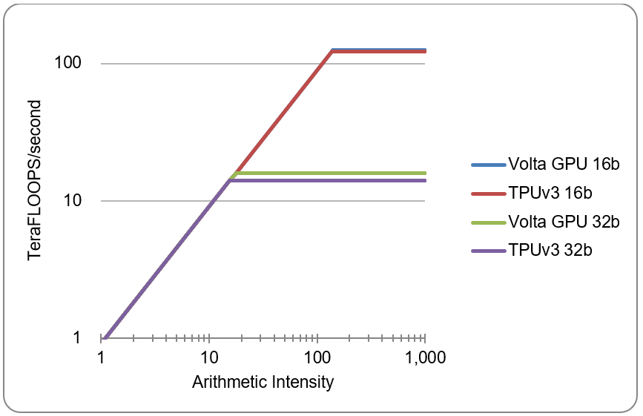
TPUv3 vs Volta for DNN

Slide 52
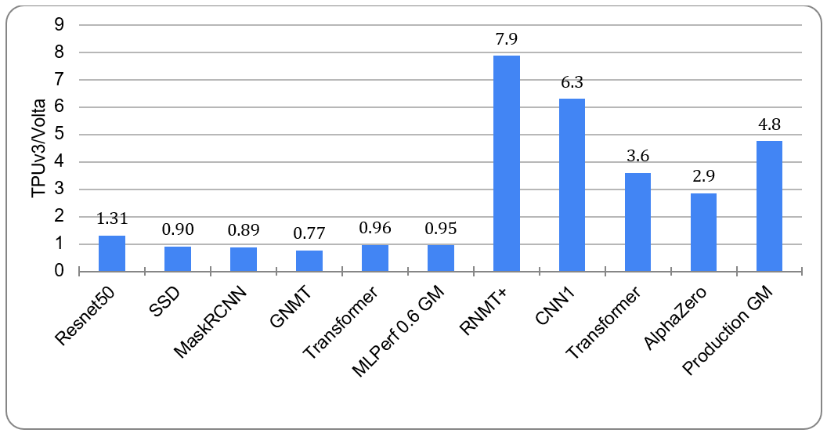
Speedup of TPUv3 vs Volta

Slide 53
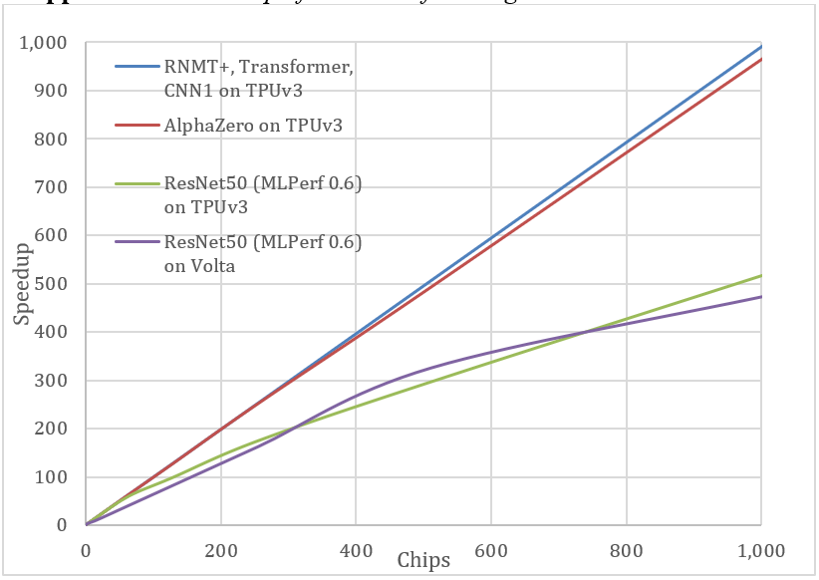
TPUv3 and Volta Scalability

Slide 54
Multi-threading DGEMM
Use OpenMP:
1. #include <x86intrin.h>
2. #define UNROLL (4)
3. #define BLOCKSIZE 32
4. void do_block (int n, int si, int sj, int sk,
5. double *A, double *B, double *C)
6. {
7. for ( int i = si; i < si+BLOCKSIZE; i+=UNROLL*8 )
8. for ( int j = sj; j < sj+BLOCKSIZE; j++ ) {
9. __m512d c[UNROLL];
10. for (int r=0;r<UNROLL;r++)
11. c[r] = _mm512_load_pd(C+i+r*8+j*n); //[ UNROLL];
12.
13. for( int k = sk; k < sk+BLOCKSIZE; k++ )
14. {
15. __m512d bb = _mm512_broadcastsd_pd(_mm_load_sd(B+j*n+k));
16. for (int r=0;r<UNROLL;r++)
17. c[r] = _mm512_fmadd_pd(_mm512_load_pd(A+n*k+r*8+i), bb, c[r]);
18. }
19.
20. for (int r=0;r<UNROLL;r++)
21. _mm512_store_pd(C+i+r*8+j*n, c[r]);
22. }
23. }
24.
25. void dgemm (int n, double* A, double* B, double* C)
26. {
27. #pragma omp parallel for
28. for ( int sj = 0; sj < n; sj += BLOCKSIZE )
29. for ( int si = 0; si < n; si += BLOCKSIZE )
30. for ( int sk = 0; sk < n; sk += BLOCKSIZE )
31. do_block(n, si, sj, sk, A, B, C);
32. }
§6.13 Going Faster: Multiple Processors and Matrix Multiply

Slide 55
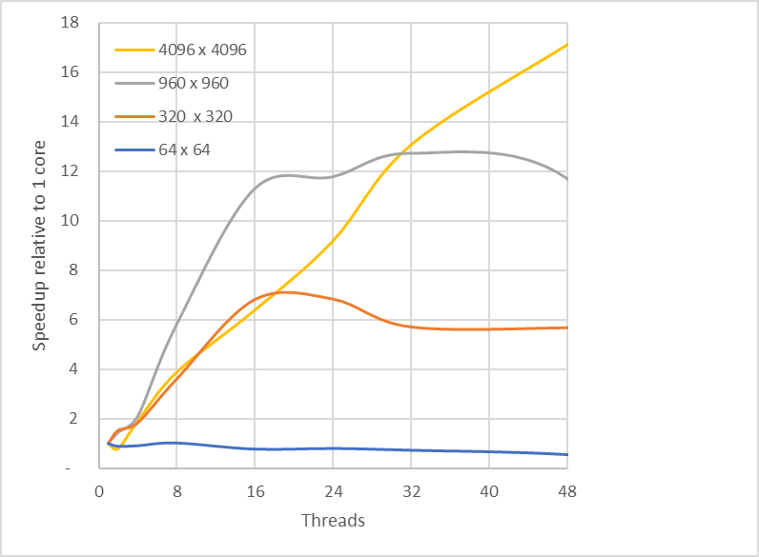
Multithreaded DGEMM

Slide 56
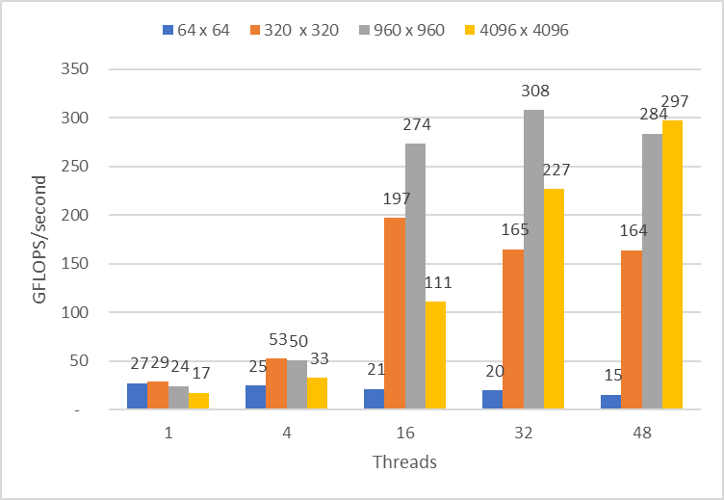
Multithreaded DGEMM

Slide 57
Fallacies
Amdahl’s Law doesn’t apply to parallel computers
Since we can achieve linear speedup
But only on applications with weak scaling
Peak performance tracks observed performance
Marketers like this approach!
But compare Xeon with others in example
Need to be aware of bottlenecks
§6.14 Fallacies and Pitfalls

Slide 58
Fallacies
Not developing the software to take advantage of, or optimize for, a novel architecture
Unexpected bottlenecks, e.g. serialization of page tables
Usability for DSAs
You can get good vector performance without proving memory bandwidth
Beware of the sloping part of the roofline

Slide 59
Pitfalls
Not developing the software to take account of a multiprocessor architecture
Example: using a single lock for a shared composite resource
Serializes accesses, even if they could be done in parallel
Use finer-granularity locking

Slide 60
Pitfalls
Assuming the ISA completely hides the physical implementation properties
Attacker can examine state changes caused by instructions that are rolled back or performance differences caused by intermixing of instructions from different programs on the same server
Speculation
Caching
Hardware multithreading

Slide 61
Concluding Remarks
Goal: higher performance by using multiple processors
Difficulties
Developing parallel software
Devising appropriate architectures
SaaS importance is growing and clusters are a good match
Performance per dollar and performance per Joule drive both mobile and WSC
§6.15 Concluding Remarks

Slide 62
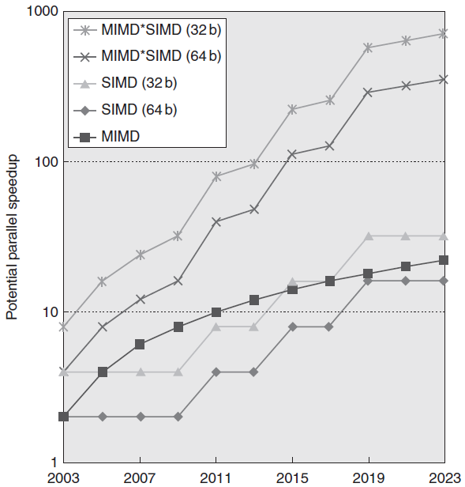
Concluding Remarks (con’t)
SIMD and vector operations match multimedia applications and are easy to program

