Slide 1
Affine Partitioning
Reading Assignment: Chapter 11 of Dragon Book
Prof. Shih-wei Liao

Slide 2
Software-Hardware Co-design. Challenge: Transactional Memory
Transactional Memory:
C.A.R. Hoare’s Monitor +
Boxing of shared mutable states: ACI (Atomicity, Coherence, Isolation)
History: 1993: Maurice Herlihy. Eliott Moss. Faded by1995. Momentum came back in 2004, thanking to multicores.
Has been under-delivering: Many tunables and hard-to-tune parameters destroy the “風水” of TM: Harmony of productivity and performance

Slide 3
Programming Models
Various programming models: End of Lazy-boy programming era
Basic: pthread kind of model. Lock-based
Transactional Memory (may not be a real model): Azul
Functional: Symbolic machine
Data-Parallel: Graphics Processor
Data flow: Network Processor
Multicore-for-latency: Helper threads

Slide 4
Bottom-Up
In addition to the Top-Down above, we also do the Bottom-Up
CFA: basic block, dominance, loop, interval analysis, reducibility
DFA: Iterative data flow analysis, lattice
SSA: Dominance frontier. ssa & de-ssa. ssa-based analysis
Dependence analysis: Dependence dag, dependence testing, dependence distance (next)
Today: Affine partitioning

Slide 5
Traditional Way of Formulating the Problem: Dependence Distance Vector
A distance vector for a nest of k loops is a k-dimensional vector d→=<d₁, …, d_{k}>, where each d_{i} is an integer
For each index vector i→, the iteration with index vector <i₁+d₁, …, i_{k}+d_{k}> depends on the one with index vector i→
Example:
A distance vector of <1, 1, 2> implies there is a dependence from iteration [2, 4, 1] to iteration [3, 5, 3]
Go back to the First Principle

Slide 6
Affine Partitioning (AP): Problem Statement (1/2)
Optimized Parallel Partition
Sequential or Parallel Code (C/Brook…)
Programming System
AP transforms code to optimal partitions, where each partition can be mapped to a thread on multicore.
Go back to the 1st principle: Abstraction level: Partition, not yet another Dependence Analysis
Outcome: a powerful unifying theory for affine domain
Rigorous, no ad-hoc foundation for generalization to other domains

Slide 7
AP: Problem Statement (2/2)
P
P
P
P
$
$
$
$
shared or private L2 $
M
Minimize communication between threads & Improve memory locality to reduce cache miss
Figures on Slide 6-13: Courtesy: Amy Lim

Slide 8
Optimizations: Parallelism & Locality
Distance Vector
Loop Distribution
Simple Test
Generalized GCD Test
Loop Interchange
Array Expansion
Tiling/Blocking
True Dependence
Two Variable Exact Test
Array Contraction
Loop Reversal
Direction Vector
Loop Reindexing
GCD Test
Array Privatization
Anti-Dependence
Dependence Level
Statement Reordering
Output Dependence
Loop Skewing
Loop Fusion
Extreme Value Test

Slide 9
Unified Transformation Framework
Loop Interchange
Loop Interchange
Unimodular Transform
Loop Reversal
Loop Reversal
Loop Skewing
Loop Skewing
r
Affine Transform
Statement Reordering
Statement Reordering
Loop Distribution
?
Loop Distribution
affine expression
+
new loop structures
Loop Fusion
Loop Fusion
Loop Reindexing
Loop Reindexing
old
iteration space
new
iteration space
Tiling/Blocking

Slide 10
Outline
Introduction
Old Approach: Unimodular Transform. (UT)
Limitation of Old Approach
New Approach: Affine Partition (AP)
Space Partition
Time Partition

Slide 11
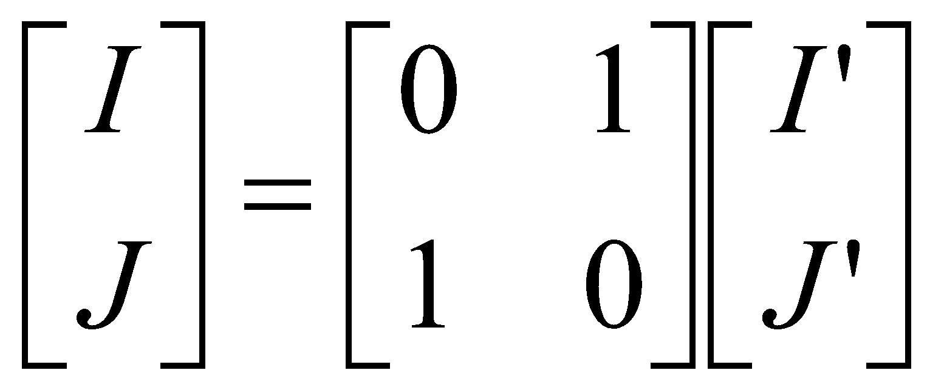
Loop Interchange
For J = 1 to 3
For I = 1 to 4
A[J,I] = …
For J’ = 1 to 4
For I’ = 1 to 3
A[I’,J’] = …
J
J’
I
I’

Slide 12
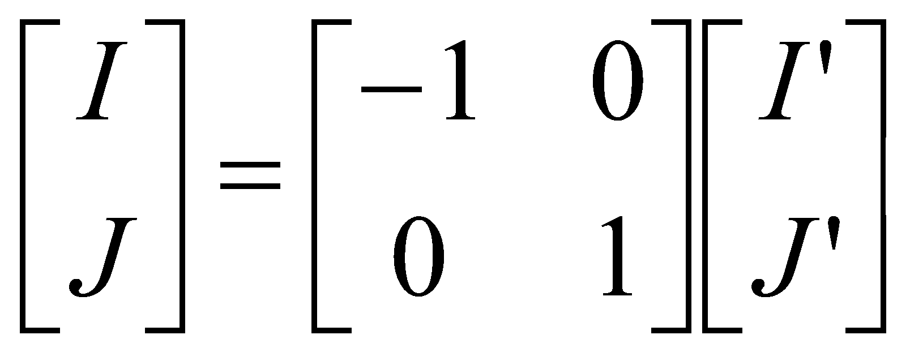
Loop Reversal
For J = 1 to 4
For I = 1 to 3
A[I,J] = …
For J’ = 1 to 4
For I’ = -3 to -1
A[-I’,J’] = …
J
J’
I
I’

Slide 13
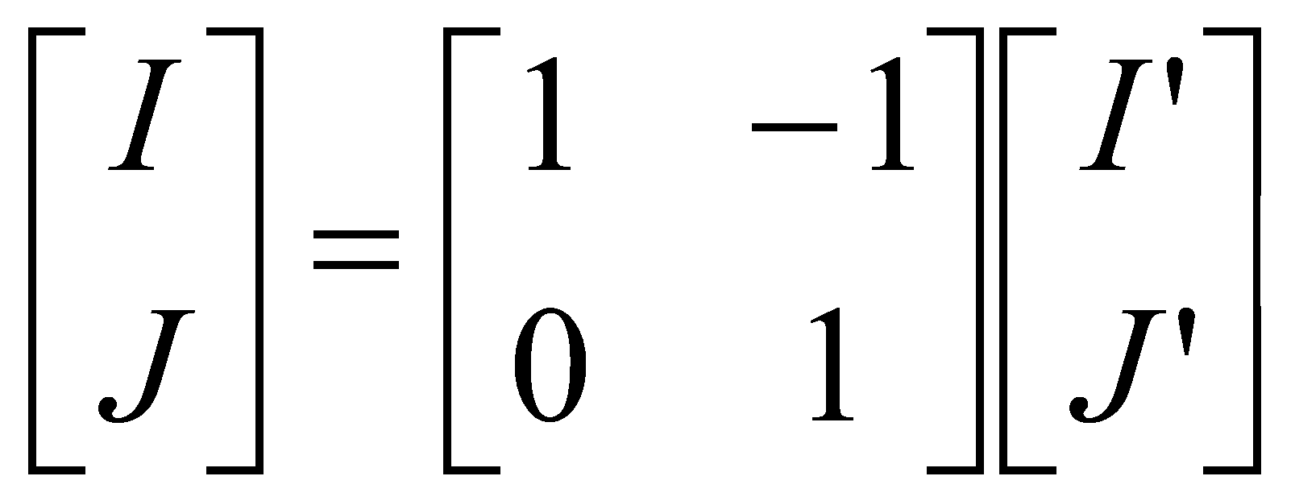
Loop Skewing
For J = 1 to 4
For I = -3 to -1
A[-I,J] = …
For J’ = 1 to 4
For I’ = J’-3 to J’-1
A[J’-I’,J’] = …
J’
J
I
I’

Slide 14
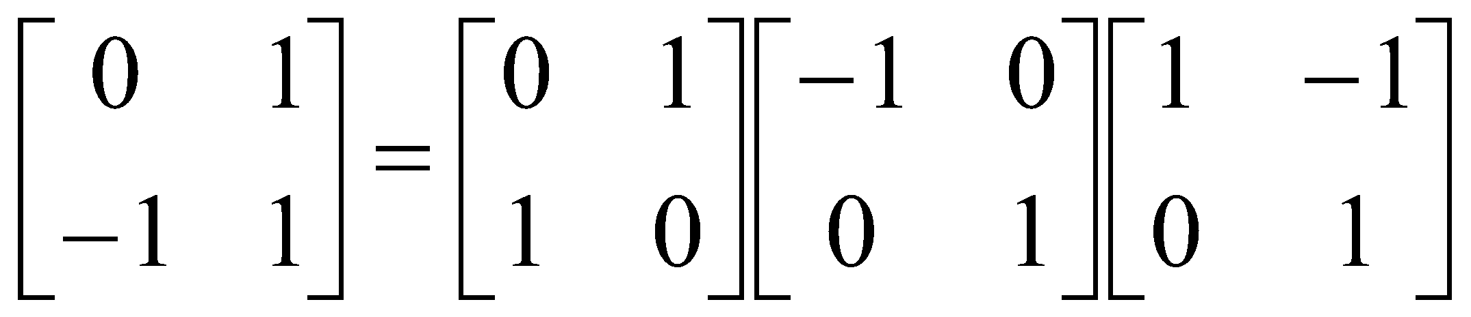

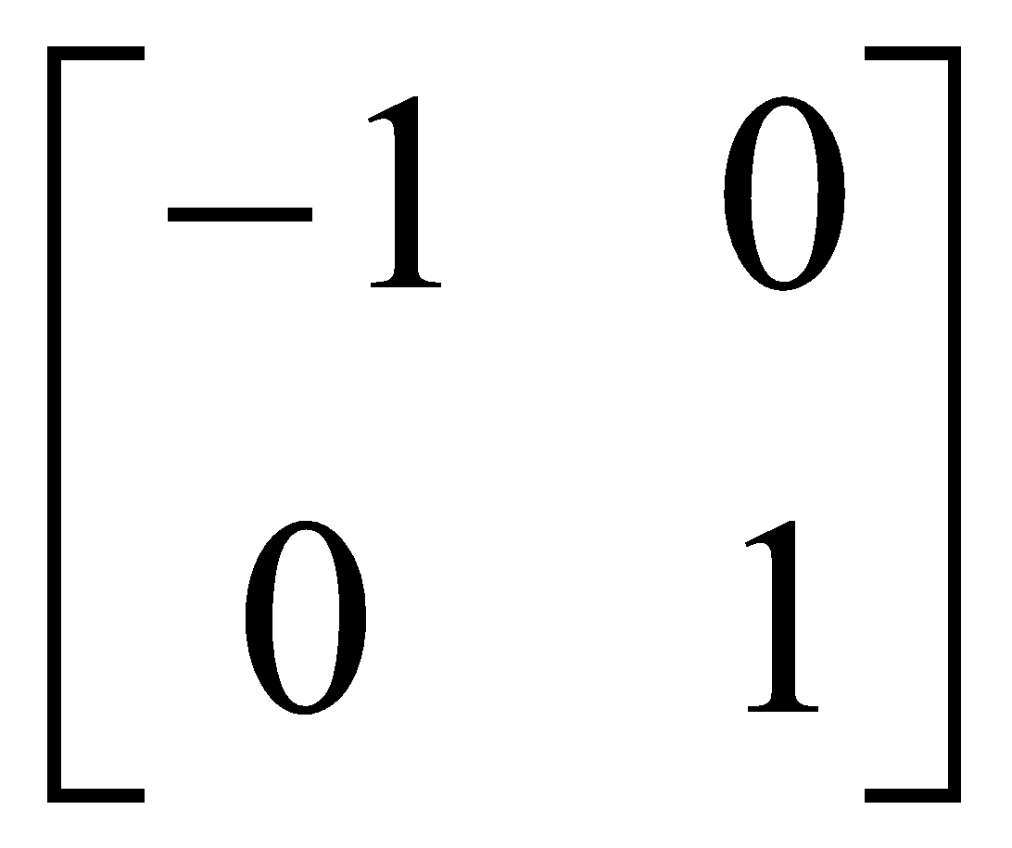
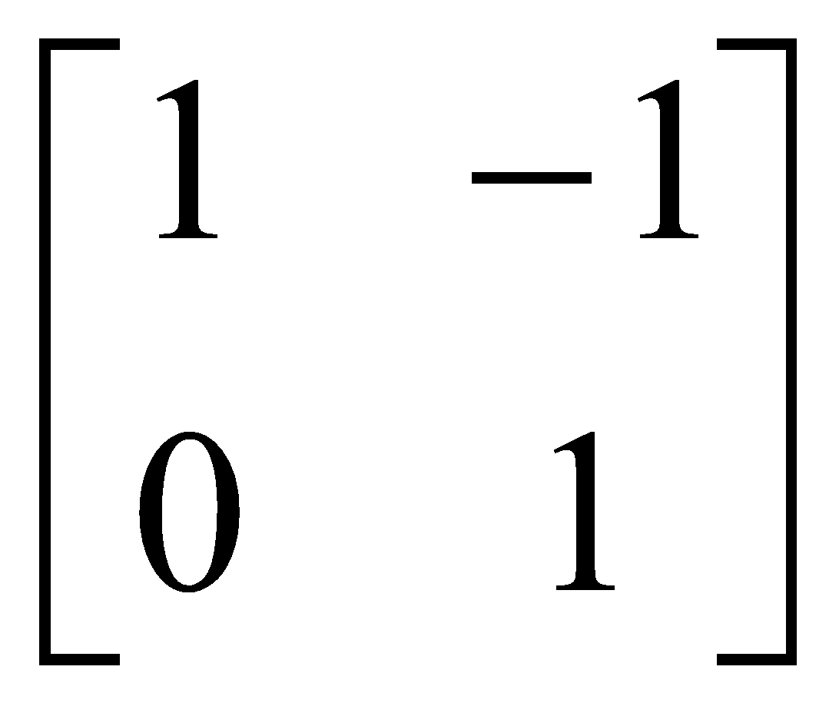
No Phase Ordering Problem betw. 3 UTs (True for AP Transforms too)
The unimodular matrix is square, integer matrix where the absolute value of the determinant is 1.

Slide 15
Limitation of UT: Only Handle Perfect Nested Loop
For I = 1 to X For J = 1 to Y B[I,J] = … For L = 1 to W A[I,J,L]=… …. For L = 1 to W2 ….
For I = 1 to X For J = 1 to Y
……
For L = 1 to W
A[I,J,L]= …
……..
All code must be in the innermost loop. Code not inside innermost loop is not supported
B[I,J]=…
B[I,J]=…
For J = 1 to Y For L = 1 to W2 ………
For J = 1 to Y For L = 1 to W2 ………
A loop with multiple child loops are not supported.
Affine partition could support uniformed transformation for multiple loops, such as loop fusion above
Solution: AP: Mapping at Statement-level

Slide 16
Limitation of UT: Cannot Reindex at Statement Level
I=1 For J = 1 to 4 T[1] = … For I = 2 to 4
For J = 1 to 4 T[I] = … … = T[I] I=5 For J = 1 to 4 … = T[5]
For I = 1 to 4
For J = 1 to 4 T[I] = … … = T[I+1]
Reindex is required to change the loop-carried dependency into loop independent dependency. Unimodular could not formulate loop reindex.
For I = 1 to 4
For J = 1 to 4 T[I] = … … = T[I+1]
I
I
J
We’ll show how AP does loop reindexing in uniform form
J

Slide 17
Limitation of UT: Dependences Must Be in Distance Vector Format
#omp for
For P = 1 to N For J = 1 to P-1 A[P, J] = B[P, J] A[P,P]=B[P,P] C[P,P]=A[P,P] For I=P+1 to N C[I, P] = A[P,I]
For I = 1 to N For J = 1 to I A[I, J] = B[I, J] C[I, J]= A[J, I]
For I = 1 to N For J = 1 to I A[I, J] = B[I, J] C[I, J]= A[J, I]
Dependency could not be formulated by distance vector and such kinds of dependency is still in linear combination format of induction variables
We’ll show later how AP parallelizes such kinds of loop. Here, we assume A, B, C don’t overlap with each other.

Slide 18
1-dim Processor Topology (ring…) 🡪 1-order AP
For each statement, apply a linear transformation of induction variables Φ_{k}(i_{k}) = C_{k}i_{k} + c_{k} =c_{k1} i_{k1}+c_{k2}i_{k2}+…c_{ks}i_{ks}+c_{k}
Each statement has a different transformation
The 1-order affine partition only determine 1 row of the transformation matrix, the objective of the transformation is to find a common outmost loop for all statements

Slide 19
AP Solves Statement-Reindex Problem
P=1
For J = 1 to 4 T[P] = … For P = 2 to 4
For J = 1 to 4 T[P] = … … = T[P] P = 5
For J = 1 to 4 … = T[P]
For I = 1 to 4
For J = 1 to 4 T[I] = … … = T[I+1]
I
P
J
J
Φ₁(I,J) = 1*I+0*J+0 = I Φ₂(I,J) = 1*I+0*J+1 = I+1

Slide 20
AP Solves Cases w/o Distance Vectors (Later slides: Space partitioning details)
For P = 1 to N For J = 1 to P-1 A[P, J] = B[P, J] A[P,P]=B[P,P] C[P,P]=A[P,P] For I=P+1 to N C[I, P] = A[P,I]
For I = 1 to N For J = 1 to I A[I, J] = B[I, J] C[I, J]= A[J, I]
Φ₁(I,J) = 1*I+0*J+0 = I Φ₂(I,J) = 0*I+1*J+0 = J

Slide 21
Space Partition
Partition iterations to different processor
No loop-carried dependency after the transformation. All data dependences are independent to the outmost loop.
P=3
P=4
P=5
P=6
P=7
FOR i = 1 TO n DO
FOR j = 1 TO n DO
A[i,j] = A[i,j]+B[i-1,j]; (S1)
B[i,j] = A[i,j-1]*B[i,j]; (S2)
S1
i
S2
j

Slide 22
Space Partition Example
FOR i = 1 TO n DO
FOR j = 1 TO n DO
A[i,j] = A[i,j]+B[i-1,j]; (S1)
B[i,j] = A[i,j-1]*B[i,j]; (S2)
Assume the affine partition is:
P = a * i + b *j + c (S1) P = d * i + e *j + f (S2)
S2[i,j]δ^{f}S1[i+1,j]
a*(i + 1)+b*j+c = d*i + e*j + f
That’s
(a-d)*I +(b-e)*j = f-c-a Or a=d, b=e, f-c=a
S1[i,j]δ^{f}S2[i,j+1]
a*i + b*j +c = P = d*i + e*(j+1)+f
That’s
(a-d)*i +(b-e)*j = f+e-c Or:
a=d, b=e, f+e=c
Let c=0, a=1, we could get a solution (a,b,c,d,e,f)=(1,-1,0,1,-1,1)
P = i – j (S1) P = i – j +1 (S2)

Slide 23
Space Partition Example
FOR i = 1 TO n DO
FOR j = 1 TO n DO
A[i,j] = A[i,j]+B[i-1,j]; (S1)
B[i,j] = A[i,j-1]*B[i,j]; (S2)
P = i – j (S1) P = i – j +1 (S2)
For P = 1-n TO n DO IF P>=1 B[i,i-P+1]=A[i,i-P]*B[i,i-P+1] For i=MAX(1,P+1) TO MIN(n,P+n-1) DO A [i, i- P] = A[i,i-P]+B[i-1,i-P] B [ i, i-P+1] = A[i,i-P]*B[i,i-P+1] IF P<=0 A[i,i-P]=A[i,i-P]+B[i-1,i-P]
For P = 1-n TO n DO For i = 1 TO n DO For j = 1 TO n DO
IF P == i-j A [i, i- P] = A[i,i-P]+B[i-1,i-P] IF P == i-j+1 B [ i, i-P+1] = A[i,i-P]*B[I,i-P+1]
For P = 1-n TO n DO For i = 1 TO n DO IF 1<=i-P<=n A [i, i- P] = A[i,i-P]+B[i-1,i-P] IF 1<=i-P+1<=n B [ i, i-P+1] = A[i,i-P]*B[i,i-P+1]

Slide 24
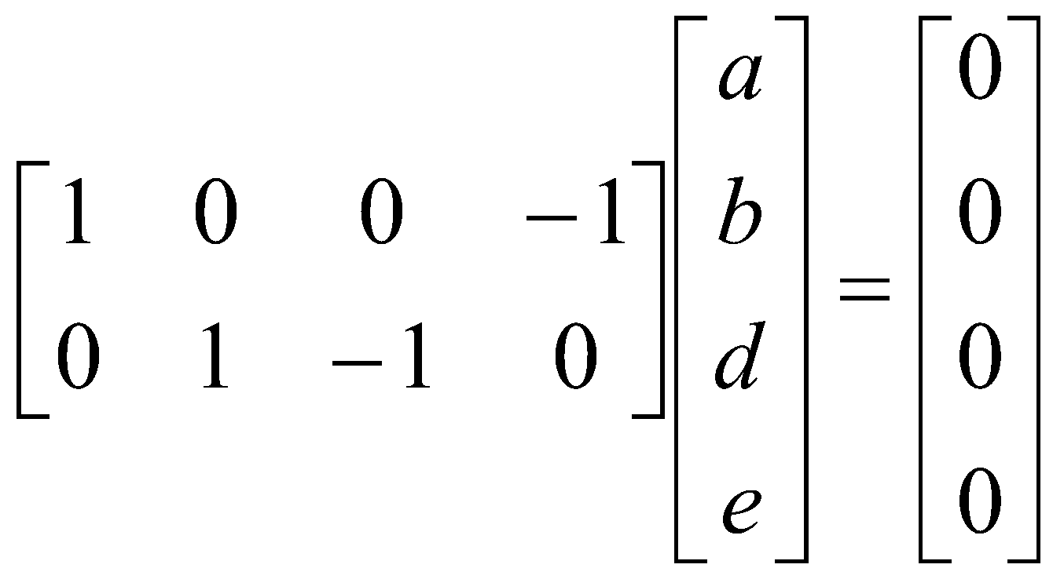
2nd Space Partition Example
For I = 1 to N DO For J = 1 to I DO A[I, J] = B[I, J] C[I, J]= A[J, I]
Φ₁(I,J) = I Φ₂(I,J) = J
Φ₁(I,J) = J Φ₂(I,J) = I
Assume the affine partition is:
P = a * i + b *j + c (S1) P = d * i + e *j + f (S2)
We could get a=e,b=d,c=f Let c=0, so f=0.
For P = 1 to N DO For I = 1 to N DO For J = 1 to I DO IF P == I A[P, J] = B[P, J] IF P == J C[I, P] = A[P,I]
There’re two independent solutions: (1,0,0,1) or (0,1,1,0)

Slide 25
2nd Space Partition Example
For I = 1 to P-1 DO For J = 1 to I DO IF P == I A[P, J] = B[P, J] IF P == J C[I, P] = A[P,I]
For I = 1 to P-1 DO For J = 1 to I DO IF P == I A[P, J] = B[P, J] IF P == J C[I, P] = A[P,I]
For I = 1 to P-1 DO For J = 1 to I DO IF P == I A[P, J] = B[P, J] IF P == J C[I, P] = A[P,I]
I < P:
For I = 1 to N DO For J = 1 to I DO IF P == I A[P, J] = B[P, J] IF P == J C[I, P] = A[P,I]
For J = 1 to P DO IF P==P A[P, J] = B[P, J] IF P == J C[P, P] = A[P,P]
For J = 1 to P DO A[P, J] = B[P, J] IF P == J C[P, P] = A[P,P]
For J = 1 to P DO A[P, J] = B[P, J] IF P == J C[P, P] = A[P,P]
I = P:
For I = P+1 to N DO C[I, P] = A[P,I]
For I = P+1 to N DO For J = 1 to I DO IF P == I A[P, J] = B[P, J] IF P == J C[I, P] = A[P,I]
For I = P+1 to N DO For J = 1 to I DO IF P == I A[P, J] = B[P, J] IF P == J C[I, P] = A[P,I]
For I = P+1 to N DO For J = 1 to I DO IF P == J C[I, P] = A[P,I]
For I = P+1 to N DO For J = 1 to I DO IF P == J IF 1<=P<=I C[I, P] = A[P,I]
For I = P+1 to N DO For J = 1 to I DO IF P == J IF 1<=P<=I C[I, P] = A[P,I]
I > P:

Slide 26
2-Order Affine Partiton
For I = 1 to N DO For J = 1 to I DO A[I, J] = B[I, J] C[I, J]= A[J, I]
Φ₁(I,J) = I Φ₂(I,J) = J
Φ₁(I,J) = J Φ₂(I,J) = I
I<MIN(P1,P2)
For P1 = 1 to N DO For P2 = 1 to N DO
IF P1< P2 I=P2, J=P1 C[I ,J ]=A[J ,I ] ELSE IF P1==P2 I=J=P1 A[I ,J ]=B[I ,J ] C[I ,J ]=A[J ,I ] ELSE //That’s P1>P2 I=P1,J=P2 A[I ,J ]=B[I ,J ]
For P1 = 1 to N DO For P2 = 1 to N DO
IF P1< P2 I=P2, J=P1 C[P2,P1]=A[P1,P2] ELSE IF P1==P2 I=J=P1 A[P1,P1]=B[P1,P1] C[P1,P1]=A[P1,P1] ELSE //That’s P1>P2 I=P1,J=P2 A[P1,P2]=B[P1,P2]
For P1 = 1 to N DO For P2 = 1 to N DO
IF P1< P2 C[P2,P1]=A[P1,P2] ELSE IF P1==P2 A[P1,P1]=B[P1,P1] C[P1,P1]=A[P1,P1] ELSE //That’s P1>P2 A[P1,P2]=B[P1,P2]
For P1 = 1 to N DO For P2 = 1 to N DO
For I = 1 to N DO For J = 1 to I DO
IF (P1 == I AND P2==J) A[I, J] = B[I, J] IF (P1 == J AND P2==I) C[I, J]= A[J, I]
I=P1 or P2
Need sort P1, P2 in runtime
I between P1 and P2
I>MAX(P1,P2)

Slide 27
Time partition
To parallelize a loop with O(n) synchronizations
All dependency become loop-carried dependency after the transformation
So only synchronization at the end of an iteration is required
Wavefront dependency example

Slide 28
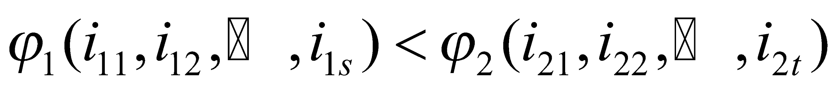
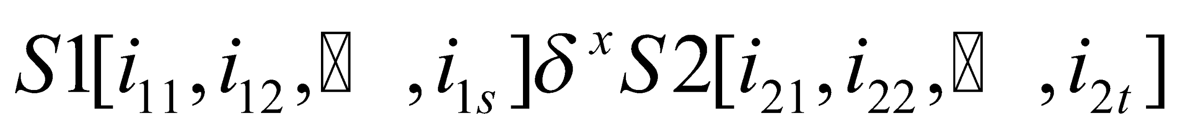
Time Partition
The time partition requires for all dependency
Or all dependency is loop-carried dependency for loop P

Slide 29
Time Partition
I
P
J
J

Slide 30
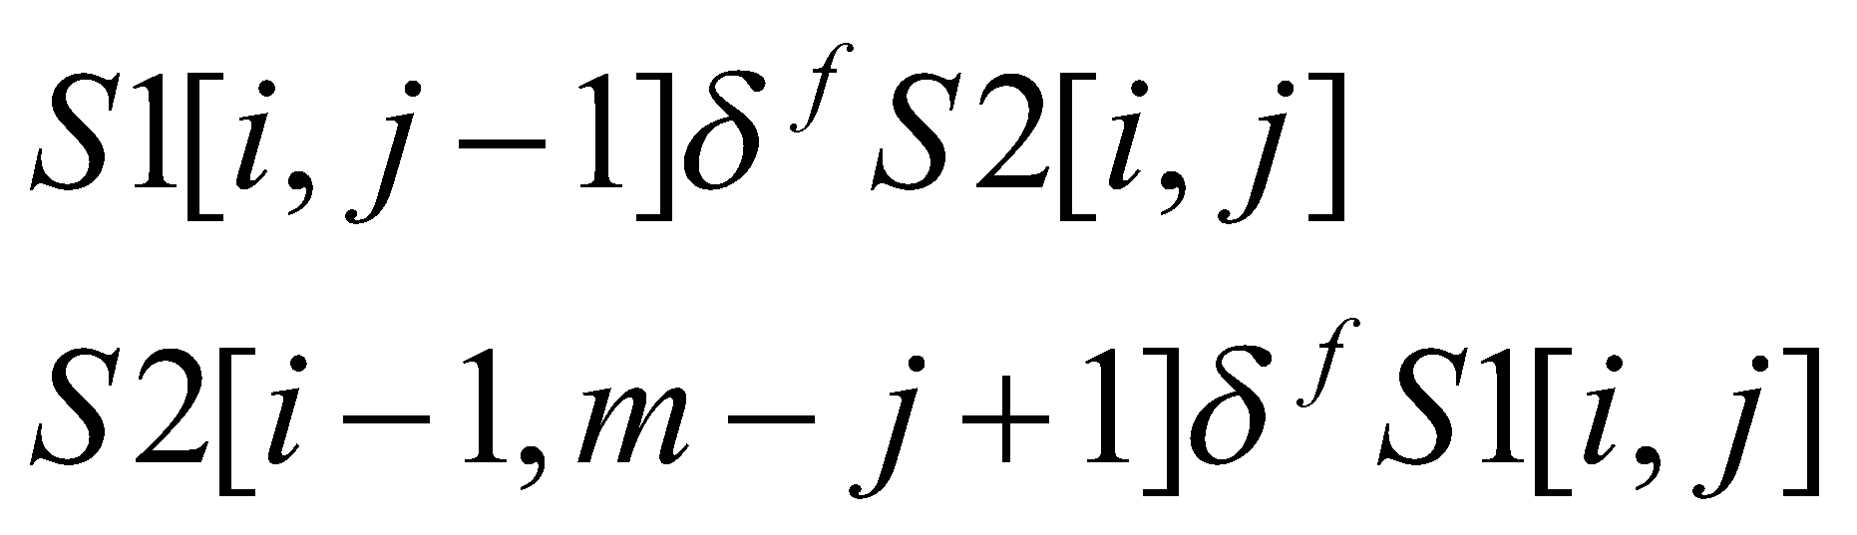
Time Partition Example
For i=1 to n
For j=1 to m
A[i,j]=B[i-1,m-j+1];
B[i,j]=A[i,j-1];
No space partition could be found, so that we could not find parallel loop with no synchronization
Assume the affine partition is:
P = a * i + b *j (S1) P = d * i + e *j + f (S2)
P = 2 * i (S1) P = 2 * i + 1 (S2)
a*i+b*(j-1)<d*i+e*j+f
d*(i-1)+e*(m-j+1)+f<a*i+b*j

Slide 31
Solve Time-Partition Constraints
Theorem: Positive combination of two legal affine partitions is legal affine partition
Proof:
If instance x1 (of a statement s1) is dependent on instance x2 (of statement s2), x1 must be executed after x2 for a legal affine partition. Which means the iteration vector of x1 is lexicographically sorted after that of x2 (or same iteration vector).
Affine partition is linear so that positive combination of two legal affine partitions is legal.
Sum of a set of legal, maximally independent affine partition

Slide 32
Overall Algorithm to Maximize Degrees of Parallelism
Construct program dependence graph and partition statements in SCCs
Using Space partition to find synchronization-free parallelism for each SCC
Using Time partition to find parallelism with synchronizations

Slide 33
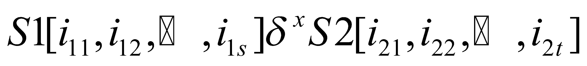
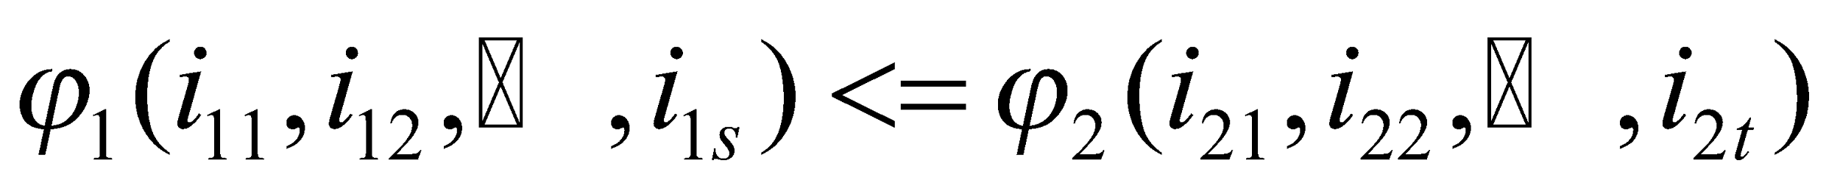
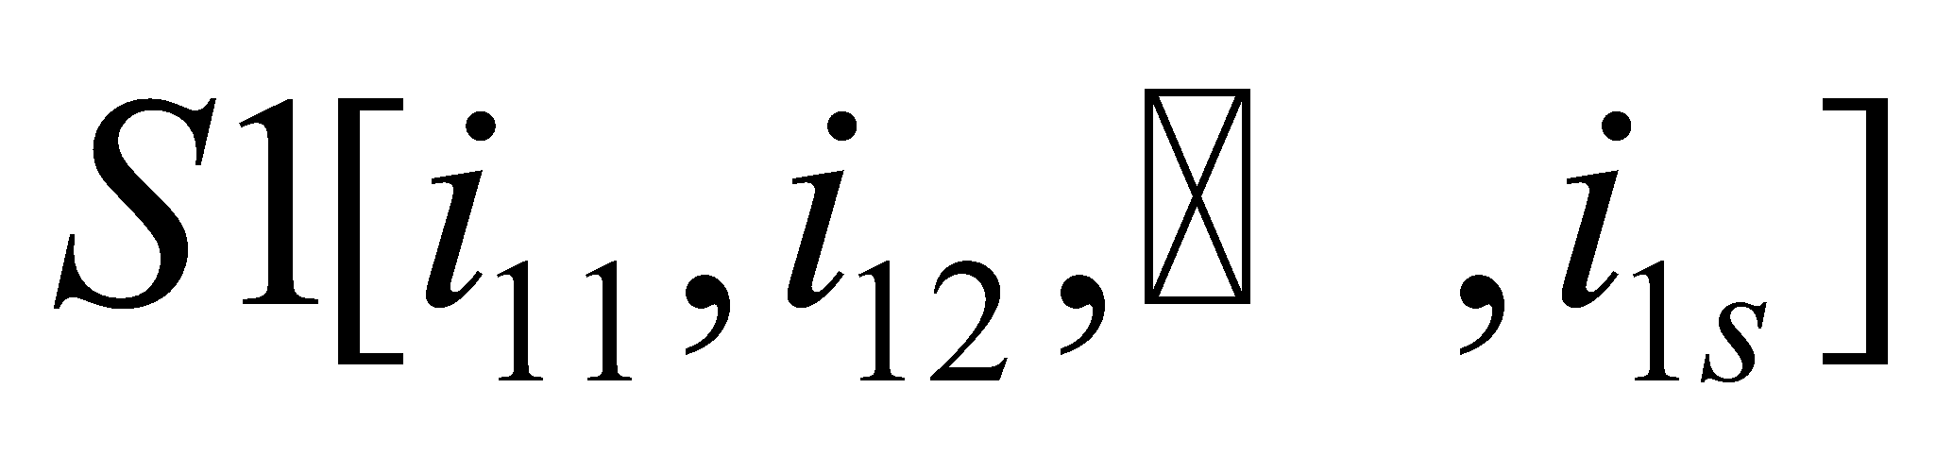
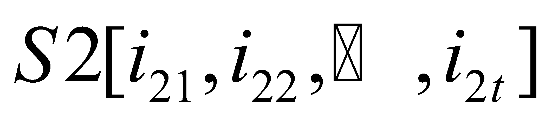
Legal Affine Partition
If there’s a dependency
For a legal affine partition, there must be
Where i₁₁,i₁₂,…,i_{1k};i₂₁,i₂₂,…,i_{2k} are induction variables of shared loops for the two statements. It must be hold that < i₁₁,i₁₂,…,i_{1k}> is before <i₂₁,i₂₂,…,i_{2k}> in lexicographical sorted order or < i₁₁,i₁₂,…,i_{1k}> =<i₂₁,i₂₂,…,i_{2k}> and statement S1 is before S2 in the shared loop body.
Which means the instance should be executed no later than the instance in loop P after the affine partition

Slide 34
Backup

Slide 35
Lexicographical order
<1, 0>
<1, 1>
<0, 2>
<0, 0>
<0, 1>
<0, 3>
I
J

Slide 36
Lexicographically positive
The difference of two lexicographical ordered elements is lexicographically positive
<1, 0>
<0, 1>
<0, 3>
I
J
<0,2>=<0,3>-<0,1> is lexicographically positive
<0,2>
<1,-3>=<1,0>-<0,3> is lexicographically positive
<1,-3>
<1,-1>=<1,0>-<0,1> is lexicographically positive
<1,-1>
The first non-zero entry is positive for lexicographically positive vector

Slide 37
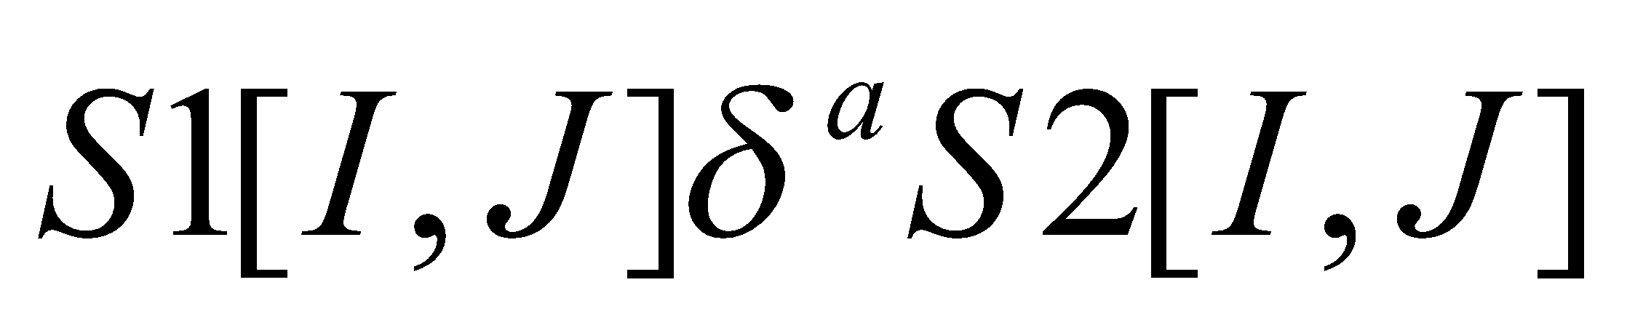
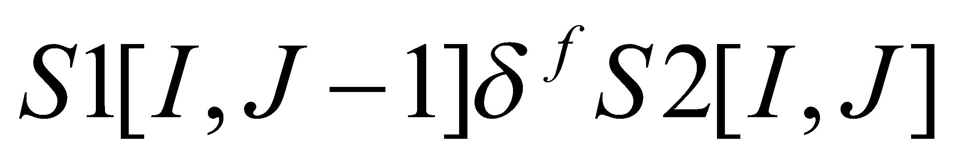



Distance Vector
For I=1 to 3
For J = 1 to 4
S1 A[I, J] = B[I, J] + C[I, J]
S2 B[I, J] = A[I, J-1]
S1
S2
I
J
For loop-carried dependency, Distance Vector is lexicographically positive

Slide 38
Legal Unimodular Transformation
For all loop-carried dependency, the Unimodular Transformation of the Distance Vector must remain lexicographically positive

