Slide 1
Lecture 15 Loop Transformations for Parallelism and Locality
Examples
Affine Partitioning
Readings: Chapter 11–11.3, 11.6–11.7.4, 11.9-11.9.6

Slide 2
Recap from last lecture: Iteration Space
FOR i = 0 to 5
FOR j = i to 7
…
n-deep loop nests: n-dimensional polytope
Iterations: coordinates in the iteration space
Assume: iteration index is incremented in the loop
Sequential execution order: lexicographic order
[0,0], [0,1], …, [0,6], [0,7], [1,1], …, [1,6], [1,7], …

Slide 3
Shared Memory Machines
Performance on Shared Address Space Multiprocessors: Parallelism & Locality
P
P
P
P
$
$
$
$
$
$
$
$
M
M
M
M
Interconnect
Notes:
Specifically, I want to be able to take computation intensive programs, such as numerical applications from aeronautics or DSP, and be able to transform the programs to improve their performance in shared address space multiprocessors…

Slide 4
Parallelism and Locality
Parallelism DOES NOT imply speed up!
Parallel performance: Improve locality with loop transformations
Minimize communication
Operations using the same data are executed on the same processor
Sequential performance: Improve locality with loop transformations
Minimize cache misses
Operations using the same data are executed close in time.

Slide 5
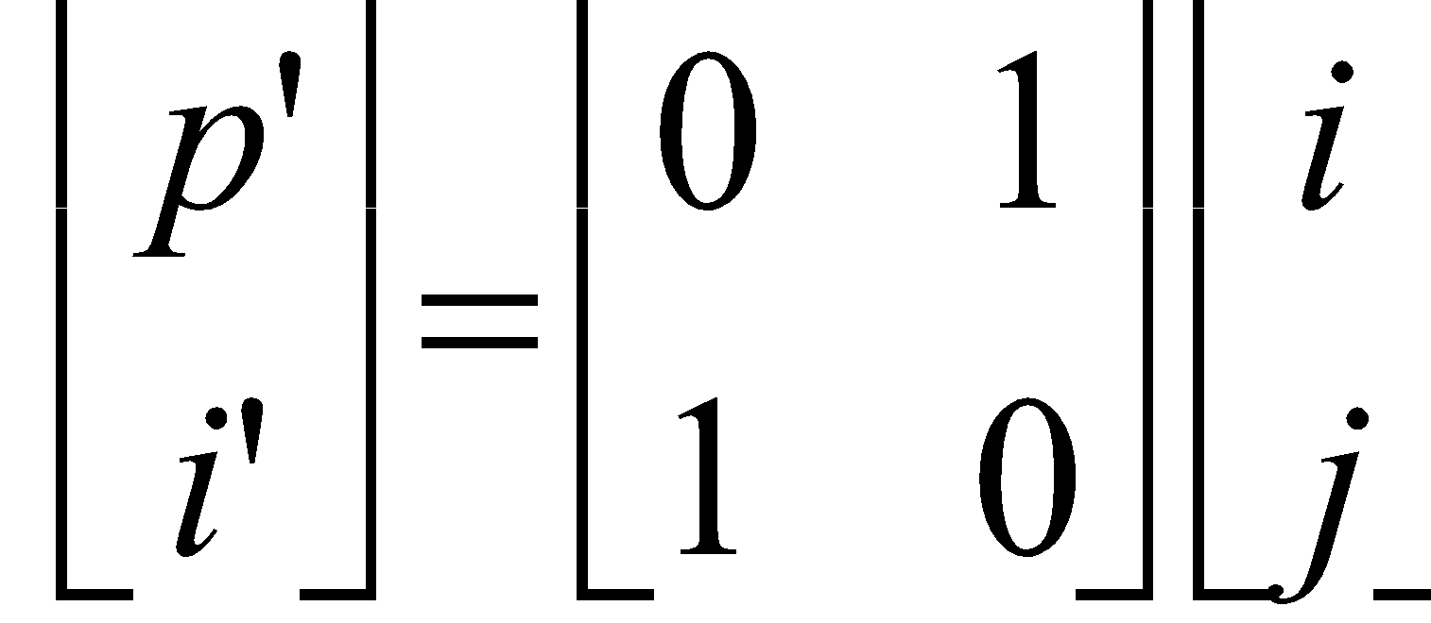
Loop Permutation (Loop Interchange)
for I = 1 to 4
for J = 1 to 3
Z[I,J] = Z[I-1,J]
For J’ = 1 to 3
for I’ = 1 to 4
Z[I’,J’] = Z[I’-1,J’]
I
J’
I’
J

Slide 6
2. Affine Partitioning: An Contrived but Illustrative Example
FOR j = 1 TO n
FOR i = 1 TO n
A[i,j] = A[i,j]+B[i-1,j]; (S₁)
B[i,j] = A[i,j-1]*B[i,j]; (S₂)
j
S₁
S₂
i

Slide 7
Best Parallelization Scheme
Algorithm finds affine partition mappings for each instruction:
S1: Execute iteration (i, j) on processor i-j.
S2: Execute iteration (i, j) on processor i-j+1.
SPMD code: Let p be the processor’s ID number
if (1-n <= p <= n) then
if [1 <= p) then
B[p,1] = A[p,0] * B[p,1]; (S₂)
for i₁ = max[1,1+p) to min[n,n-1+p) do
A[i₁,i₁-p] = A[i₁,i₁-p] + B[i₁-1,i₁-p]; (S₁)
B[i₁,i₁-p+1] = A[i₁,i₁-p] * B[i₁,i₁-p+1]; (S₂)
if (p <= 0) then
A[n+p,n] = A[n+p,N] + B[n+p-1,n]; (S₁)
Notes:
Even the SPMD code is gross, given the affine partition mappings, step for code generation is very mechanical [partly based on Ancourt & Irigoin’s polyhedron scanning code generation algorithm)

Slide 8
Maximum Parallelism & No Communication
F₁i₁+f₁
Loops
Array
F₂i₂+f₂
C₁i₁+c₁
C₂i₂+c₂
Processor ID
For every pair of data dependent accesses F₁i₁+f₁ and F₂i₂+f₂ Find C₁, c₁, C₂, c₂:
∀ i₁, i₂ F₁ i₁+ f₁ = F₂ i₂+f₂ → C₁i₁+c₁ = C₂i₂+c₂
with the objective of maximizing the rank of C₁, C₂
Notes:
Fundamental observation:
computation using same data map to same processor

Slide 9
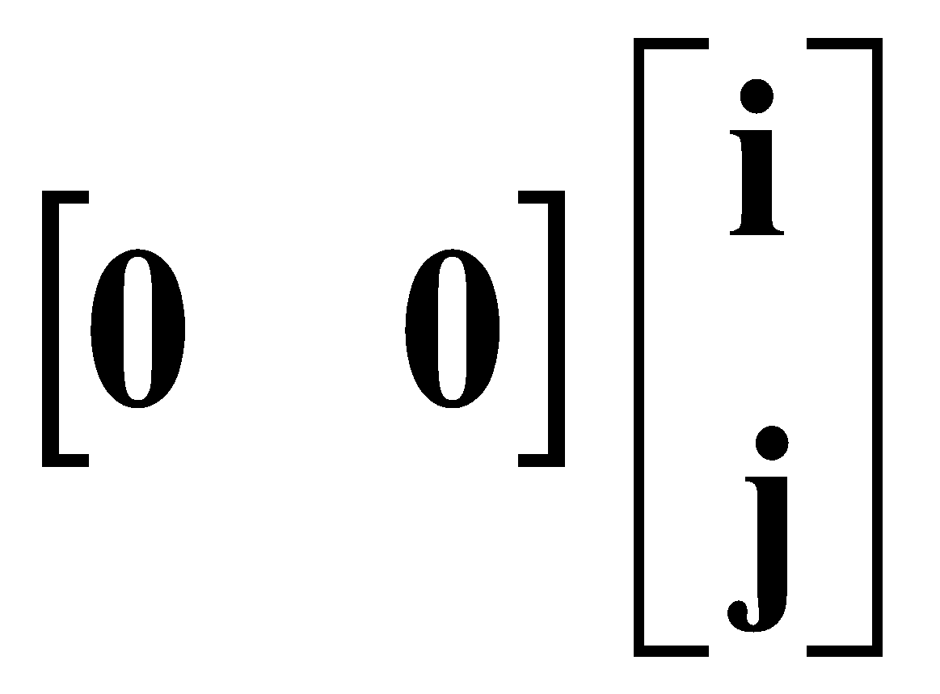
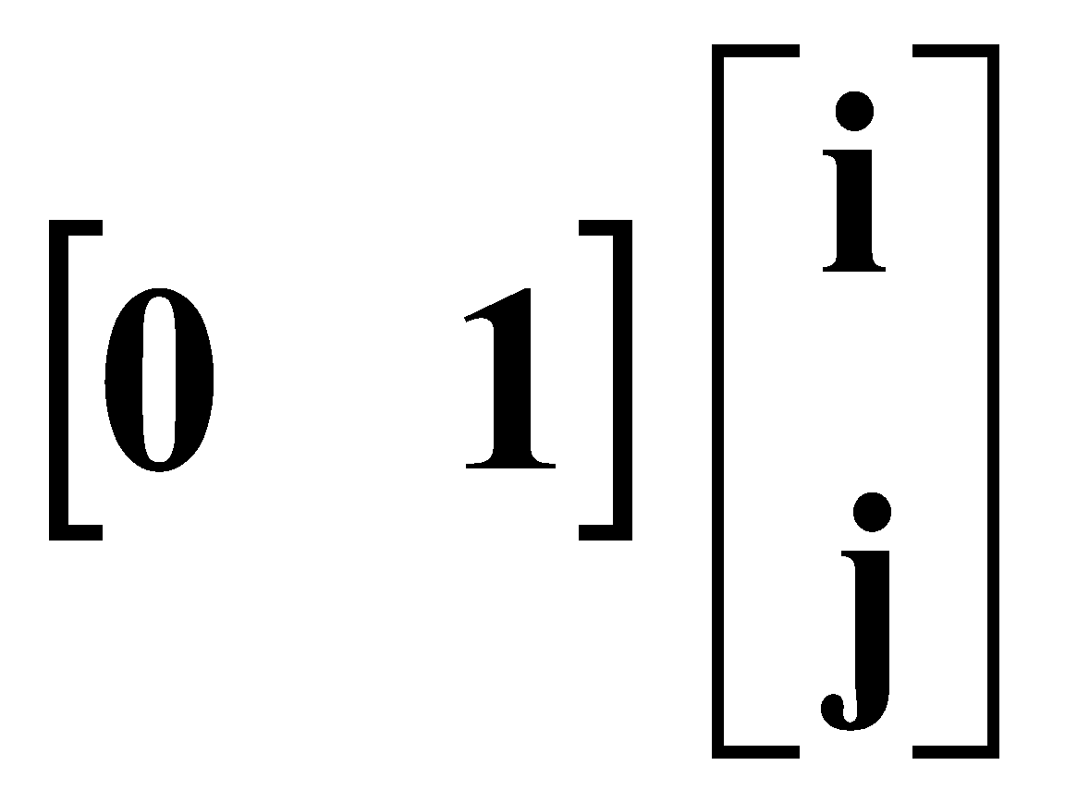
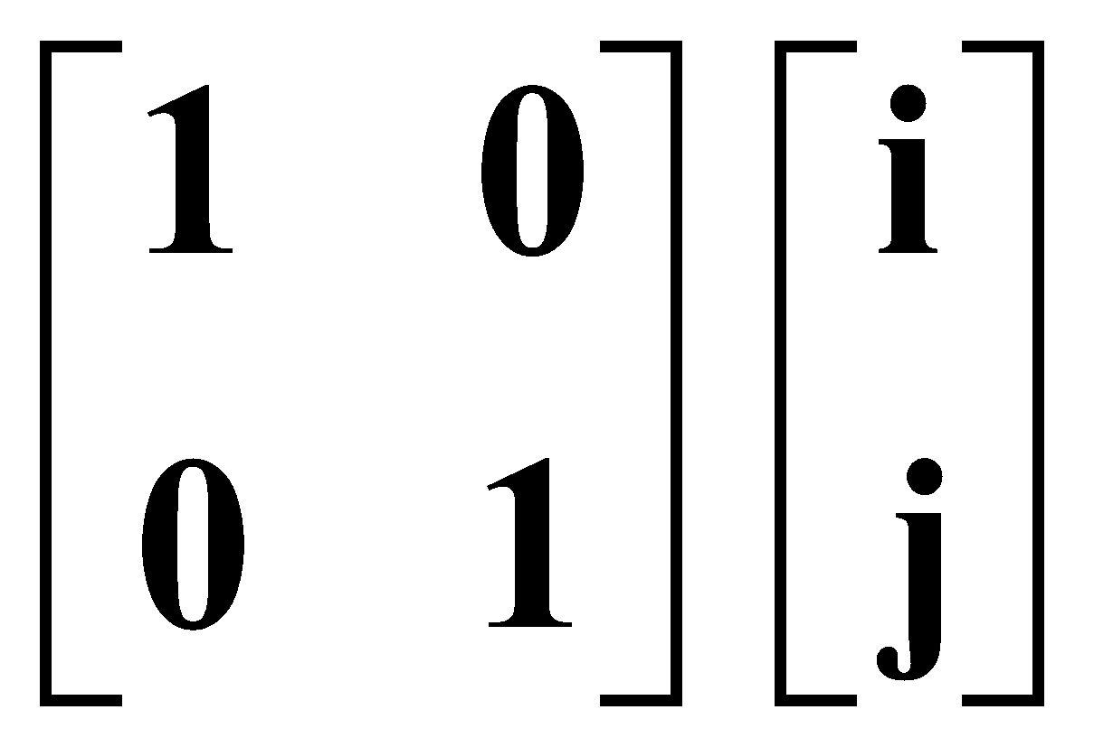
Rank of Partitioning = Degree of Parallelism
Affine Mapping
Rank 0 1 2
Mapped to
same processor

Slide 10
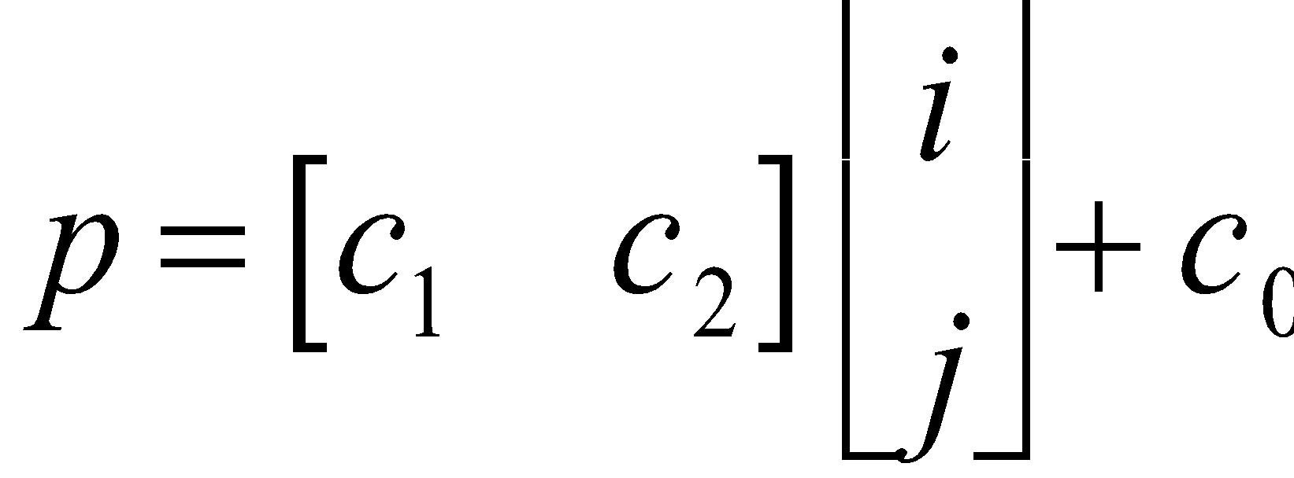
Example
for I = 1 to 4
for J = 1 to 3
Z[I,J] = Z[I-1,J]
Find affine partitioning: c₁, c₂, c₀ such that
i = i’ - 1
j = j’
c₁ i + c₂ j + c₀ = c₁ i’ + c₂ j’ + c₀
I
J

Slide 11
Code Generation
for I = 1 to 4
for J = 1 to 3
Z[I,J] = Z[I-1,J]
for P = 1 to 3
for I = 1 to 4
for J = 1 to 3 if (j == P)
Z[I,J] = Z[I-1,J]
for P = 1 to 3
for I = 1 to 4
Z[I,P] = Z[I-1,P]
I
p = j
J
SPMD (single program multiple data) code:
for I = 1 to 4
Z[I,P] = Z[I-1,P]

Slide 12
Loop Permutation (Loop Interchange)
for I = 1 to 4
for J = 1 to 3
Z[I,J] = Z[I-1,J]
for P = 1 to 3
for I = 1 to 4
Z[I,P] = Z[I-1,P]
I
P
I
J

Slide 13
Optimizing Arbitrary Loop Nesting Using Affine Partitions (chotst, NAS)
DO 1 J = 0, N
I0 = MAX ( -M, -J )
DO 2 I = I0, -1
DO 3 JJ = I0 - I, -1
DO 3 L = 0, NMAT
3 A(L,I,J) = A(L,I,J) - A(L,JJ,I+J) * A(L,I+JJ,J)
DO 2 L = 0, NMAT
2 A(L,I,J) = A(L,I,J) * A(L,0,I+J)
DO 4 L = 0, NMAT
4 EPSS(L) = EPS * A(L,0,J)
DO 5 JJ = I0, -1
DO 5 L = 0, NMAT
5 A(L,0,J) = A(L,0,J) - A(L,JJ,J) ** 2
DO 1 L = 0, NMAT
1 A(L,0,J) = 1. / SQRT ( ABS (EPSS(L) + A(L,0,J)) )
DO 6 I = 0, NRHS
DO 7 K = 0, N
DO 8 L = 0, NMAT
8 B(I,L,K) = B(I,L,K) * A(L,0,K)
DO 7 JJ = 1, MIN (M, N-K)
DO 7 L = 0, NMAT
7 B(I,L,K+JJ) = B(I,L,K+JJ) - A(L,-JJ,K+JJ) * B(I,L,K)
DO 6 K = N, 0, -1
DO 9 L = 0, NMAT
9 B(I,L,K) = B(I,L,K) * A(L,0,K)
DO 6 JJ = 1, MIN (M, K)
DO 6 L = 0, NMAT
6 B(I,L,K-JJ) = B(I,L,K-JJ) - A(L,-JJ,K) * B(I,L,K)
A
L
B
L
L
EPSS

Slide 14
Chotst: Results with Affine Partitioning + Blocking
(Unimodular: a subset of affine partitioning for perfect loop nests)
Unimodular + Blocking
Affine Partitioning + Blocking
8
7
6
5
Speedup
4
3
2
1
0
1
2
3
4
5
6
7
8
Number of Processors

Slide 15
Summary of Affine Partitioning
Communication-Free
F₁i₁+f₁
Loops
Array
F₂i₂+f₂
C₁i₁+c₁
C₂i₂+c₂
Processor ID

Slide 16
Conclusions
Parallelism is plentiful in numeric code, but locality is important
Two kinds of transforms
Affine partitioning maximizes the degree of parallelism without communication
Operations using same data are mapped to the same processor
Blocking: Exploit locality across multiple dimensions

Slide 17
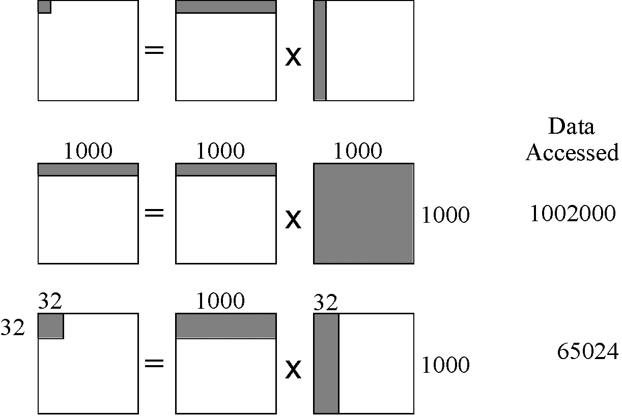
Blocking Example: Matrix Multiplication

Slide 18
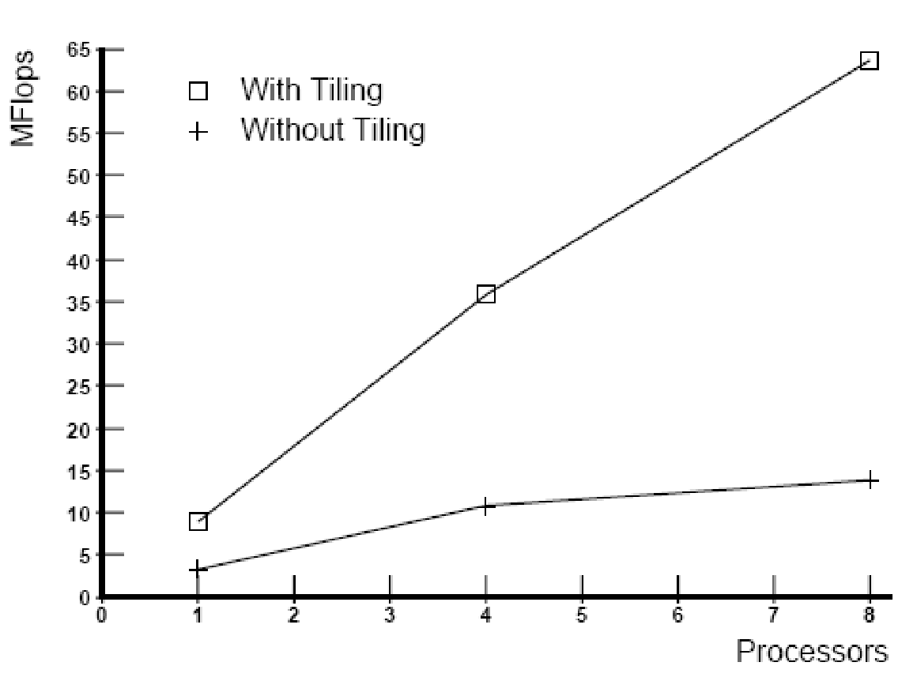
Experimental Results
With Blocking
Without Blocking

Slide 19
Code Transform
Before
for (i = 0; i < n; i++) { for (j = 0; j < n; j++) {
for (k = 0; k < n; k++) {
Z[i,j] = Z[i,j] + X[i,k]*Y[k,j]; }}}
After
for (ii = 0; ii < n; ii = ii+B) { for (jj = 0; jj < n; jj = jj+B) {
for (kk = 0; kk < n; kk = kk+B) {
for (i = ii; i < min(n,kk+B); i++) { for (j = jj; j < min(n,kk+B); j++) {
for (k = kk; k < min(n,kk+B); k++) {
Z[i,j] = Z[i,j] + X[i,k] * Y[k,j]; }}}}}}

