Slide 1





SYNC LIP MOVEMENTS TO DUBBING AUDIO
配音口型同步
Presented by : 羅翡瑩 Valencia Lo
vlooo.sch@gmail.com

Slide 2
INTRODUCTION
“Have you ever watched a movie where the actor’s lip don’t match the words you hear?
It feels strange, right?”
  Problem :
    Traditional dubbing only changes the audio without adjusting lip movements
    Cannot correctly identify who is talking and adjust lips accordingly
    Fixing this manually is time-consuming and expensive
  Project Objectives :
    Development for film industry by synchronizes lip movements with dubbed speech
    Implement speaker identification, allowing the system to recognize and sync multiple people’s lips accurately
    Optimize to process longer videos

Slide 3
METHODOLOGY
  Wav2Lip
    Model designed to synchronize lip movements in videos with corresponding audio that match the speech in the audio track.
    Cons :
      Only support single speaker and can’t identify which speaker need to change
      Video frame without any speaker’s face will appear mouth shape randomly on the frame
      Works well for video quality lower than 720p
      Not really work well for sided-face angle
  Face-recognition
    Ensure that Wav2Lip applied to correct speaker’s face
Notes:
Faster Whisper excels in speed, simplicity, and ease of deployment for general transcription tasks. It’s a great choice when you need fast, accurate transcription for common use cases without worrying about hardware or customizations.
NeMo shines when you need advanced features like speaker diarization, noise suppression, or large-scale deployment. It’s ideal for applications requiring fine-tuned, customizable, and scalable speech models, especially when you have access to NVIDIA hardware for optimization.
face recognition:
by replacing the original batch-face method with face-recognition, and combining it with Euclidean distance calculation to record and distinguish the facial features of different characters. By analyzing the facial coordinates of the characters in the video and matching them with the text script assigned by the user, the system can accurately match and synchronize the dialogue content of multiple characters to achieve smooth transitions in multi-character scenes. Even in the case of frequent character switching, the system can smoothly transition, effectively reducing the sense of visual dissonance.

Slide 4
METHODOLOGY
METHODOLOGY
  Faster-whisper
    Reimplementation of OpenAI's Whisper model and much faster.
    Faster-Whisper used for speech-to-text conversion of the dubbing audio. It would automatically generate the transcription of the spoken words and their timestamp, which essential for assigning speaker.
    Can handle multiple languages effectively.
    Cons : Didn’t support speaker diarization.
  NeMo 2.0 (NVIDIA Neural Modules)
    Provide ASR (Automatic Speech recognition) and TTS (Text To Speech).
    Speaker Diarization to identify and label different speaker with their speech based on their distinguish voices.
    Cons : Required more efforts to do customization and slower than faster-whisper

Slide 5









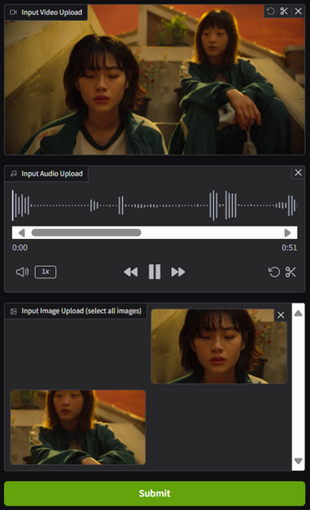
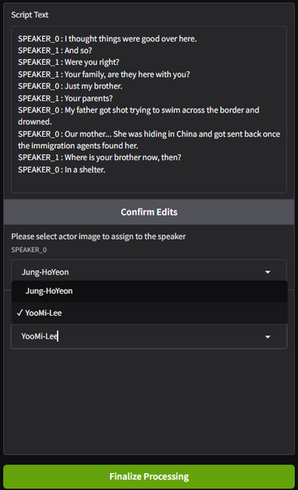
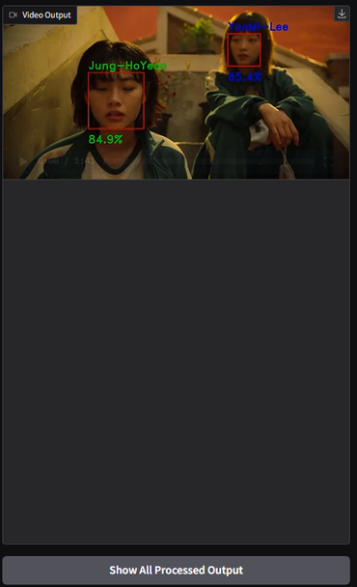

IMPLEMENTATION
Cut video into clip file
by timestamp
combine all
lip-synced clips
Face recognition
Wav2Lip
Interface
Speech Recognition:
speaker identification:
assign actor images to speaker ID and speech in each video clip that been cut before
Lip Syncronization:
Adjusts only the speaking actor's mouth shape during their time of speech
Output Video:
Lip-synced videos
Input:
Actor images, video file, dubbed audio file
Using Faster-whisper + NeMo to transcribing audio to text, label speaker and generate timestamp
(1)
(5)
(9)
(2)
(6)
(3)
(7)
(4)
(8)
Interface
(1) upload video movie file,
(2) upload audio dubbing,
(3) upload actor images,
(4) Click ‘submit’ button
(5) Generated script, edit if necessary
(6) Confirm the script generated
(7) Assign the actor image to speaker
(8) Click ‘finalize’ button
(9) Output video

Slide 6
RESULT
  This project proves the practicability of the developed system, especially in multi-language and multi-character dubbing scenarios, providing a feasible and efficient technical solution for future film and television production.
  Analysis :
    Speech recognition: generates transcriptions quickly and accurately label speakers and their speech. If needed, you can adjust the transcription.
    Lip synchronization: The actor’s face recognition achieves an average of above 80% accuracy and successfully matches the lips with the dubbed speech, though the mouth movement may have slight artifacts, depending on the quality of the video.

Slide 7
CONCLUSION
  Our system achieved multilingual lip synchronization in multi-character scenes, succesfully in voice alignment, and character recognition. By integrating advanced technologies like Faster-Whisper, NeMo, and Wav2Lip, it overcomes traditional lip-sync limitations, maintaining audio-visual even during frequent character switches, enhancing the dubbing experience in film and television.
  Future Improvement:
    Improving processing speed and resource utilization efficiency to support higher resolution rate of film and larger scale data processing needs.
    Resulting lip shape details are optimized to reduce blurring

Slide 8
METHODS
  Faster-whisper + NeMo
  Face-recognition
  Wav2Lip
STEPS
  Speech recognition : Use Faster-Whisper + NeMo to transcribe dubbed audio, detect speakers, and generate timestamps.
  Speaker identification : Match uploaded actor images to speaker’s ID and speech in each clip cut by timestamps.
  Lip sync : Use Face-Recognition + Wav2Lip to adjust lip movements accurately.
  Combine all processed clip into a final lip-synced video.
RESULT
  Successfully match the dubbed audio speech with the actor’s lip

Slide 9
THANK YOU :)

