Slide 1
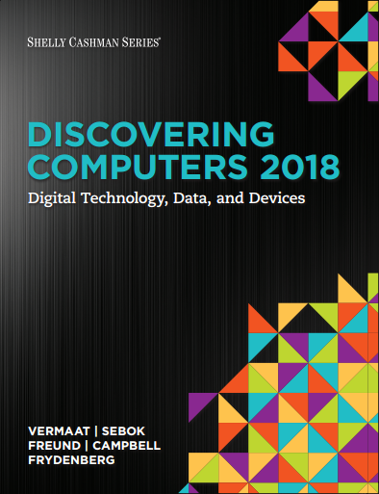

DISCOVERING COMPUTERS 2018
Digital Technology, Data, and Devices
Module 12
Working in the Enterprise: Systems, Certifications, and Careers
© 2018 Cengage版權所有，為課本著作之延伸教材，亦受著作權法之規範保護，僅作為授課教學使用，禁止列印、影印、未經授權重製和公開散佈

Slide 2
Objectives Overview (1 of 2)
Identify the qualities of valuable information.
Describe various information systems used in an enterprise.
Identify the components of and steps in information literacy.
Describe career opportunities available in various segments of the computer industry.
Identify job titles and responsibilities for various technology jobs.

Slide 3
Objectives Overview (2 of 2)
Identify mobile app development strategies.
Identify ways to prepare for certification.
Describe the general areas of Information Technology (IT) certification.
Identify ways to begin a job search.
Explain how to create a professional online presence.

Slide 4
The Technology Industry (1 of 2)
Nearly every job requires you to interact with technology to:
  Complete projects
  Exchange information with coworkers
  Meet customers’ needs
As new technologies emerge, organizations look for potential employees who possess skills and a desire to learn and who are comfortable using all types of technology

Slide 5

Figure 12-1 The technology industry offers many rewarding careers. iStockphoto.com / jayfish

Slide 6
Information Systems in the Enterprise (1 of 13)
An information system is a set of hardware, software, data, people, and procedures that work together to produce information
To assist with sound decision making, information must have value

Slide 7
Information Systems in the Enterprise (2 of 13)
For information to be valuable, it should be:
  Accurate
  Verifiable
  Timely
  Organized
  Accessible
  Useful
  Cost effective

Slide 8
Information Systems in the Enterprise (3 of 13)
A typical enterprise consists of a wide variety of departments, centers, and divisions — collectively known as functional units
  Human Resources (HR)
  Engineering or Product Development
  Manufacturing
  Marketing
  Sales
  Customer Service

Slide 9
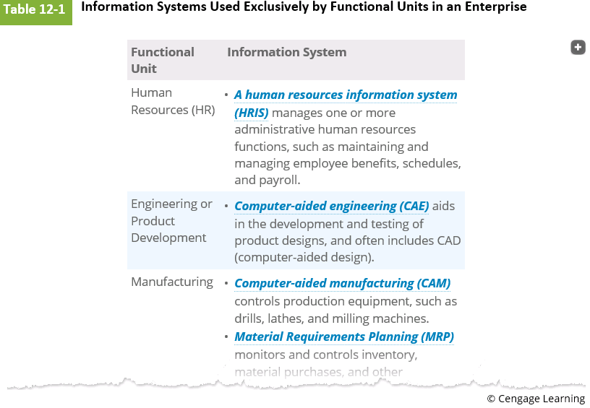

Slide 10
Information Systems in the Enterprise (4 of 13)
Enterprise Resource Planning (ERP) integrates Manufacturing Resource Planning (MRP) II with the information flow across an organization to manage and coordinate the ongoing activities of the enterprise:
  Product planning
  Manufacturing and distribution
  Accounting and finance
  Sales
  Human resources
  Customer support

Slide 11

Figure 12-2 ERP encompasses all of the major activities throughout an enterprise.

Slide 12
Information Systems in the Enterprise (6 of 13)
Document Management System (DMS)
  Allows for storage and management of a company’s documents
  Supports access control, security, version tracking, and search
Content Management System (CMS)
  Enables and manages the publishing, modification, organization, and access of various forms of documents and other files
  Provides security controls
  Content added through a graphical user interface or webpage

Slide 13
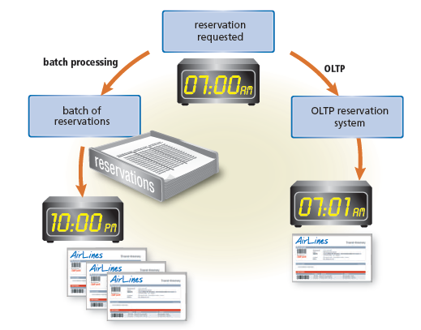
A Transaction Processing System (TPS) is an information system that captures and processes data from day-to-day business activities
  On-Line Transaction Processing (OLTP)
Figure 12-3 With batch processing, all reservations would be processed together at the end of the day. With OLTP, by contrast, reservations are processed immediately.

Slide 14
Information Systems in the Enterprise (8 of 13)
A Management Information System (MIS) is an Information system that generates accurate, timely, and organized information, so that managers and other users can make decisions, solve problems, supervise activities, and track progress

Slide 15
Information Systems in the Enterprise (9 of 13)
Detailed Flight Report for Flight #328
Passenger Name | Gender | Birthdate | Seat | Premier Club
Adams, Latisha | F | 4/25/92 | 3C | Y
Brewer, Milton | M | 10/14/45 | 22F | N
Cam, Lin | F | 12/16/91 | 2A | Y
Canaan, Lana | F | 4/12/90 | 21A | N
Cole, Kristina | F | 5/10/79 | 16C | N
Drake, Louella | F | 3/4/81 | 4A | Y
Galens, Lynette | F | 11/2/75 | 2C | N
Gilbert, Laura | F | 2/20/78 | 4F | N
Henreich, Max | M | 3/10/85 | 17C | Y
Hidalgo, Ronald | M | 10/15/44 | 3F | Y
Marsh, Constance | F | 11/5/82 | 2C | N
McGill, Teresa | F | 2/27/73 | 16F | Y

Slide 16
Information Systems in the Enterprise (10 of 13)
Passenger Name | Gender | Birthdate | Seat | Premier Club
Moretti, Leo | M | 9/22/90 | 17A | Y
Nitz, Dawn | F | 7/12/65 | 3F | N
Ruiz, Albert | M | 2/13/93 | 10D | Y
Stein, Michelle | F | 8/16/50 | 3A | N
Tu, Benjamin | M | 1/16/77 | 22C | N
Van Wijk, Fred | M | 6/9/89 | 10A | Y

Slide 17
Summary Flight Report for March 30
Flight # | Origin/ Destination | Passengers | Premier Club Members
1048 | ORD – RSW | 108 | 33
543 | ORD – BMI | 24 | 12
715 | ORD – LAX | 160 | 62
701 | ORD – JFK | 26 | 10
Exception Flight Report for March 30
Flight # | Class | Origin/ Destination | Passengers | Premier Club Members Goal
108 | A | ORD – RSW | 1 | 4
701 | C | ORD – JFK | 3 | 5

Slide 18
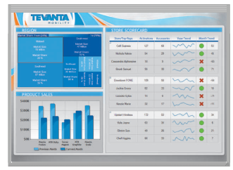
A Decision Support System (DSS) helps users analyze information and make decisions
  On-Line Analytical Processing (OLAP)
Figure 12-5 This decision support system helps managers analyze sales by product and by sales rep. Courtesy of Dundas Data Visualation, Inc.

Slide 19
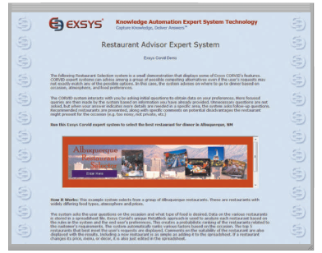
An expert system is an information system that captures and stores the knowledge of human experts and then imitates human reasoning and decision making.
Figure 12-6 This company’s restaurant advisor expert system recommends a restaurant based on a user’s answers to specific questions.

Slide 20
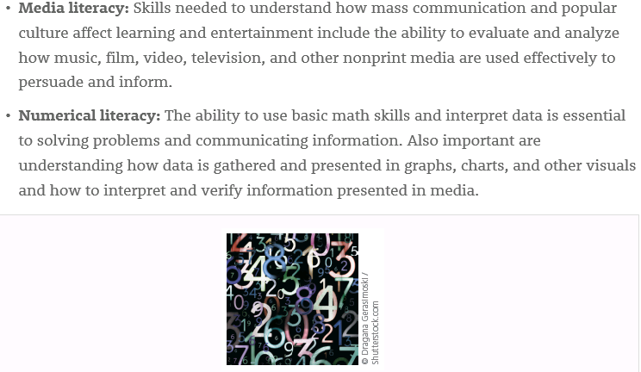

Slide 21
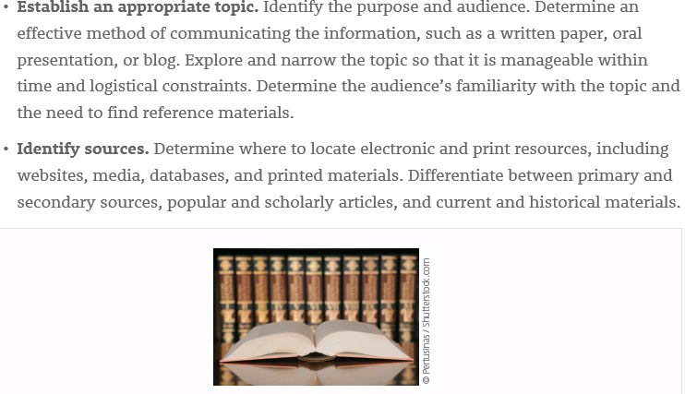

Slide 22
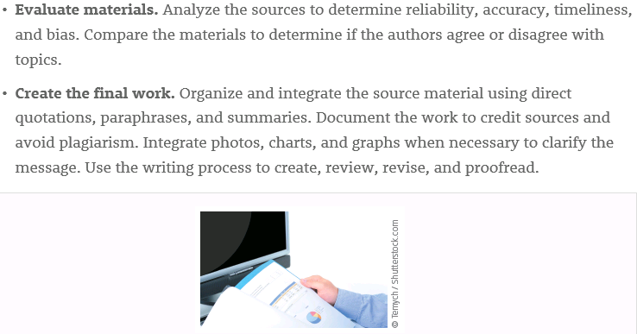

Slide 23
Technology Careers (1 of 15)
Business and government organizations of all sizes use a variety of computers, mobile devices, and other technology
Larger organizations use computers and other technology to answer and route phone calls, process orders, update inventory, and manage accounts receivable, accounts payable, billing, and payroll activities

Slide 24
Technology Careers (2 of 12)
IT jobs usually are divided into the following areas:
  Management
  Research and software development
  Technical support services
  Operations
  Training/Support
  Information security services
  Marketing/Strategy

Slide 25


Slide 26
Technology Careers (3 of 15)
The technology equipment field consists of manufacturers and distributors of computers, mobile devices, and other hardware, such as magnetic and optical drives, monitors, printers, and communications and networking devices
The software and apps field consists of companies that develop, manufacture, and support a wide range of software and apps for computers, the web, and mobile devices

Slide 27

Figure 12-8 This laboratory technician tests internal computer components.

Slide 28

The technology service and repair field provides preventive maintenance, component installation, and repair services to customers.
Figure 12-9 This repair technician is replacing a laptop hard drive.

Slide 29

Technology salespeople must possess a general understanding of technology and a specific knowledge of the product they are selling.
Figure 12-10 A salesperson in an electronics store shows a digital camera to customers.

Slide 30
Technology Careers (7 of 15)
Schools, colleges, universities, and private companies all need qualified educators to provide technology-related education and training
Corporate trainers teach employees how to use software and apps, design and develop systems, write programs, integrate and sync data from apps used on multiple devices, and perform other technology-related activities

Slide 31

Figure 12-11 A corporate trainer shows employees how to use new software.

Slide 32
Technology Careers (9 of 15)
A help desk specialist answers hardware, software, and networking questions in person, over the phone, or electronically via email or a chat room.
An Information Technology (IT) consultant, typically hired based on expertise, provides technology services to his or her clients.

Slide 33
Technology Careers (10 of 15)
Table 12-2 System Development Jobs
Job Title | Job Description
Cloud Architect | Identifies business requirements, strategies, and solutions for cloud storage and services that meet a company’s goals or needs
Cognitive Engineer | Develops artificial-intelligence-based machines and programs based on data analysis to mimic human thought processes
Database Designer | Specifies the structure, interface, and requirements of a large-scale database; determines security and permissions for users
Program and App Developer | Specifies, designs, implements, tests, and documents programs and apps in a variety of fields, including robotics, operating systems, animation, and applications
Systems Analyst | Works closely with users to analyze their requirements, designs and develops new information systems, and incorporates new technologies
Systems Programmer | Installs and maintains operating system software and provides technical support to the programming staff
Web Designer | Designs the layout, navigation, and overall appearance of a website with a focus on user experience; specifies a website’s appearance using Hyper-Text Markup Language (HTML5), JavaScript, Cascading Style Sheets (CSS), media, and other web design technologies.
Web Developer | Analyzes, develops, and supports the functionality of a website, including applications that often interact with databases or other online resources

Slide 34
Technology Careers (11 of 15)
Table 12-3 Technology Operations Jobs
Job Title | Job Description
Computer Technician | Installs, maintains, and repairs hardware and servers; installs, upgrades, and configures software; troubleshoots hardware problems
Help Desk Specialist/ Help Desk Technician | Answers technology-related questions in person, on the phone, or via email or an online chat room
Network Administrator/ Engineer | Installs, configures, and maintains Local Area Networks (LANs), Wide Area Networks (WANs), wireless networks, intranets, Internet systems, and network software; identifies and resolves connectivity issues.
Technical Project Manager | Guides design, development, and maintenance tasks; serves as interface between programmers/developers and management

Slide 35
Technology Careers (12 of 15)
Table 12-4 Web Marketing and Social Media Jobs
Job Title | Job Description
Customer Relationship Management (CRM) Specialist | Integrates apps and data related to customer inquiries, purchases, support requests, and behaviors in order to provide a complete application that manages a company’s relationships with its customers
Internet/Social Media Marketing Specialist | Directs and implements an organization’s use of Internet and social media marketing, including Facebook pages, Twitter feeds, blogs, and online advertisements
Search Engine Optimization (SEO) Expert | Writes and develops web content and website layouts so that they will appear at the beginning of search results when users search for content
User Experience (UX) Designer | Plans and designs software and apps that consider a user’s reaction to a program and its interface, including its efficiency, its effectiveness, and its ease of use

Slide 36
Technology Careers (13 of 15)
Table 12-5 Data Storage, Retrieval, and Analysis Jobs
Job Title | Job Description
Data Scientist | Uses analytics and other Big Data techniques to interpret a company’s data from a variety of sources to better understand its performance, make recommendations for improvement, and predict future outcomes
Database Administrator | Creates and maintains the data dictionary; monitors database performance
Database Analyst | Uses data modeling techniques and tools to analyze and specify data usage
Digital Forensics Examiner | Collects and analyzes evidence found on computers, networks, mobile devices, and databases
Web Analytics Expert | Collects and measures Internet data, such as website traffic patterns and advertising, and develops reports that recommend strategies to maximize an organization’s web presence

Slide 37
Technology Careers (14 of 15)
Table 12-6 Information and Systems Security Jobs
Job Title | Job Description
Computer Security Incident Responder | Creates logs, documentation, and recovery plans based on cybersecurity threats and incidents
Computer Security Specialist/ Mobile Security Specialist | Responsible for the security of data and information stored on computers and mobile devices within an organization
Digital Forensics Analyst | Inspects electronic data to recover documents and files from data storage devices that may have been damaged or deleted, in order to use them as evidence in a crime investigation
Network Security Administrator | Configures routers and firewalls; specifies web protocols and enterprise technologies
Security Analyst | Implements security procedures and methods, looks for flaws in security of a company’s devices and networks, works with and trains employees at all levels, and assigns permissions and network settings
Security System Project Manager | Develops and maintains programs and tools designed to provide security to a network

Slide 38
Technology Careers (15 of 15)
Table 12-7 App Development and Mobile Technologies Jobs
Job Title | Job Description
Desktop or Mobile Application Programmer/ Developer | Converts the system design into the appropriate application development language, such as Visual Basic, Java, C#, and Objective C, and toolkits for various platforms
Games Designer/Programmer | Designs games and translates designs into a program or app using an appropriate application development language
Mobile Strategist | Integrates and expands the company’s initiatives for mobile users
Mobile Technology Expert | Develops and directs an organization’s mobile strategy, including marketing and app development
Virtual Reality Engineer | Designs applications that incorporate technologies (such as Virtual Reality (VR) and 3-D) with tools (such as Google Cardboard) to create storytelling tools and apps.

Slide 39
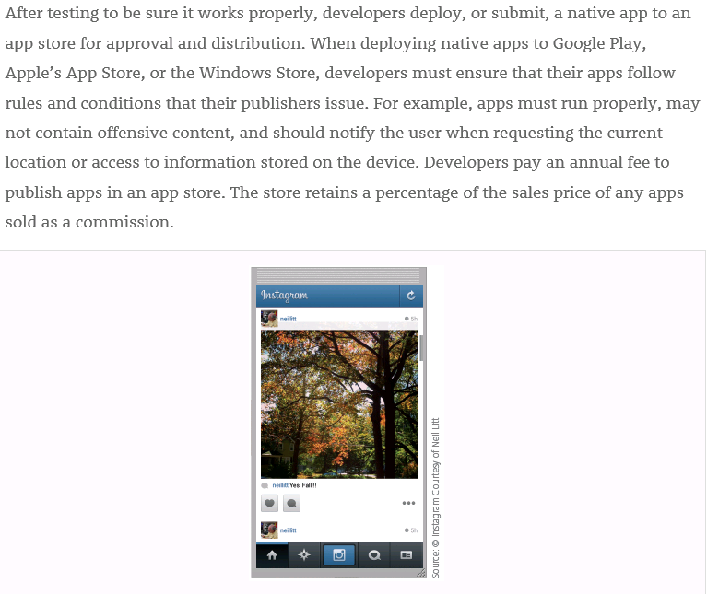

Slide 40
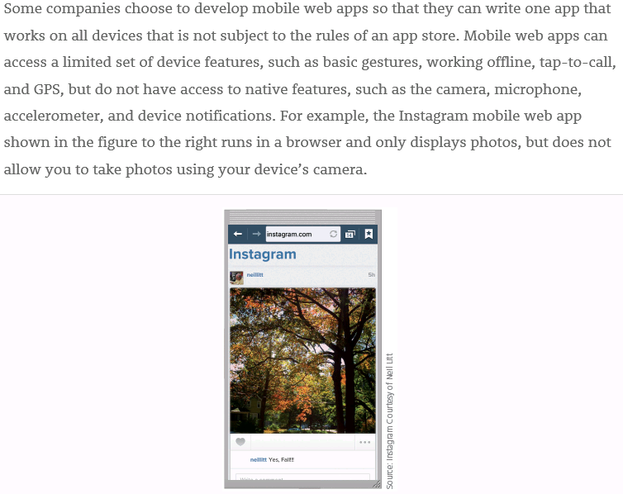

Slide 41
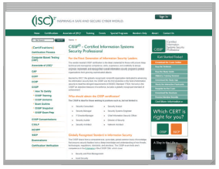
A certification demonstrates your knowledge in a specific area to employers or potential employers.
Obtaining a certification requires time and money.
(ISC)²: International Information Systems Security Certification Consortium
Figure 12-12 Certification exam sponsors, such as (ISC)2 shown here, provide ways for you to prepare for exams, register and pay for exams, and more. Source: (ISC)2

Slide 42
Technology Certifications (2 of 8)
Application Software Certifications
  Corporate trainers
  Help desk specialists
  Office managers/workers
  Technology sales representatives
  Technology teachers

Slide 43
Technology Certifications (3 of 8)
Data Analysis and Database Certifications
  Data scientist
  Database administrators
  Database analysts
  Digital forensics examiners

Slide 44
Technology Certifications (4 of 8)
Hardware Certifications
  Cable installation technicians
  Computer repair technicians
  Corporate trainers
  Help desk specialists
  IT consultants
  System engineers and administrators

Slide 45
Technology Certifications (5 of 8)
Networking Certifications
  Hardware service technicians
  IT consultants
  Network managers
  Network engineers
  System administrators

Slide 46
Technology Certifications (6 of 8)
Operating System Certifications
  Hardware technicians
  Help desk specialists
  Network administrators
  IT consultants
  System administrators

Slide 47
Technology Certifications (7 of 8)
Program/Developer Certifications
  Game developers
  IT consultants
  Mobile application developers
  Project leaders/managers
  Systems analyst
  Web developers

Slide 48
Technology Certifications (8 of 8)
Security Certifications
  Information security officers and managers
  Law enforcement officials
  Military intelligence officers
  Network administrators
  Wireless network administrators
  Network security specialists
  Security administrators

Slide 49
Job Searching and Career Planning (1 of 2)
Many job opportunities may exist in your industry, so it is important to narrow down the available jobs to ones for which you are qualified and in which you are interested
Tools at your disposal include the career service department at your school, career planning websites, and online social networks
Whether you are seeking a new job or currently are employed, you may find a career planning website useful

Slide 50

Figure 12-13 A college or university career services website, such as the Illinois
State University one shown here, provides helpful career planning information.
Source: Illinois State University

Slide 51
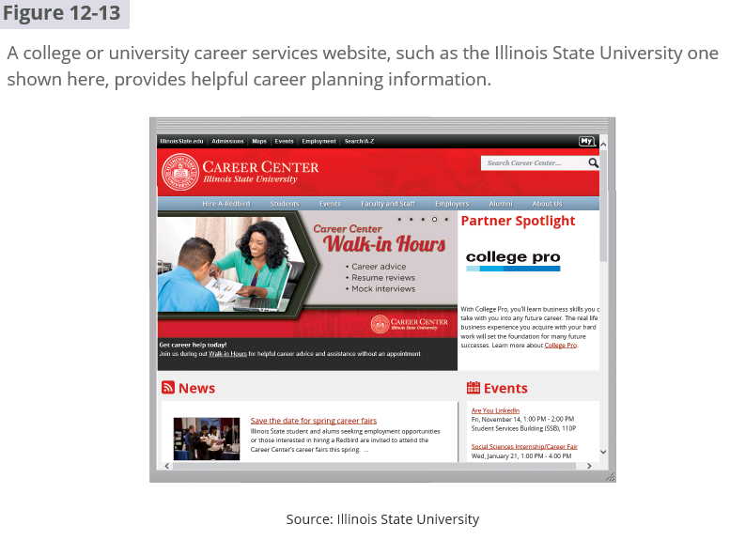

Slide 52
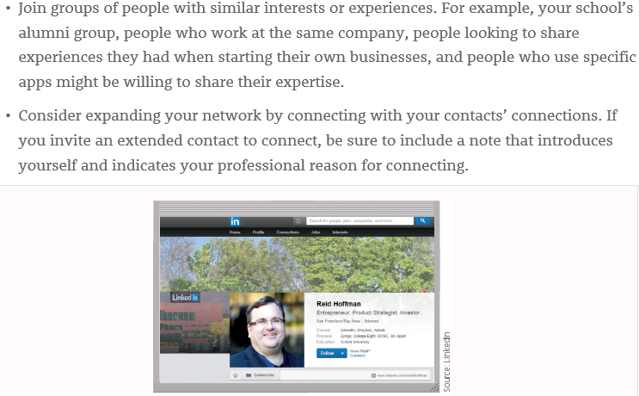

Slide 53
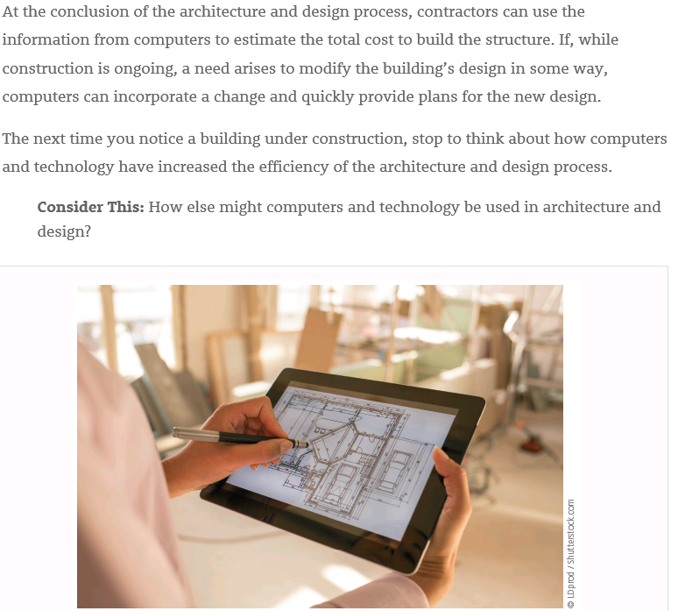

Slide 54
Summary
Information systems in an enterprise
Various technology career fields and specific technology jobs
Technology certifications
How to begin a job search and create a professional online presence

