Slide 1
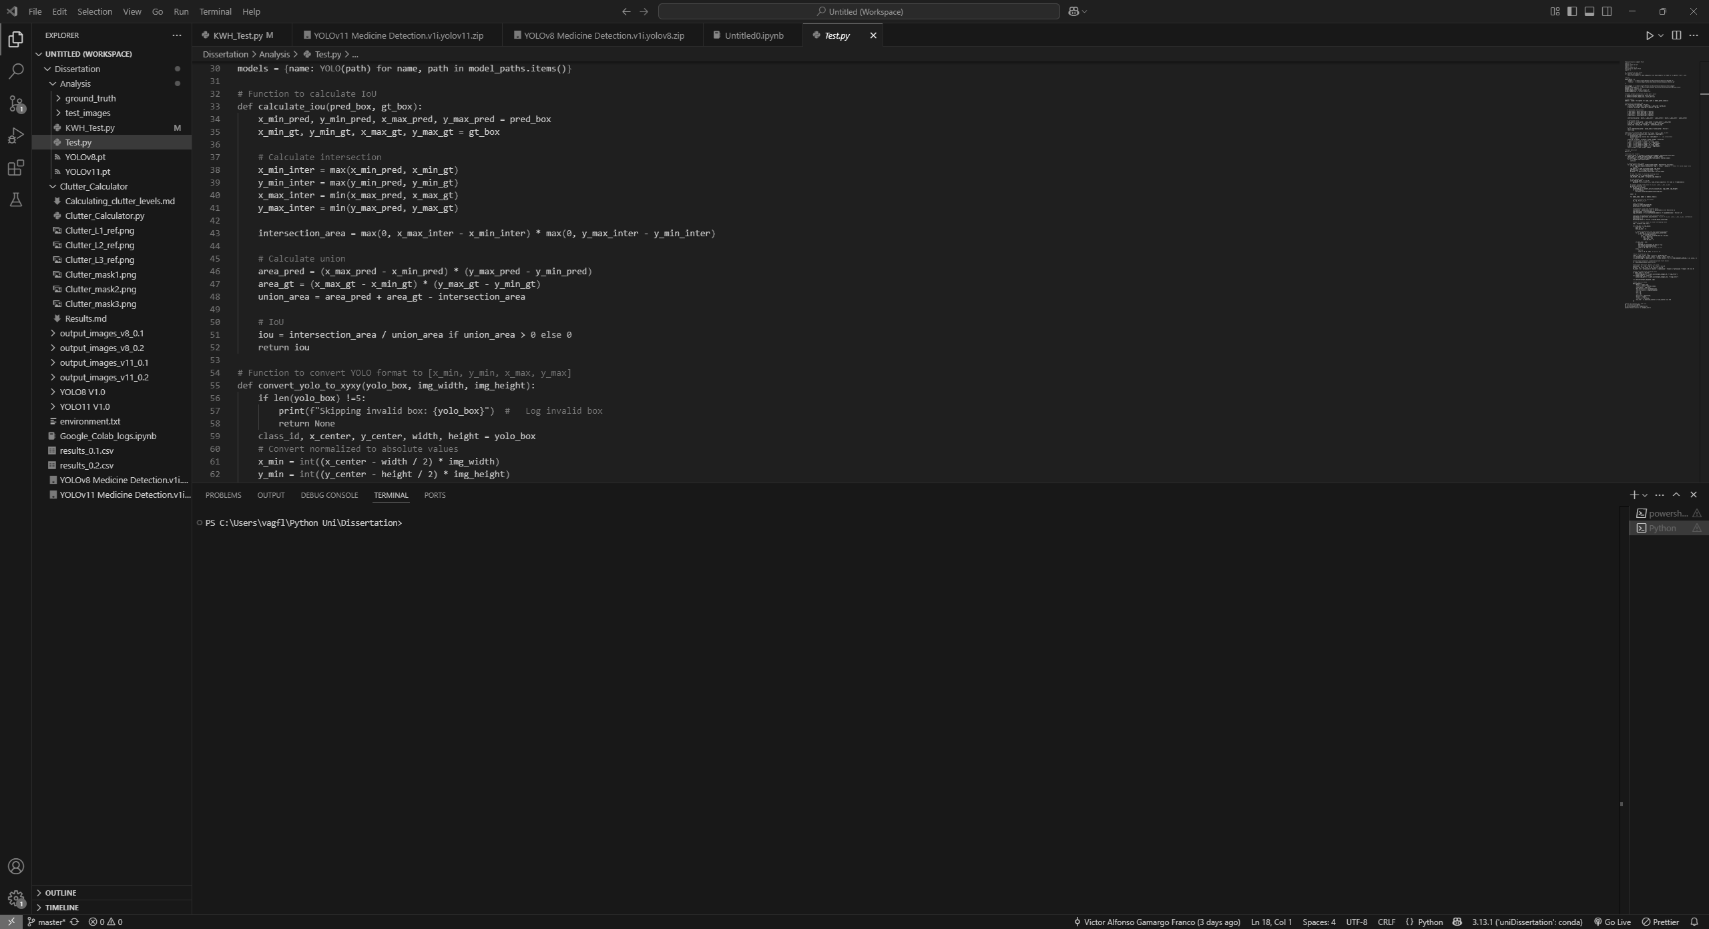
Dissertation: Presentation
Developing a YOLO-based system to localise a medicine box in a shelf in different levels of clutter
Falmouth University
Victor Alfonso Gamargo Franco
Computer Science BSc 3rd Year

Slide 2
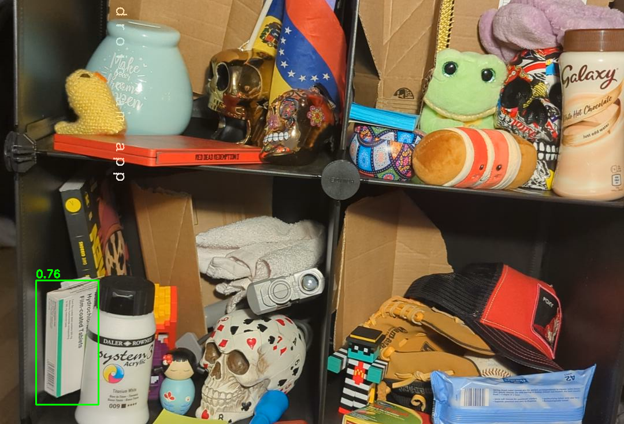
Introduction
A brief overview of my goal

Slide 3
Solving a problem
Aiding visual impairment people
Object detection with YOLO.
Comparing YOLOv8 and YOLOv11.
Medicine localisation (in a shelf).
Object localisation in different levels of clutter:
Level 0: no clutter.
Level 1: ~25% (+-10%) clutter.
Level 2: ~50% (+-10%) clutter.
Level 3: ~75% (+-10%) clutter.
Notes:
What is the problem I am trying to solve?
I want to help people with visual impairment problems to be able to localise important items in different levels of clutter in a home environment.
I want them to be able to be more independent with the help of an assistive system that could help them localise important items as for example a medicine in a cluttered shelf.
System brief description:
This paper analyse two YOLO models, YOLOv8 and YOLOv11, in localising a medicine box in different levels of clutter in a shelf.
The aim of this analysis it to get a conclusion of which one would be the best candidate for a development of an assistive system.
Levels of clutter metrics:
The metrics I am using to determine the level of clutter are as follow:
Level 0: there is not clutter at all.
Level 1: around 25% of the pixels from the image is cover in clutter.
Level 2: is around 50%.
Level 3: is around 75%.

Slide 4
Motivation
Why am I doing this?
To help, even a little bit, people with visual problems.
Learn new and improve my technical skills.
Help in future projects
Notes:
I am doing this projects for a few reason:
I want to help people with visual impairment, even if it is just a little bit, by creating an assistive device which could help them localising important items in a home environment. This idea came from another idea I had of creating a system to help elder people, especially people with Alzheimer's, in developing a system which depend in a camera with an object detection model to help them localise object in their houses as well as make their family monitor them remotely in case, they need help as the camera would has a microphone and speaks installed. I know this could be useful as I had a similar personal family scenario like I described.
In this paper I worked on, I have learned a few things as: being able to create an object detection model with YOLO, worked with Python packages as Ultralytics and OpenCV, used Google Colab and Roboflow for my models’ training process and I feel like I improve in creating documentation, as I want to keep track of what I have done.
This dissertation paper would be helpful for future projects as for example the development for a proper assistive device with object detection.

Slide 5
Research
Literature review & related work

Slide 6
Literature review
Object detection in assistive technology
Object detection helps visually impaired individual to be more independent enhancing navigation.
YOLO models widely used in real-time assistive systems.
Object detection challenges:
Object occlusion
Lighting conditions
Small object visibility
Some solutions:
Feature pyramids
Attention mechanisms
Domain adaptation
Notes:
Object detection systems has been developed to empowering visually impaired people to be able to recognise and navigate their surroundings.
YOLO models has been used widely in different system developments due to their speed and high accuracy in real-time object detection.
However, there are still some challenges when development object detections systems like poor lighting conditions, occluded or small objects, and perspective distortion making detection harder.
To address these challenges, researches uses techniques like:
Multi-scale feature extraction: a technique that allows a model to detect objects at multiple scales by combining features from different layers of the neural network.
Attention mechanisms: a technique that helps the model to focus on the most relevant parts of an image.
Domain adaptation: a method to help models which has been trained in one environment work well in real-life conditions like different lighting, clutter or different camera angles.

Slide 7
Dataset, assistive systems & research gaps
YOLO tech & gaps
YOLOv8 vs YOLOv11: speed & accuracy trade off.
YOLOv11 better small object detection in cluttered scenarios.
Existing systems: mobile, wearable, embedded systems.
Limitations:
Performance under too much clutter.
Device constraints.
Dataset generalisation.
Datasets & alternative approaches
Better generalisation with diverse datasets.
Preprocessing and data augmentation improve model robustness.
Alternatives systems like Bluetooth/RFID exist but have range/scale issues.
Notes:
YOLOv8 is great for lightweight devices due to its speed in real-time localisation. However, YOLOv11, on the other hand, has better accuracy, especially for small or occluded objects in cluttered scenarios. The negative of using YOLOv11 is that it cost more computational power compared to YOLOv8.
The are other existing systems, like wearable devices or mobile setups, showing promise, but they often struggle under cluttered scenes or require high-end devices to function properly.
There is a gap in evaluating newer YOLO models, specially under certain levels of clutter. That is where my paper comes in. My system addresses this by performing a direct comparison under a controlled clutter levels using a custom dataset aim to real-world assistive use cases.
A strong dataset is important for the training phase of the YOLO models, past research shows diverse, well-annotated data improves detection under real-world conditions.
Methods as preprocessing and data augmentation improve model robustness. In my project, I used Roboflow for those methods.
There are other alternatives systems like using Bluetooth and RFID-based tracking systems to localise objects, however they have scalability issues, making vision-based detection systems more practical in the long run.

Slide 8
Proposed system
System overview

Slide 9
Custom dataset creation
My dataset creation method
Set-up:
Smartphone camera.
Shelf and items for clutter.
Software: OBS Studio with DroidCam OSB.
Python: labelme and labelme2yolo.
Roboflow: preprocessing and data augmentation.
Google Colab: for model training process.
Draw bounding box from images taken in labelme.
Convert to dataset with labelme2yolo.
Preprocessing & data augmentation in Roboflow.
Use A100 GPU from Google Colab to train YOLO models with custom dataset.
Notes:
To create my dataset, I manage a set up with a shelf and different items to used them as clutter, and I used a medicine box which would be the item to be localised by both YOLO models.
I use my phone camera to take pictures, for this I used OBS Studio with DroidCam OBS which is a software to be able to use my phone camera as a webcam and be able take pictures and save it in my computer.
After collected all the images, which were 626 photos, I used labelme to draw and label the medicine box from all the images I took.
Then, I used labelme2yolo to convert the output data into a data that YOLO models could read.
After creating my dataset, I went to Roboflow to preprocess my dataset and do data augmentation to have a more robust dataset. I ended up with 1498 images in my final dataset.
I used a A100 GPU in Google Colab to speed my training process in both models.

Slide 10
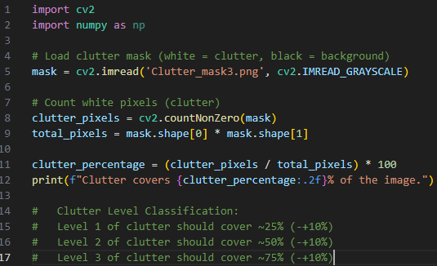
Clutter levels
Clutter Calculations
Python code with libraries:
Cv2.
Numpy.
GIMP to insolate clutter.
Clutter levels:
Level 0: no clutter.
Level 1: ~25% (+-10%) clutter.
Level 2: ~50% (+-10%) clutter.
Level 3: ~75% (+-10%) clutter.
Notes:
To calculate the number of clutter in the shelf, I took reference images with different levels of clutter I set up.
I used GIMP which is a free software like Adobe Photoshop to isolate the clutter with a mask, then I paint the isolated clutter with a white colour.
Then the background I painted it with black.
After getting my images with the mask, I used a Python script to detect the amount of pixel in white and black, then get the percentage of how much white pixels they are in the image.
Then, this script would give me the percentage of how much clutter there is in the image based in pixels.

Slide 11
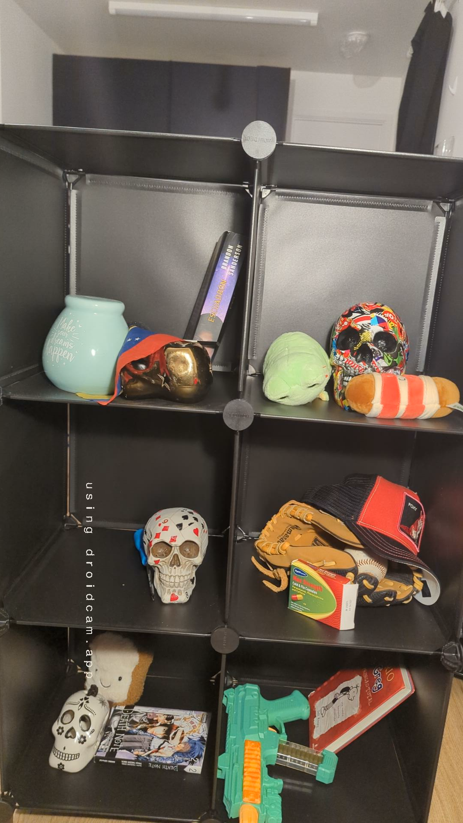
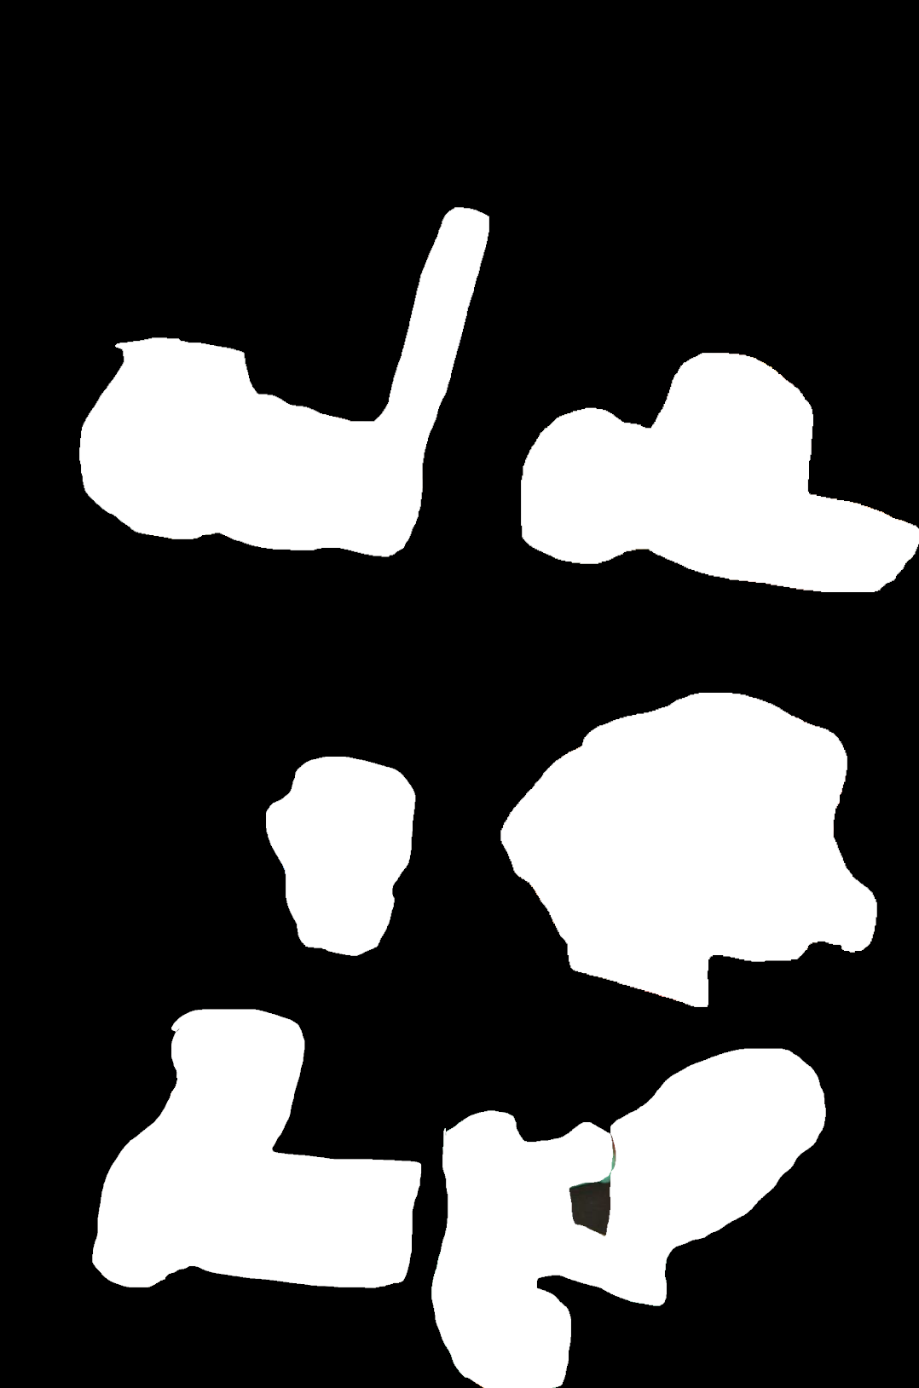
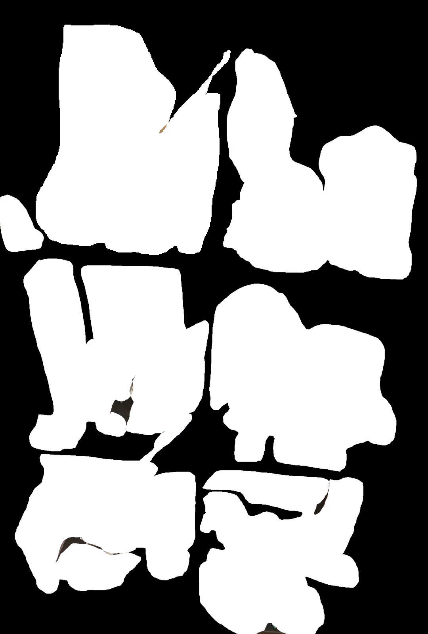
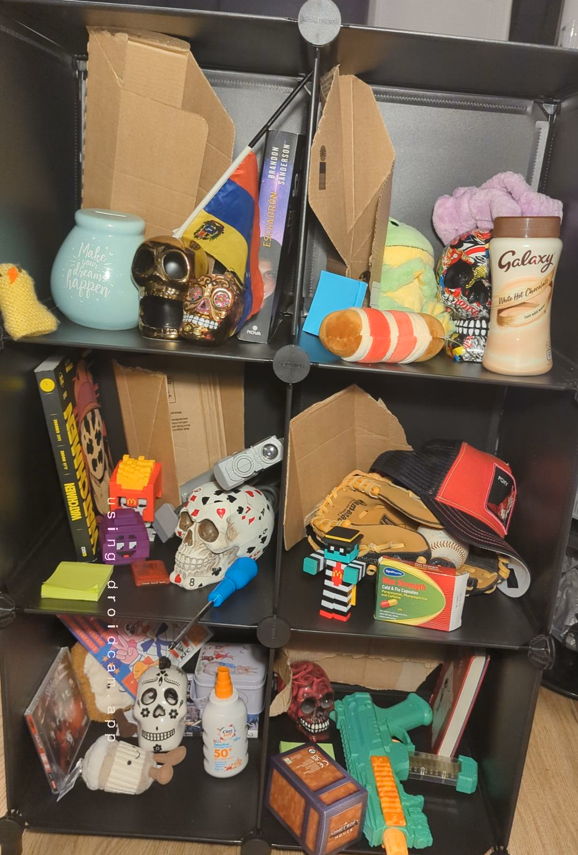
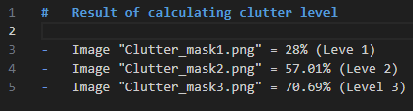
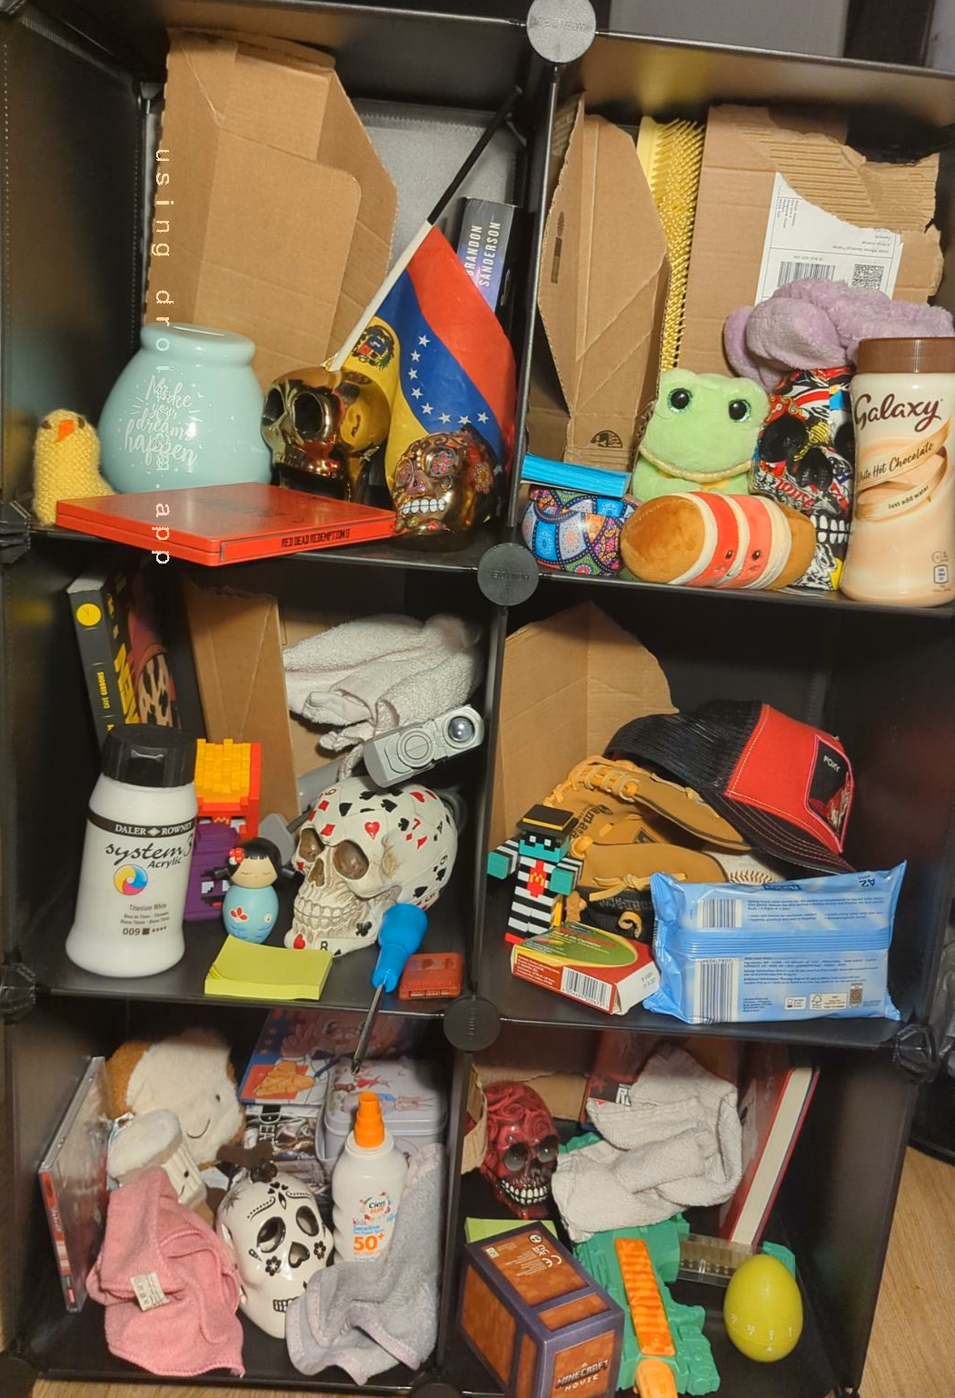
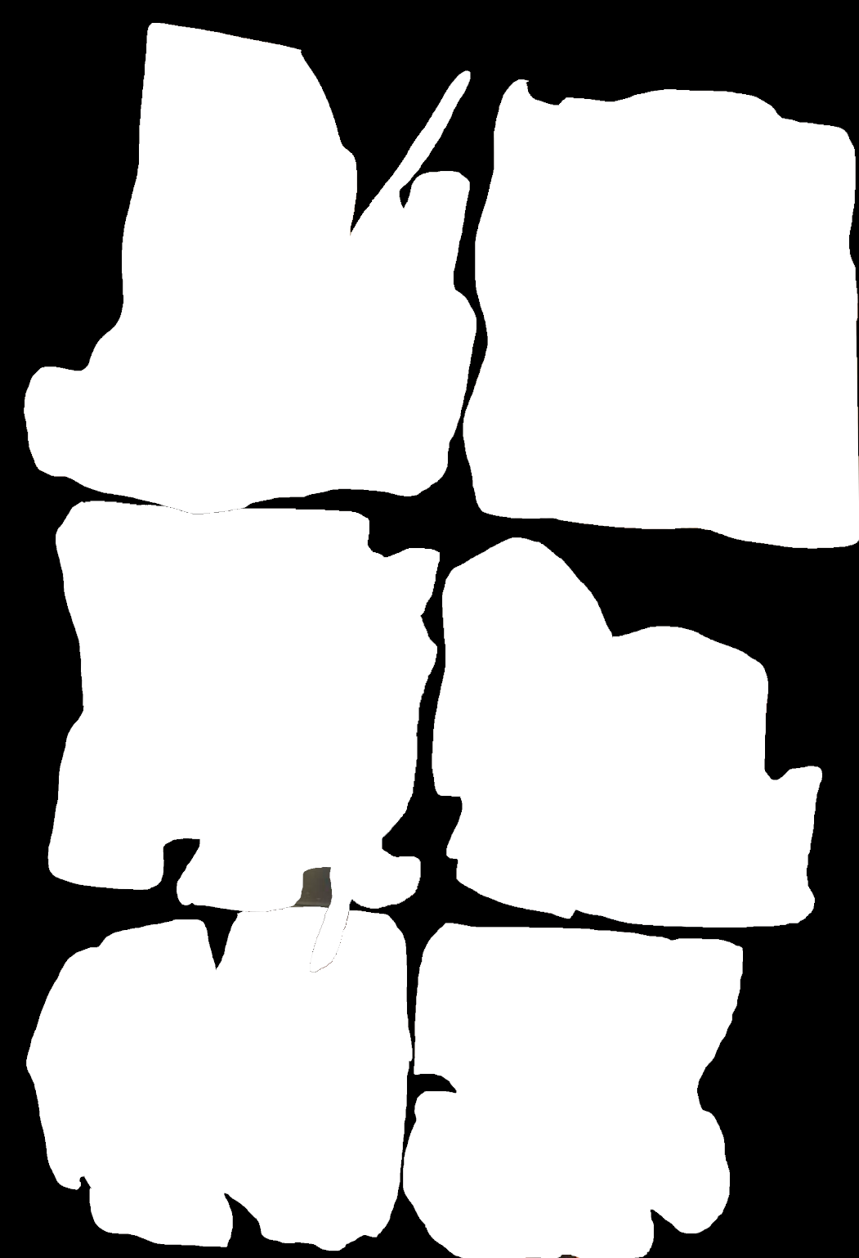
Left side: reference images.
Right side: masked images.
Results after clutter calculations:

Slide 12
Test
Testing YOLOv8 & YOLOv11
Python script to perform tests and output results.
Libraries used: ultralytics, os, pandas, cv2, numpy, pathlib, re.
Test images with ground truth annotation.
Output images from models into folders.
CSV file with test results contains:
Model name
Clutter level
Image name
Number of detections
Average confidence
True Positive (TP)
False Positive (FP)
False Negative (FN)
Precision
Recall
F1 score
Average Intersection over Union (IoU)
Notes:
I have performed a test in both YOLOv8 and YOLOv11 to see differences in on how they detect a medicine in a shelf in 4 levels of clutter. Which starts with no clutter until level 3 with around 75% of clutter.
I set up my shelf 4 times for each level of clutter and then took 25 pictures in each level with my medicine box placed in different position each time, having at the end a total on 100 images. Then, I used lebelme again to label and draw boxes in each image where my object was to have a dataset as ground truth, I had to use labelme2yolo again to transform the output from labelme to a YOLO format so the models can read that data.
I have a python script to perform my test which takes both models and make them run in all 100 test images, then compare the result with the ground truth to see how many true detection they’ve got.
After the program finishes, it creates a folder for each output from each model and a csv file with the results. The csv file is organised showing the result of each image from each model showing in each row the name of the model, clutter level, the image name file, number of detections, average confidence, true positives, false positives, false negatives, precision, recalls, F1 score and the average intersection over union.

Slide 13
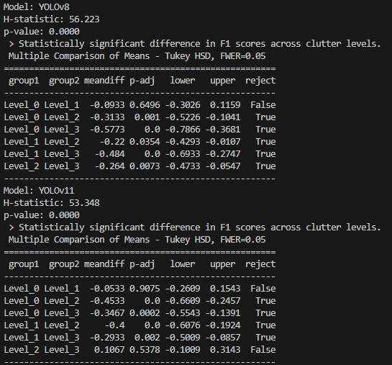
Analysis
Kruskal-Wallis test & Dunn’s Post-Hoc test
Kruskal-Wallis test to compare four groups (Clutter level 0 to 3).
Check if there is a statistically significant difference.
Uses F1 scores grouped by clutter level.
Run Post-Hoc test if there is a significant difference.
Check which levels of clutter differ.
Uses Tukey’s HSD to test each pair of clutter level.
Output after test:
Notes:
For my statistical comparison I use the Kruskal-Wallis test to see if there is a significant difference in different levels of clutter focusing in F1 score for both YOLOv8 and YOLOv11. We can see that the p value in each model is below 0.05 which means that there is a significant difference. Then the post hoc analysis using tukey hsd revealed that YOLOv8 performance deteriorate with each incrementation in clutter level. In YOLOv11, the performance deteriorate as well as there are more clutter, but we can see there is a big difference in level 3 where YOLOv11 beats YOLOv8 clearly. This results shows that YOLOv11 performs better than YOLOv8 when there is a high level of clutter. This could mean that YOLOv11 could be a nice candidate for real-world applications in cluttered environments. However, further research is needed.

Slide 14
Research Methods
Methodology, Research Question & Data Management

Slide 15
Methodology overview
YOLOv8 vs YOLOv11: detecting medicine box under clutter
Approach:
Create a custom dataset
Set levels of clutter
Train and evaluate YOLO models
Aid future development of assistive system for visually impaired users
Dataset collection
Training
Labelling
Testing
Analysis
Notes:
The goal of my research was to compare YOLOv8 and YOLOv11 in detecting a medicine box in a shelf under different levels of clutter.
To approach this challenge, I created a dataset by taking multiples pictures of a medicine box in a shelf with clutter. After data augmentation in Roboflow, I trained both YOLO models with the same dataset to keep consistency. After that, I set up different levels of clutter in a shelf and taking multiples pictures with the medicine box in different positions for each level of clutter, then with the test dataset I created, perform a test. With the results, I analysed the data to see if there is a significant difference between both YOLO models.
This research is important as this could help in a future development of an assistive system for visually impaired users.

Slide 16
Hypothesis & research design
Research question: “How does the level of clutter affect the object detection performance of YOLOv8 model compared to YOLOv11 model when locating a medicine box on a shelf?”
Hypothesis:
H0: No statistically significant between both models across levels of clutter.
H1: Statistically significant between both models across levels of clutter.
Testing set up:
100 images (25 per clutter level).
Same test for both models.
Metrics: Precision, Recall, F1 score, IoU.
Hypothesis testing
H0: No difference in F1 scores between clutter levels
H1: Significant difference in F1 scores between clutter level
Kruskal-Wallis Test
(p < 0.05)
Run Tukey HSD to check differences in clutter levels
Notes:
My research question is: “How does the level of clutter affect the object detection performance of YOLOv8 model compared to YOLOv11 model when locating a medicine box on a shelf?”
My null hypothesis is that there is not a statically significant difference in the object detection performance between YOLOv8 and YOLOv11 across different levels of clutter.
My alternative hypothesis is that there is a statically significant difference between both models across different levels of clutter.]
The test I performed is based in 100 images, 25 images per level of clutter, which both YOLO models undertake. The metrics that I was looking for to check are the precision, recall, F1 score and Intersection over Union.

Slide 17
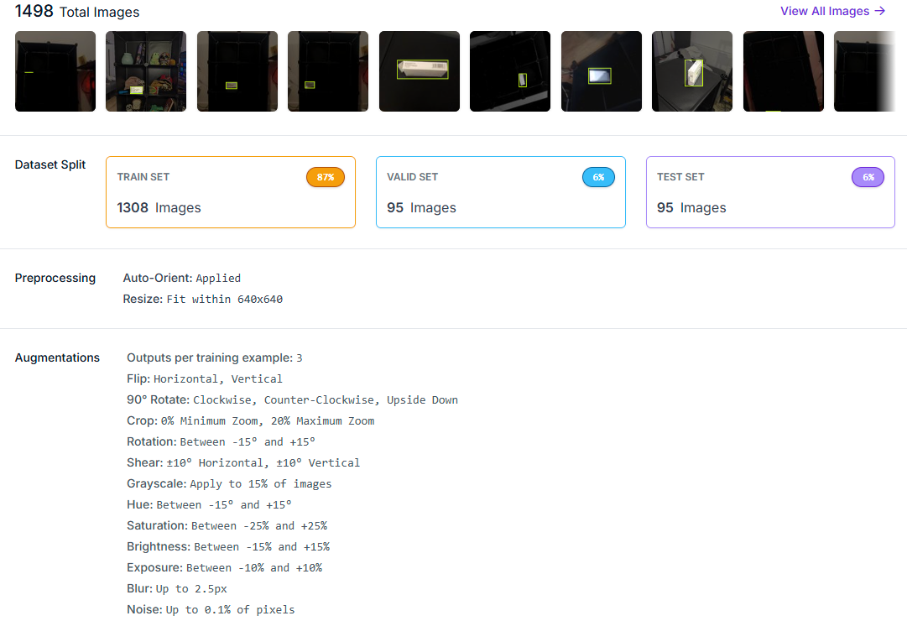
Data Management & Evaluation
Data pipeline & statistical approach
Data collection:
626 raw images + data augmentation = 1498 (train/val/test).
Labelling:
Labelme & labelme2yolo
Clutter levels:
Pixel coverage
GIMP & Python
Statistical tests:
Kruskal-Wallis
Dunn’s Post-Hoc
Notes:
I used my smartphone to collect all the images used to create my custom dataset, collected 626 images. Images were at 1920 x 1080 pixels. Then, after preprocessing and data augmentation done in Robloflow, I ended up with 1498 images at 640 x 640 pixels. My dataset was split into 1308 train set images, 95 for valid set and 95 for test set.
I used labelme as my label tool and labelme2yolo to transform the output which was a json file into a txt file which YOLO models can read.
Cluttered levels were based on pixels in the images. I used GIMP to create a mask in the images so there were only black and white colours, and the run a python script to calculate the number of pixels covered by clutter in the images which were coloured with white because of the mask.
After testing both YOLO models, I perform a Kruskal-Wallis test to see if there were any differences in F1 score across different levels of clutter and Dunn’s Post-Hoc to see where the differences were.

Slide 18
System development lifecycle
Iterative & Incremental

Slide 19
SDLC
Iterative & incremental
Dataset:
Collect and annotate images.
Preprocess and augment dataset created for training.
Training:
Use dataset to train models (YOLOv8, YOLOv11).
Optimise hyperparameters & model configurations.
Testing:
Run models on test data to evaluate performance.
Evaluation:
Evaluate models performance (Precision, recall, F1 score, IoU).
Analyse statistically significant (Kruskal-Wallis, Dunn’s Post-Hoc).
Analysis:
Compare YOLO models performance.
Identify pros and cons in each model.
Future work:
Plan improvements.
Implement system integration for practical use.
Evaluation
Analysis
Dataset Creation
Training Models
Testing
Future Work
Initial Planning
Notes:
My system development lifecycle consist in an iterative and incremental model. I am going through cycles by starting creating a dataset for training, then training object detection models, then testing them with a test dataset, then perform an evaluation and analyse the results. This would be going through cycles until I find a good candidate for a future system integration.

Slide 20
Ethical considerations
With Health and Safety Risks

Slide 21
Ethical Considerations
Laws & regulations:
Adhere to GDPR and university research policies.
No unnecessary personal data is collected.
Compliance with national/international laws on surveillance.
Ethical implications:
No external participants.
Bias mitigations with diverse dataset.
Privacy risks minimised by limiting sensitive data use.
Professional responsibility:
Independent research – future may involve collaboration.
AI development must ensure safety, transparency, and accountability.
Health & safety risks:
Safe computer usage to avoid eye strain and ergonomic issues.
Simple system design to avoid cognitive overload.
Sustainability:
Efficient use of computational resources and hardware.
Long-term potential for low-power embedded devices like Raspberry Pi.
Notes:
This project follows data protection laws, specially GDPR, to ensure ethical handling of data.
No unnecessary personal data is collected or transmitted. This ensures privacy for any data used.
I align with university’s research policies, and I am waiting to get ethical approval for this study. I ensure to make this study as low risk as possible as there is no personal data collected, or any external devices used apart from the use of my personal computer and mobile phone in my own personal space.
Since this research doesn’t involve external participants, privacy risks are minimal. However, if the system is used publicly in the future, stricter ethical standards will be required.
The ethical concerns addressed include privacy, informed consent, and bias in object detection.
I ensure that no external parties are involved in data collection or testing, and all images are taken withing my home.
Bias mitigation is critical, so I’ve used diverse and representative dataset to avoid any discrimination by the algorithms.
The system is designed to complement human judgment, not replace it, in line with ethical AI principles.
While this project is individual, future developments may involve collaborations with engineers, designers, and healthcare professionals.
This ensures the system is safe, effective, and user-friendly.
It’s also important to ensure transparency, accountability, and stick to AI safety best practices, particularly if the system is deployed in real-world settings.
Health and safety concerns are important even in a home environment, so I’ve taken steps to avoid eye strain and ergonomic issues while using my computer.
I’ve designed the system to be simple to use, avoiding unnecessary complexity to reduce cognitive load.
The tests are being conducted at home, so there are no safety concerns with external participants.
The project addresses sustainability by optimizing computational resource use. Using Google Colab for training reduces the carbon footprint compared to local GPUs.
I’ve also ensured that the final model can be run on my personal computer, minimizing the need for additional hardware.
In the long term, the system can be deployed on low-power devices like Raspberry Pi to further reduce environmental impact.

Slide 22


THANK YOU
Falmouth University
Victor Alfonso Gamargo Franco
vg279879@falmouth.ac.uk
https://github.falmouth.ac.uk/GA-Undergrad-Student-Work-24-25/COMP303-279879.git

